Slide 1

Unit 1: SCHOOL
Lesson 2.1
Page 9

Slide 2
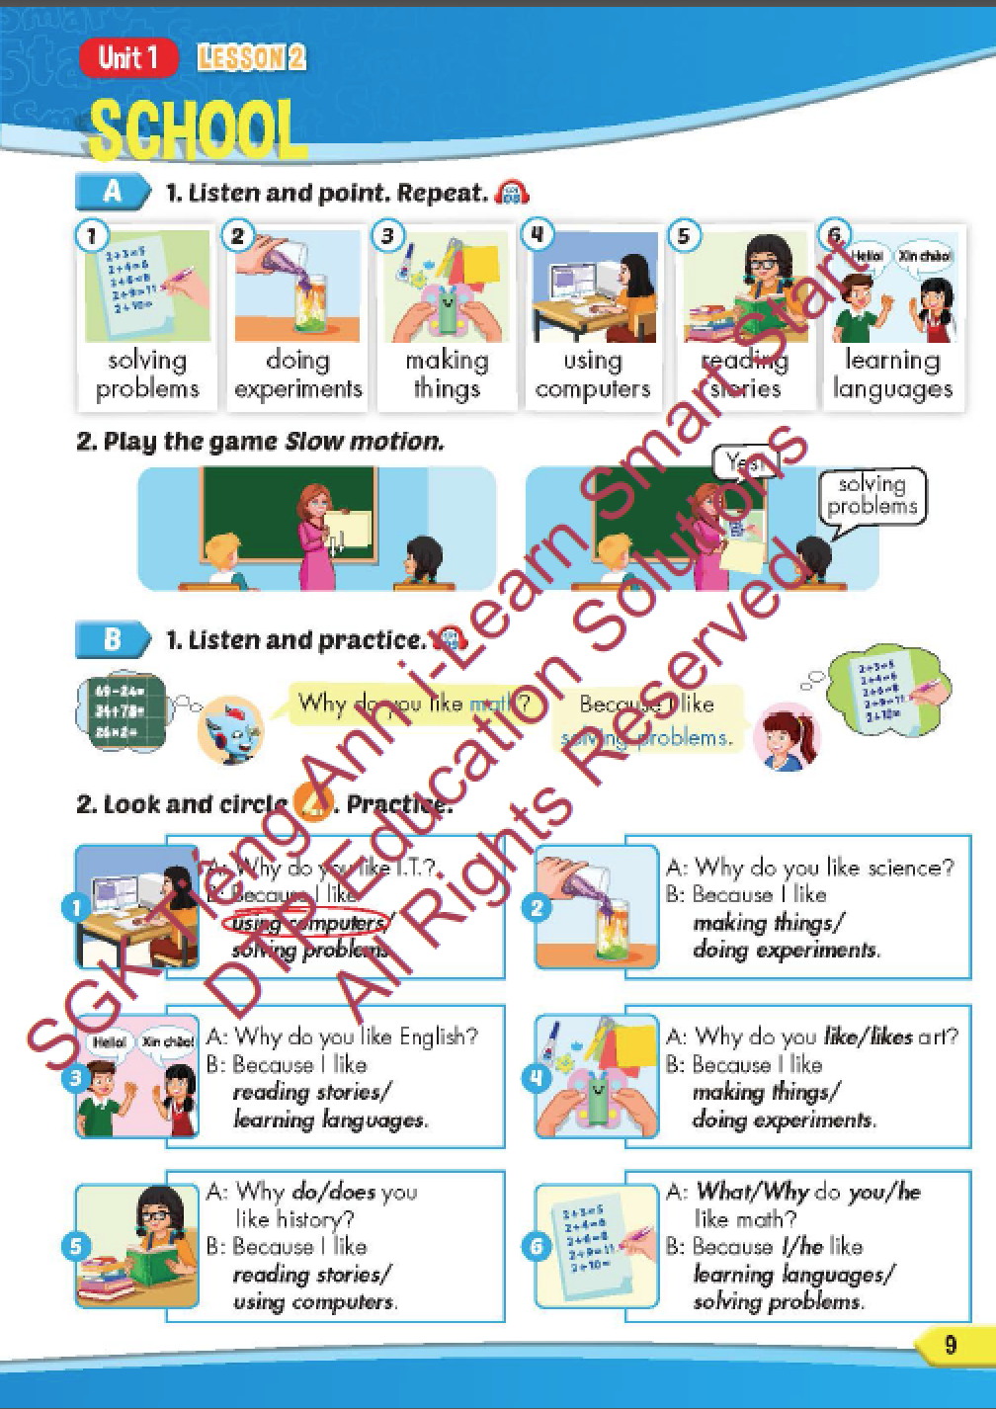
Lesson Outline
Warm-up
Vocabulary
Structure
Consolidation
Wrap-up

Slide 3
Objectives
By the end of this lesson, students will be able to recognize the vocabulary and get to know the structure asking and answering about why they like a school subject.
Vocabulary: solving problems, doing experiments, making things, using computers, reading stories, learning languages.
Structure: Why do you like math?
Because I like solving problems.

Slide 4

WARM-UP

Slide 5

Guess the SCHOOL SUBJECT

Slide 6

You learn about kings, queens, wars and facts from the past.
H I S T O R Y

Slide 7
You add, subtract, divide and multiply numbers.
M A T H S
3 x 4 = 12
25 : 5 = 5
10 + 7 = 17

Slide 8

You learn about continents, countries, oceans, rivers, lakes and cities.
G E O G R A P H Y

Slide 9
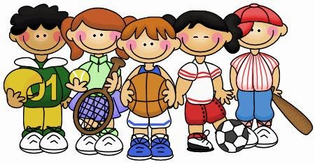
You do gymnastics and play sports there.
P.E.

Slide 10
You learn about plants, animals and human body.
S C I E N C E

Slide 11

You learn about composers, singing and listening to music.
M U S I C

Slide 12

You draw and paint there.
A R T

Slide 13

You learn how to use a computer there.
I.T.
Microsoft
Windows

Slide 14

It’s time to learn …

Slide 15

New words
solving problems,
doing experiments,
making things,
using computers,
reading stories,
learning languages.

Slide 16

Presentation

Slide 17

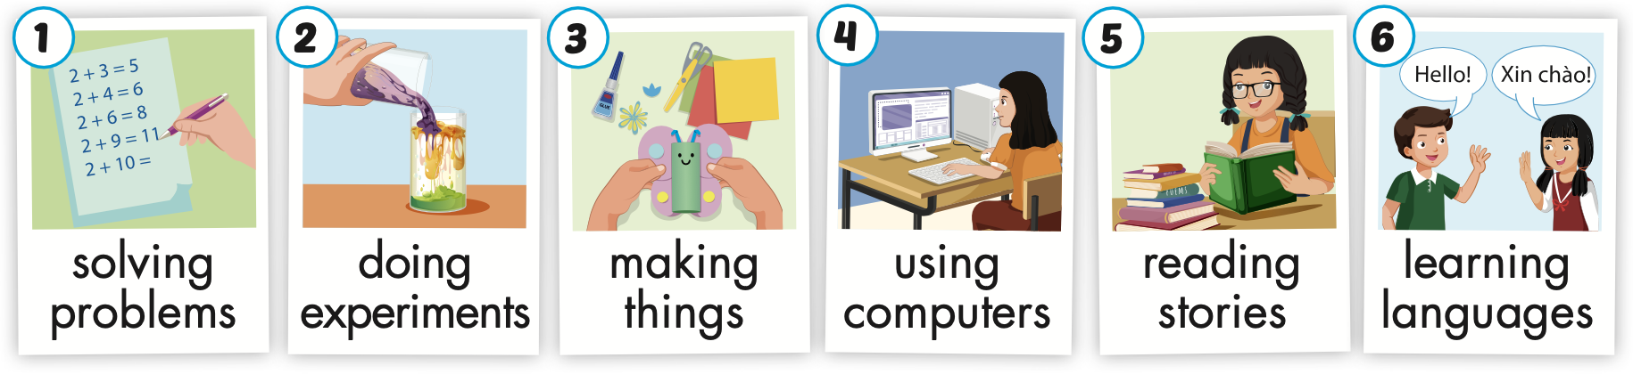
Click on A to hear the sound.
Notes:
Click vào hình A. 1. Listen and point. Repeat để cho cả audio full chạy

Slide 18
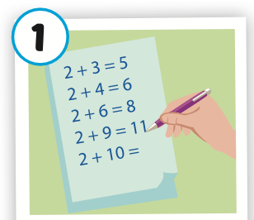
Click on the picture to hear the sound.
solving problems
/ ˈ sɑːlvɪŋ ˈprɑːbləmz/
giải bài toán

Slide 19
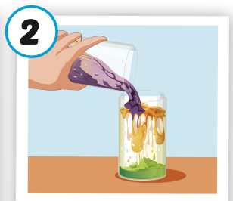
Click on the picture to hear the sound.
doing experiments
/ˈduːɪŋ ɪkˈsperəmənts/
làm thí nghiệm

Slide 20
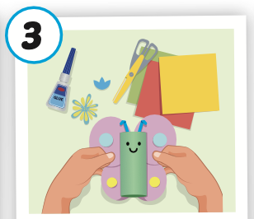
Click on the picture to hear the sound.
making things
/ ˈmeɪkɪŋ θɪŋz/
làm đồ vật

Slide 21
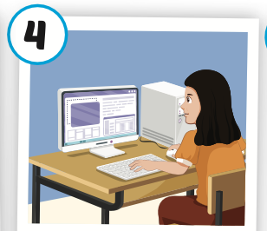
Click on the picture to hear the sound.
using computers
/ˈjuːzɪŋ kəmˈpjuːtərz/
sử dụng máy vi tính

Slide 22
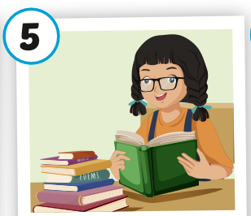
Click on the picture to hear the sound.
reading stories
/ ˈ riːdɪŋ ˈstɔːriz/
đọc truyên

Slide 23
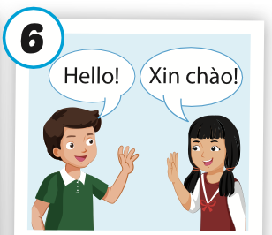
Click on the picture to hear the sound.
learning languages
/ ˈlɜːrnɪŋ ˈlæŋɡwɪdʒiz/
học ngôn ngữ

Slide 24
Practice

Slide 25
Read and choose. Then say.

Slide 26


Read and choose
A
B
C
solving problems

Slide 27
Read and choose
A
B
C
making things

Slide 28
Read and choose
A
B
C
using computers

Slide 29
Read and choose
A
C
B
doing experiments

Slide 30

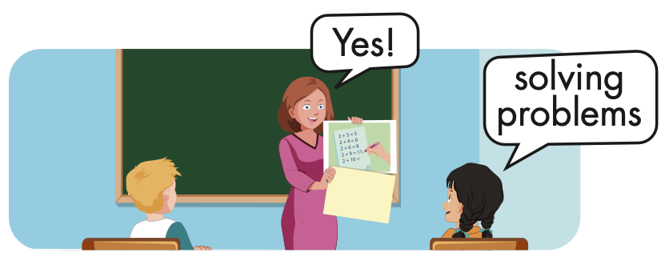


Slide 31
Structure
Why do you like math?
- Because I like solving problems.

Slide 32
Presentation

Slide 33
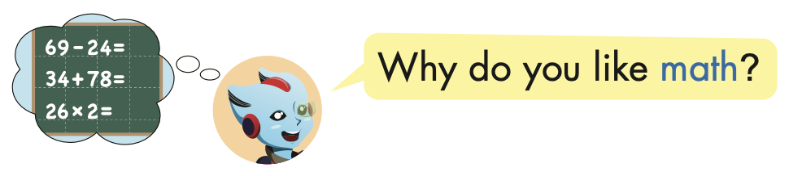
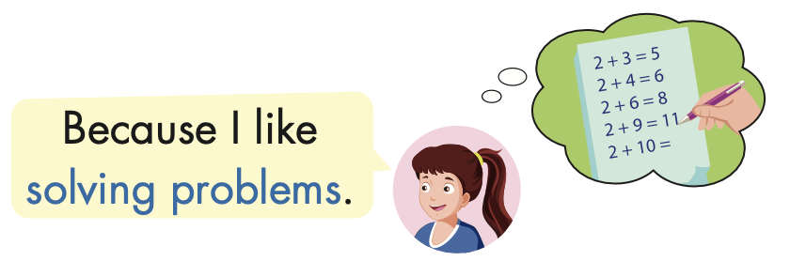
Structure

Slide 34

Practice

Slide 35



Slide 36

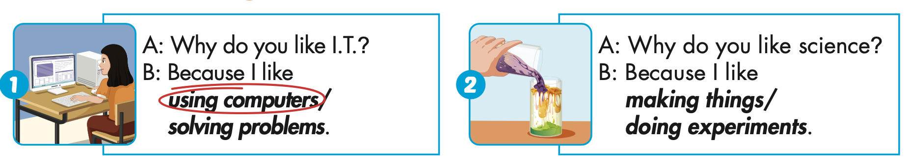

Slide 37
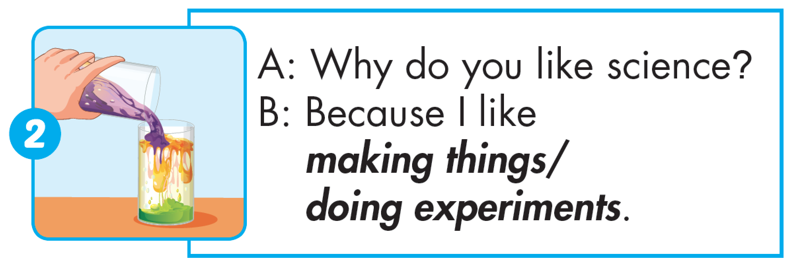

Slide 38
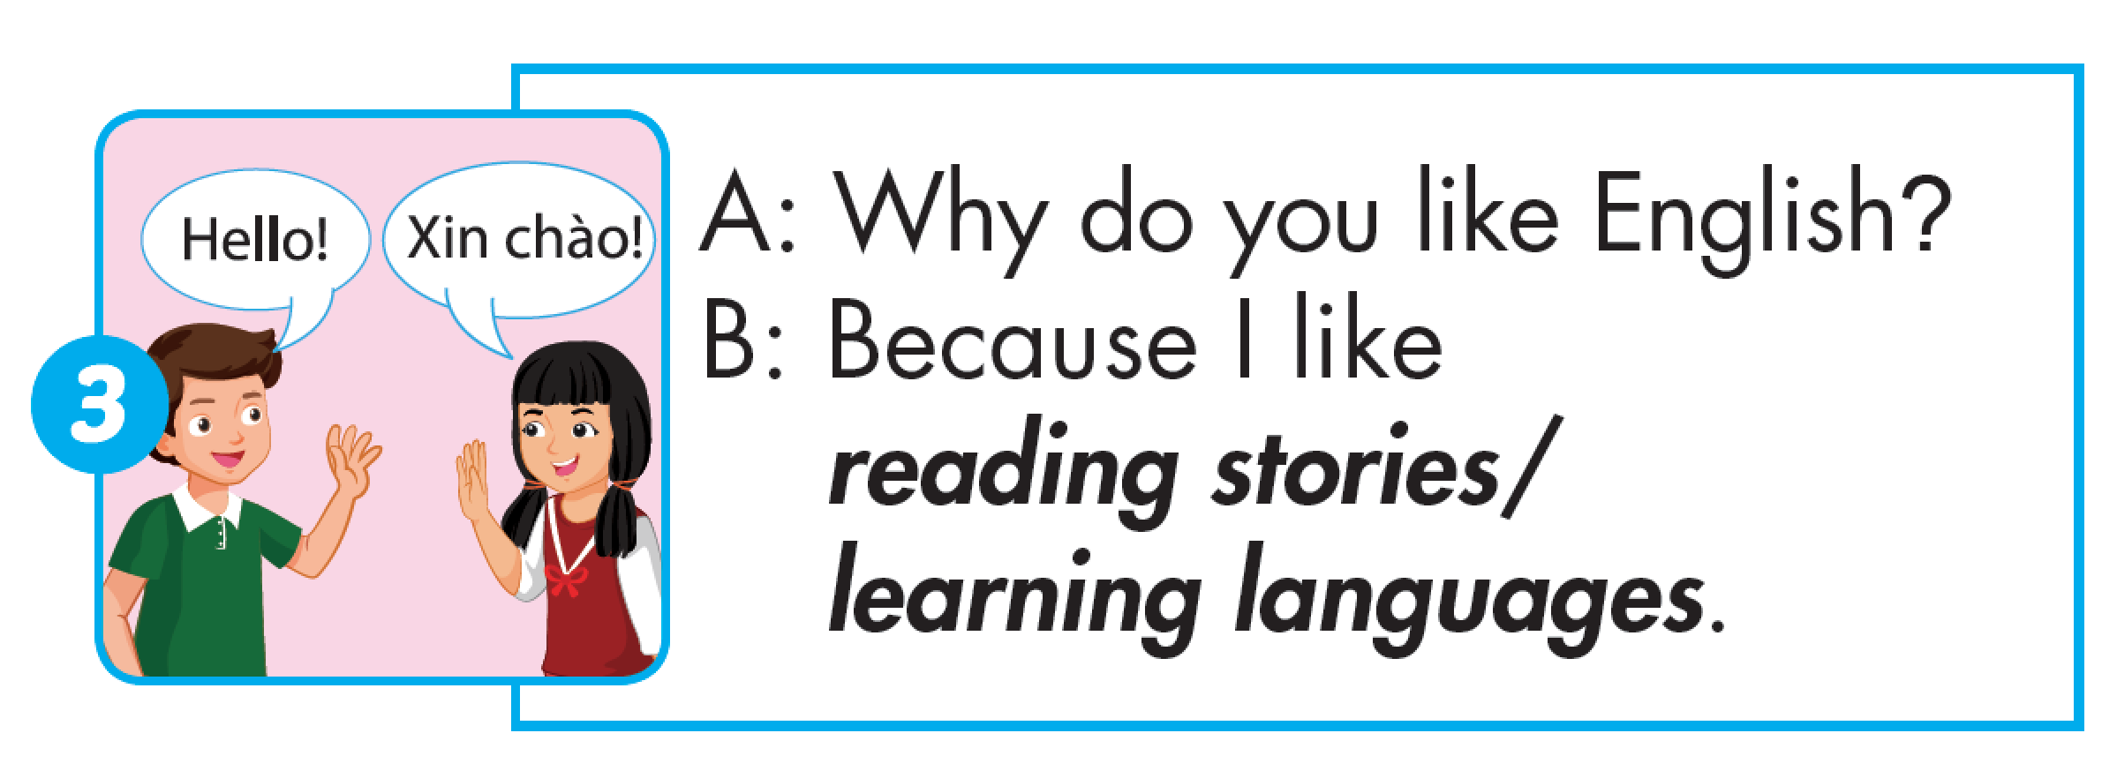

Slide 39
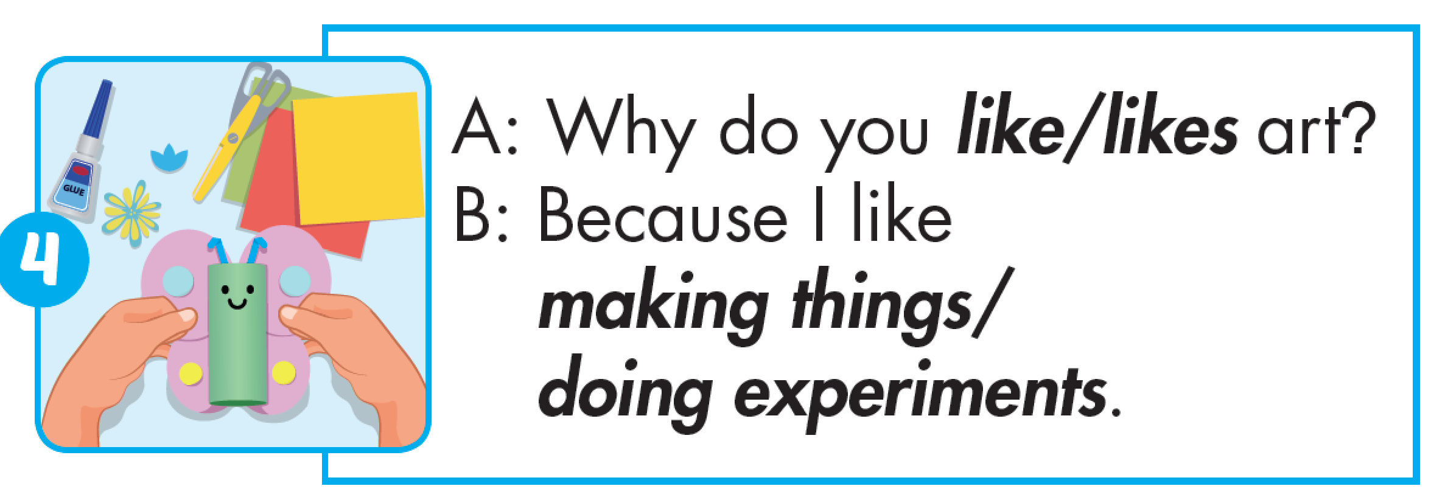

Slide 40
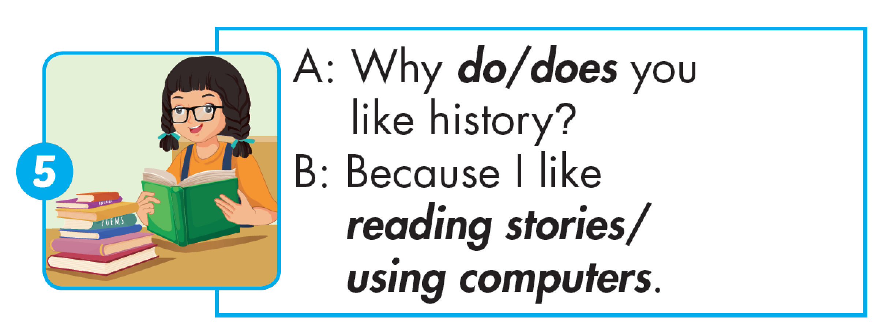

Slide 41
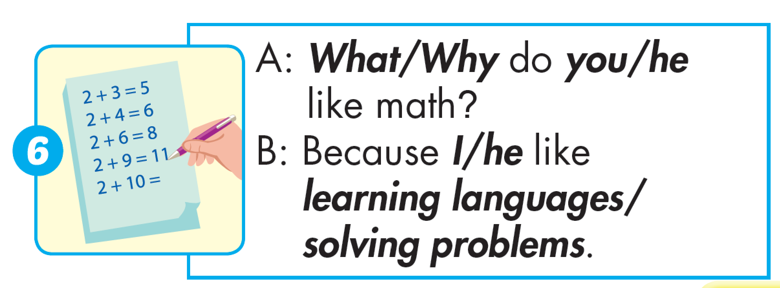

Slide 42

Production

Slide 43

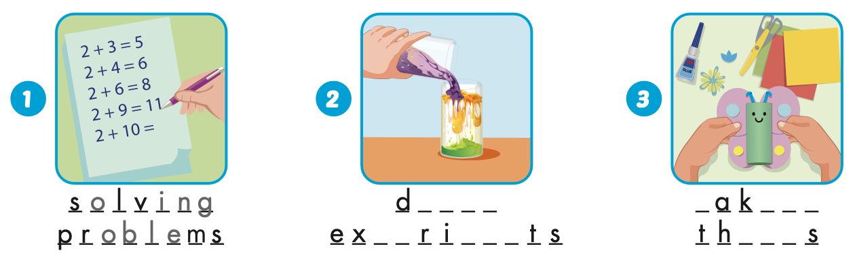
Extra Practice
WB, page 4
o i n g
m
i n g
p e
men
i n g

Slide 44
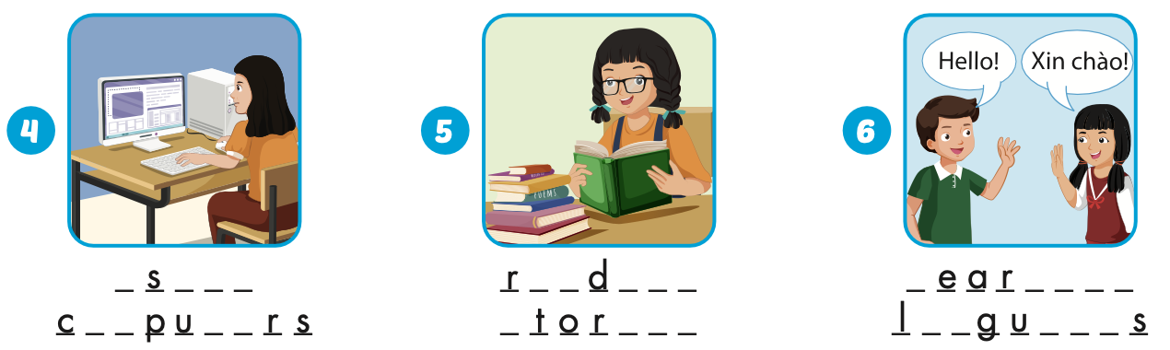
Extra Practice
WB, page 4
u
i n g
e a
i n g
l
n i n g
om
t e
s
i e s
a n
a g e

Slide 45

CONSOLIDATION

Slide 46

WRAP-UP

Slide 47
Today’s lesson
Vocabularies
solving problems, doing experiments, making things,
using computers, reading stories, learning languages.
Structures/ Sentence patterns
Why do you like math?
- Because I like solving problems.

Slide 48
Homework
Practice the vocabularies and structure, and make sentences using them.
Do the exercises in Tiếng Anh 5 i-Learn Smart Start WB (page 4).
Do the exercises in Tiếng Anh 5 i-Learn Smart Start Notebook.
Prepare the next lesson (page 10 SB).
Play the consolidation games in Tiếng Anh 5 i-Learn Smart Start DHA App on www.eduhome.com.vn

Slide 49

Enjoy your day!

Slide 50

Lesson 3
Stay positive and have a nice day!

