Slide 1

Unit 1: SCHOOL
Lesson 1.1
Page 6

Slide 2
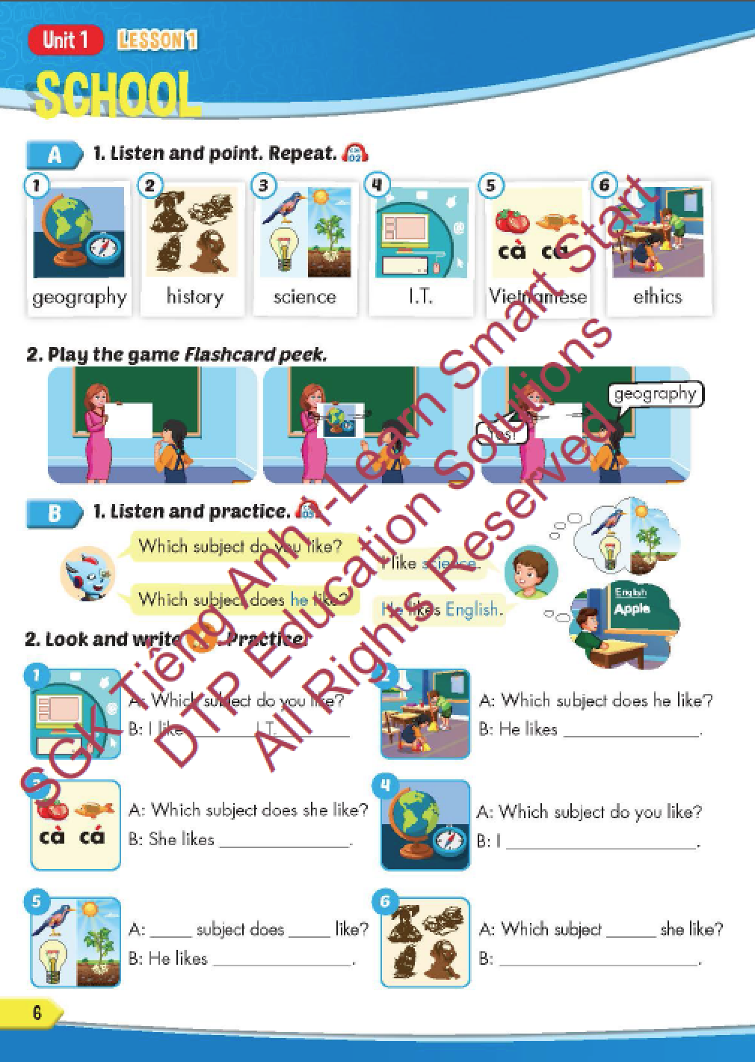
Lesson Outline
Warm-up
Vocabulary
Structure
Consolidation
Wrap-up

Slide 3
Objectives
By the end of this lesson, students will be able to point out and say different school subjects and get to know asking and answering about the subject they like.
Vocabulary: geography, history, science, I.T., Vietnamese, ethics.
Structure: Which subject do you like? - I like science.
Which subject does he like? - He likes English.

Slide 4

WARM-UP

Slide 5


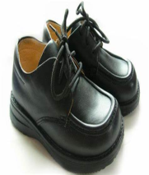














Click on SPIN and STOP.
Answer the questions.

Slide 6



WHAT IS IT?

Slide 7
WHAT IS IT?

Slide 8
WHAT IS IT?

Slide 9
WHAT IS IT?

Slide 10
WHAT IS IT?

Slide 11
WHAT IS IT?

Slide 12

It’s time to learn …

Slide 13

New words
geography,
history,
science,
I.T.,
Vietnamese,
ethics.

Slide 14

Presentation

Slide 15

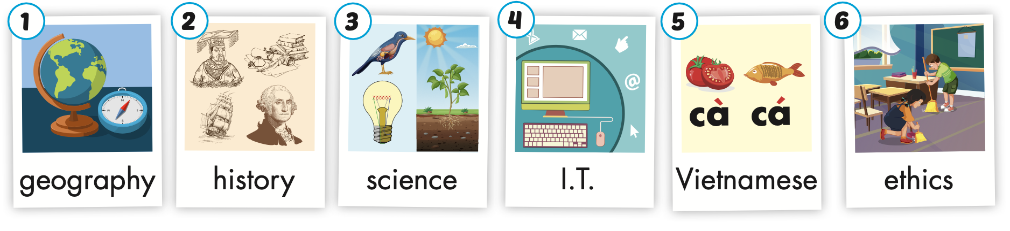
Click on the picture to hear the sound.
/ˈhɪstri/
môn Lịch sử
/ˌaɪ ˈtiː/
môn Tin học
/ˈeθɪks/
môn Đạo đức
/dʒiˈɑːɡrəfi/
môn Địa lí
/ˈsaɪəns/
môn Khoa học
/ˌviːetnəˈmiːz/
môn Tiếng Việt
Notes:
Click vào hình A. 1. Listen and point. Repeat để cho cả audio full chạy

Slide 16


Click on the picture to hear the sound.
geography
/dʒiˈɑːɡrəfi/
môn Địa lí

Slide 17
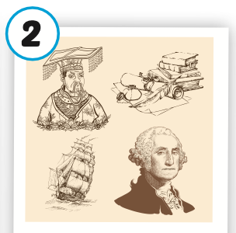
Click on the picture to hear the sound.
history
/ˈhɪstri/
môn Lịch sử

Slide 18
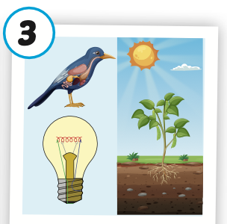
Click on the picture to hear the sound.
science
/ˈsaɪəns/
môn khoa học

Slide 19

Click on the picture to hear the sound.
I.T.
/ˌaɪ ˈtiː/
môn Tin học

Slide 20
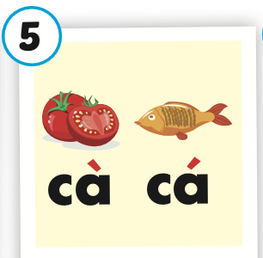
Click on the picture to hear the sound.
Vietnamese
/ˌviːetnəˈmiːz/
môn Tiếng Việt

Slide 21
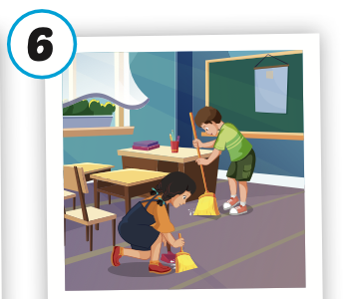
Click on the picture to hear the sound.
ethics
/ˈeθɪks/
môn Đạo đức

Slide 22
Practice

Slide 23
Listen and choose. Then say.

Slide 24


Listen and choose
A
B
C

Slide 25
Listen and choose
B
C
A

Slide 26
Listen and choose
B
C
A

Slide 27
Listen and choose
A
B
C

Slide 28
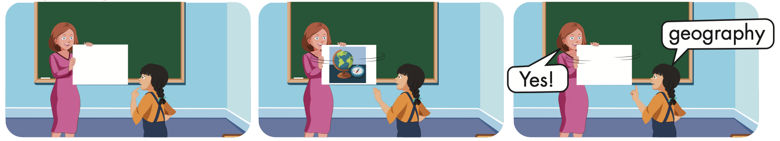

Slide 29
Look and say.

Slide 30
Structure
Which subject do you like?
- I like science.
Which subject does he like?
- He likes English.

Slide 31
Presentation

Slide 32

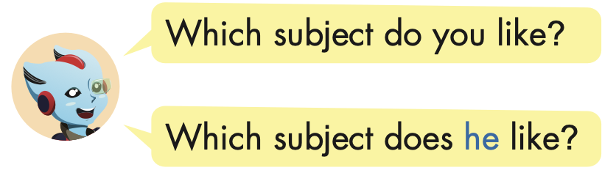
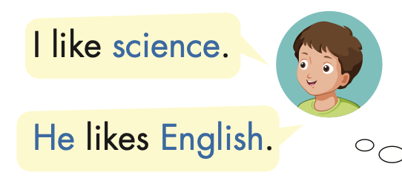
Structure

Slide 33

Practice

Slide 34


Slide 35


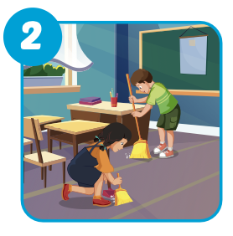
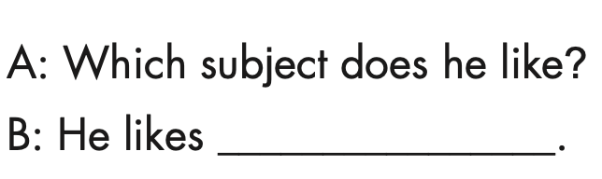
ethics

Slide 36
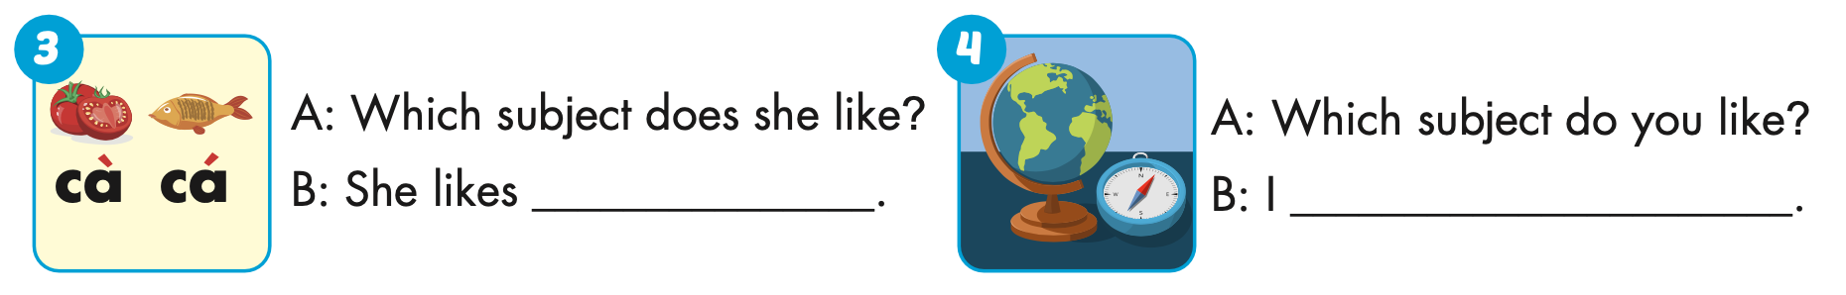
Vietnamese
like geography

Slide 37
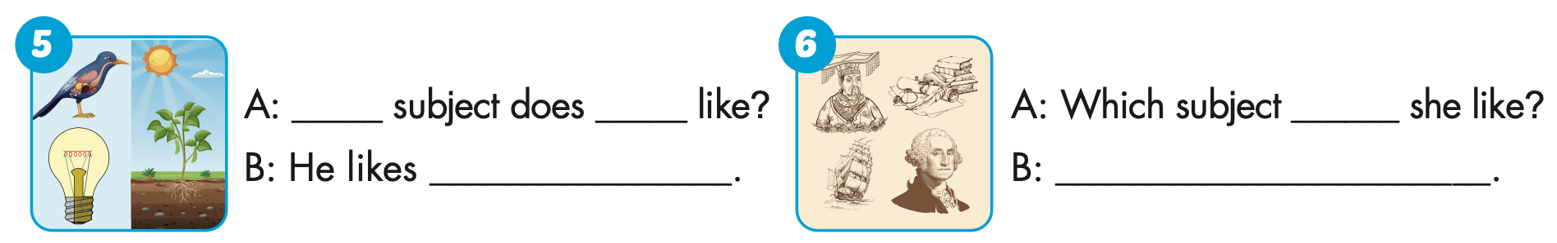
Which
he
science
does
She likes history

Slide 38

Production

Slide 39
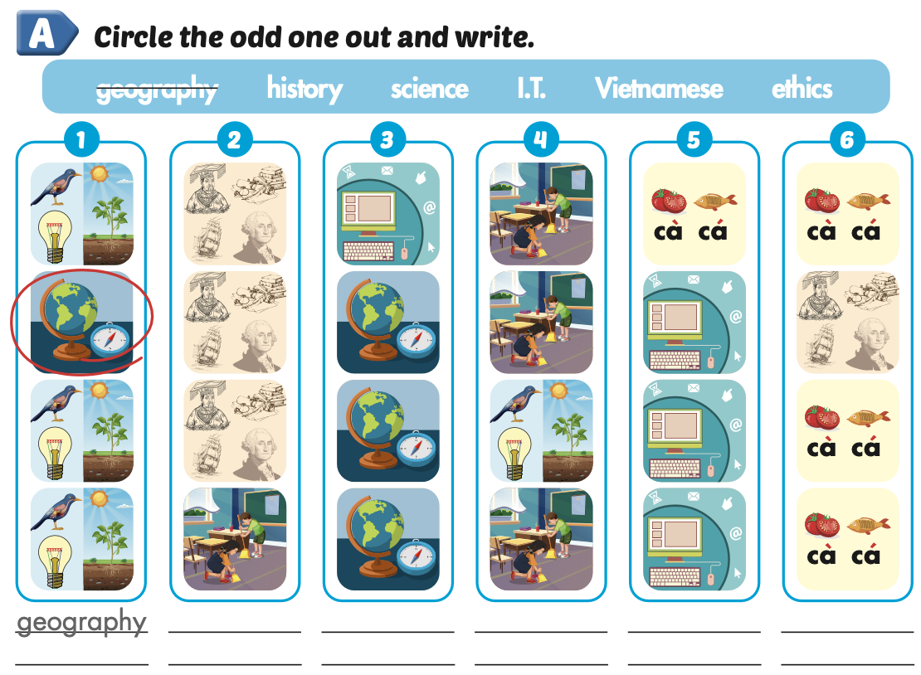
Extra Practice
WB, page 2
ethics
I.T.
science
history
Vietnamese

Slide 40

CONSOLIDATION

Slide 41

WRAP-UP

Slide 42
Today’s lesson
Vocabularies
geography, history, science, I.T., Vietnamese, ethics.
Structures/ Sentence patterns
Which subject do you like?
- I like science.
Which subject does he like?
- He likes English.

Slide 43
Homework
Practice the vocabularies and structure, and make sentences using them.
Do the exercises in Tiếng Anh 5 i-Learn Smart Start WB (page 2).
Do the exercises in Tiếng Anh 5 i-Learn Smart Start Notebook.
Prepare the next lesson (page 7 SB).
Play the consolidation games in Tiếng Anh 5 i-Learn Smart Start DHA App on www.eduhome.com.vn

Slide 44

Enjoy your day!

Slide 45

Lesson 3
Stay positive and have a nice day!

