Slide 1
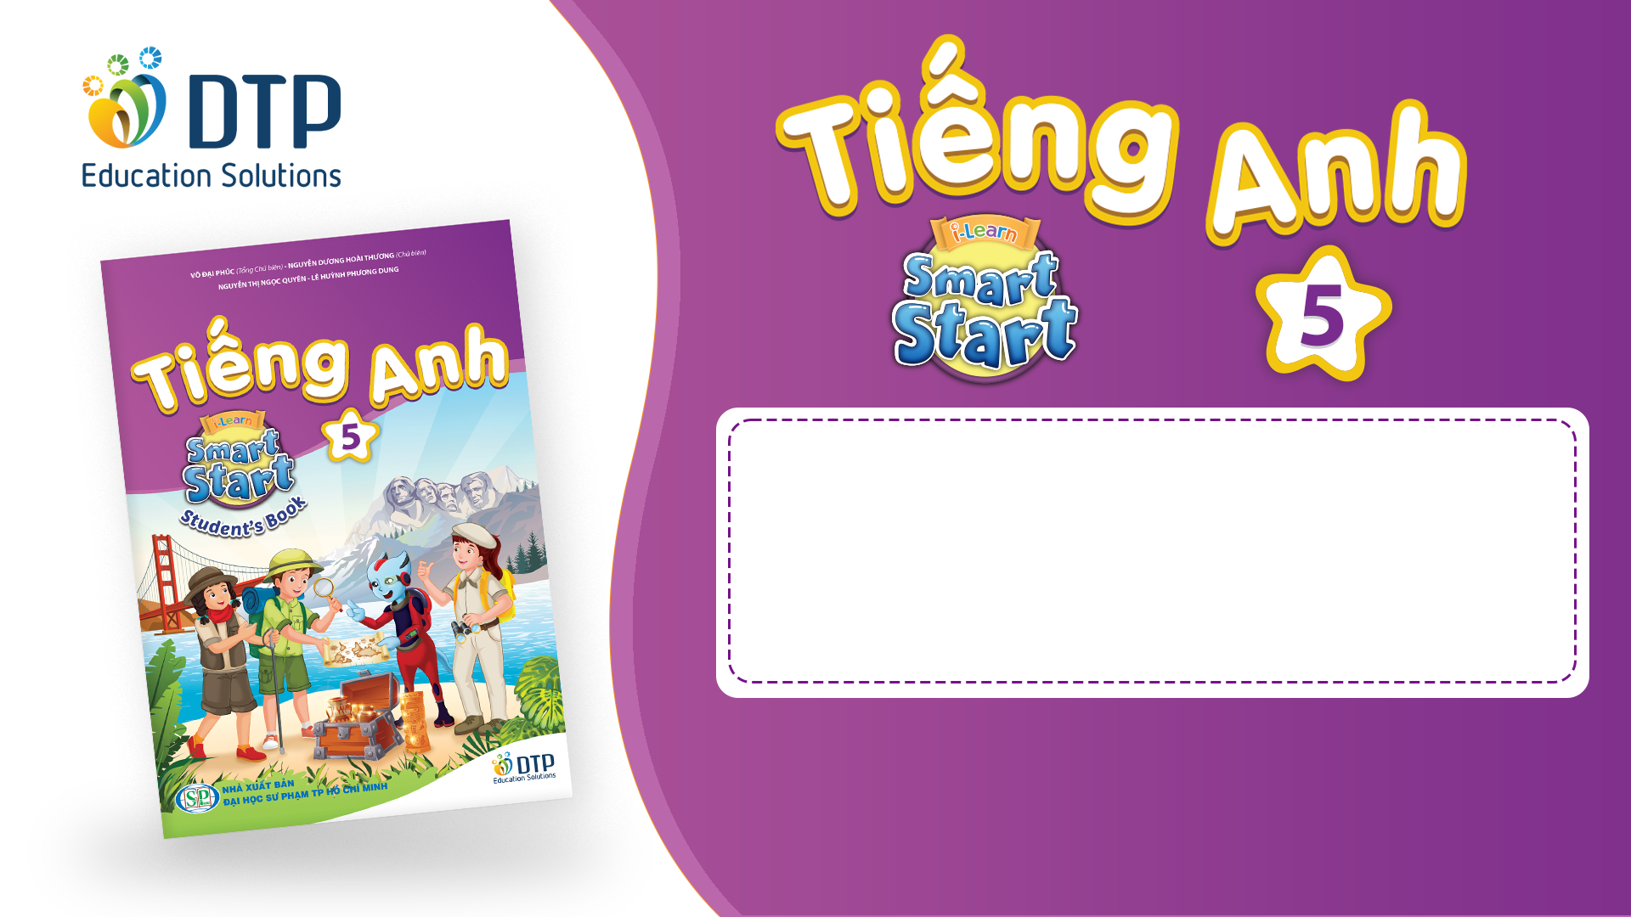
Unit 2: Holiday
Review and Practice 2
Page 33

Slide 2
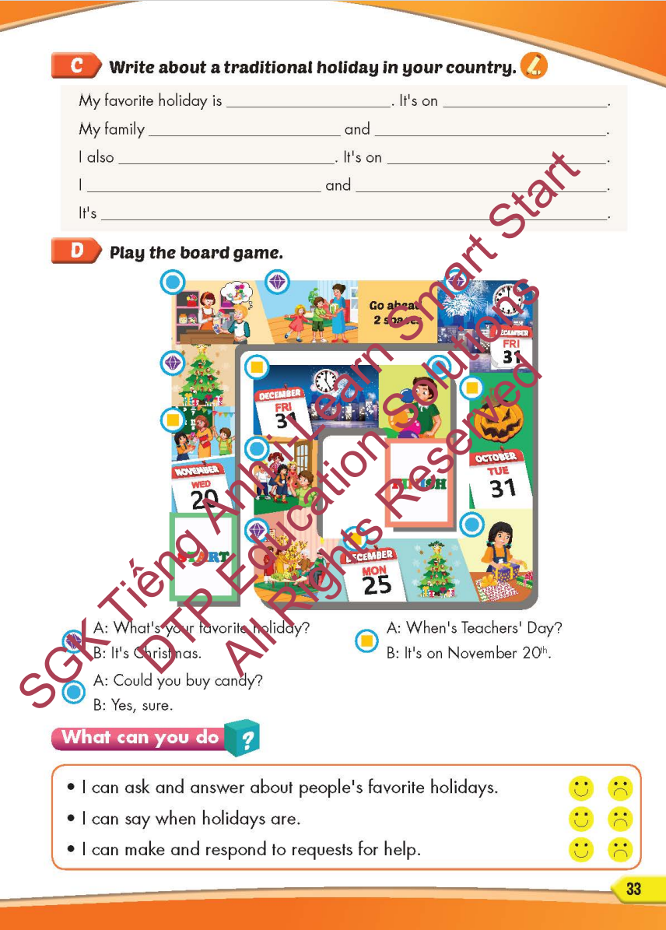
Lesson Outline
Warm-up
Writing
Speaking
Consolidation
Wrap-up

Slide 3
Objectives
By the end of this lesson, students will be able to…
Vocabulary: Review: Halloween, New Year's Eve, Lunar New Year (Tết), Christmas, Teachers' Day, Children's Day, first, second, third, fourth, fifth, put up colored paper, buy candy, invite friends, blow up the balloons, make a cake, wrap the presents, put up a Christmas tree, give presents, watch fireworks, wear costumes, give lucky money, watch the lion dance.
Structure: What's your favorite holiday? - It's Halloween, What's her favorite holiday? - It's Christmas, When's Christmas Day? - It's on December twenty-fifth, Could you blow up the balloons? - Yes, sure, What do people do to celebrate Christmas? - They put up a Christmas tree.

Slide 4

WARM-UP

Slide 5



LISTEN AND CHOOSE

Slide 6
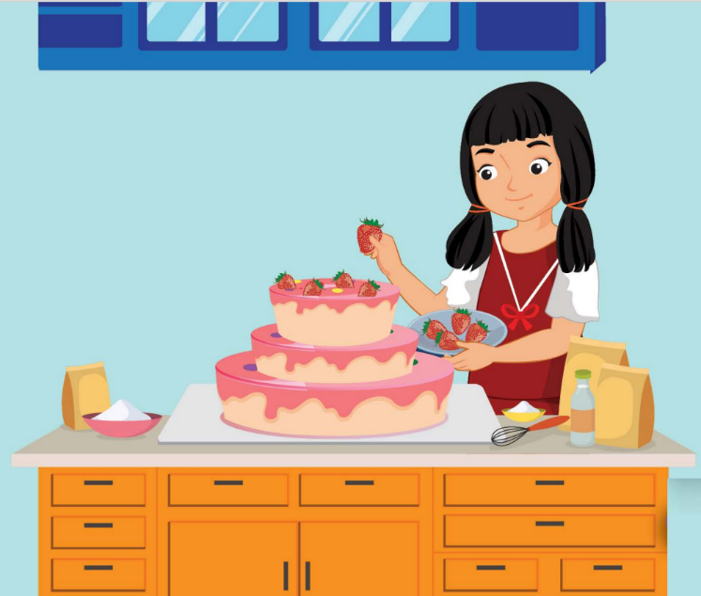
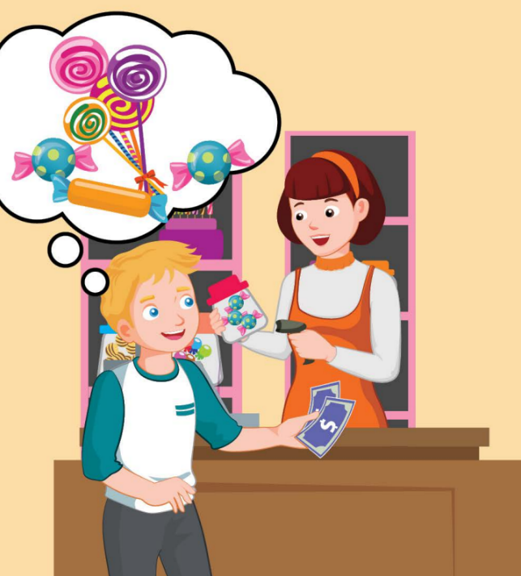
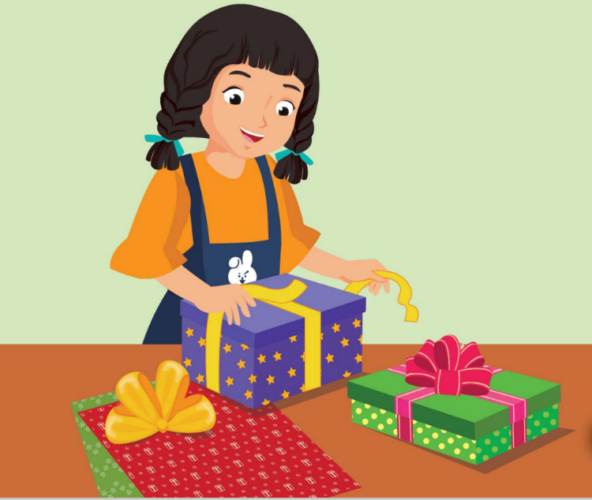


Slide 7
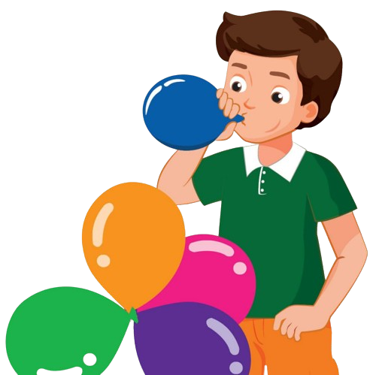
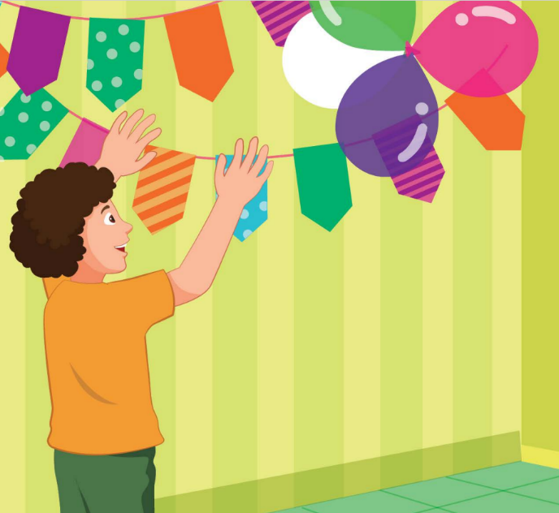

Slide 8
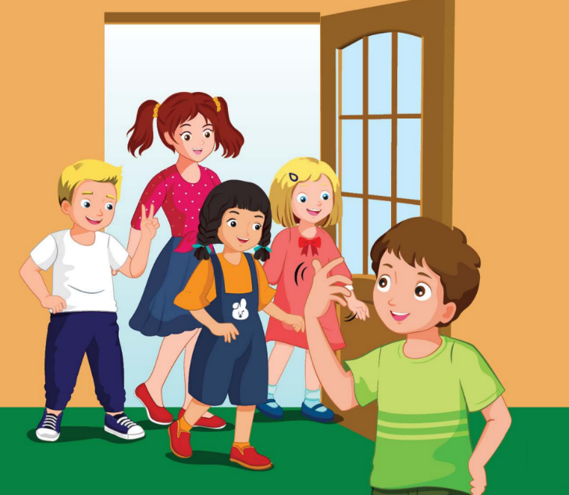

Slide 9
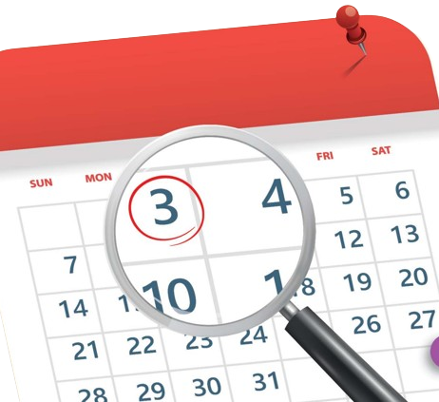
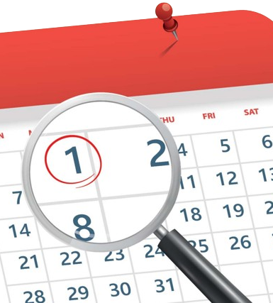
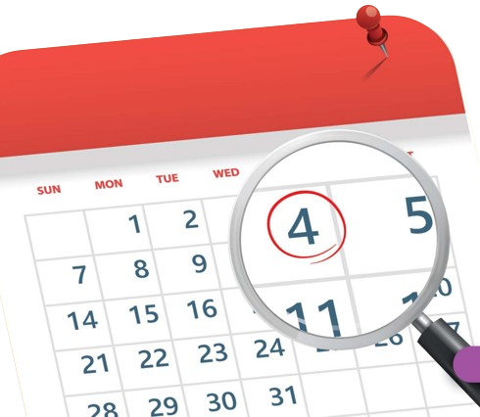

Slide 10
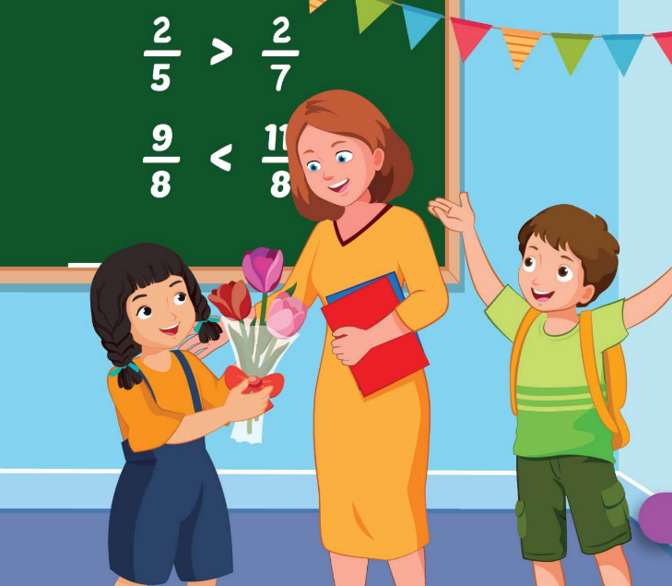
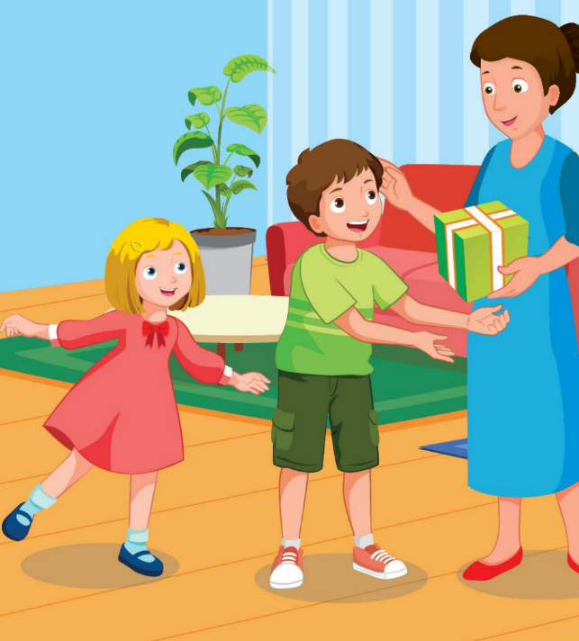
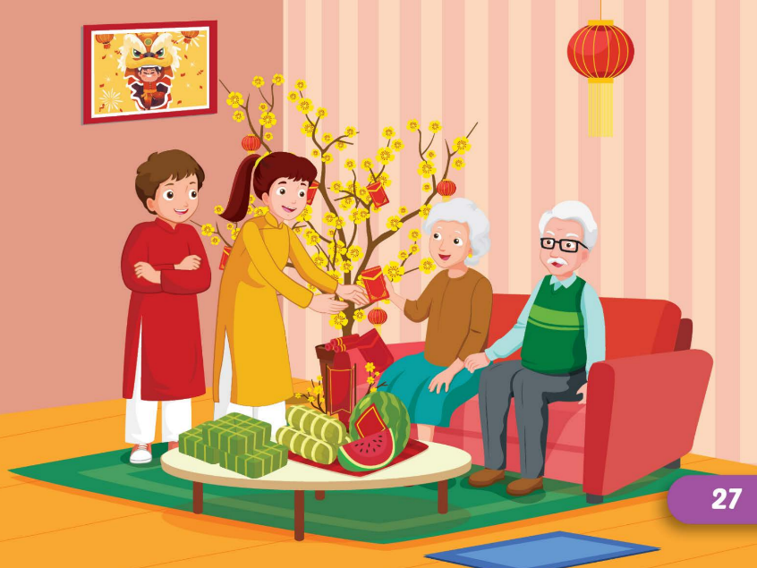

Slide 11
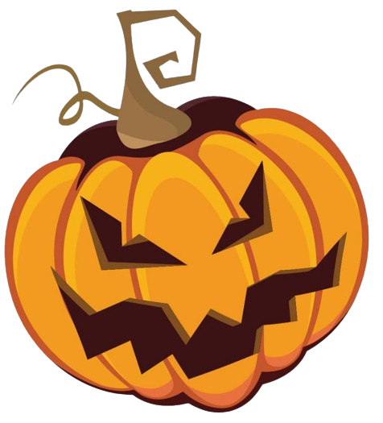
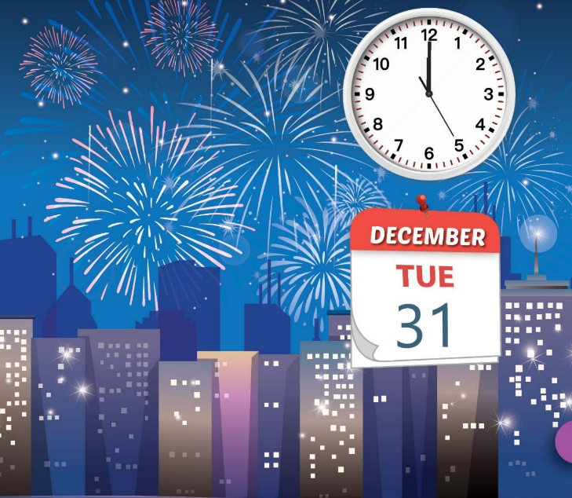

Slide 12



Slide 13

It’s time to learn …

Slide 14
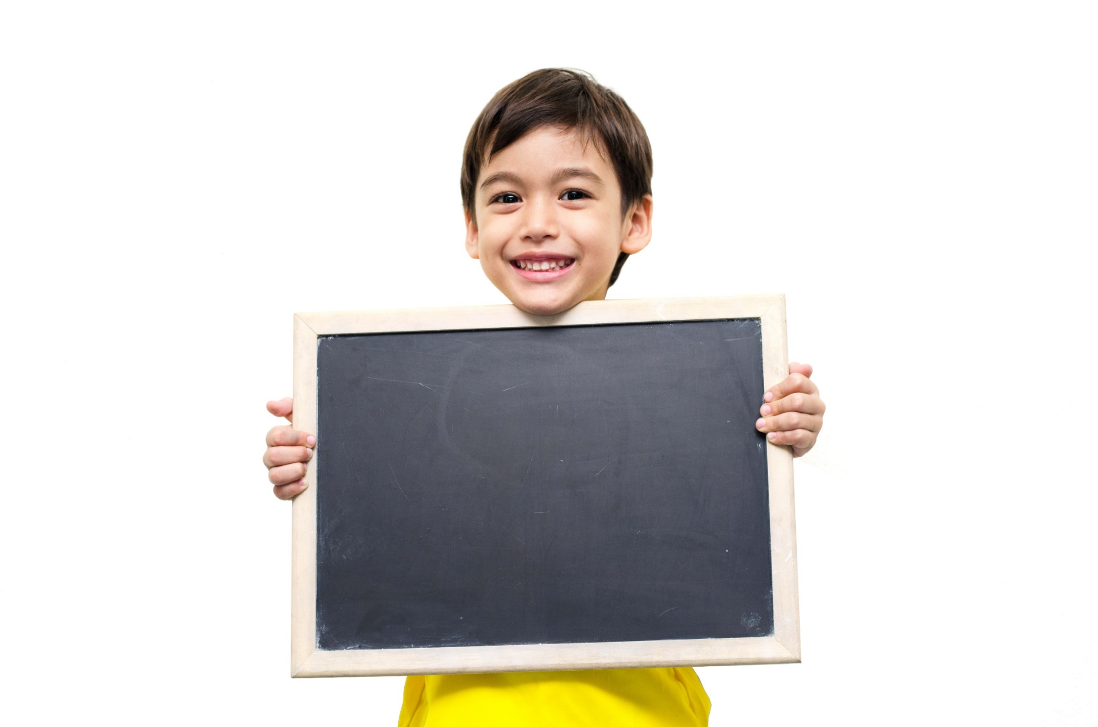
Writing

Slide 15
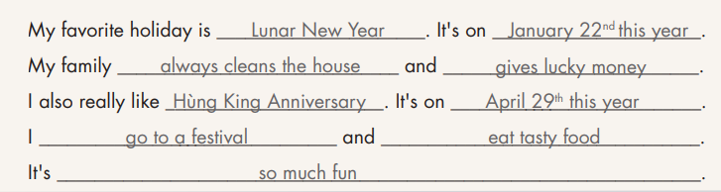
1. What's your favorite holiday?
2. When is it?
3. What does your family do to celebrate that holiday?
4. How about you?
5. How is that holiday?
Sample writing:

Slide 16
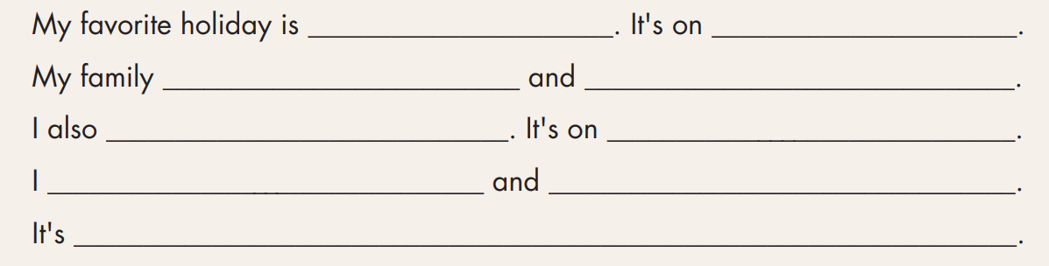

Slide 17
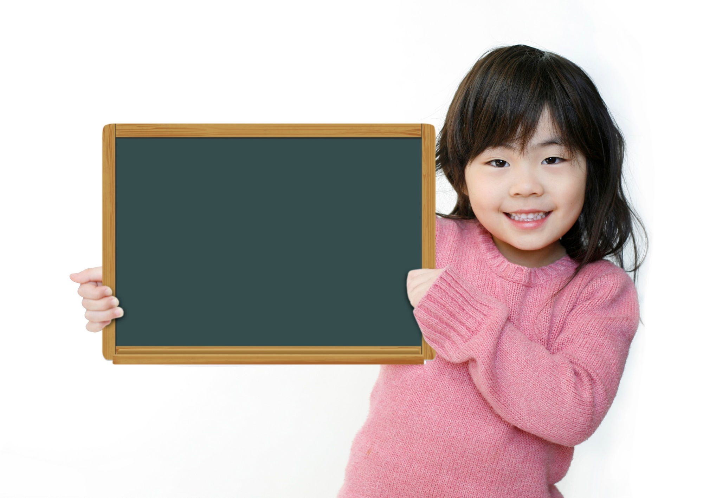
Speaking

Slide 18

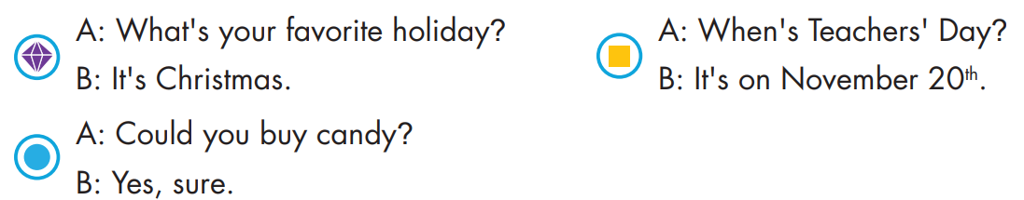
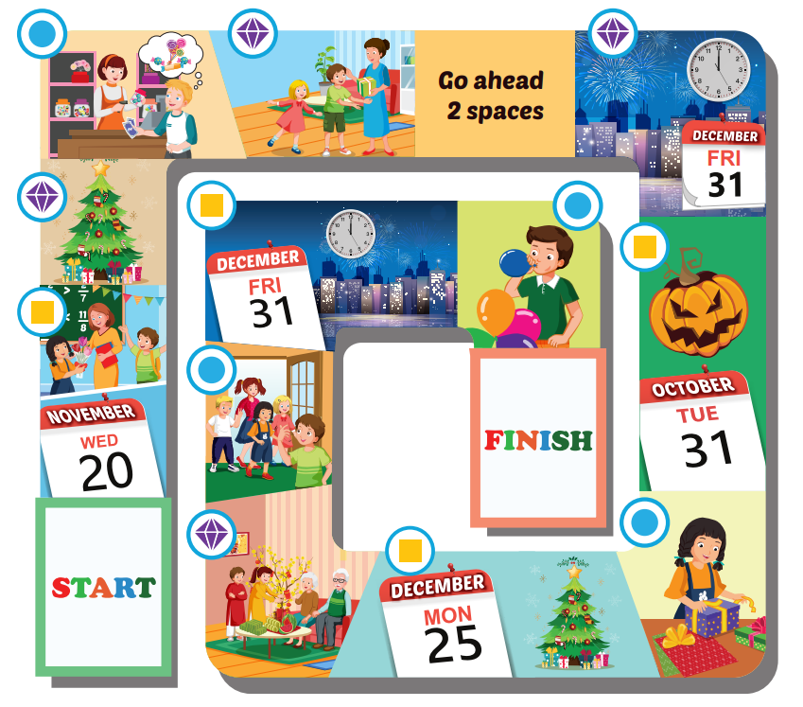

Slide 22

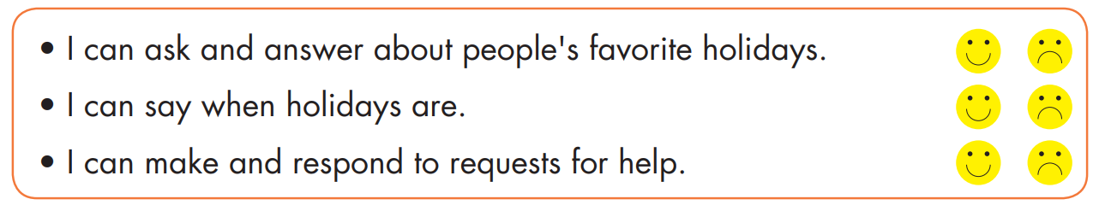

Slide 23
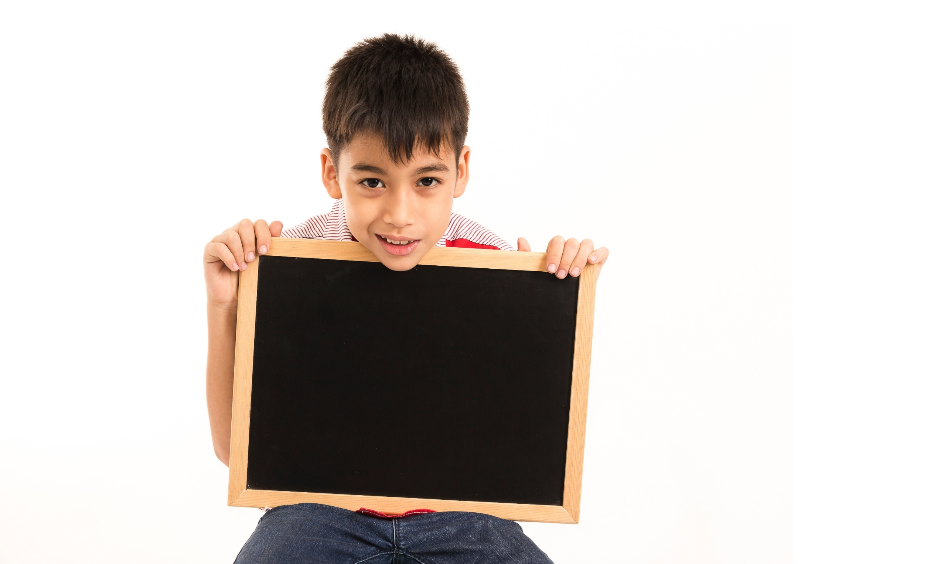
Listening

Slide 24

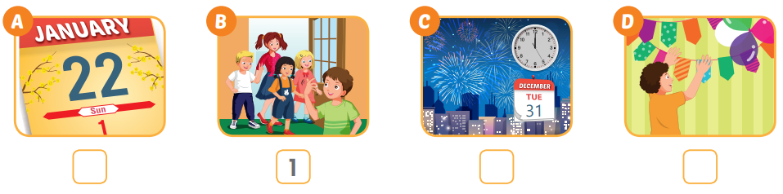
Extra Practice
WB, page 21
3
2
4

Slide 25
Production

Slide 26

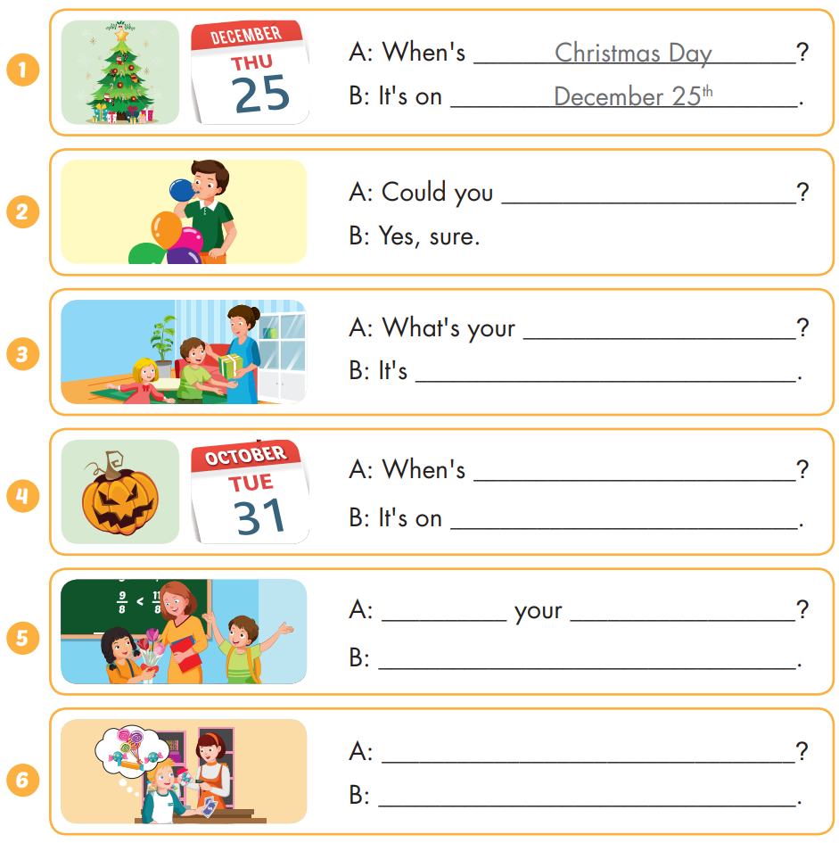
Extra Practice
WB, page 21

Slide 27
Extra Practice
WB, page 21
blow up the balloons
favorite holiday
Children's Day

Slide 28
Extra Practice
WB, page 21
Halloween
October 31st
What's
favorite holiday
It's Teachers' Day.
Could you buy candy?
Yes, sure.

Slide 29

CONSOLIDATION

Slide 30
Read and answer
Hi David, I live in Vietnam. My favorite holiday is Lunar New Year. I visit my grandparents, and they always give me lucky money. I love watching fireworks because they're so beautiful. We sometimes go to the park and watch the lion dance. I also really like Teachers' Day in Vietnam. It's on November 20th. We give presents to our teachers, and we thank them for helping us. I always wrap my teacher's presents with beautiful paper, and he is very happy. What's your favorite holiday? Let me know.
Khang
He's from Vietnam
1. Where is David from? _______________________________________.
It's Lunar New Year
2. What is his favorite holiday? _______________________________________.
He visits his grandparents
3. What does he do? _______________________________________.
It's on November 20th
4. When is Teachers' Day in Vietnam? _______________________________________.
They give presents to their teachers
5. What do people do to celebrate Teachers' Day? _______________________________.

Slide 31
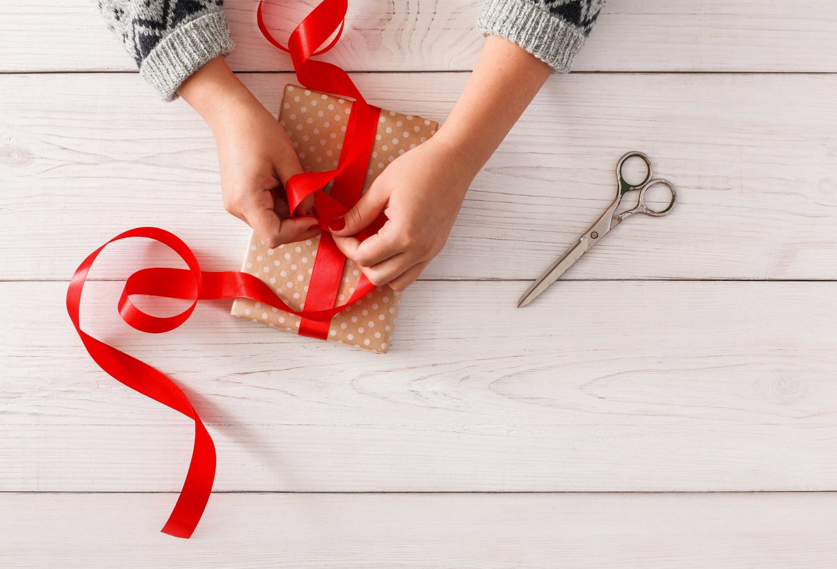
WRAP-UP

Slide 32
Today’s lesson
Structures/ Sentence patterns
What's your favorite holiday?
- It's Halloween;
What's her favorite holiday? - It's Christmas; When's Christmas Day?
- It's on December twenty-fifth;
Could you blow up the balloons? - Yes, sure; What do people do to celebrate Christmas?
- They put up a Christmas tree.
Vocabularies
Halloween, New Year's Eve, Lunar New Year (Tết), Christmas, Teachers' Day, Children's Day, first, second, third, fourth, fifth, put up colored paper, buy candy, invite friends, blow up the balloons, make a cake, wrap the presents, put up a Christmas tree, give presents, watch fireworks, wear costumes, give lucky money, watch the lion dance.

Slide 33
Homework
Practice the vocabularies and structure; and make sentences using them.
Do the exercises in Tiếng Anh 5 i-Learn Smart Start WB (page 21)
Do the exercises in Tiếng Anh 5 i-Learn Smart Start Notebook (page 15)
Prepare the next lesson (page 34 SB)
Play the consolidation games in Tiếng Anh 5 i-Learn Smart Start DHA App on www.eduhome.com.vn

Slide 34

Enjoy your day!

Slide 35
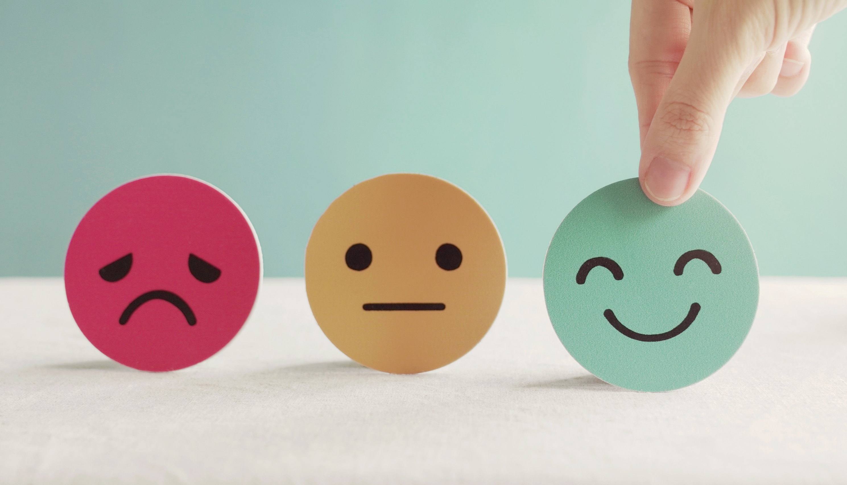
Lesson 3
Stay positive and have a nice day!

