Slide 1

Unit 2
WHAT I CAN DO
REVIEW 2- PAGE 33

Slide 2
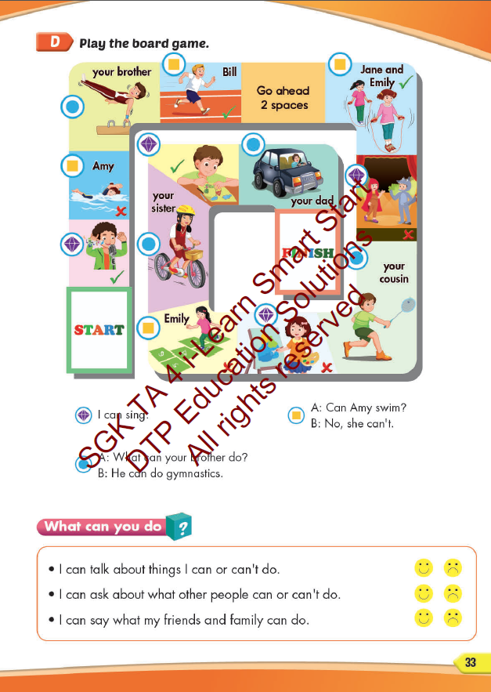
Lesson Outline
Warm-up
Speaking
Consolidation
Wrap-up

Slide 3
Objectives
By the end of this lesson, students will be able to review unit 2.
Vocabulary: play badminton, play the guitar, swim, play the piano, do gymnastics
Structure:
What can you do?
I can swim.
Can you play the piano?
Yes, I can. / No, I can’t.

Slide 4

WARM UP

Slide 5



LISTEN AND CHOOSE

Slide 6
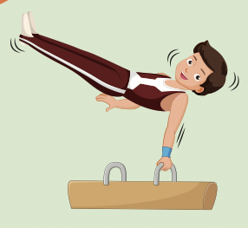
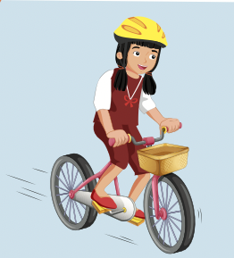
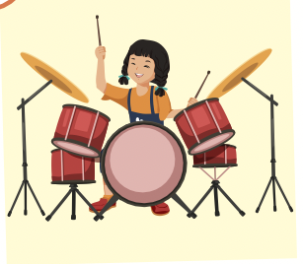


Slide 8
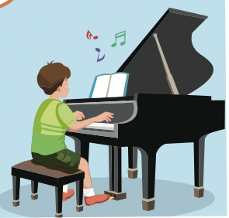
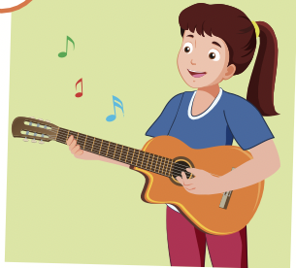
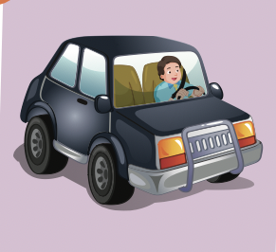

Slide 10

It’s time to learn …

Slide 11

Speaking

Slide 12




Slide 13
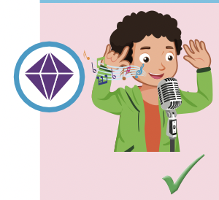
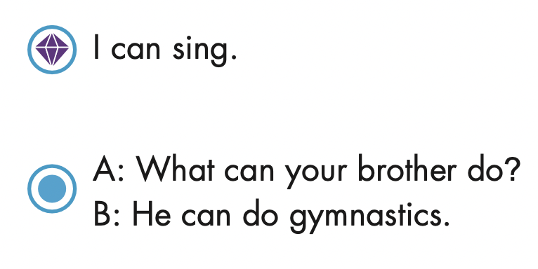

Slide 14
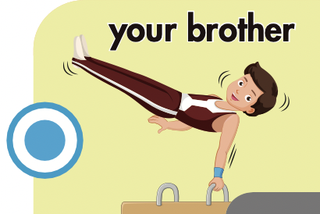

Slide 15
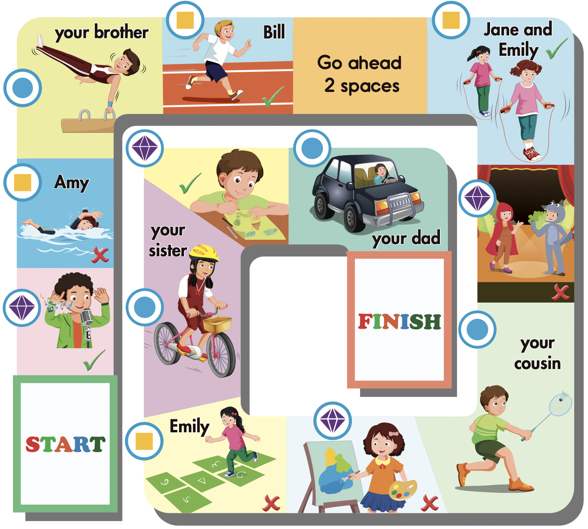

Slide 16



Slide 17

Listening

Slide 18

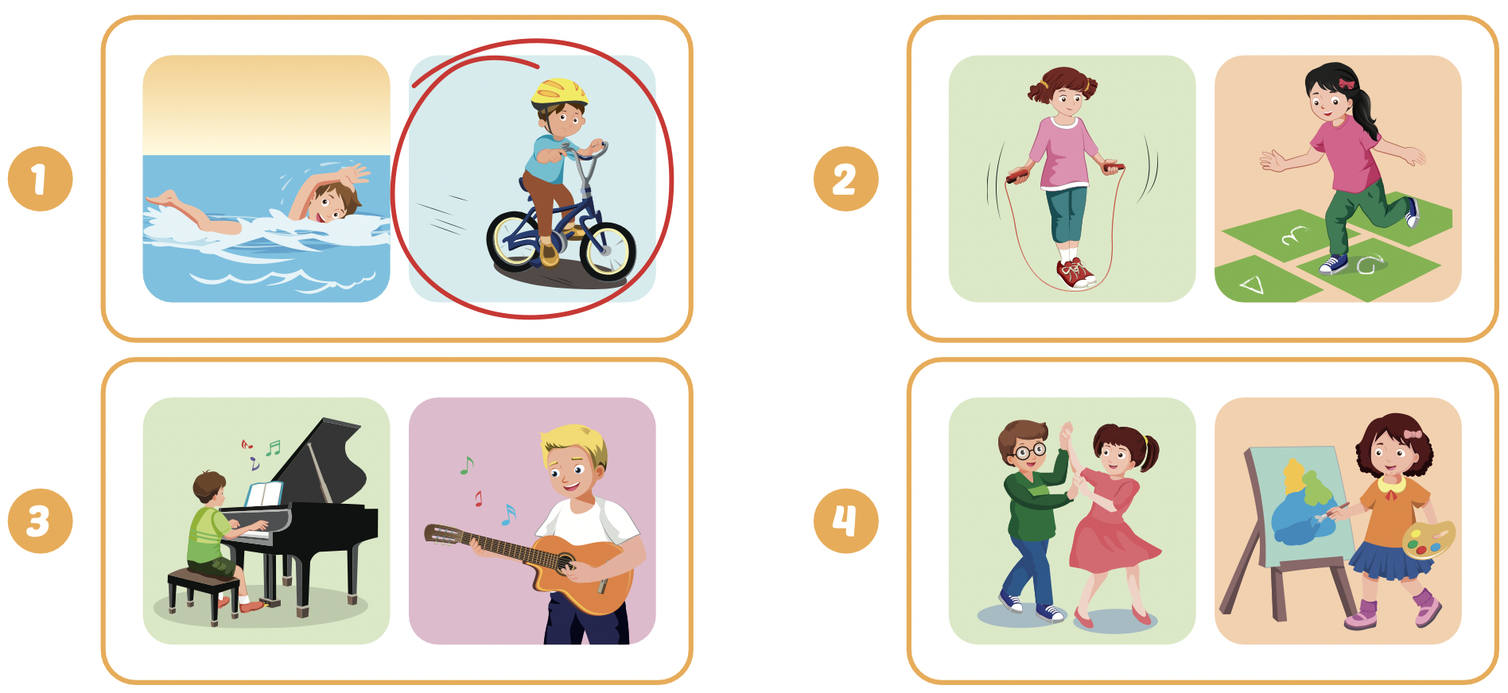
Extra Practice
WB, page 20

Slide 19


UNSCRAMBLE THE SENTENCES

Slide 20

can’t / the / They / keyboard/ play/.
They can’t play the keyboard.

Slide 21
she / can/ What / do /?
What can she do?

Slide 22
you/ Can / the / play / guitar/?
Can you play the guitar?

Slide 23
mom / What / your / do / can / ? /
What can your mom do?

Slide 24
climb / he / tree/ Can / tree / a / ?
Can he climb a tree?

Slide 25

Writing

Slide 26

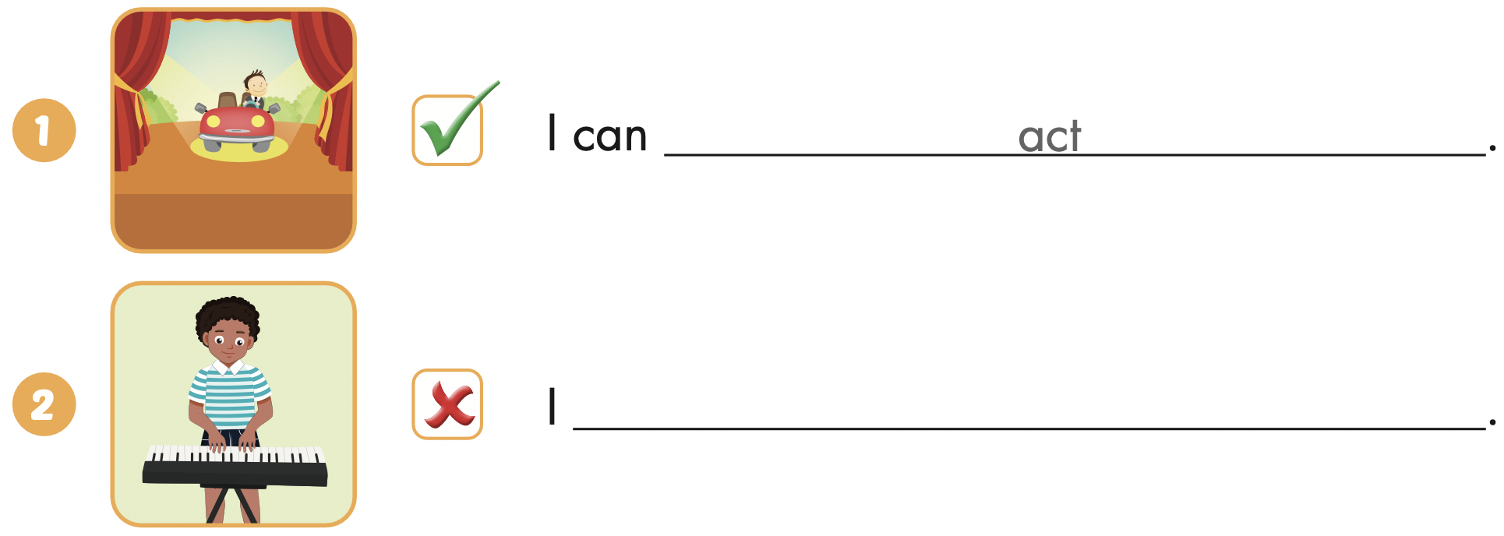
Extra Practice
WB, page 21
can’t play the keyboard

Slide 27
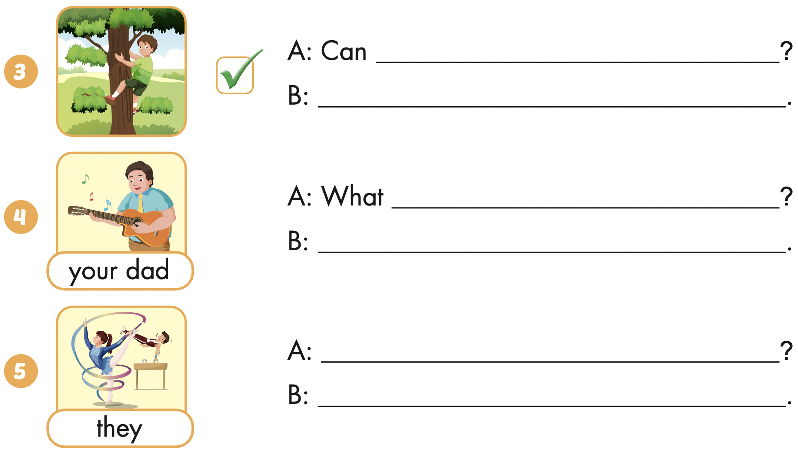
Extra Practice
WB, page 21
you climb a tree
Yes, I can
can your dad do
He can play the guitar
What can they do
They can do gymnastics

Slide 28

CONSOLIDATION

Slide 29

WRAP-UP

Slide 30
Today’s lesson
Vocabularies
play badminton,
play the guitar,
swim,
play the piano,
do gymnastics
Structures/ Sentence patterns
What can you do?
I can swim.
Can you play the piano?
Yes, I can. / No, I can’t.

Slide 31
Homework
Practice the vocabularies and structure; and make sentences using them.
Do the exercises in Tiếng Anh 4 i-Learn Smart Start Notebook (page 16)
Prepare the next lesson (page 34 SB)
Play the consolidation games in Tiếng Anh 4 i-Learn Smart Start DHA App on www.eduhome.com.vn

Slide 32

Enjoy your day!

