Slide 1

Unit 1: My friends
Lesson 1.1
Page 10

Slide 2
Lesson Outline
Warm-up
Vocabulary
Structure
Consolidation
Wrap-up

Slide 3
Objectives
By the end of this lesson, students will be able to spell names.
Vocabulary: The Alphabet
Structure: How do you spell “Alfie”?
A-L-F-I-E.

Slide 4

WARM UP

Slide 5

Whisper...
Try to convey the message to your friends as fast as possible!
Notes:
Divide students into 2-3 teams. Make lines.
Give the first the students the MESSAGE (Lucy, white, stand up, sit down, hands up, open your book, What’s your name?, What colour is it?, I’m ten (10) years old.)
Students whisper the MESSAGE to the next friend. The last students have to run quickly and write the MESSAGE CORRECTLY on the board.
The fastest and most correctly is the winner.

Slide 6

It’s time to learn …

Slide 7

New words
The alphabet
A B C...

Slide 8

Presentation

Slide 9

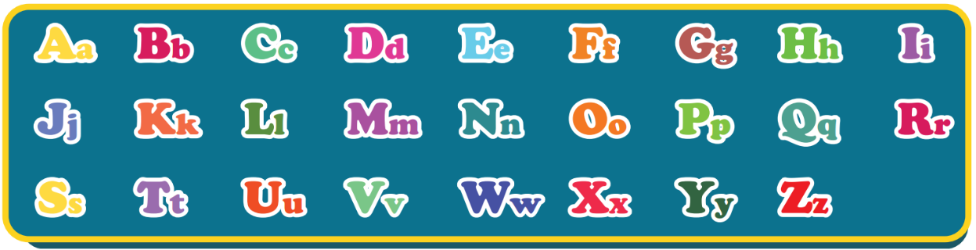
The Alphabet Song
Notes:
Click on the picture to listen to the Alphabet song.
For the first time, the arrow icon automatically appears in group of two-three letters along with the music.
For the second time, guider has to point every single letter for students.

Slide 10

Practice

Slide 11
Act1. Heads up. What’s missing?
Aa
Bb
Cc
Dd
Ee
Ff
Gg
Hh
Ii
Jj
Kk
Ll
Mm
Nn
Oo
Pp
Qq
Rr
Ss
Tt
Uu
Vv
Ww
Xx
Yy
Zz
Notes:
Review
Heads down on the table. When hearing guider’s command, heads up guess the missing letter (letters)
10 turns (1 missing letter -> 2 missing letters -> 3 missing letters)

Slide 12



Act2. Look and write.
Aa
Bb
Cc
Dd
Ee
Ff
Gg
Cat
_all
_at
Ball
Apple
Dog
_lephant
Fish
_oat
_pple
_og
Elephant
_ish
Goat
Notes:
apple: 692424901
Ball: 535561051
Cat: 457791871
Dog: 399897679
Elephant: 1929090011
Fish: 643769101
Goat: 2008803551

Slide 13
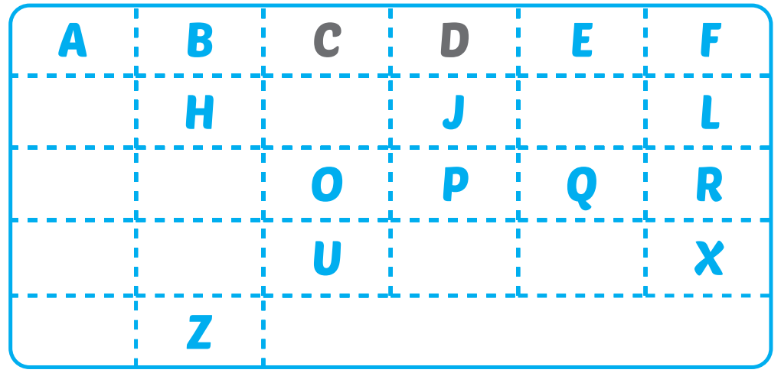
Extra-Act1 - WBp8. Write missing letters.
G
I
K
M
N
S
T
V
W
Y

Slide 14
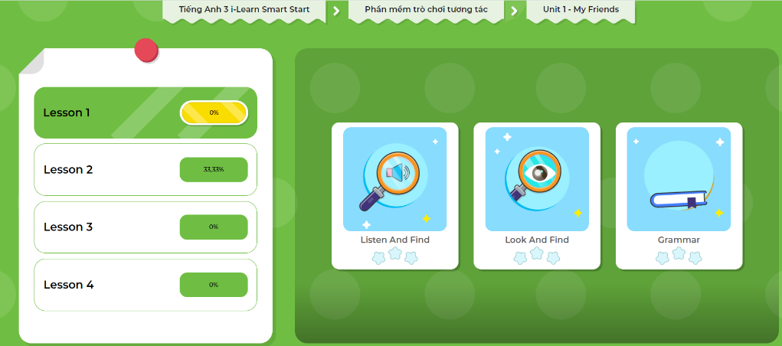
Extra-Act2. DHA app.
Click here to play the games

Slide 15

Structures
How do you spell “Alfie”?
A-L-F-I-E.

Slide 16
Presentation

Slide 17


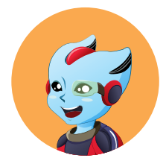
How do you spell “Alfie”?
A-L-F-I-E.
Mai
Alfie
Notes:
- Click on the WORDS to hear the SOUND

Slide 18
Practice

Slide 19
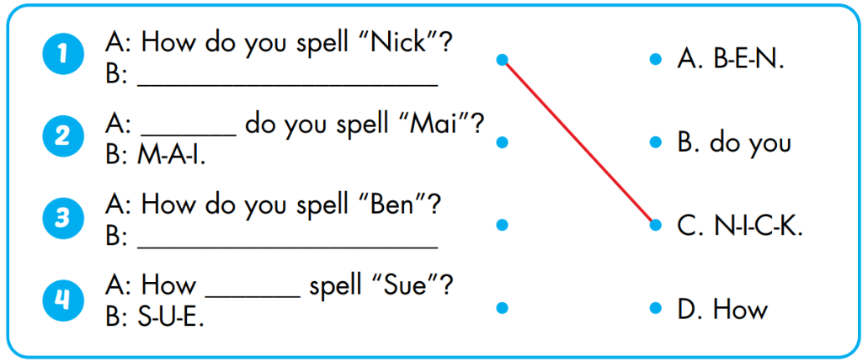
Act1. Look and match. Practice.

Slide 20

Act2. Guess your friends’ names.
N-I-C-K.
NICK?
Notes:
Teacher spell a student’s name in the class => students have to guess who is that and get point if having the right answer.
Invite student to SPELL NAME.
Up the level by spelling with faster speed.

Slide 21
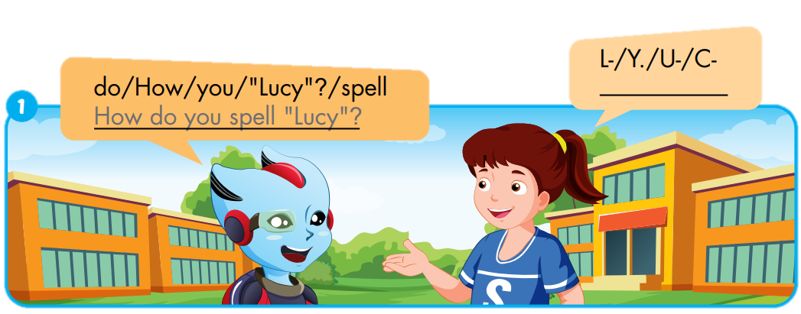
Extra-Act1 - WBp8. Unscramble and write.
L-
U-
C-
Y.

Slide 22
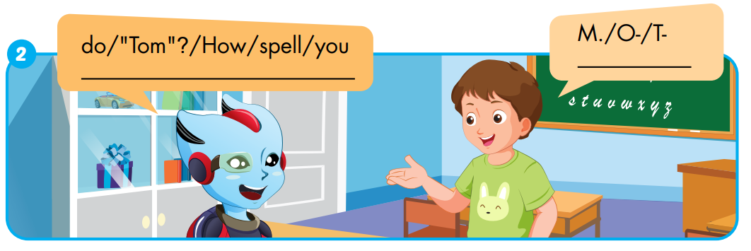
Extra-Act1 - WBp8. Unscramble and write.
T-
O-
M.
How
do
you
spell
“Tom”?

Slide 23
Extra-Act2. DHA app.
Click here to play the games

Slide 24

CONSOLIDATION

Slide 25
Act1. Sing the Alphabet song.
The Alphabet Song
Notes:
- Click on the picture to hear the sound.

Slide 26
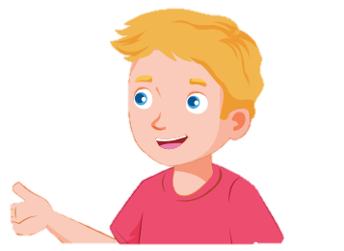
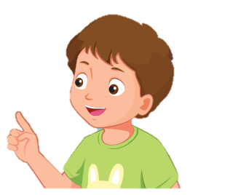
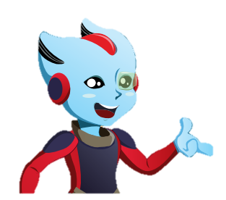



Act2. Spell names of yours and friends.
Hello.
My name’s Alfie.
A-L-F-I-E.
Nick
Tom
His name’s Nick.
N-I-C-K.
Her name’s Mai.
M-A-I.
Mai
Sue

Slide 27

WRAP-UP

Slide 28
Today’s lesson
Vocabularies
The Alphabet
Structures/ Sentence patterns
How do you spell “Alfie”?
A-L-F-I-E.

Slide 29
Homework
Practice the vocabularies and structure; and make sentences using them.
Do the exercises in Tiếng Anh 3 i-Learn Smart Start WB (page 8)
Do the exercises in Tiếng Anh 3 i-Learn Smart Start Notebook (page 10)
Prepare the next lesson (page 11 SB)
Play games in Tiếng Anh 3 i-Learn Smart Start DHA App on www.eduhome.com.vn

Slide 30

Enjoy your day!

