Slide 1




Slide 2









Slide 3



Slide 4

Câu 3
Câu 1
Câu 2

Slide 5



$\frac{1}{8}:\frac{4}{5}=$ ?
$$\frac{5}{32}$$

Slide 6


$\frac{2}{8}:\frac{3}{4}=$ ?
$$=\frac{2×4}{8×3}=\frac{8}{24}=\frac{1}{3}$$

Slide 7


$\frac{3}{7}:\frac{5}{8}=$ ?
$$=\frac{3×8}{7×5}=\frac{24}{35}$$

Slide 8


Slide 9






1
Tính
$$= \frac{18}{35}$$
$$= \frac{2}{9} x 6$$
$$= \frac{60}{7}$$
$$= \frac{42}{7}$$
$$=6$$
$$= \frac{12}{9}=\frac{4}{3}$$

Slide 10
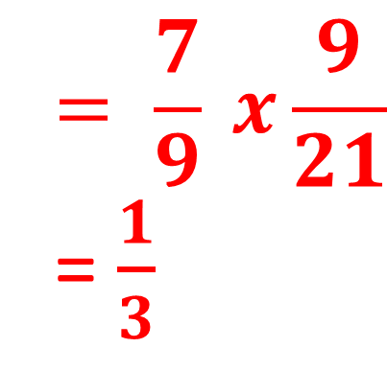

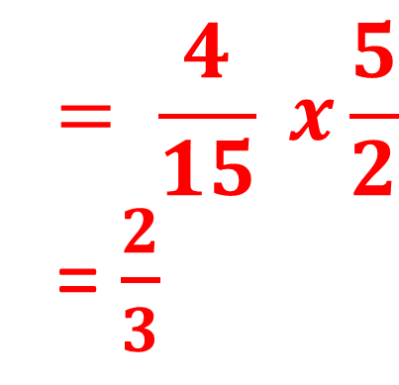
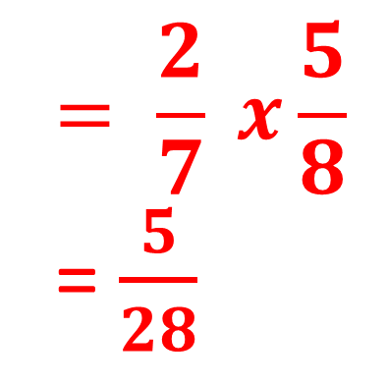
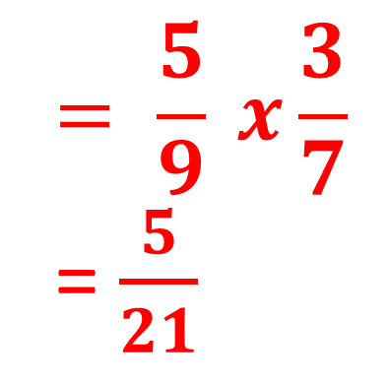
2
$$Tính$$
$$= \frac{5}{9} x\frac{3}{7}$$
= $\frac{5}{21}$
$$= \frac{2}{7} x\frac{5}{8}$$
= $\frac{5}{28}$
$$= \frac{4}{15} x\frac{5}{2}$$
= $\frac{2}{3}$
$$= \frac{7}{9} x\frac{9}{21}$$
= $\frac{1}{3}$

Slide 11
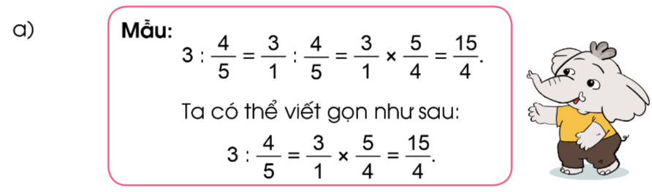
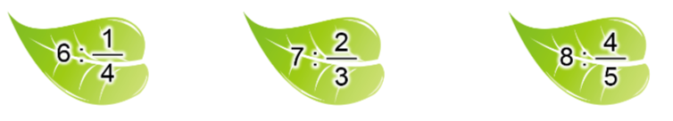
3
Tính theo mẫu

Slide 12

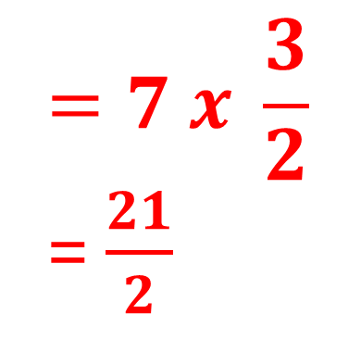

$$=7 x \frac{3}{2}$$
= $\frac{21}{2}$
$$=8 x \frac{5}{4}$$
= $\frac{40}{4}=10$
$$=6 x \frac{4}{1}$$
= 24

Slide 13
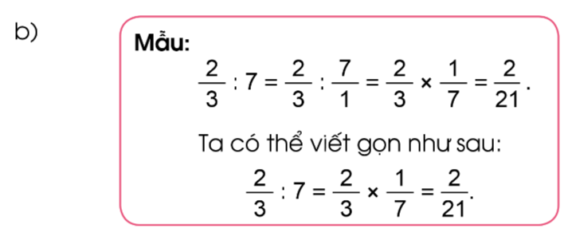
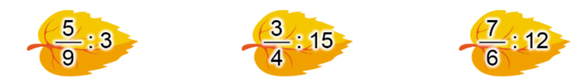

Slide 14
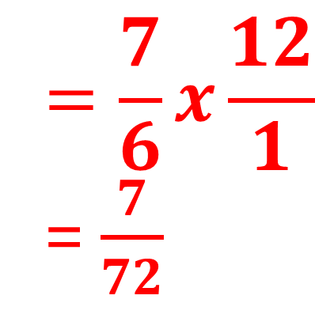
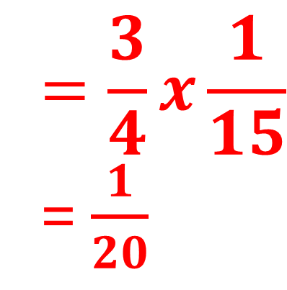
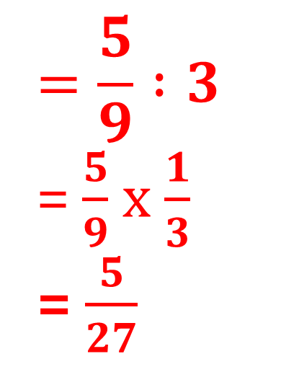
$$=\frac{5}{9} :3$$
= $\frac{5}{9}$x $\frac{1}{3}$
= $\frac{5}{27}$
$$=\frac{3}{4}x\frac{1}{15}$$
= $\frac{1}{20}$
$$=\frac{7}{6}x\frac{12}{1}$$
= $\frac{7}{72}$

Slide 15

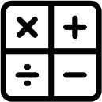






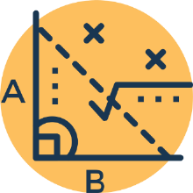

Slide 16


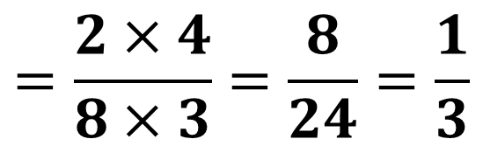
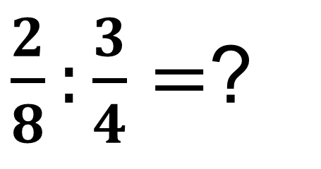
AI NHANH HƠN?
$\frac{2}{8}:\frac{3}{4}=$?
Content 2
$$=\frac{2×4}{8×3}=\frac{8}{24}=\frac{1}{3}$$
Content 1

Slide 17

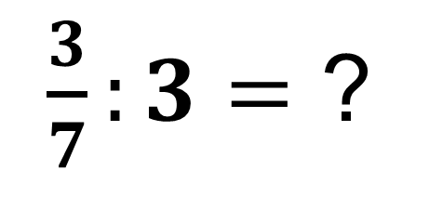
AI NHANH HƠN?
$$=\frac{3}{7} X\frac{1}{3}=\frac{1}{7}$$
$\frac{3}{7}:3=$ ?
Content 2
Content 1

Slide 18


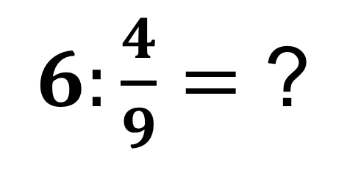
AI NHANH HƠN?
$$=6 X \frac{9}{4}$$
$$=\frac{27}{2}$$
$6:\frac{4}{9}=$ ?
Content 2
Content 1

Slide 19


