Slide 1
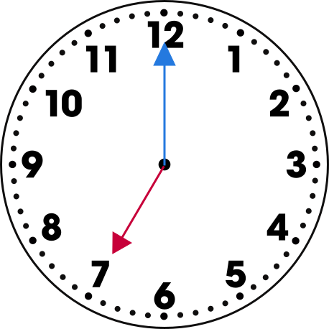
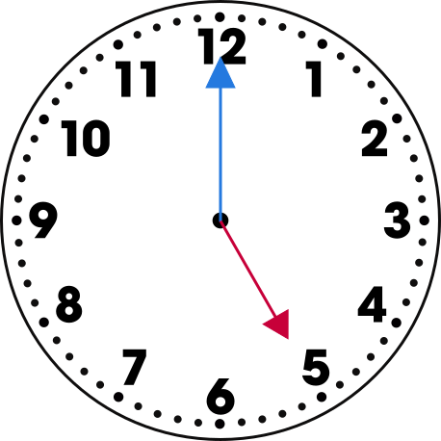
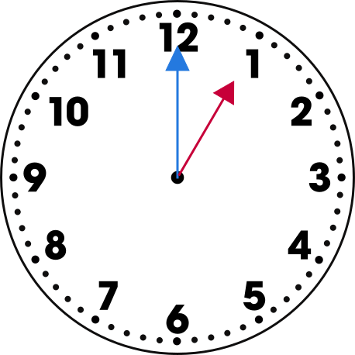
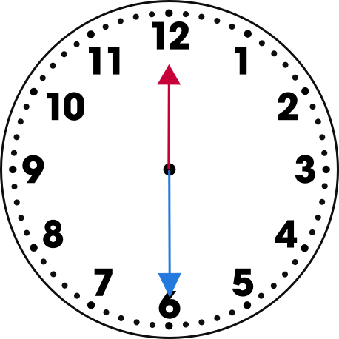
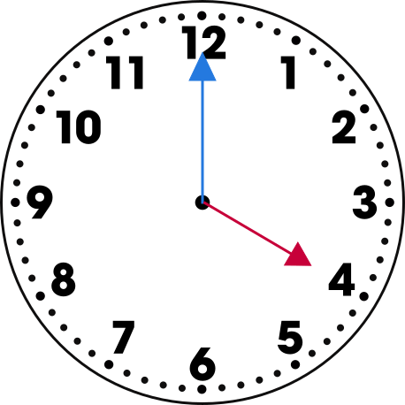
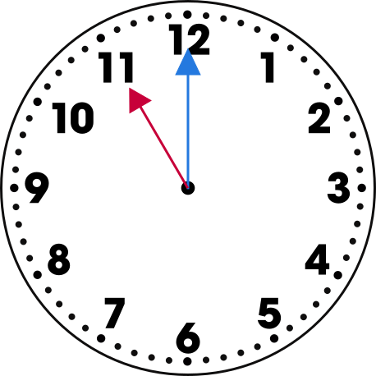
Name:
Telling Time
Write the time shown on each clock.

Slide 2
Name:
Clock
Trace and write the missing numbers on the clock. Draw the minute hand at 12 and the hour hand at 6.
12

Slide 3
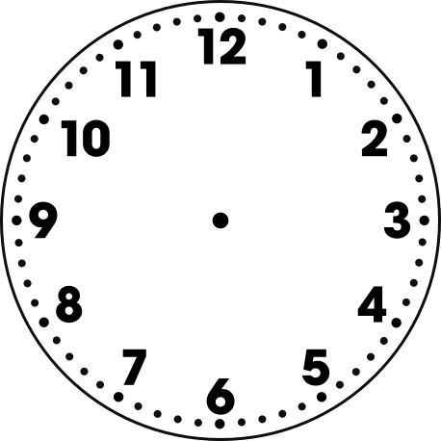
Name:
Drawing Time
Draw the hands on the clock.
10:00
8:30
9:15
12:30
4:45
2:00

