Slide 1

LQVH
Phòng GD&ĐT quận Long Biên
Trường MN Hoa Mộc Lan
Bài thơ:
LÀNG EM BUỔI SÁNG
Lứa tuổi: MGN 4-5 tuổi

Slide 2
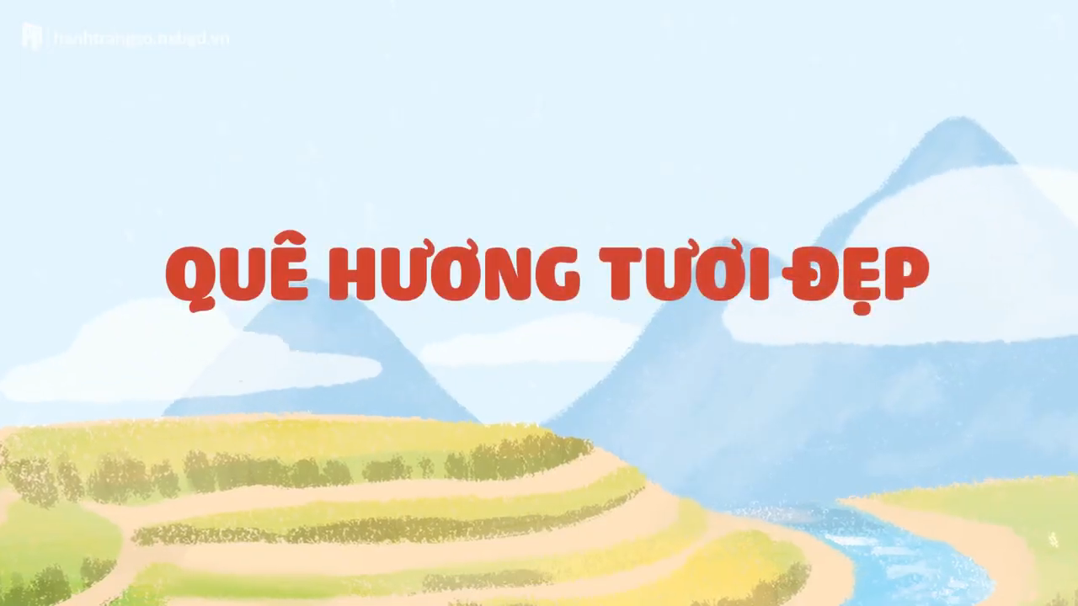
Contents of this template
You can delete this slide when you’re done editing the presentation
Fonts | To view this template correctly in PowerPoint, download and install the fonts we used
Used and alternative resources | An assortment of graphic resources that are suitable for use in this presentation
Thanks slide | You must keep it so that proper credits for our design are given
Colors | All the colors used in this presentation
Icons and infographic resources | These can be used in the template, and their size and color can be edited
Editable presentation theme | You can edit the master slides easily. For more info, click here
For more info:
SLIDESGO | BLOG | FAQs
You can visit our sister projects:
FREEPIK | FLATICON | STORYSET | WEPIK | VIDEVO

Slide 3
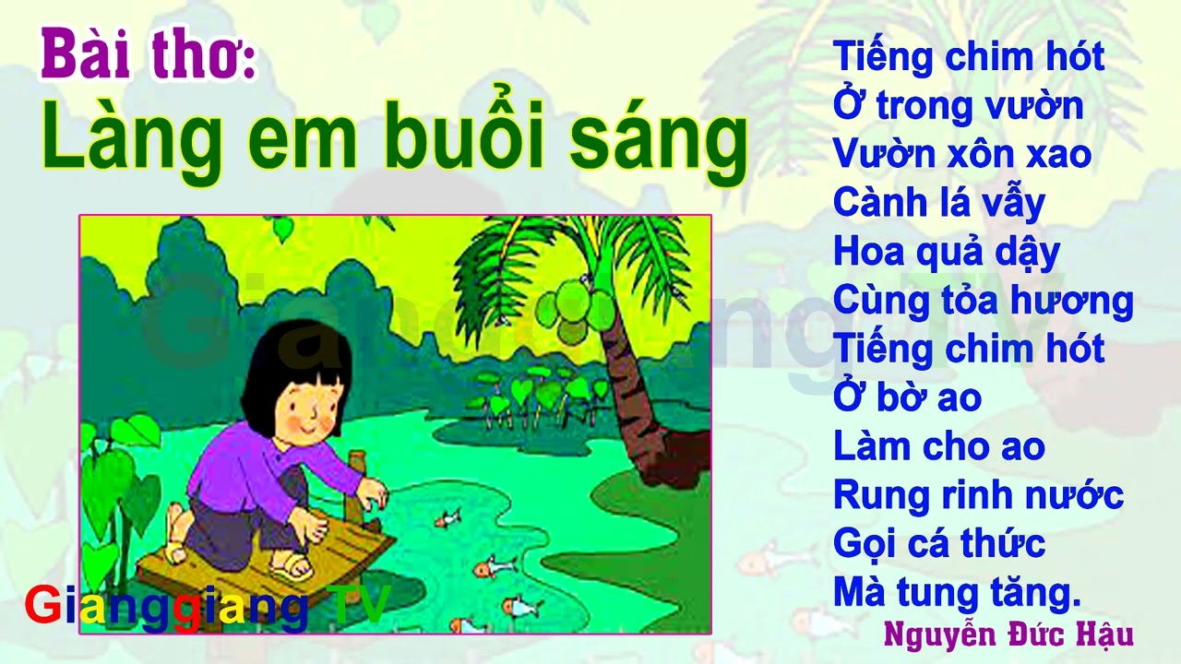
Table of contents
01
02
03
04
05
Section
Section
Section
You can describe the topic of the section here
You can describe the topic of the section here
You can describe the topic of the section here
Section
Section
You can describe the topic of the section here
You can describe the topic of the section here

Slide 4
Bài thơ có tên là gì?
Do ai sáng tác?

Slide 5
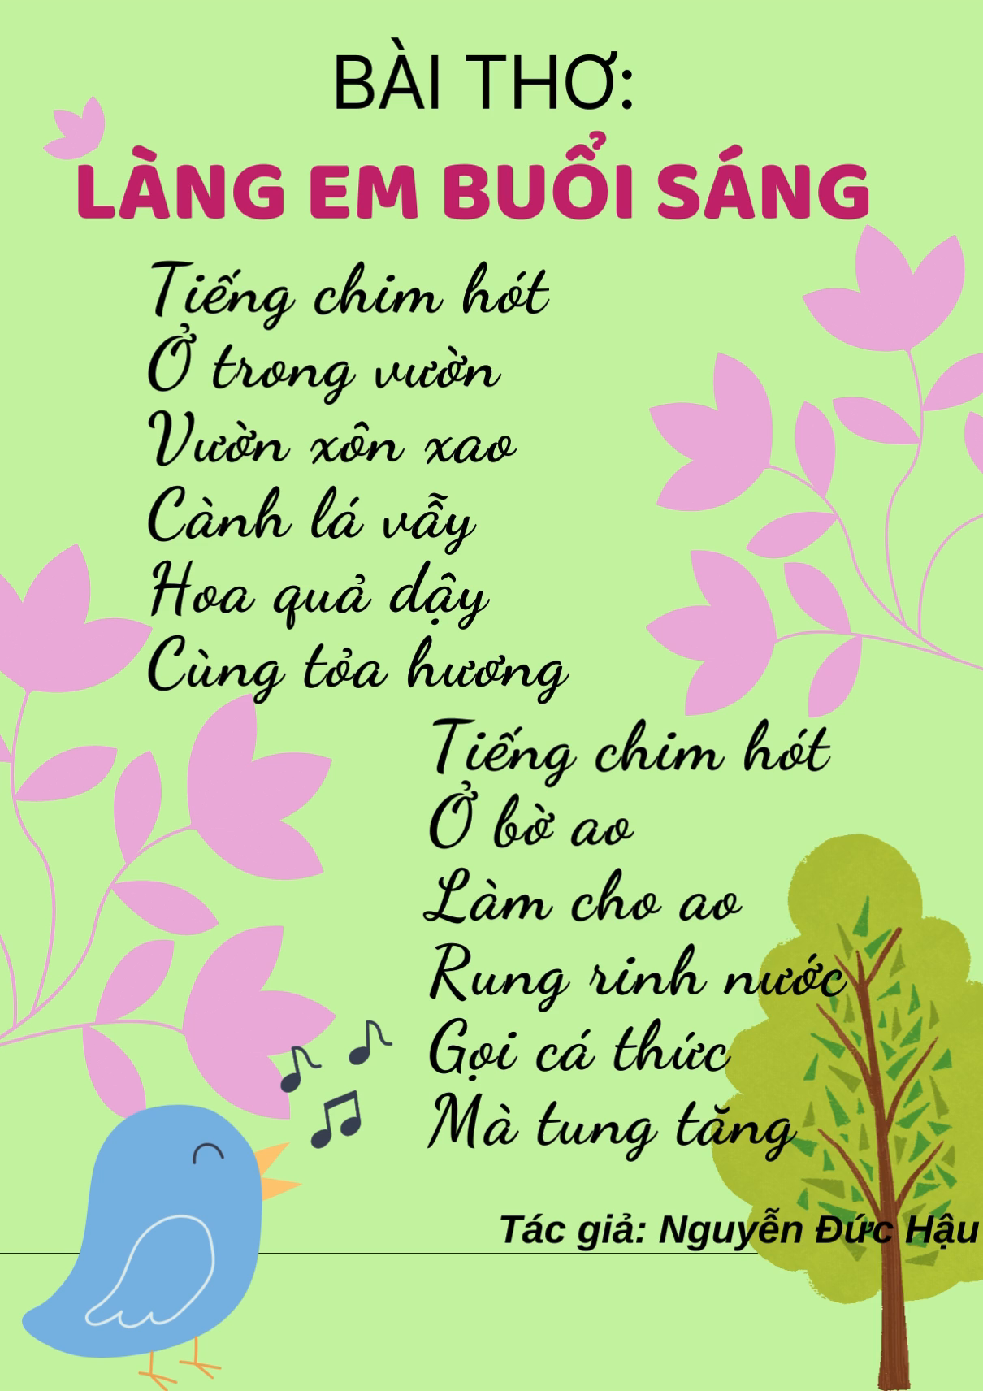

Slide 6
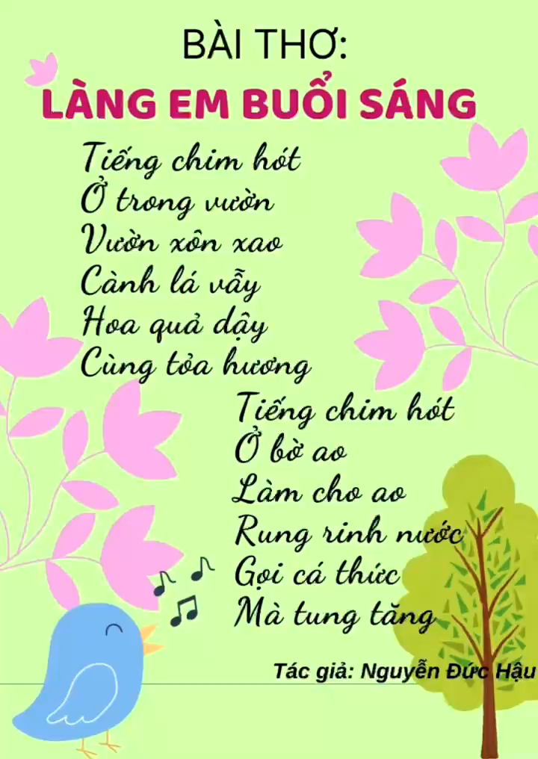

Slide 7
Giáo dục: Trẻ biết yêu thiên nhiên, quê hương đất nước, có ý thức bảo vệ môi trường

