Slide 1
Tạo hình
Vẽ chiếc kem
Phòng GD&ĐT quận Long Biên
Trường mầm non Gia Quất
Lứa tuổi: MGN 4-5 tuổi

Slide 2
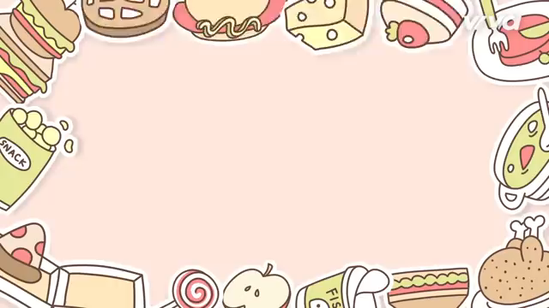
Bài hát: Chiếc bụng đói
This is a slide structure based on a multi-purpose presentation
You can delete this slide when you’re done editing the presentation
Fonts | To view this template correctly in PowerPoint, download and install the fonts we used
Used and alternative resources | An assortment of graphic resources that are suitable for use in this presentation
Thanks slide | You must keep it so that proper credits for our design are given
Colors | All the colors used in this presentation
Infographic resources | These can be used in the template, and their size and color can be edited
Customizable icons | They are sorted by theme so you can use them in all kinds of presentations
For more info:
Slidesgo | Slidesgo School | Faqs
You can visit our sister projects:
Freepik | Flaticon | Storyset | Wepik | Vidfy

Slide 3
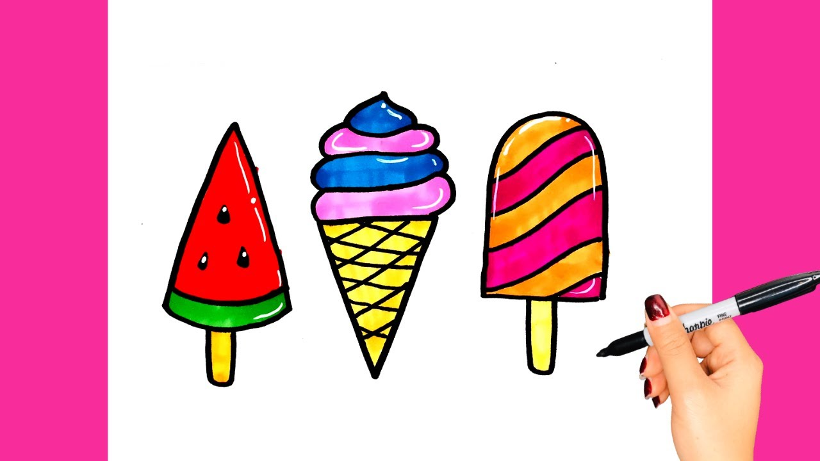
Table of contents
01
02
03
04
About ice cream
History
You can describe the topic of the section here
You can describe the topic of the section here
About the month
Conclusions
You can describe the topic of the section here
You can describe the topic of the section here

Slide 4
Đàm thoại
Hỏi ý tưởng trẻ

Slide 5
Con sẽ vẽ chiếc kem như thế nào?
Cô sử dụng những nét nào để vẽ chiếc kem?
Bức tranh vẽ gì?
Bố cục tranh như thế nào?
Cô dùng màu gì để tô?
Con sẽ tô màu gì cho chiếc kem?

Slide 6
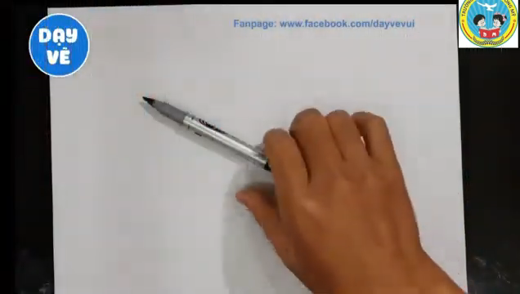
Introduction
You can give a brief description of the topic you want to talk about here. If you want to talk about Mercury, you can say that it’s the smallest planet in the Solar System

Slide 7
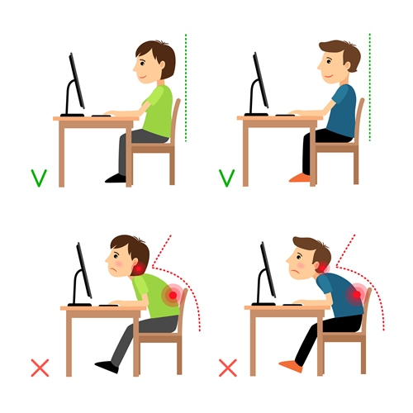

Tư thế ngồi đúng
Cách cầm bút đúng

Slide 8
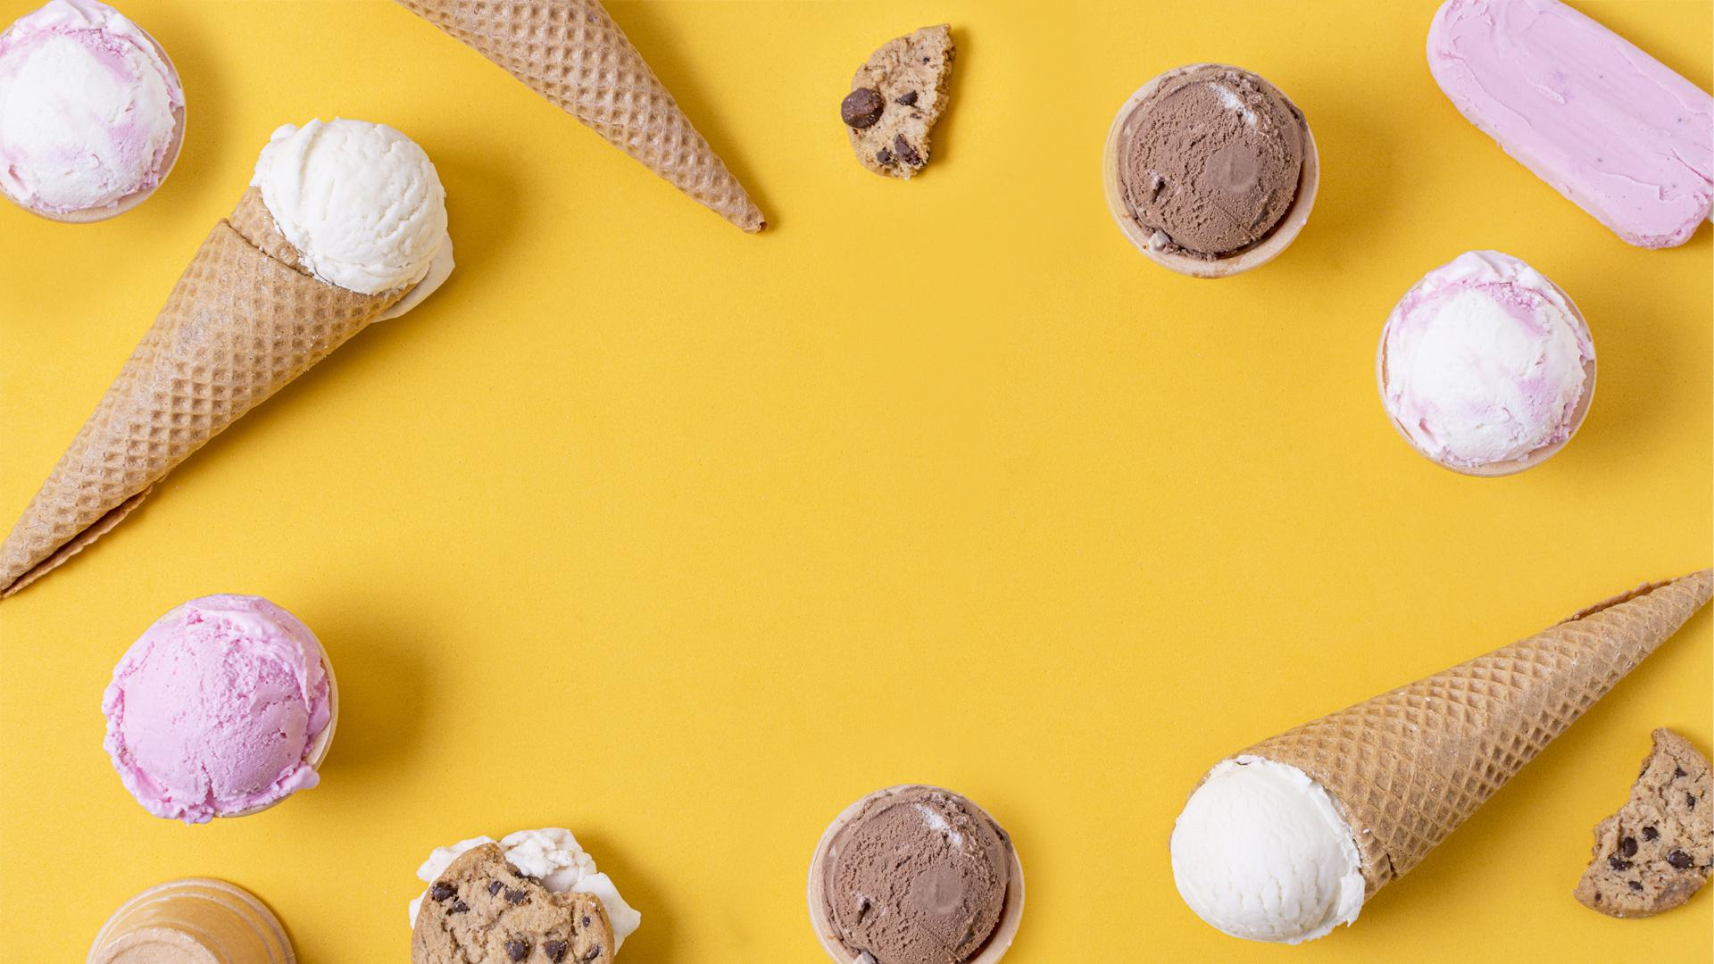
Trẻ thực hiện

