Slide 1






WELCOM TO
MS Linh
ENGLISH CLASS

Slide 2


Objectives
By the end of this lesson, students will be able to ask the colors of things.
Vocabulary:
red, yellow, blue, black, white
Structures:
What color is it?/ It’s yellow.

Slide 3



Slide 4



NEW LESSON

Slide 5






1
Vocabulary
1
2
3
4
5
red
yellow
blue
black
white
/red/
màu đỏ
/ˈjeləʊ/
màu vàng
/bluː/
màu xanh dương
/blæk/
màu đen
/waɪt/
màu trắng
Click on each English word to hear the sound.

Slide 6
1
red
/red/
màu đỏ
Click on each English word to hear the sound.

Slide 7
2
yellow
/ˈjeləʊ/
màu vàng
Click on each English word to hear the sound.

Slide 8
3
blue
/bluː/
màu xanh dương
Click on each English word to hear the sound.

Slide 9
4
black
/blæk/
màu đen
Click on each English word to hear the sound.

Slide 10
5
white
/waɪt/
màu trắng
Click on each English word to hear the sound.

Slide 11
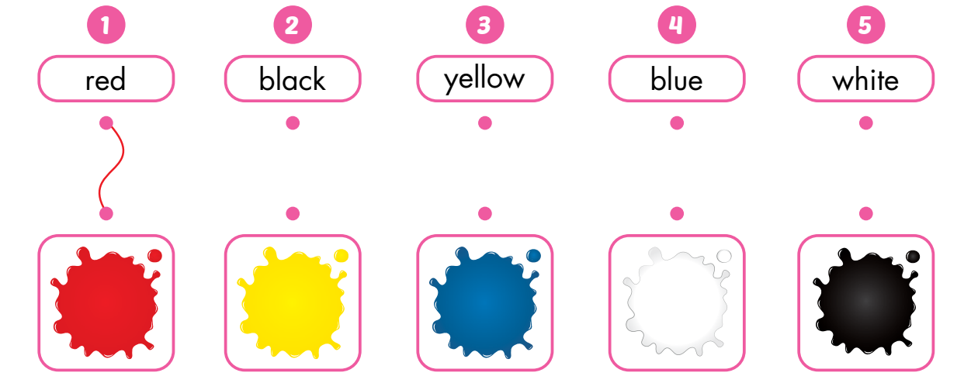
Draw lines.

Slide 12
2
STRUCTURES
What color is it?
It’s yellow.

Slide 13

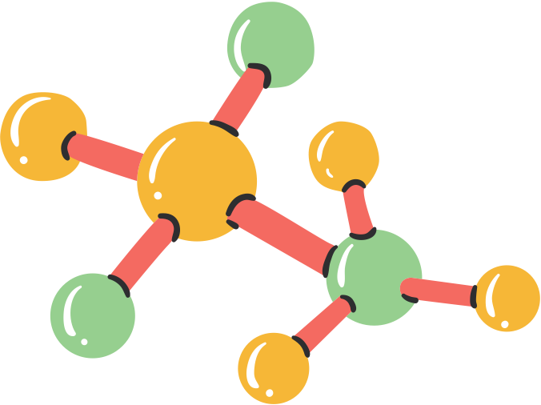






What color is it?
It’s red
It’s yellow
It’s black
It’s blue
It’s white

Slide 14


Slide 15
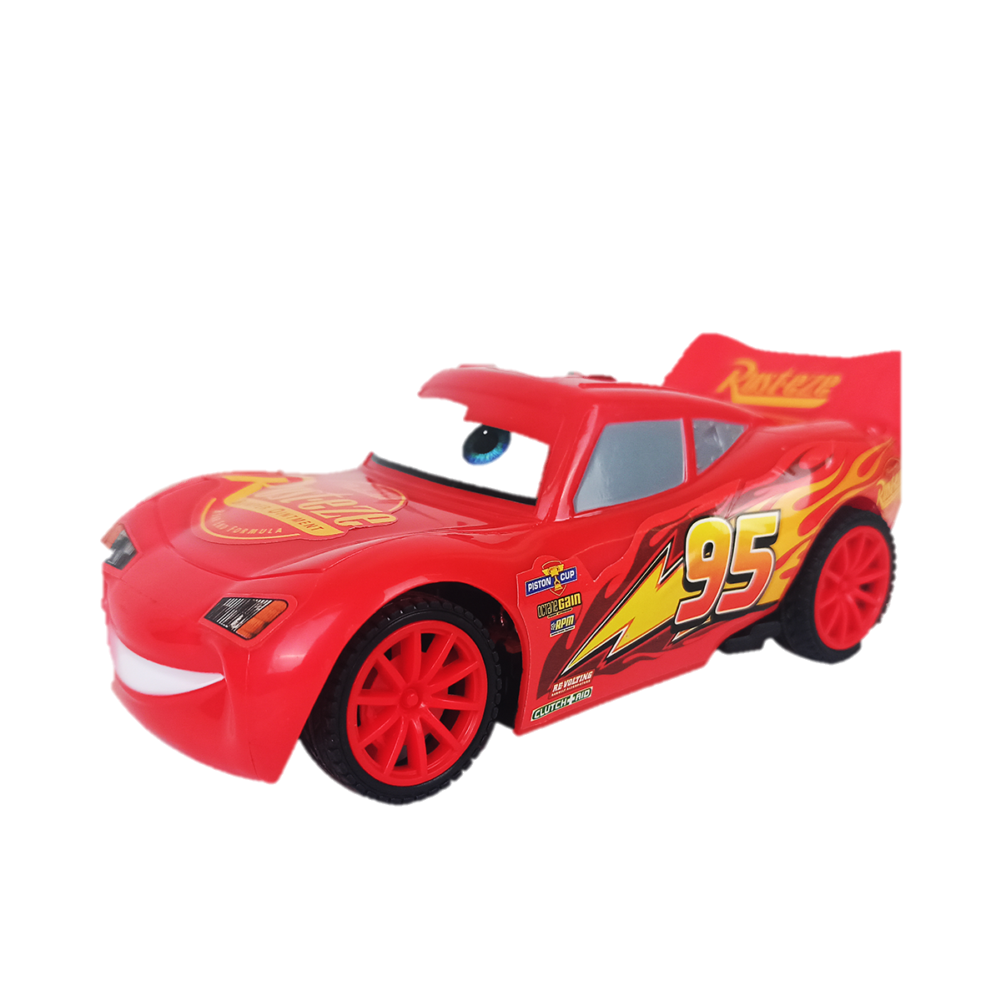
What color is it?
red
blue
Well done !
black

Slide 16
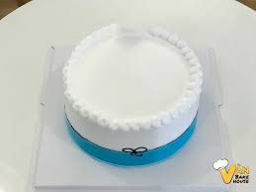
What color is it?
red
white
Well done !
blue

Slide 17

What color is it?
red
blue
Well done !
yellow

Slide 18
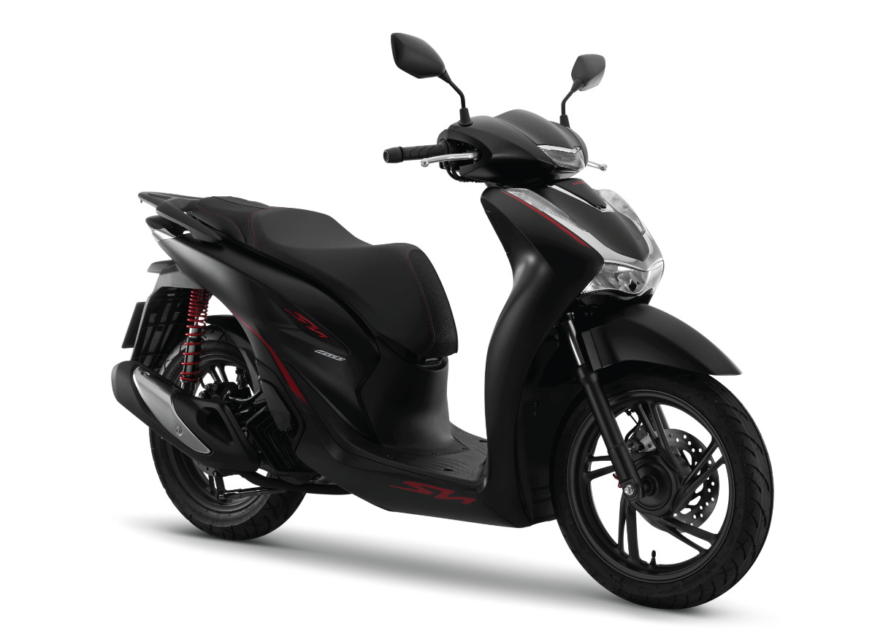
What color is it?
yellow
black
Well done !
blue

Slide 19
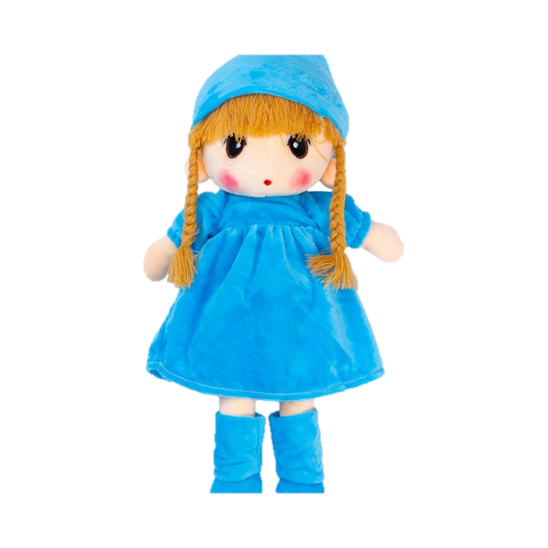
What color is it?
white
blue
Well done !
red

Slide 20


