Slide 1
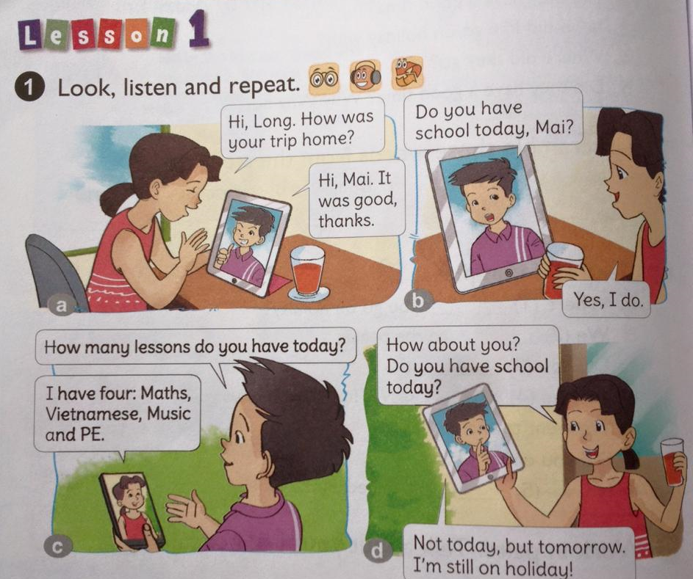

Unit 6:How many lessons do you have today ?

Slide 2
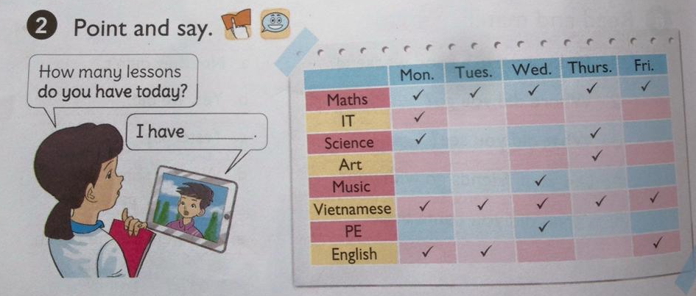
five
How many lessons do you have on Monday ?
I have three:Maths, Vietnamese and English
Notes:
How many lessons do you have on Monday ? I have three:Maths, Vietnamese and English

Slide 3
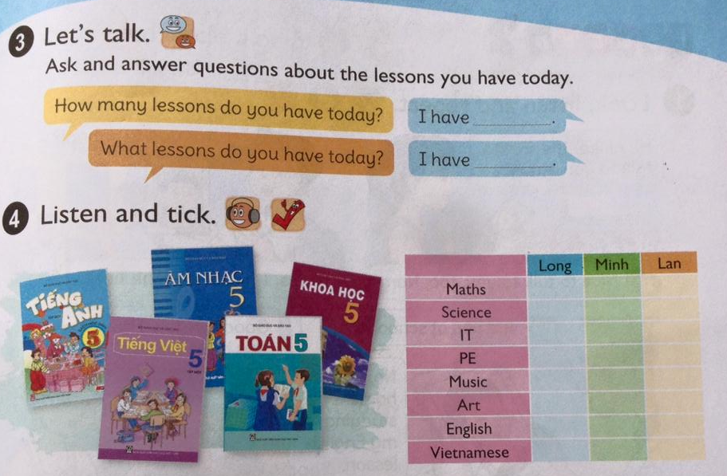
√
√
√
√
√
√
√
√
√
√
√
√
Notes:
√

Slide 4
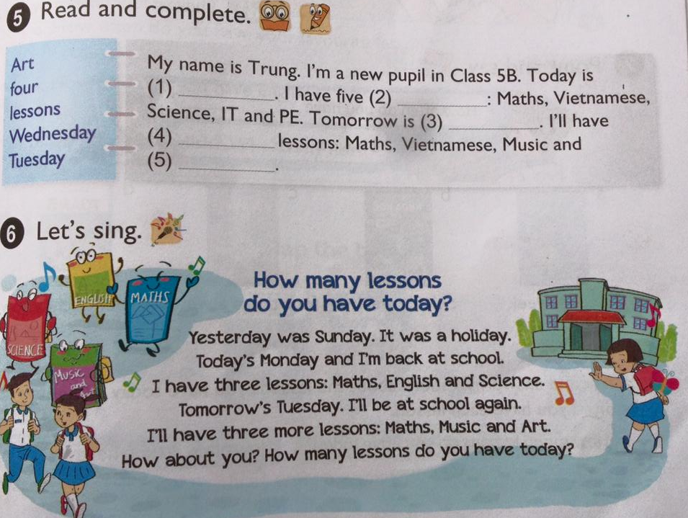
Tuesday
lessons
Wednesday
four
Art
Notes:
Wednesday

Slide 5
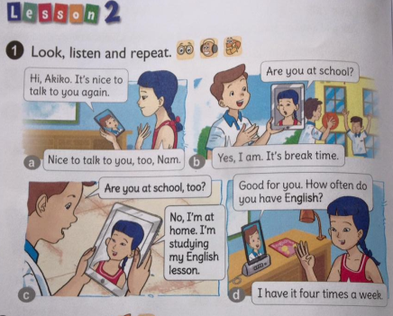

Slide 6
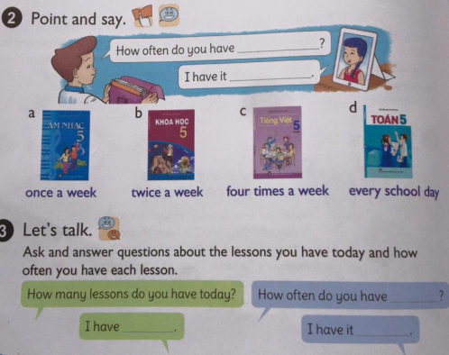

Slide 7
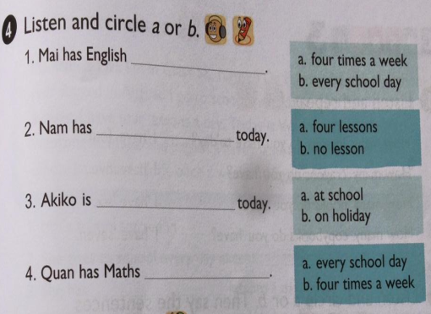
a
a
b
a

Slide 8
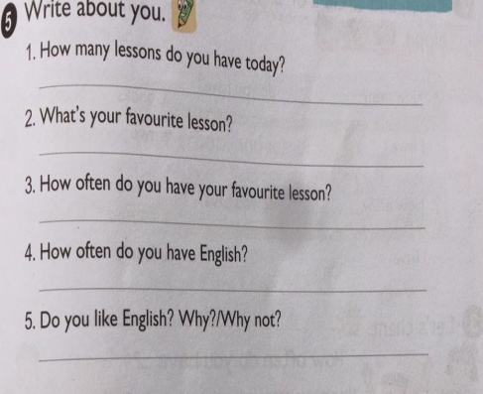

Slide 9
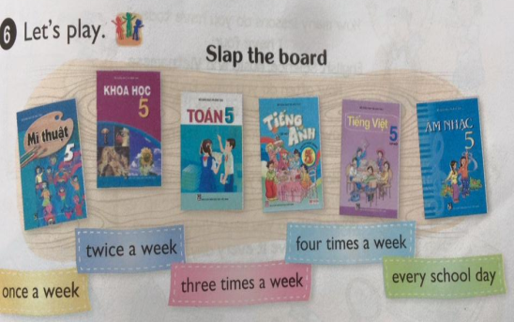

Slide 10
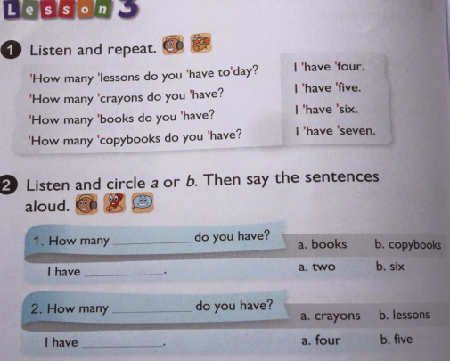
books
six
lessons
four

Slide 11
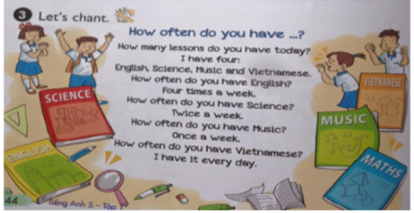

Slide 12
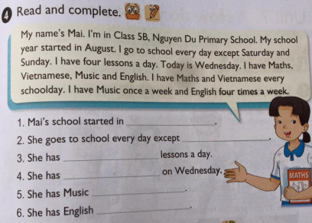
August
Sunday and Saturday
four
Maths,Vietnamese,Music and English
once a week
four times a week

Slide 13
homework
- Write about your school schedule.
- Do all exercises in workbook.
- Prepare next lesson.
Notes:
Homework

