Slide 1

TO MY ENGLISH CLASS 4A2

Slide 2
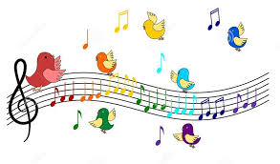

Slide 3
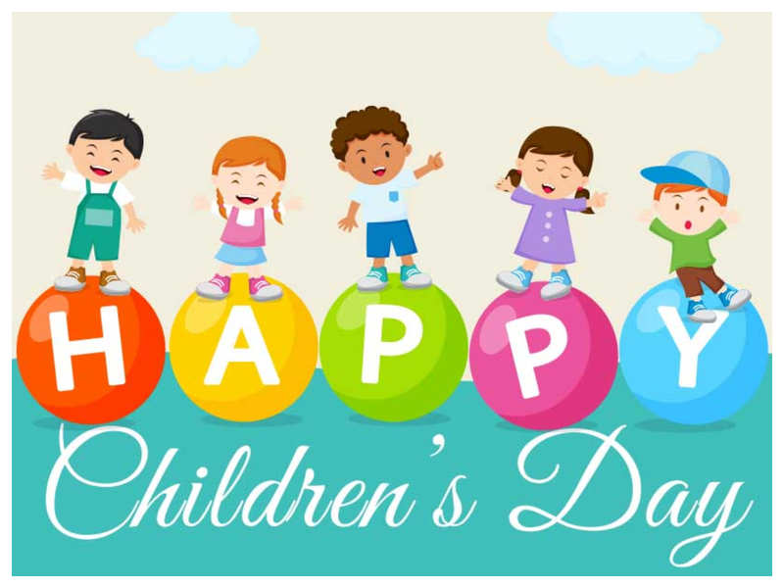
UNIT 15: When’s Children’s Day?
(Lesson 1: Part 1-2-3)

Slide 4

NEW WORDS

Slide 5


New Year

Slide 6
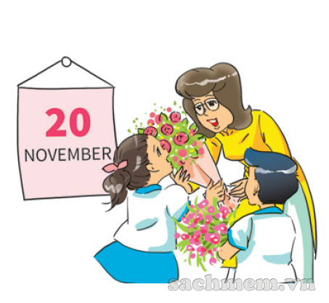
Teachers’ Day

Slide 7
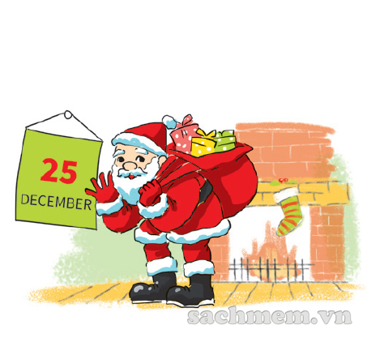
Christmas

Slide 8
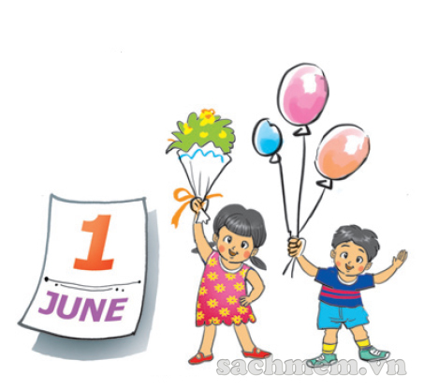
Children’s Day

Slide 9
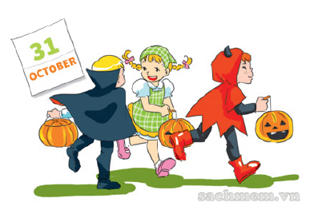
Halloween

Slide 10
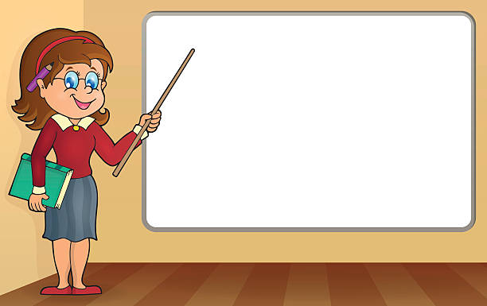
New Year
Teachers’ Day
Christmas
Children’s Day
Halloween

Slide 11


Slide 12
1. LOOK, LISTEN & REPEAT

Slide 13
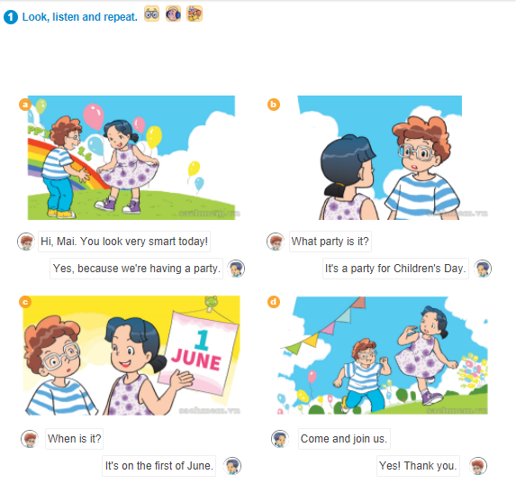

Slide 14
When’s Children’s Day?
- It’s on the first of June.

Slide 15
2. POINT AND SAY

Slide 16
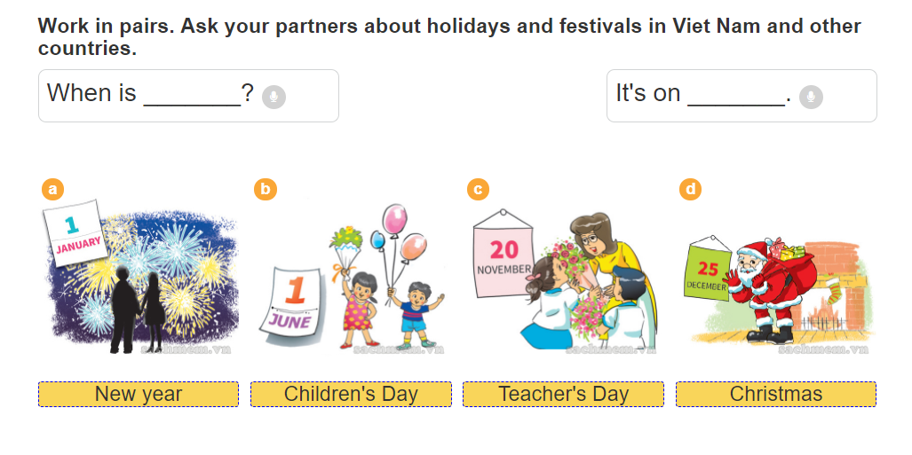

Slide 17
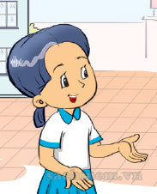
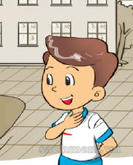
When’s ________?
It’s on _____ .

Slide 18
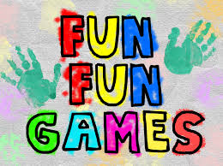

Slide 19
3. Listen and tick

Slide 20

SUMMARY

Slide 21
New Year
Teachers’ Day
Christmas
Children’s Day
Halloween

Slide 22
When’s Children’s Day?
- It’s on the first of June.

Slide 23


