Slide 1
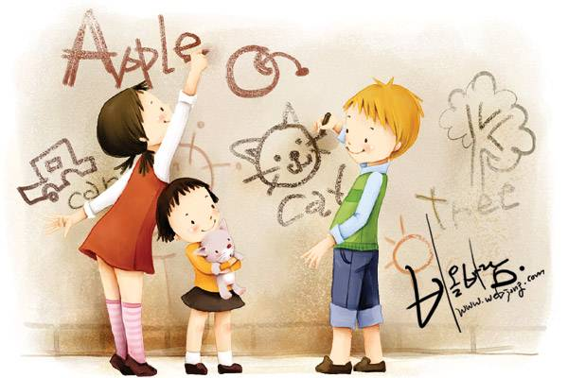

Welcome to our class !

Slide 2


Listen …

Slide 3
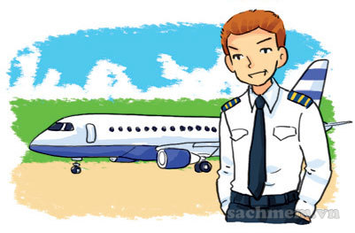
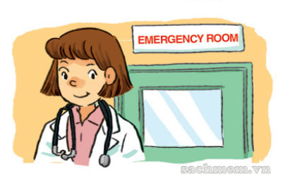
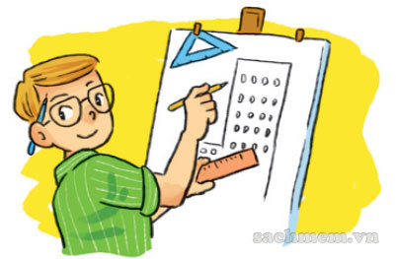

Vocabulary
pilot
doctor
architect
writer

Slide 4

Super Guess
Choose one number to buy a picture.
You pay by 1, 2 or 3 points.
You guess the word → 5

Slide 5





Super Guess
?
3
-2
1
-3
2
-1

Slide 6




Super Guess
-1
1
2
?
-2
-3
3

Slide 7

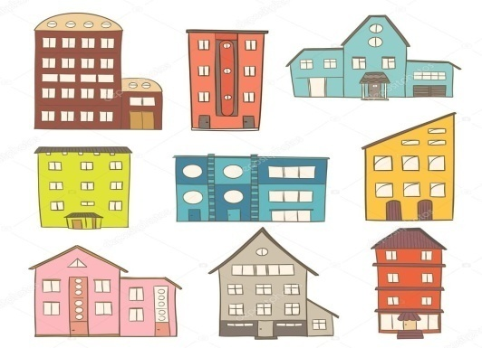


Super Guess
2
-1
-2
1
?
3
-3

Slide 8
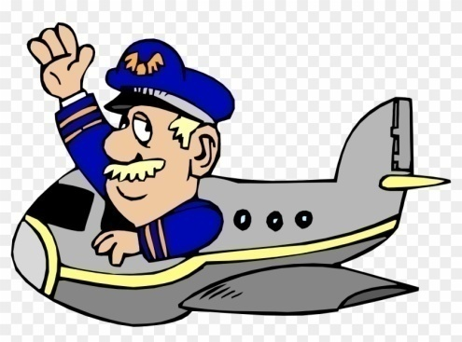

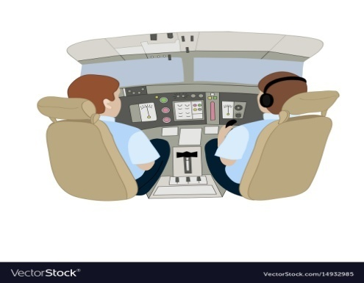
Super Guess
-3
1
-1
2
?
-2
3

Slide 9



Super Guess
?
-2
3
1
-1
-3
2

Slide 10
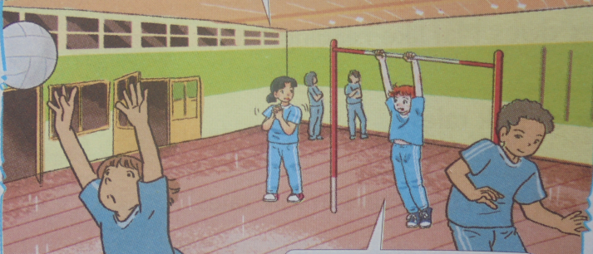
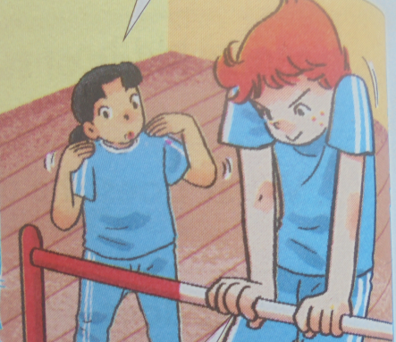
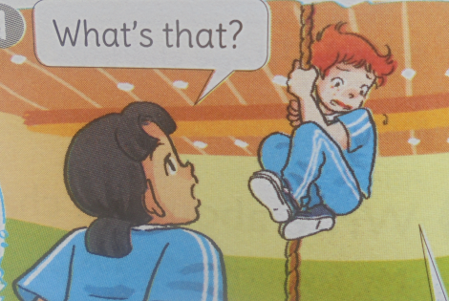
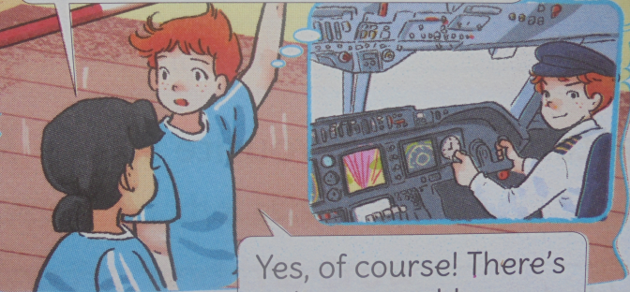
1. Look, listen and repeat.
What would you like to be in the future ,Tony?
Is that why you work out so much in the gym?
a
b
I’d like to be a pilot.
Yes. Pilots have to be strong.
So would you like to fly a plane?
d
What’s that?
c
Yes, of course! There’s only one problem.
I’m scared of heights!

Slide 11
Work in
group of 4
2. Point and say.
What would you like to be in the future?
I’d like to be a/an _________ .
a
b
c
d
pilot
doctor
architect
writer

Slide 12
Connect 4
Say the sentence to have X.
FIRST team to get 4 of your color in a row.

Slide 13
3. Let’s talk.
Work in pairs, ask and answer questions:
What would you like to be in the future?
I’d like to be _________________ .
a film star
a police officer
a firefighter
a basketball player

Slide 14
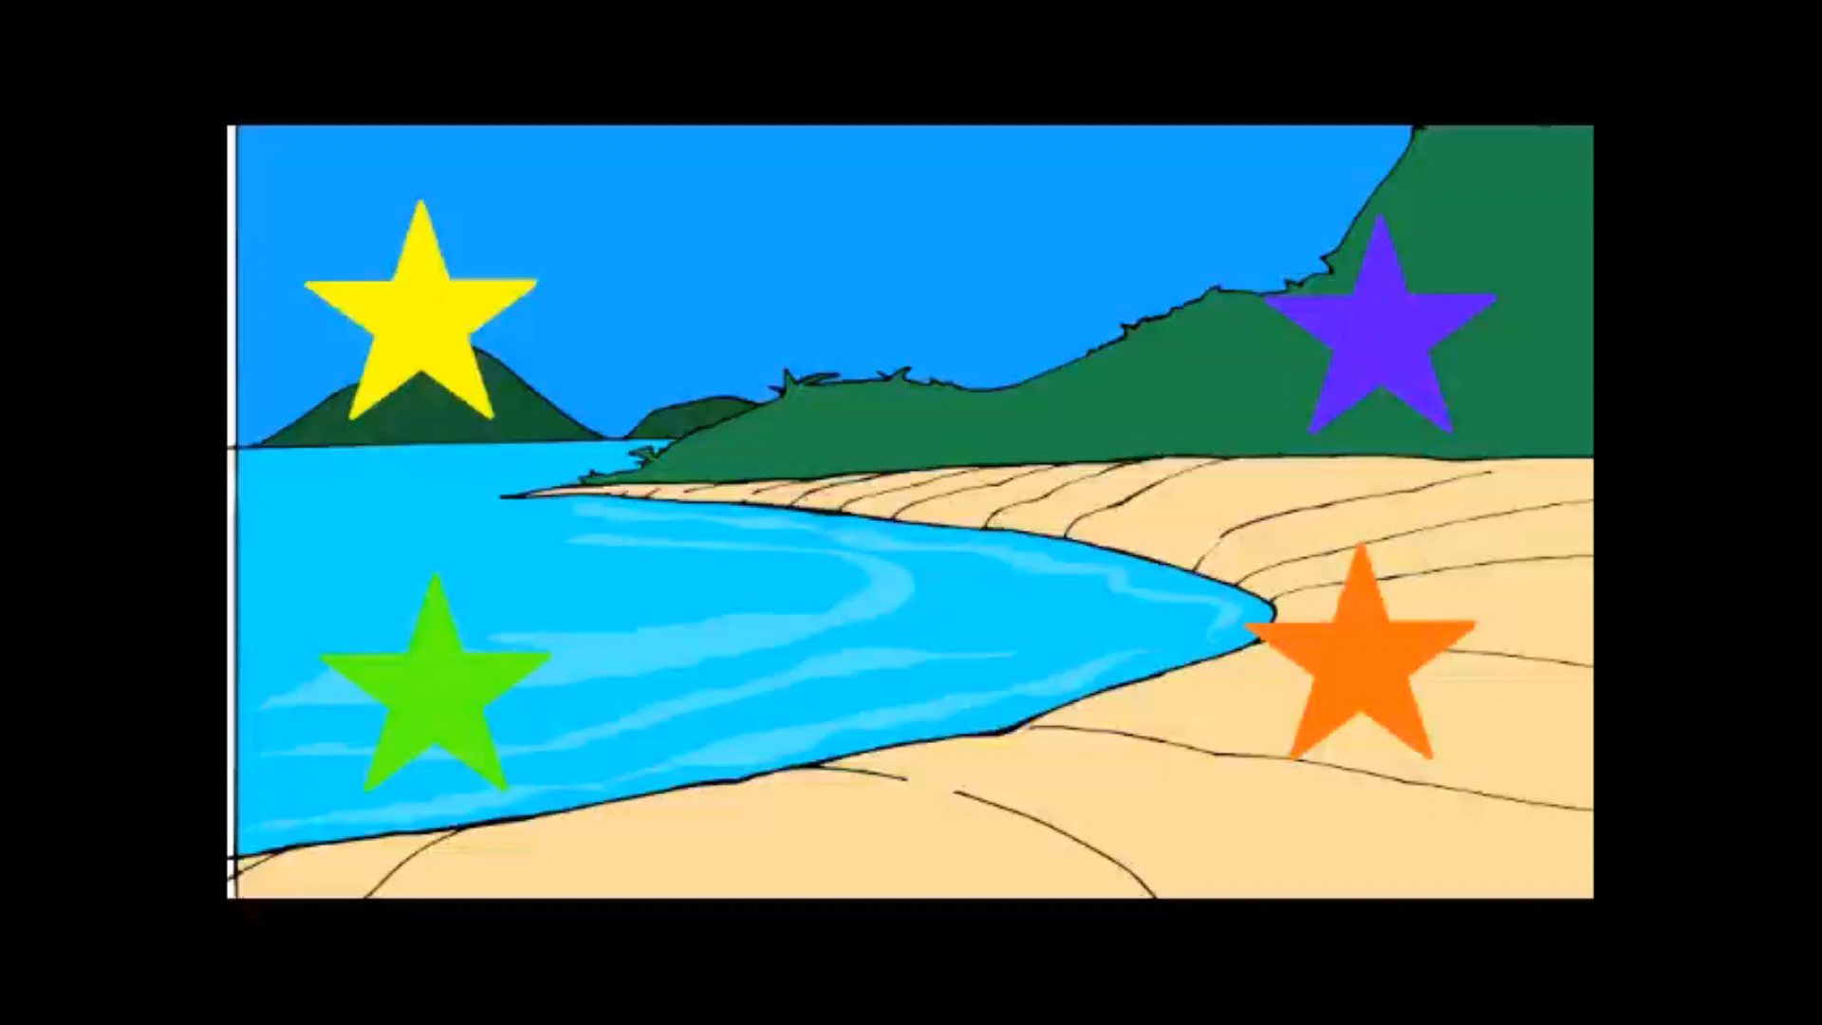
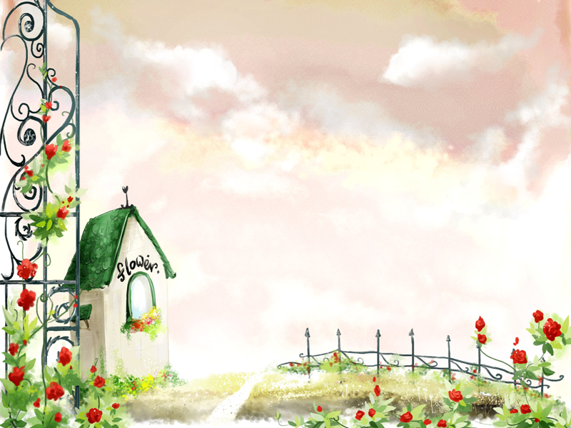

THANK YOU
SO MUCH!

