Slide 1
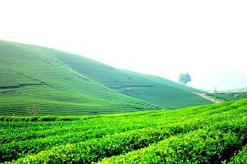
Thursday, October 3rd 2017
UNIT 3
PEOPLES IN VIET NAM
Lesson 5: Skill 1
Period 20

Slide 2
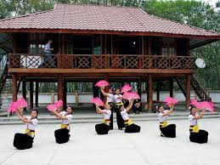
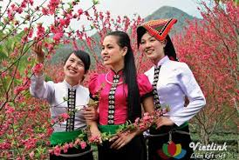
I- reading
The thai
Who are they?

Slide 3
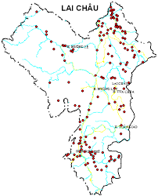
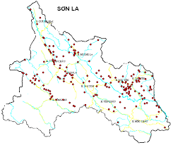
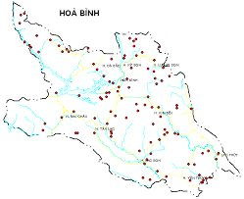
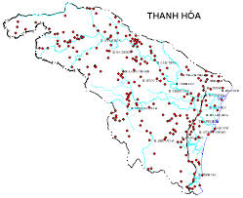
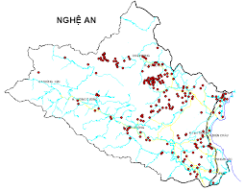
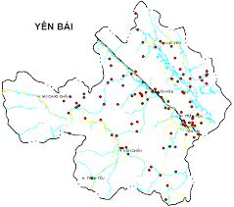
Where do the Thai live?

Slide 4
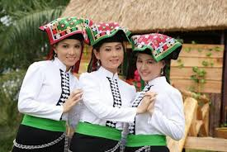
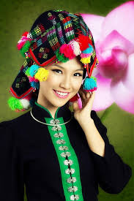
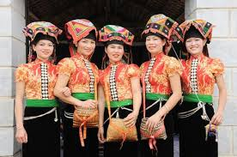
What is their population?
The white Thai
The black Thai
The red Thai

Slide 5
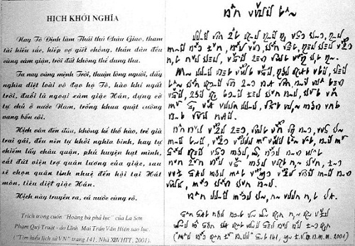
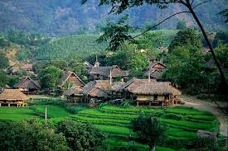
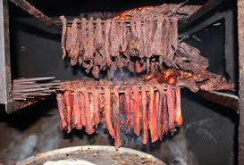
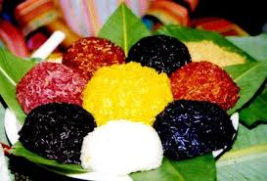
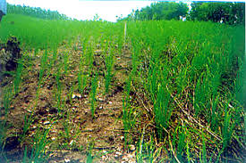
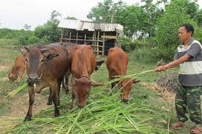
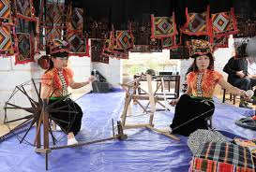
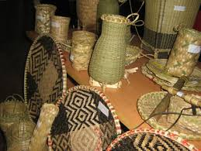
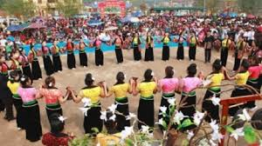
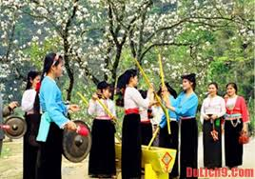
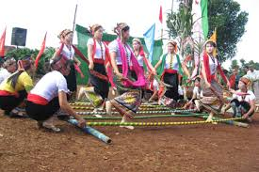
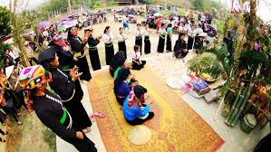
Main features
Language
Housing
Special food
Production activities
Festivals and ceremonies

Slide 6
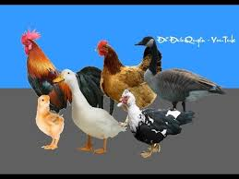
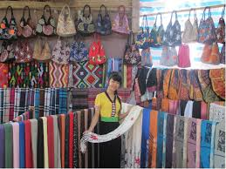
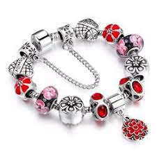

Vocabulary:
poultry: gia cầm
Canal(n):
Weave cloth : thổ cẩm
Ornament(n): đồ trang sức
Kênh đào

Slide 7
Check
poultry
Đồ trang sức
canal
Gia cầm
Weave cloth
Kênh đào
ornament
Thổ cẩm

Slide 8
What do you know about the Thai?
features | information
1. Population
2. Regions
3. Language
4. Housing
5. Main jobs
6. Main products
7. Costumes
8. Festivals
1,500,000
Lai Chau, Son La, Yen Bai, Nghe An…
Tay-Thai group
Stilt houses
Farming, cattle raising, cloth weaving
Bamboo items, cloth
Short blouse, long skirt, ornaments
Festivals with traditional games

Slide 9
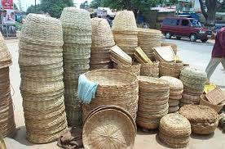
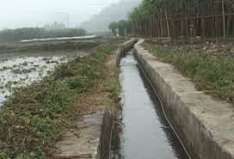
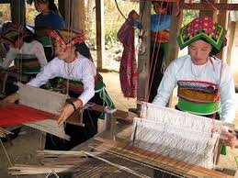
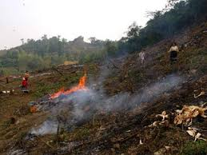

Slide 10
Read the text then complete these sentences
with no more than ONE word
0. The Thai_______________ belongs to the Tay-Thai group
1. They get water for their fields from________________
2. The Thai earn their living from_______________ rice, raising
cattle, weaving cloth or making items from_______________
3. The Thai live in _________________ with 40 to 50 houses each
4. Their________________ consists of a short blouse, a long skirt
and ornaments
5. “Xoe” is the traditional______________ of the Thai
6. The Thai worship their________________
language
canals
growing
bamboo
villages
costume
dance
ancestors

Slide 11
Answer the questions
1.Do the Thai people have their own language?
.
2.What is the main food of the Thai people?
.
3.What is the Thai cloth well-known for?
.
4.Which still wear their traditional costumes, Thai men or Thai women?
.
5.Who do the Thai worship?
.

Slide 12
Make a summary about the Thai?
features | information
1. Population
2. Regions
3. Language
4. Housing
5. Main jobs
6. Main products
7. Costumes
8. Festivals
1,500,000
Lai Chau, Son La, Yen Bai, Nghe An…
Tay-Thai group
Stilt houses
Farming, cattle raising, cloth weaving
Bamboo items, cloth
Short blouse, long skirt, ornaments
Festivals with traditional games

Slide 13
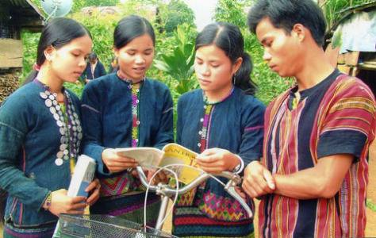
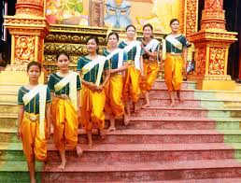
II- speaking
The bru-van kieu
The Khmer
Population: 74,500
Regions: Quang Binh, Quang Tri, Hue
Language: Mon- Khmer group
Productions: growing rice on terraced fields,
raising cattle and poultry
Festivals: Festival before sowing seeds
Population: 1,260,000
Regions: Mekong Delta
Language: Mon- Khmer group
Productions: growing rice, making sugar,
raising cattle
Festivals: Chaul Chnam Thmay
Greeting the Moon

Slide 14

HOMEWORK
Learn new words by heart.
Write a passage (100-120 words) about a people you know
* Prepare skill two.

