Slide 1

Welcome teachers to our class
CLASS 7A1
Teacher: Nguyen Thi Hieu

Slide 2

JIGSAW GAME

Slide 3
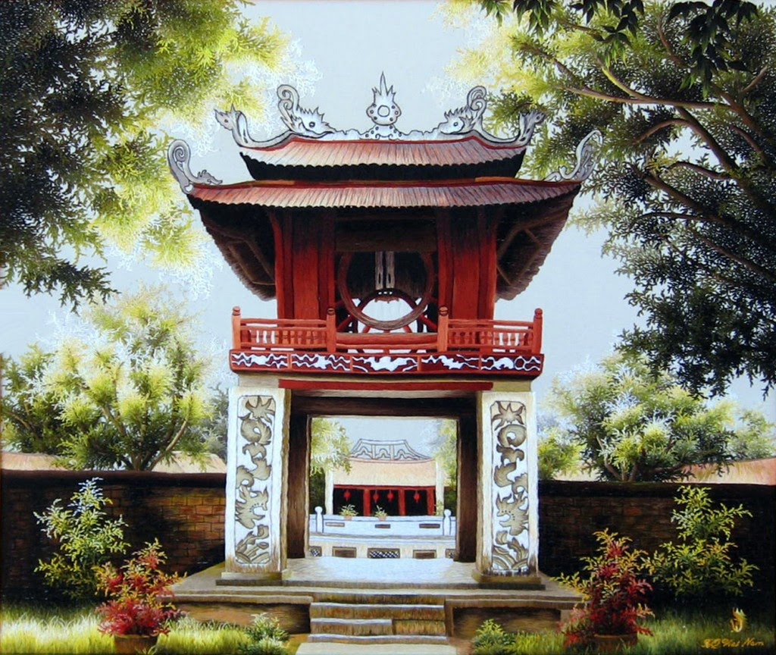
1
2
3
4
5
6
Next

Slide 4
QUESTION 4
What is VAN MIEU – QUOC TU GIAM called in English?
THE TEMPLE OF LITERATURE
– THE IMPERIAL ACADEMY
BACK

Slide 5
QUESTION 2
BACK
WHEN WAS THE TEMPLE OF LITERATURE FOUNDED?
IN 1070

Slide 6
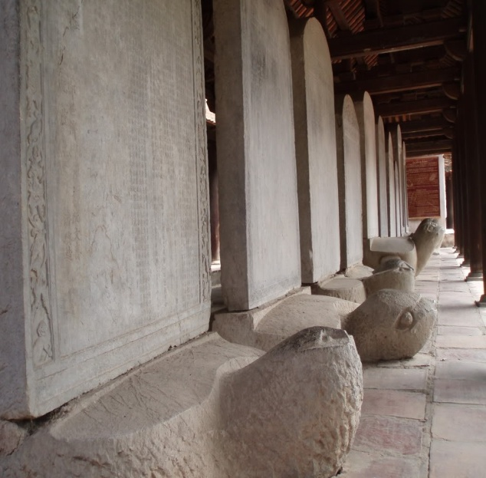
QUESTION 3
WHAT ARE THEY CALLED?
THE DOCTOR’S STONE TABLETS
BACK

Slide 7
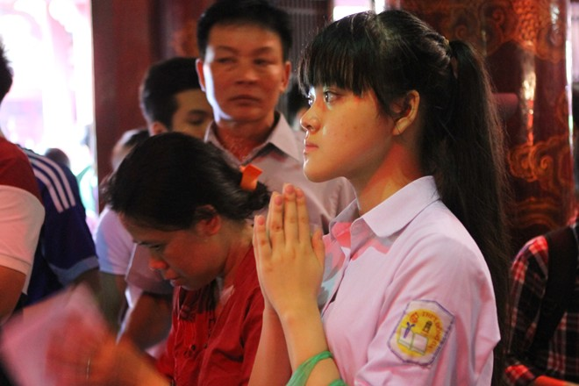
QUESTION 6
BACK
What do many students go to the Van Mieu – Quoc Tu Giam for?
To pray

Slide 8
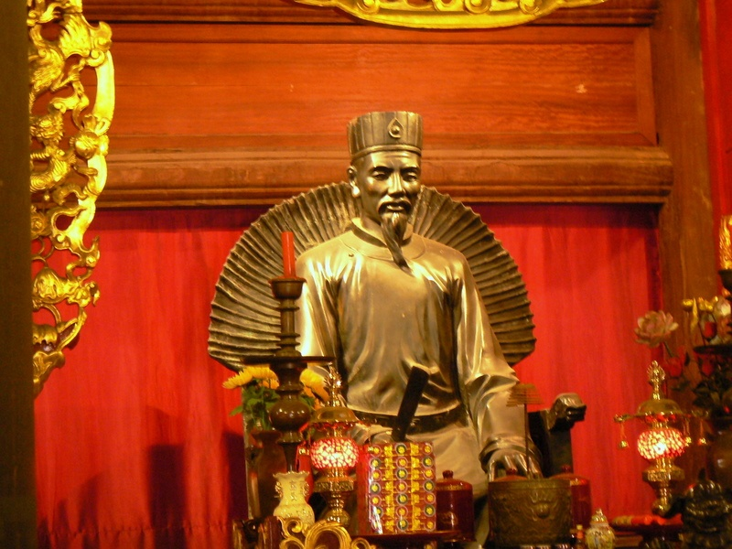
QUESTION 5
WHO IS HE?
CHU VAN AN
BACK

Slide 9
QUESTION 1
IS VAN MIEU – QUOC TU GIAM A FAMOUS HISTORIC PLACE IN HANOI?
YES, IT IS.
BACK

Slide 10
THE IMPERIAL ACADEMY

Slide 11

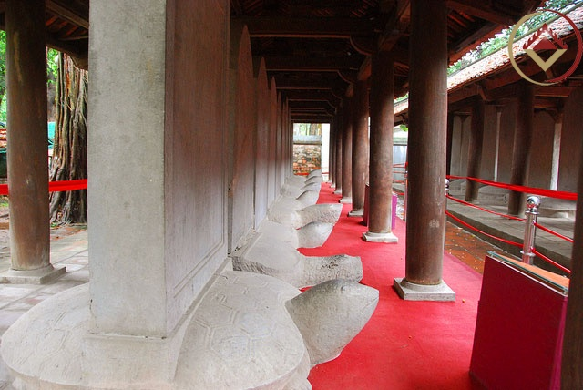
UNIT 6
THE FIRST UNIVERSITY IN VIETNAM
Lesson 5: skills 1 (reading + speaking)

Slide 12

VOCABULARY

Slide 13
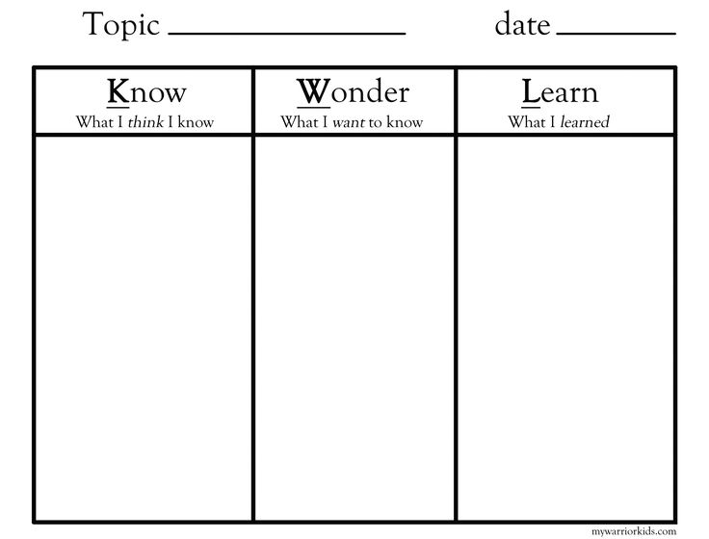
00:07
00:05
00:10
00:09
00:08
00:02
00:06
00:04
00:01
00:03
K – W – L TABLE
The Imperial Academy
Time’s up!

Slide 14
COMPREHENSION QUESTIONS
When was the Imperial Academy founded?
Why was it successful?
Who was one of the most famous teachers at the Imperial Academy?
What is another special thing about it?
Time’s up!
00:07
00:05
00:10
00:09
00:08
00:02
00:06
00:04
00:01
00:03

Slide 15
“HOT SEAT” GAME
- 1 people/ group/ question.
- Sit down when the music stops.
Student sitting in green chair ask the question, Student sitting in red one answer the question and write on the board

Slide 16
QUESTION 1
When was the Imperial Academy founded?
(It was founded) in 1076.

Slide 17
QUESTION 2
Why was it successful?
Because thousands of Vietnamese scholars graduated from it.

Slide 18
QUESTION 3
Who was one of the most famous teachers at the Imperial Academy?
Chu Van An.

Slide 19
QUESTION 4
What is another special thing about it?
It was considered the first university
in Viet Nam.

Slide 20

WATCH A VIDEO CLIP

Slide 21
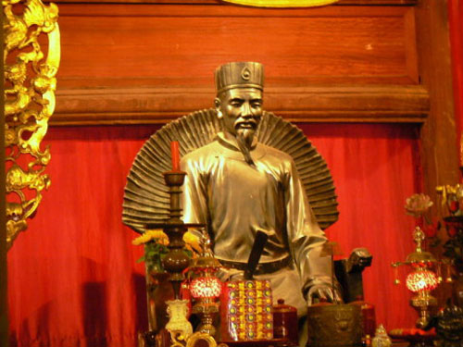
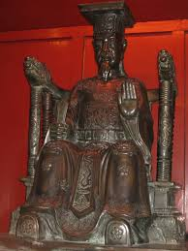
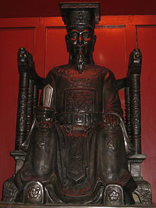
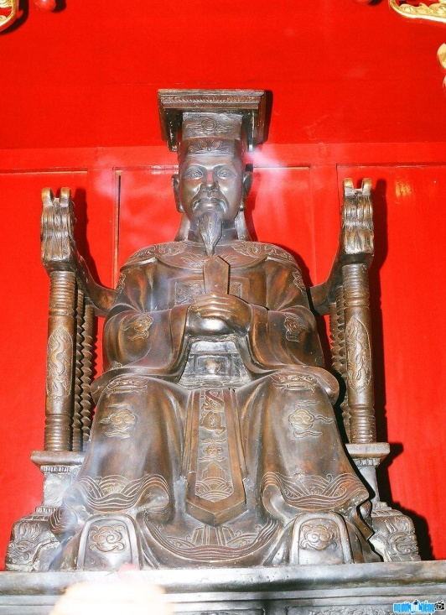
FAMOUS PEOPLE IN THE IMPERIAL ACADEMY
CHU VAN AN
LY THANH TONG
LY NHAN TONG
LE THANH TONG

Slide 22
SUMMARY
The Imperial Academy

Slide 23
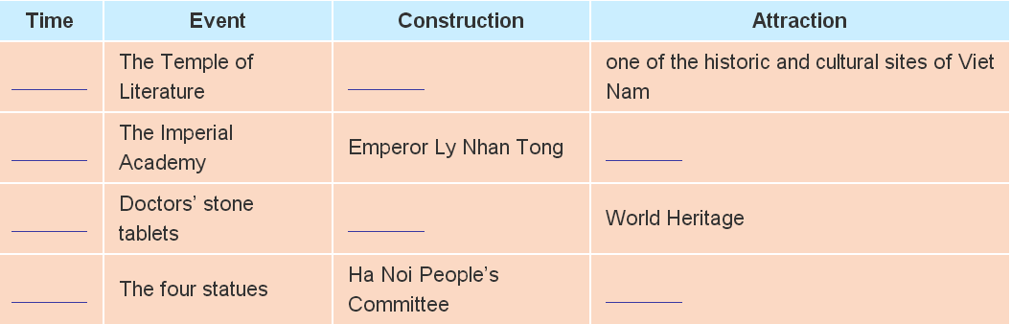
HOMEWORK
Learn by heart new words
Complete the table to prepare for the next lesson

Slide 24

THANK YOU
FOR YOUR ATTENTION!

