Slide 1


English 9
UNIT 1 . LOCAL ENVIRONMENT
PERIOD 3: A CLOSER LOOK 1
Teacher: Nguyen Thi Hien
Long Bien secondary school
Welcome to our class

Slide 2
GAME:NETWORKS
Entertaining
- cinema
Educational
-library
Places of interest
Cultural
-operahouse
Historycal
-building

Slide 3
Period 3
UNIT 1: LOCAL ENVIRONMENT
LESSON 2: A CLOSER LOOK 1

Slide 4
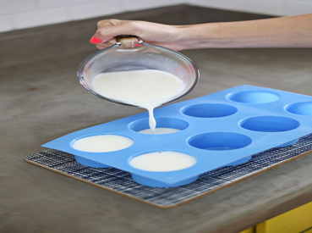
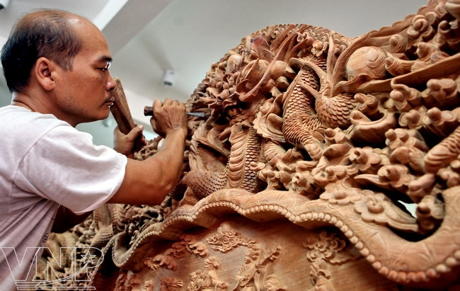
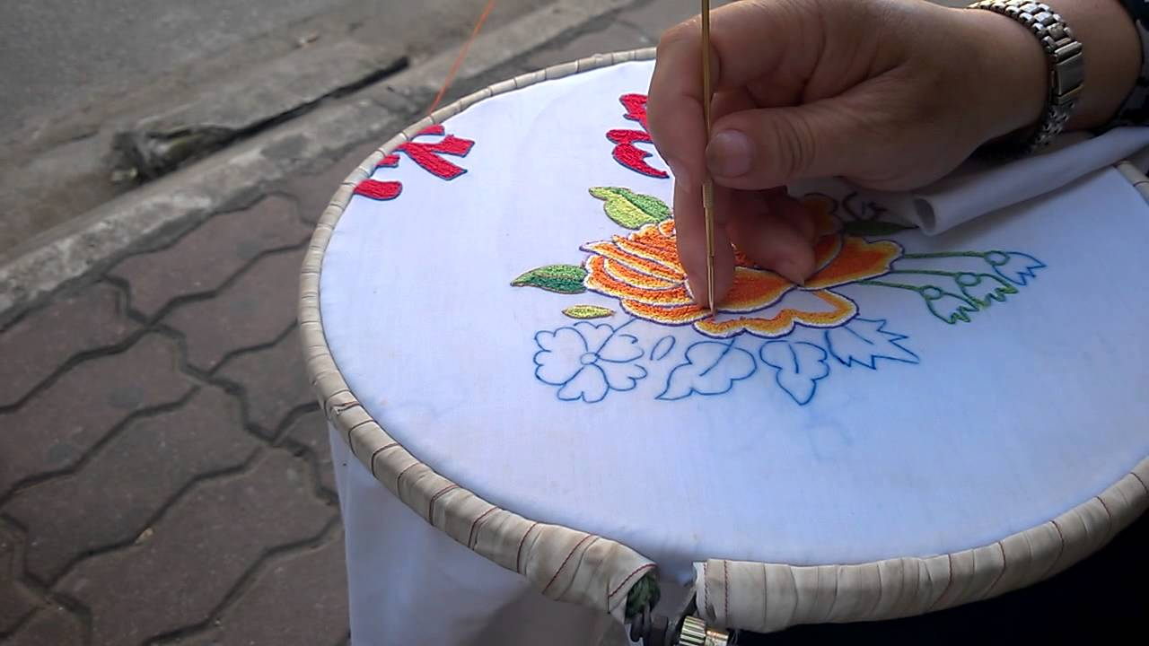
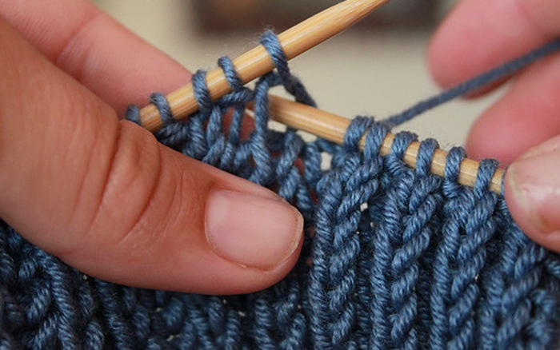
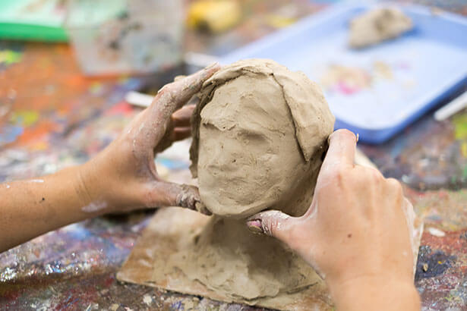
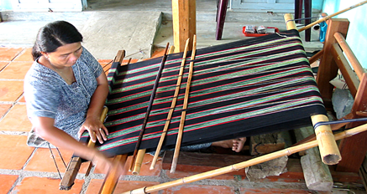
1. Write the verbs in the box under the pictures.
A.Carve B.cast C.weave D.embroider E.knit F.mould
2.
carve
3.
embroider
1.
Cast
4.
knit
5.
mould
6.
weave

Slide 5
Match the verbs in column A with the groups of nouns in column B
A
1.Carve
2.cast
3.weave
4.embroider
5.knit
6.mould
B
a. handkerchiefs, tablecloths pictures
b. Stone, wood, eggshells
c. clay, cheese, chocolate
d. bronze, gold, iron
e. baskets, carpets, silk, cloth
f. sweaters, toys, hats

Slide 6
Now write the correct form for these verbs
infinitive | Past tense | Past participle
1.To carve | I carved it | It was carved
2. To cast | I……………… it | It was ………………….
3. to weave | I……………… it | It was ………………….
4.To embroider | I……………… ………..it | It was ………………….
5.To knit | I……………… it | It was ………………….
6.To mould | I……………… it | It was ………………….
cast
cast
wove
woven
embroidered
embroidered
knitted
knitted
moulded
moulded

Slide 7
Complete the passage by filling each blank with a suitable words
1. historical
2. attraction
3. exercise
4. traditional
5. culture
6. handicrafts

Slide 8
Listen to the speaker read the …………
1. Sentence 1: craft, village, lies, river, bank
Sentence 2: painting, embroidered
Sentence 3: what, region, famous; Sentence
Sentence 4: drums, aren't, made, village; Sentence
Sentence 5: famous, artisan, carved, table, beautifully

Slide 9
2. What kind of words are they?
They are: nouns, verbs, adjectives, adverbs, wh-question words, and negative auxiliaries.
Noun :house, teacher…
Verb : go, walk, …
Adj, adv : big, historic…
Wh: what, how…
Negative : isn’t, don’t…

Slide 10
3. Which words are not as loud and clear as the others?
Sentence 1: the, on, the
Sentence 2: this, is
Sentence 3: is, this, for
Sentence 4: in, my
Sentence 5: a, this

Slide 11
4. What kind of words are they?
They are: articles, prepositions, pronouns, and possessive adjectives.
Articles: a, an, the
Preposition : in , on, at…
Pronoun : I, you, we…
Possessive adj : his, her, my….

Slide 12
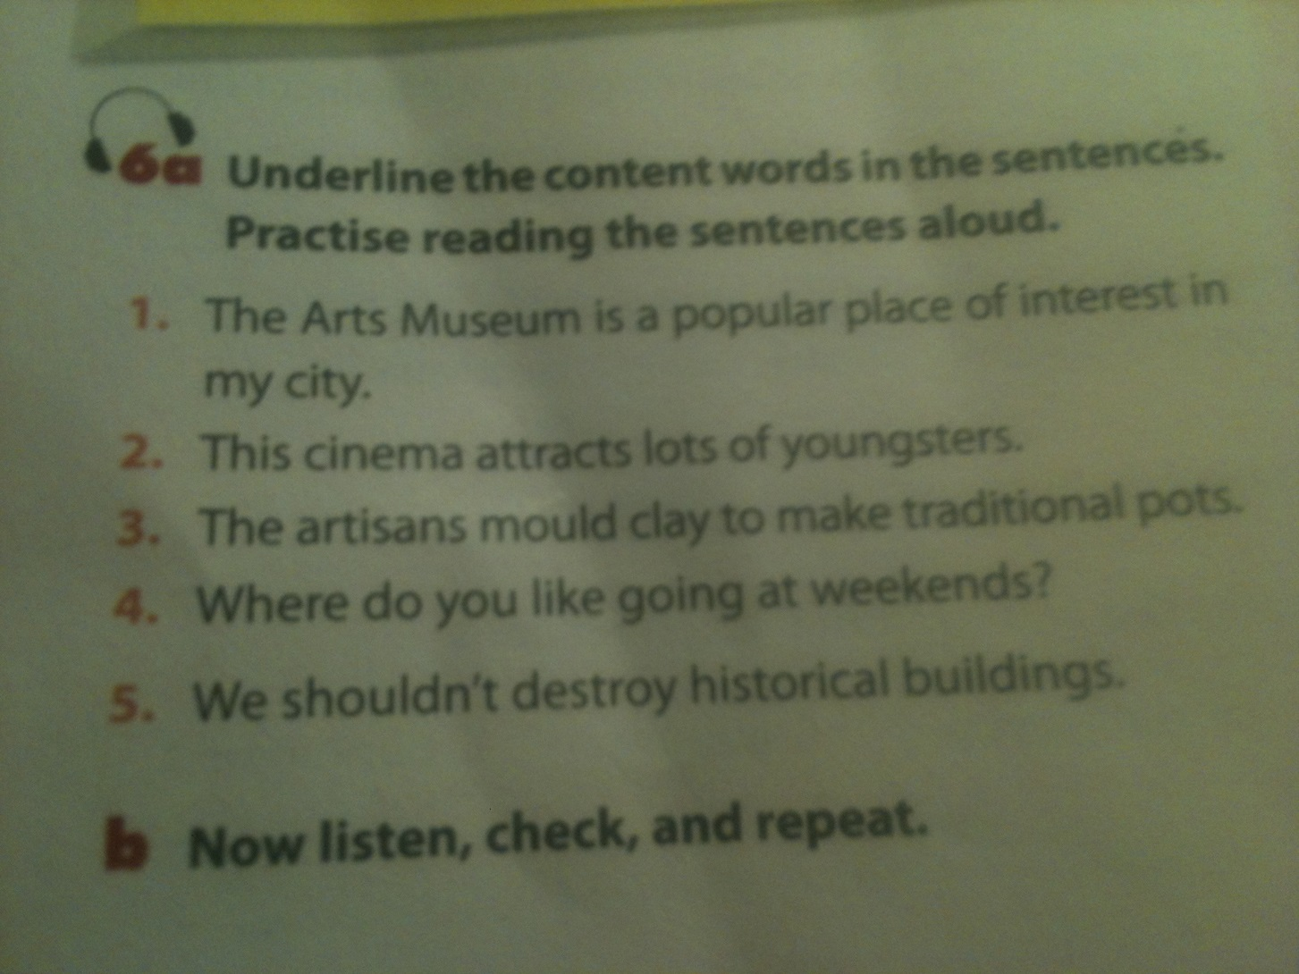
Underline the content words in the ……..

Slide 13
Homework
- Learn by heart all the new words.
Practice saying and reading exercises 3 and 4
- Prepare: Closer Look 2

