Slide 1









TO OUR CLASS
LONG BIEN SECONDARY SCHOOL
Teacher : Bui Thi Huyen Trang

Slide 2
WARM-UP:
Find these 12 words in the word square.
M | U | S | I | C | E | R | S | O | N | L
T | E | L | E | P | A | T | H | Y | E | B
A | S | I | N | T | E | R | N | E | T | M
L | I | A | T | L | V | F | G | A | W | E
G | N | I | I | A | O | L | N | W | O | D
O | G | A | S | E | L | N | E | L | R | I
N | M | T | A | S | R | E | L | R | K | A
E | R | I | R | L | E | A | T | I | R | A
R | E | S | E | A | R | C | H | T | N | E
E | C | H | A | T | T | I | N | G | E | E
C | O | N | F | E | R | E | N | C | E | R

Slide 3
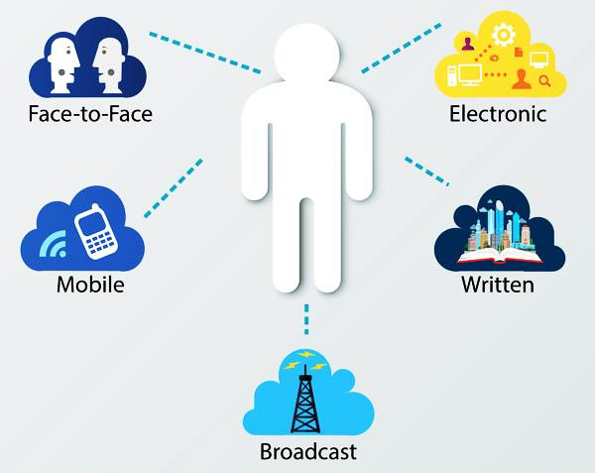
New lessons
UNIT 8
LESSON 3: A CLOSER LOOK 2

Slide 4
GRAMMAR
Future continuous: review

Slide 5
I. FORMATION
a) Affirmative:
S + Will be + V_ing
Ex: I will be playing tennis at 10am tomorrow.
b) Negative:
S + Will be + NOT + V_ing
Ex: They won't be watching TV at 9pm tonight.
c) Negative:
Will + S + be + V_ing..?
Ex: What will you be doing at 10pm tonight?

Slide 6
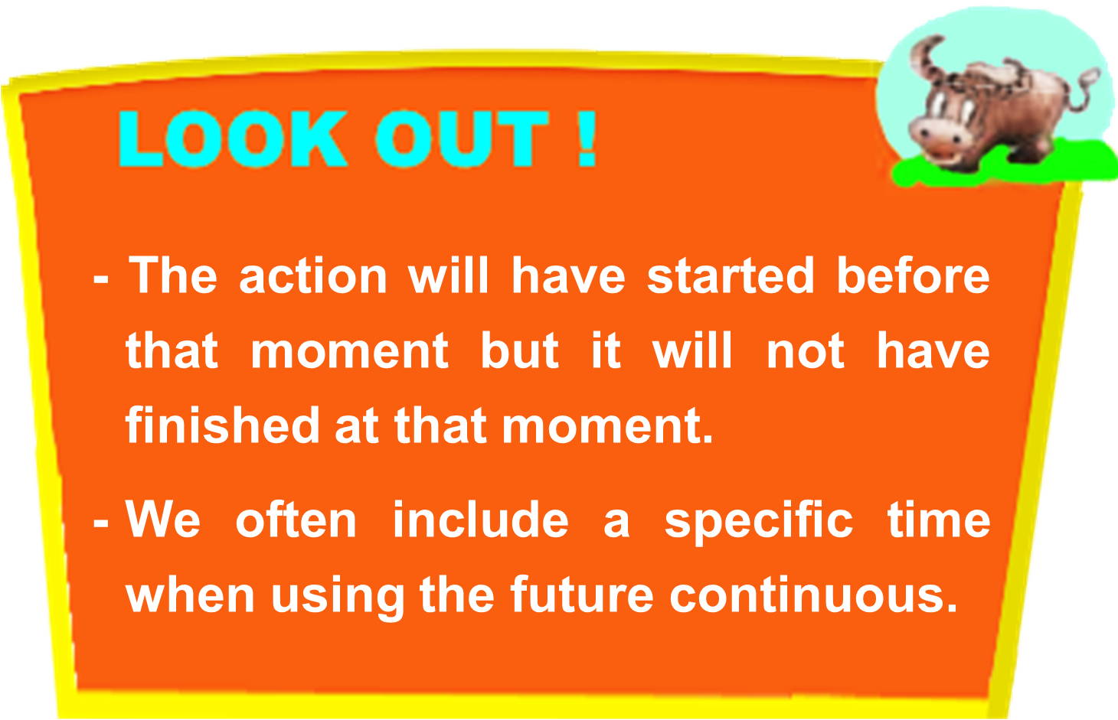
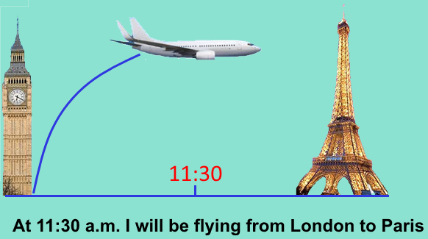
II. USES:
Express action that is in progress at a particular moment in the future.
Click
Example:
Tonight at 8.30 p.m. Mai will be watching Frozen again at home. She loves it!
(She will be in the process of watching the film at 8.30 p.m.)
Example:
Tonight at 8.30 p.m. Mai will be watching Frozen again at home. She loves it!
(She will be in the process of watching the film at 8.30 p.m.)

Slide 7

1. Listen again to part of the conversation in GETTING STARTED. Underline the future continuous tense and answer the questions.
Phuc: … How about this Sunday afternoon at 2.30 p.m.? There’s Superman 3.
Nick: Great…, but I’ll be having my Vietnamese class then. Let’s go for the 4.15 p.m. show. I’ll need to take the bus to Nguyen Du and it’s quite far.
Phuc: But it’s not Galaxy Nguyen Du! We’ll be seeing it at Galaxy Nguyen Trai ...

Slide 8
Phuc: … How about this Sunday afternoon at 2.30 p.m.? There’s Superman 3.
Nick: Great…, but I’ll be having my Vietnamese class then. Let’s go for the 4.15 p.m. show. I’ll need to take the bus to Nguyen Du and it’s quite far.
Phuc: But it’s not Galaxy Nguyen Du! We’ll be seeing it at Galaxy Nguyen Trai ...
1. What will Nick be doing at 2.30 p.m. this Sunday?
He will be having his Vietnamese class.
2. What will Phuc and Nick be doing at about 4.15 p.m. this Sunday?
They will be watching a film at the cinema.

Slide 9

Review
Click
We use the future continuous tense to express being in the process of doing something at a specific time in the future.
Example:
Tonight at 8.30 p.m. Mai will be watching Frozen again at home. She loves it!
(She will be in the process of watching the film at 8.30 p.m.)

Slide 10
2. Complete the sentences with the future continuous.
1. ____ he still (sleep) ___________ this time tomorrow?
- No, he (study) ______________ in the library.
2. She’s now in Ho Chi Minh City but she (have)______ _______a holiday in Da Nang at the end of this month.
3. They (eat) _______________ dinner at 8 p.m.
___ she (stay) __________ in her classroom during the break today?
- Yes, she (write) _____________ an email to her friend.
5. Mona says the children (play) _____________ in the garden when you arrive.
6. This time next year Phuc (learn) ______________ a new language.
Will
be sleeping
will be studying
will be
having
will be eating
Will
be staying
will be writing
will be playing
will be learning

Slide 11

3. Look at the years provided. Work in groups to predict when the following may happen in the future. Then compare your answers with other groups.
1. We won’t be using landline telephones in _______.
2. We will still be sending snail mail in _______.
3. We will be communicating with telepathy devices in _______.
4. We will still be using art to communicate in _______.
5. We won’t be working F2F any more in _______.
6. We will be using signs in _______, but the signs will be more interactive
2030
2030
2114
2214
2214
2114

Slide 12
GRAMMAR
Verb + to-infinitive

Slide 13


4. Look at the conversation in GETTING STARTED again and write down all the verbs that are followed by to-infinitive that you can find.
Click
Ex: I also wanted to call you.
wanted to call
Verbs + to-infinitive
If we want to follow a verb with another action, we must use either a gerund (Unit 1) or an infinitive.
Ex: They want to see Superman 3 this Sunday.
* Some common verbs followed by to-infinitive
• Verbs of thinking: choose, decide, plan
• Verbs of feeling: love, hate, prefer
• Other verbs: try, want, need

Slide 14
5 Choose the best answer.
1. We’ve decided _______ in Ho Chi Minh City for three more days.
a. stay b. staying c. to stay
2. Do you want _______ a mobile phone battery that uses solar energy?
a. having b. to have c. has
3. They chose _______ the bus there.
a. to take b. will take c. taking
4. I tried _______ you lots of times but couldn’t get through.
a. called b. call c. to call
5. I think in the future many people will prefer ______ by using social media.
a. to communicate b. will communicate
c. communicate

Slide 15
6. The Dream List. Imagine we are in the year 2050. Work in pairs and select three ways of communication that you think will be most common. Then make the list longer by sharing your ideas with another pair using full sentences.
1. People throw rubbish in the street. The street doesn’t look attractive.
→ If people didn’t throw rubbish in the street, it would look attractive.
Example:
We’ll be using video conferencing in every meeting.

Slide 16
Model list:
- We will be using video conference in every meeting.
- We will be using telepathy devices regularly.
- We will be using the interactive signs.
- We'll using video chatting in every talking.
- We'll using social media as Facebook and Twitter allow users to communicate with networks of people.
- We'll using voice over Internet protocol (VoIP) in several communication products and services.
1. People throw rubbish in the street. The street doesn’t look attractive.
→ If people didn’t throw rubbish in the street, it would look attractive.

Slide 17



HOMEWORK
- Review the grammar points: The Future continuous tense & Verb + to-infinitive.
- Do exercises B1-6 in workbook (page 30, 31)
- Prepare for Unit 10: Communication
+

Slide 18

THANKS FOR YOUR ATTENTION!
Goodbye!
See you again!

