Slide 1


LONG BIEN SECONDARY SCHOOL
Unit 10: OUR HOUSE IN THE FUTURE
Lesson 2: A closer look 1

Slide 2

Warm up: Brainstorming
dishwasher
Rice cooker
Washing machine
Appliances in a house
iron
fan
refrigerator
TV

Slide 3
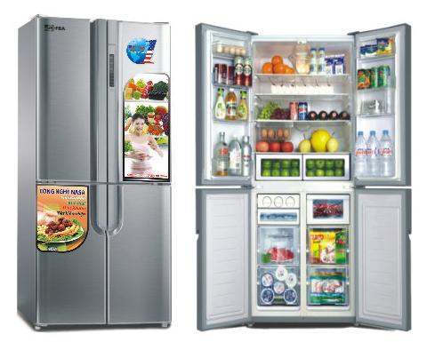
Modern fridge

Slide 4

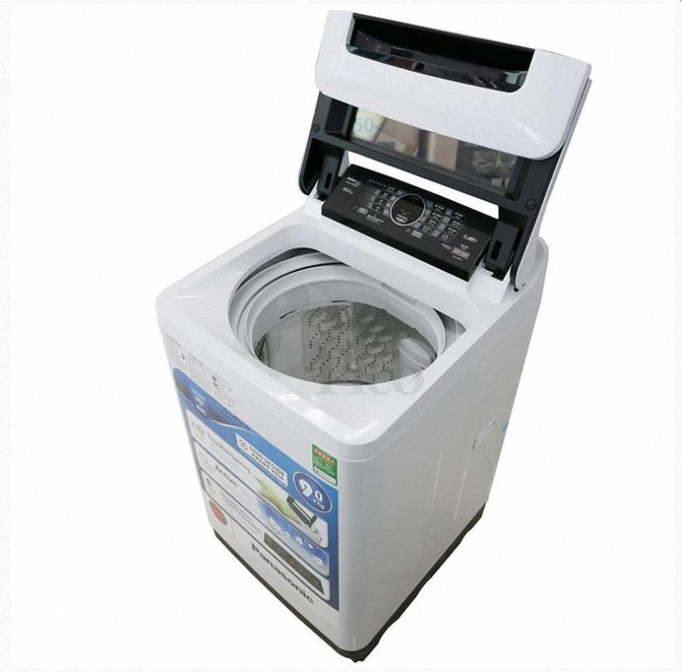
Automatic washing machine

Slide 5

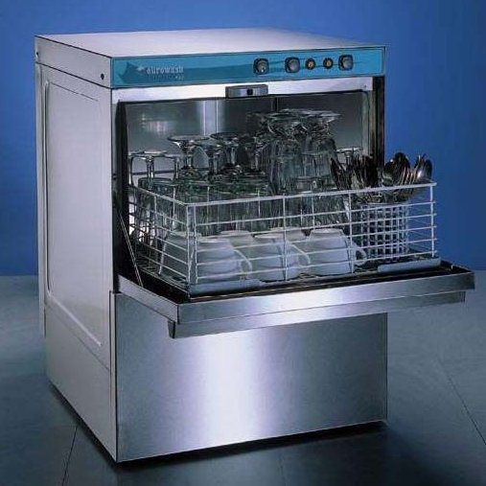
Automatic dishwasher

Slide 6

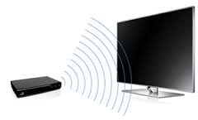
Wireless TV

Slide 7

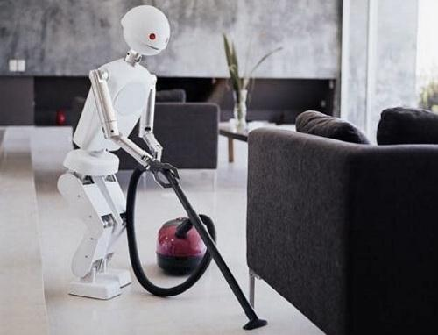
Hi-tech robot

Slide 8

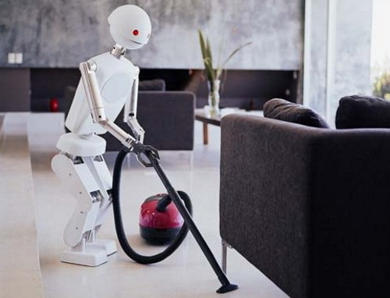
Vocabulary
2.
1.
Automatic dishwasher
Automatic washing machine
3.
Hi-tech robot
4.
Wireless TV
5.
Modern fridge

Slide 9






Ex1: Listen and repeat the appliances in the box. Then put them in the appropriate columns. ( You may use an appliance more than once)
Living room bedroom kitchen bathroom
Wireless TV
√
√
Automatic dishwasher
√
Modern fridge
√
Automatic
washing machine
√
Hi-tech robot
√
√
√
√

Slide 10

2: Match the appliances in A with the thing they can or might to in B
A
1. Wireless TV
2. Automatic dishwasher
3. Modern fridge
4. Automatic washing machine
5. hi-tech robot
B
a. Look after children
b. Cook meals
c. Helps us watch TV programmes from space
d. Wash and dry dishes
e. Wash and dry clothes

Slide 11

3. Work in pairs. Using the information in 2, ask and answer questions about appliances in the house.
Notice :
Help sb do/ to do st : giúp ai làm gì
Example:
A: What does a wireless TV do?
B: It helps us watch TV programmes from space.
A: What does a/an ___________ do?
B: It ________________________ .

Slide 12


Slide 13



Lucky Numbers
60
70
50
80
40
20
30
10
30
10
40
50
70
20
60
1
2
3
4
5
6

Slide 14

1. automatic dishwasher/ wash and dry dishes
A:What does an automatic dishwasher do?
B: It helps us wash and dry dishes

Slide 15



Lucky Number
Lucky Number

Slide 16

3. modern fridge / cook meals
A:What does a modern fridge do?
B: It helps us cook meals

Slide 17
5. automatic washing machine /wash and dry clothes
A:What does an automatic washing machine do?
B: It helps us wash and dry clothes

Slide 18

6. a hi-tech robot / look after children
A:What does a hi-tech robot do?
B: It helps us look after children

Slide 19
Dry
Try
II. PRONUNCICTION:

Slide 20
II. Pronunciation: /dr/ and /tr/
4. Listen to the chants. Write the words with the sounds /dr/ and /tr/ in the table.
Drops of water
Little drops of water
Drip, drip, drip
Dripping from the cottage roof (nhà tranh)
On a rainy day.
I’d like to live in the countryside
I’d like to travel in a train
Along the track
I’d like to drive a tractor ( máy kéo)
Through the hay ( cỏ khô )

Slide 21

WRITE THE WORDS WITH THE SOUNDS /DR/ & /TR/ IN THE TABLE
/dr/ | /tr/
drops
countryside
drip
travel
drive
tractor
dripping
train

Slide 22

5: Say the words you have written in the table. Pay attention to sounds /dr/ and /tr/ . Can you add some more words ?
/dr/
/tr/
dream | track
drink | tradition
drug | traffic
draw | true
drain | train
dramatic | trick
dress | tree

Slide 23


HOMEWORK
- Learn by heart new words.
- Prepare : A closer look 2.
- Do exsercise A1,2 (p26), B1,2 (p27)

Slide 24

THANK YOU
FOR
your attention!!!

