Slide 1
Welcome to our class

Slide 2
Crossword
1
B
E
F
O
R
E
2
A
L
R
E
A
D
Y
3
S
I
N
C
E
4
L
A
S
T
Y
E
A
R
5
F
O
R
6
I
N
2
0
1
3
7
N
E
V
E
R
8
Y
E
S
T
E
R
D
A
Y
What is it?

Slide 3

Unit 3
COMMUNITY SERVICE
Period 22
COMMUNICATION

Slide 4
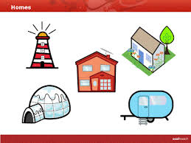

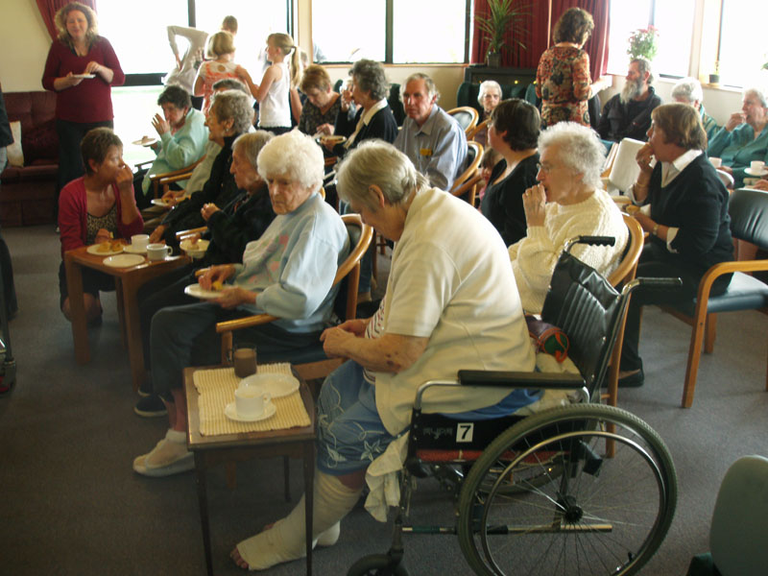
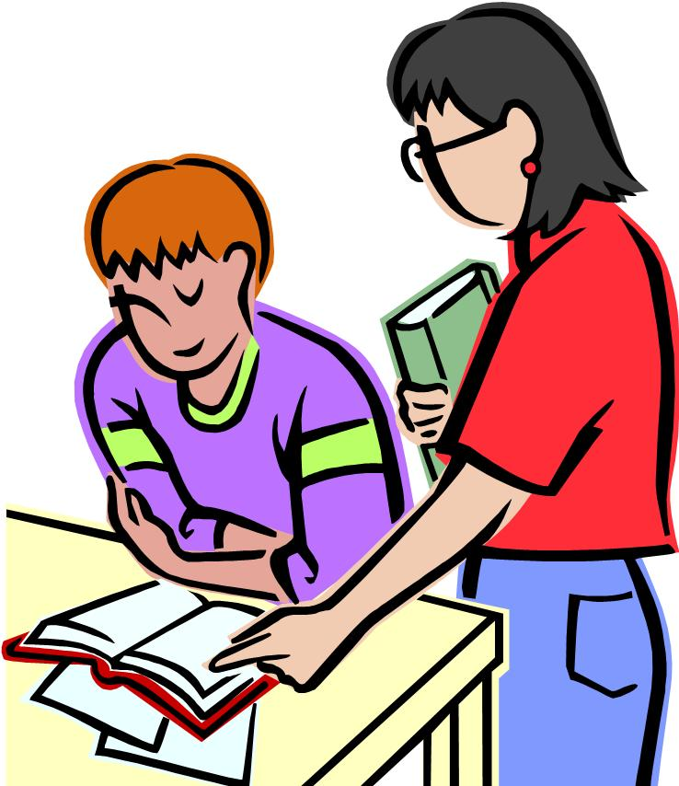
i. VOCABULARY
tutor (n)
: Người dạy kèm
blanket (n)
: chăn mền
shelter (n)
: Chổ ẩn nấp
mural (n)
: Tranh khổ lớn trên tường
sort (n)
: sự phân loại
Nursing home
: Nhà dưỡng lão

Slide 5


2
1
tutor
blanket
shelter
mural
4
Nursing
home
5
3

Slide 6

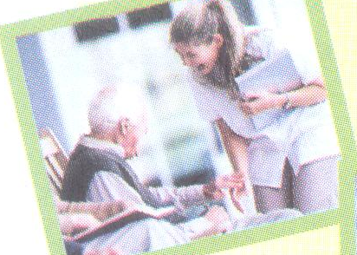
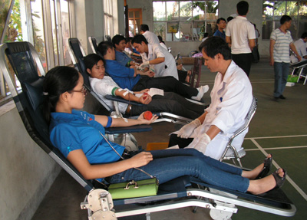
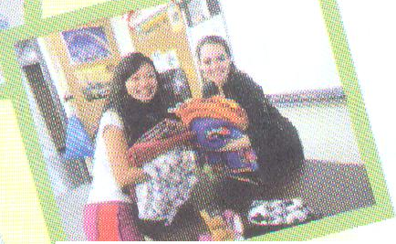
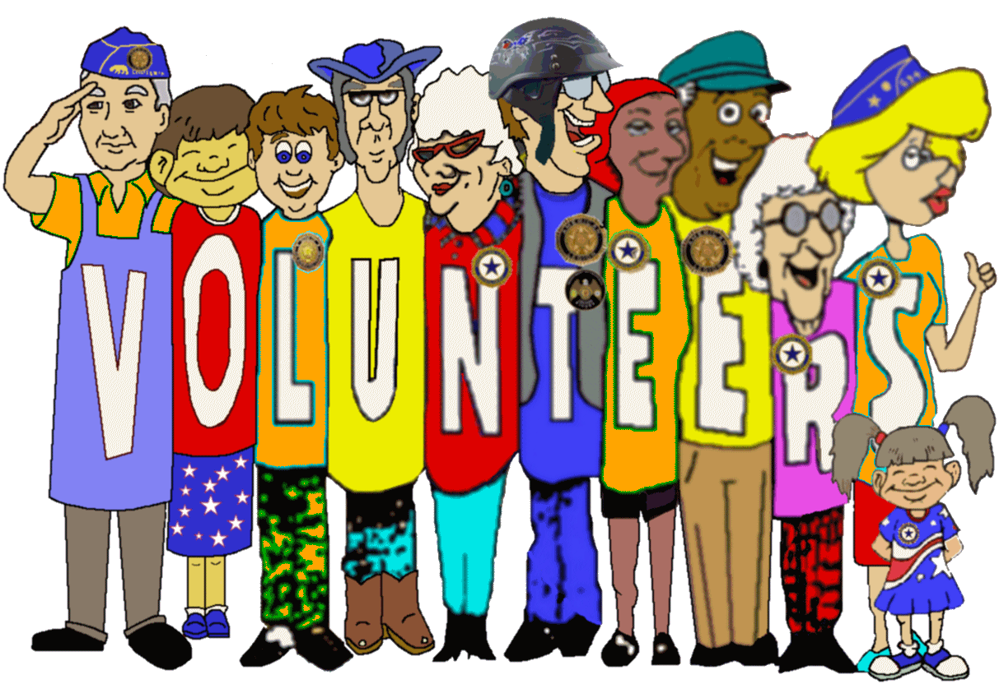
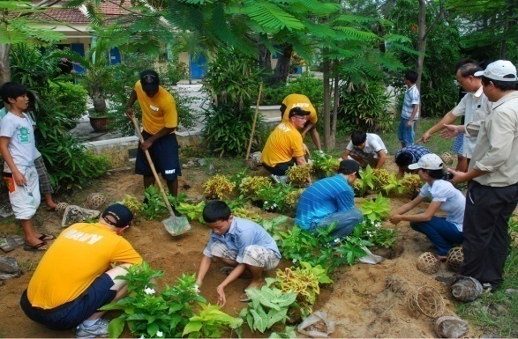
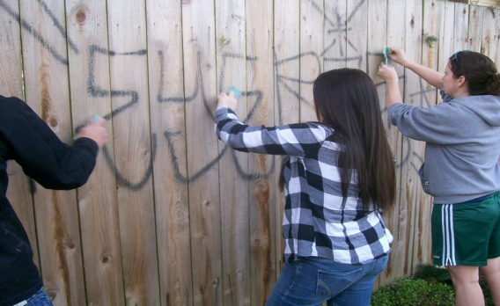
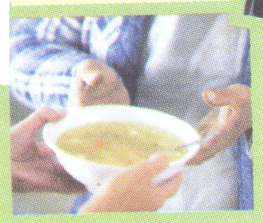
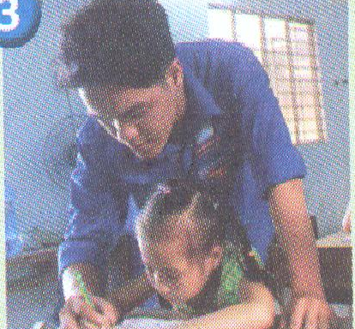
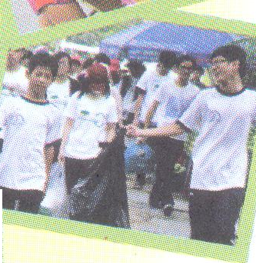
Talk to or sing for the elderly at a nursing home
Donating blood
Make blankets for children who are ill
Paint the mural over the graffiti
Plant trees and flowers in the neighborhood
Tutor a younger child or provide homework help before or after school
Cook a meal at the shelter for homeless youths and families
Recycle things and teach others how to do so

Slide 7
II. PRACTICE
1. Look at the photos and read about the following volunteer activities for teenagers in the United States.
1. Tutor a younger child or provide homework help before or after school.
2. Recycling things and teach others how to do so.
3. Plant trees in publics area where the whole neighbourhood can enjoy them.
4. Donate blood.
5. Talk to and sing for the elderly at the nursing house.
6. Make blankets for children who are ill.
7. Cook a meal at a shelter for homeless youths and families.
8. Paint a mural over graffiti.

Slide 8
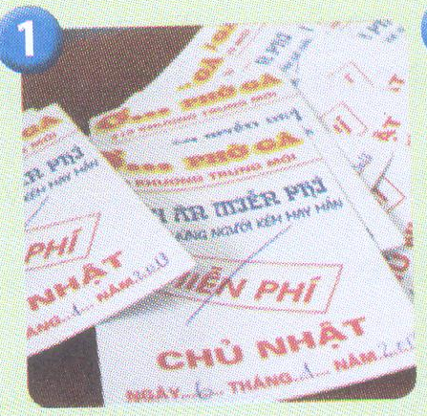
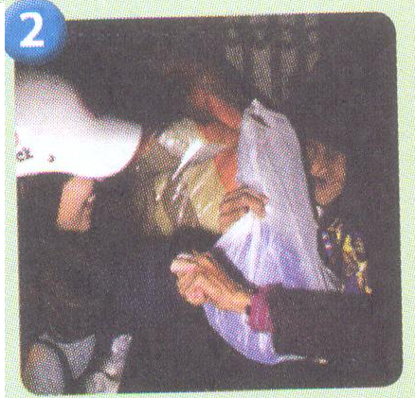
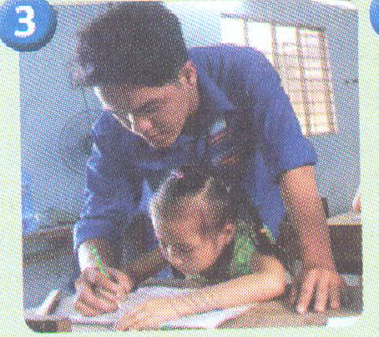
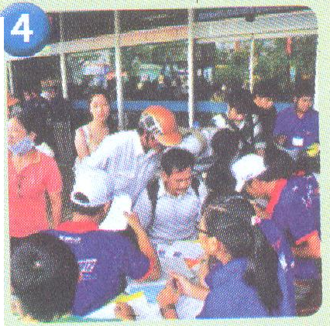
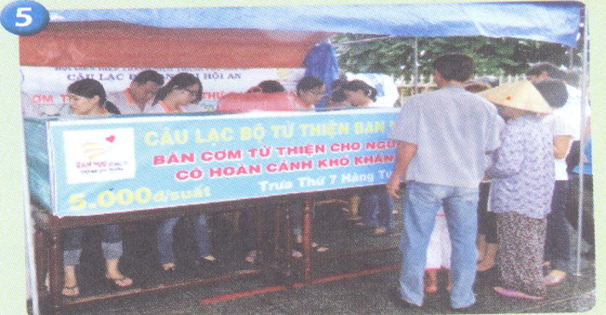
2. Look at the photos about community service in Vietnam. Match them with the activities. (Ex. 2/ p. 31)
d. Offering meals at 5.000 VND for the poor in Quang Nam.
b. Offering coupons for free chicken noodle soup for the poor in Hanoi.
c. Giving away warm clothes to homeless people in Hanoi.
e. Tutoring children from poor families in Ho Chi Minh city.
a.Volunteering to give information in bus stations and railway station.

Slide 9


III. discussion
1. Discuss the benefits
each activity may bring
to the community.

Slide 10
2. Take a survey
Activities | Have you ever ....?
1. Donating blood | Nga
2. Helping the elderly
3. Cooking for the poor
4. Planting trees
5. Recycle things
6. Tutoring the young children
7. Provide food to street children
8.Painting the graffiti

Slide 11
IV. At home
Learn new words by heart.
Do exercises C1 – C2 (page 20/ workbook).
Prepare SKILLS 1.

Slide 12




The bye bye song
Bye, bye.
See you tomorrow.
Bye, bye.
See you tomorrow.
Bye, bye.
See you tomorrow.
Bye, bye. Bye, bye.
The bye bye
song
Notes:
12

