Slide 1
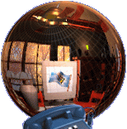

ENGLISH 9
UNIT 8

Slide 2
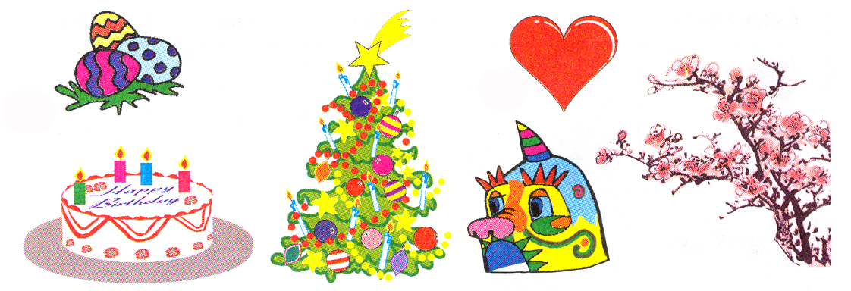

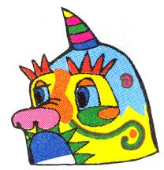
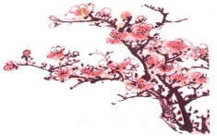
UNIT 8. CELEBRATIONS.
GETTING STARTED & LISTEN AND READ
Game: who is faster?
Birthday
1. GETTING STARTED
1 |  | a. Lunar New Year ( Tet )
2 |  | b .Christmas
3 |  | c. Easter
4 |  | d. Wedding
5 |  | e. Birthday
6 |  | f. Mid – Fall Festival
Celebrations

Slide 3
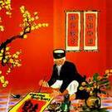
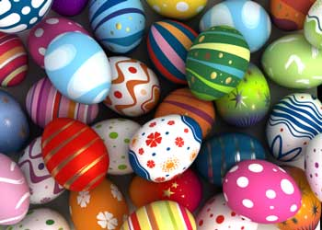
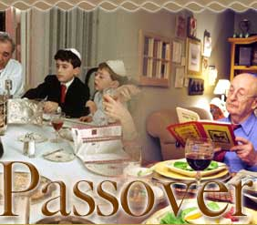
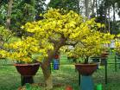
UNIT 8. CELEBRATIONS.
GETTING STARTED & LISTEN AND READ
1. GETTING STARTED
1c, 2e, 3f, 4b, 5a, 6d
2. LISTEN AND READ
Did you have a happy Tet holiday?
Is Tet an important holiday in Viet Nam ?
- How many celebrations are there in the passage?
- What are they?
* Listen to the tape

Slide 4
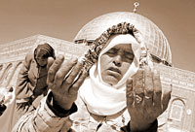
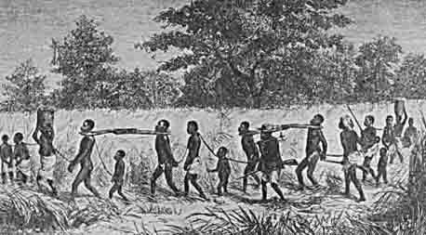
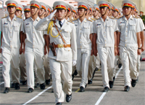
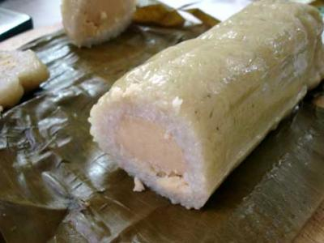
UNIT 8. CELEBRATIONS.
1. GETTING STARTED
2. LISTEN AND READ
- There are three celebrations.
- They are Lunar New Year (Tet), Passover and Easter.
Vocabulary:
Catholic people are going to celebrate Easter Day.
Passover (n)
occur (v)
= happen (v)
…Tet is a festival which occurs in late january…
…Family members who live apart try to be together at Tet…
sticky rice cake
Jewish (n)
slavery (n)
# freedom (n)
parade (n)

Slide 5
UNIT 8. CELEBRATIONS.
1. GETTING STARTED
2. LISTEN AND READ
Checking vocabulary
người Do Thái
occur (v)
sticky rice cake
cuộc diểu hành
Passover (n)
Jewish (n)
sự nô lệ
slavery (n)
Xảy ra
parade (n)
bánh chưng
Lễ Quá hải ( của người do thái)

Slide 6
UNIT 8. CELEBRATIONS.
1. GETTING STARTED
2. LISTEN AND READ
Vocabulary:
* Now, listen to the tape again and then complete the table.
occur (v)
Celebration | When? | Activities | Food | Country
Tet
= happen (v)
sticky rice cake
Passover (n)
Jewish (n)
slavery (n)
# freedom (n)
parade (n)

Slide 7
UNIT 8. CELEBRATIONS.
1. GETTING STARTED
2. LISTEN AND READ
* Now, complete the table.
Celebration | When? | Activities | food | country
in late January or early February
cleaning and decorating home and enjoying special food
Tet
sticky rice cakes
Viet Nam
late March or early April
special meal called the Seder
Passover
eating
Israel
around the same time as Passover
people crowd the streets to watch colorful parades
chocolate or sugar eggs
Easter
In many counties
When does Tet occur?
In which country does Tet occur occording to the text?
What activities do people often do before and on Tet ?
Which special food do people enjoy on Tet ?

Slide 8
UNIT 8. CELEBRATIONS.
1. GETTING STARTED
2. LISTEN AND READ
Celebration | When? | Activities | food | country
in late January or early February
cleaning and decorating home and enjoying special food
sticky rice cakes
Viet Nam
Tet
late March or early April
special meal called the Seder
Passover
eating
Israel
around the same time as Passover
people crowd the streets to watch colorful parades
chocolate or sugar eggs
In many counties
Easter
*Now say these statements are true ( T ) or false ( F )
1. Tet is festival which occurs in late January or early February.( )
2. Passover is celebrated in Israel and by all Jewish people. ( )
3. On Passover, People celebrate freedom from slavery. ( )
4. Easter happens at around the same time as Lunar New Year.( )
T
T
T
F

Slide 9
HOMEWORK
- Learn all the new words by heart.
- Study the table, and read the text at home.
- Prepare: Speak & Listen.
- Learn more celebrations .

