Slide 1


English 8
UNIT 6. PEOPLES OF VIET NAM
PERIOD 16: A CLOSER LOOK 1
Welcome to our class

Slide 2
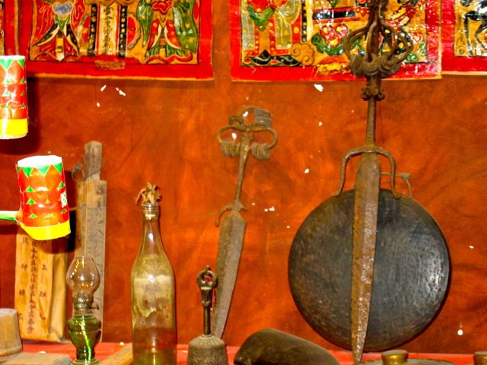
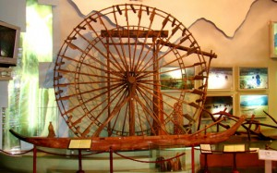
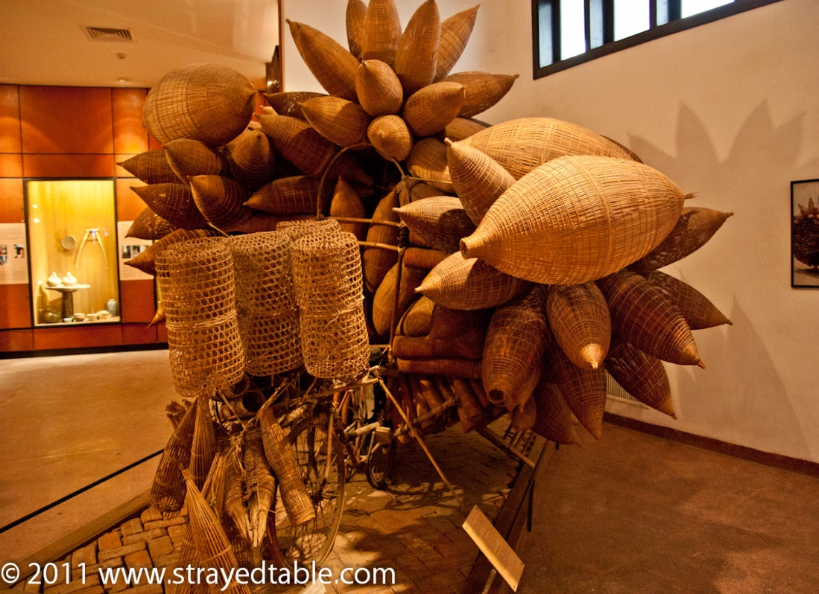
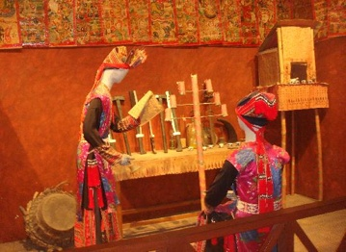

Slide 3
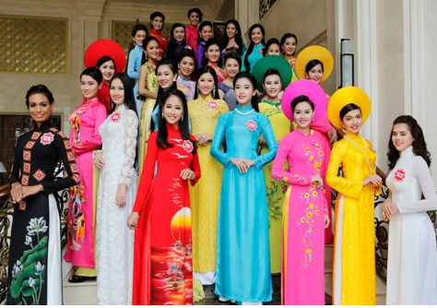
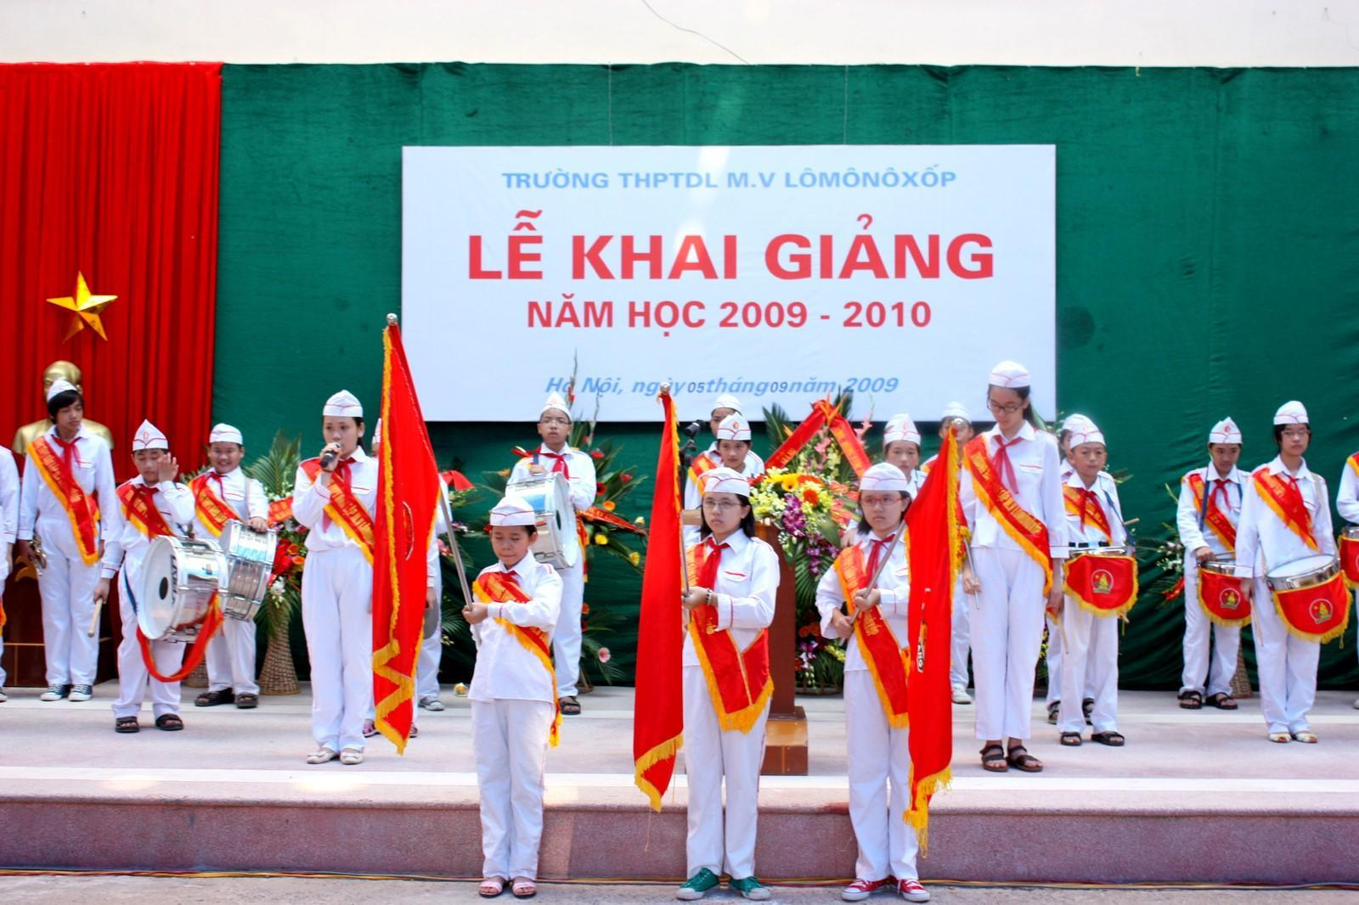
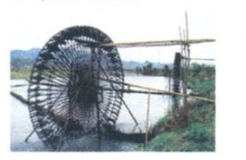
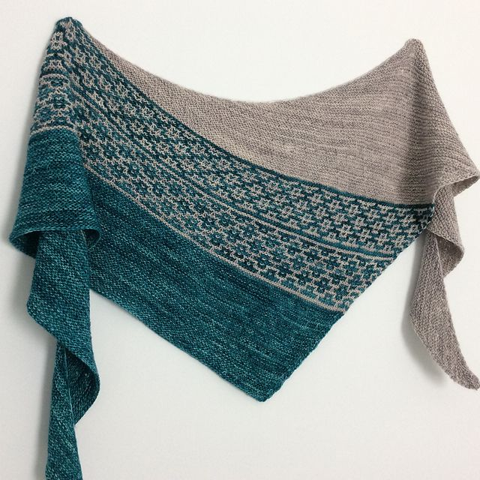
- Traditional (a):truyền thống
- Ceremony (n):nghi lễ
-Water wheel (n):cối xay nước
Shawl (n): khăn quàng

Slide 4

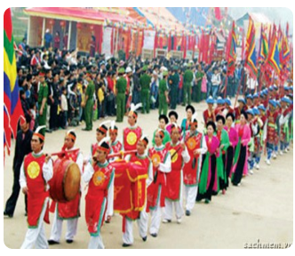
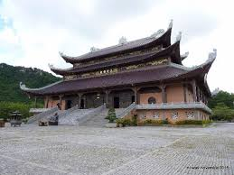
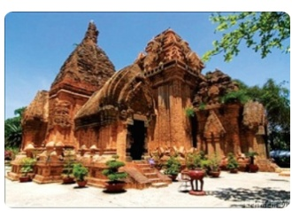
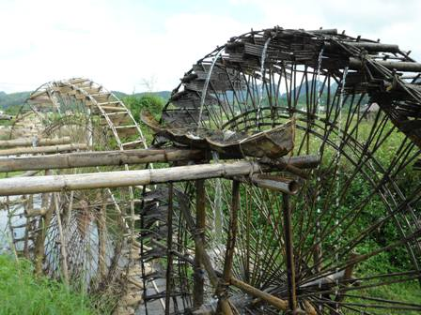
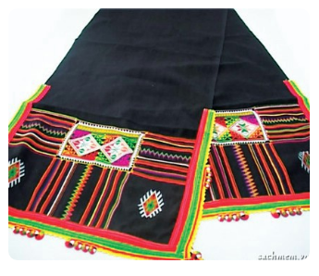
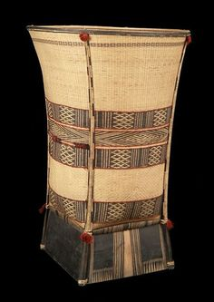
Work in pairs. Discuss what the word is for each picture. The first and the last letters of each word are given.
1. c---------------y
1. ceremony
2. pagoda
2. p---------------a
3. temple
3. t---------------e
4. w---------------l
4. waterwheel
5. shawl
5. s---------------l
6. b---------------t
6. basket

Slide 5
Match the adjectives in A with their opposites in B .
1. major
a. written
2. simple
b. insignificant
3. modern
c. complicated
4. spoken
d. minor
5. rich
e. basic
6. developed
f. poor
7. important
g. traditional

Slide 6
Use some words from 1 to complete the sentences
Many ethnic groups have their own languages. And some even have ………………………………languages.
People in some far-away mountainous regions still keep their …………………….. way of life.
Gathering and hunting still play a(n) …………………….. role in the economy of the Laha.
Ethnic peoples in the mountains have a …………………….way of farming. They use …………………….. tools to do the farm work.
The Muong in Hoa Binh and Thanh Hoa are well-known for their …………………….. folk literature and their traditional songs.
written
traditional
important
simple
basic
rich

Slide 7

pronunciation
Clusters: /sk/, /sp/ and /st/
4. Listen and repeat the following words.
skateboard stamp speech display first station Instead crisp school basket space task

Slide 8
5. Listen again and put them in the right column according to their sounds
/sk/ | /sp/ | /st/
skateboard | Speech | Stamp
School | Display | First
Basket | Crisp | Station
task | Space | Instead

Slide 9
6. Listen and read the following sentences. Then underline
the words with the sounds /sk/, /sp/, or/st/.
1. The Hmong people I met in Sa Pa speak English very well.
2. You should go out to play instead of staying here.
3. The local speciality is not very spicy.
4. Many ethnic minority students are studying at boarding schools.
5. Most children in far-away villages can get schooling.

Slide 10


