Slide 1
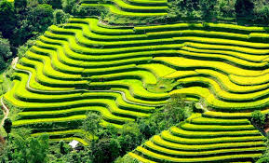

Slide 2
1
chatting
questions | T | F
1. There are more than 54 groups in Viet Nam
F
2. The H’mong don’t live in the Red river delta
t
3. Most ethnic group live mainly on hunting
F
4. The musical of the Tay is flute
F
5. The Viet live all over the country
t
6. All the groups have the same languages
F
7. The Tay live in a stilt house
t
8. The Odu has the smallest population
t
9. The Cham live mainly in southern provinces
F
10. The Viet work on terraced fields
F

Slide 3
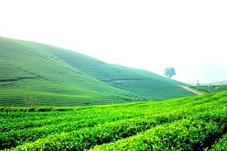
UNIT 3
PEOPLES IN VIET NAM
Lesson 5: Skill 1

Slide 4
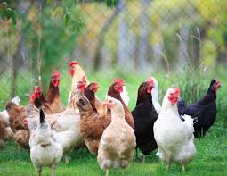
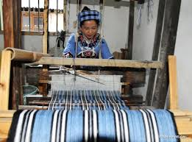
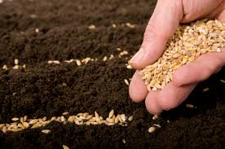
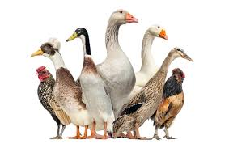
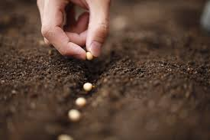
* Vocabulary:
- Poultry /'poultri/ (n) :
- Weave cloth /wi:v klɔθ/ (v) :
- Sow seeds /sau si:d (v) :

Slide 5
* Matching:
- Poultry (n) :
1
- Weave cloth (v) :
2
- Sow seeds (v) :
3

Slide 6
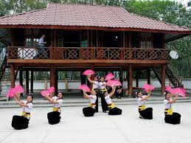
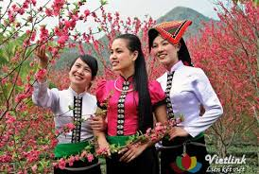
The thai

Slide 7
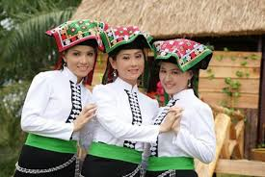
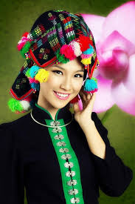
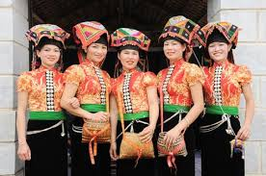
There are three kinds of Thai people
The white Thai
The black Thai
The red Thai

Slide 8
The thai
1, Where do the Thai people live?
2, What is their population?

Slide 9
Read the passage
The Thai have a population of about one and a half million people living in the provinces of Lai Chau, Son La, Yen Bai, Hoa Binh, Thanh Hoa, and Nghe An. The Thai language belongs to the Tay- Thai group.
The Thai are experienced farmers. They dig canals to bring water to their fields. Their main food is rice, especially sticky rice. The Thai also grow other crops on burnt- out land. They raise cattle and poultry for their own use. They also make bamboo items, and weave cloth. Thai cloth is well- known for being unique, colourful and strong.
Recently, Thai men prefer to wear the Kinh’s style of dress, while Thai women keep their traditional costumes including short blouses, long skirts, scarves and ornaments. The Thai live in houses on stilts. Their villages comprise 40 to 50 houses, usually built side by side
The Thai worship their ancestors. Every year, they hold festivals and ceremonies with alternating songs between boys and girls, and many traditional games

Slide 10
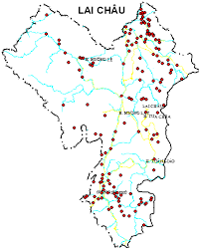
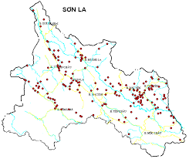
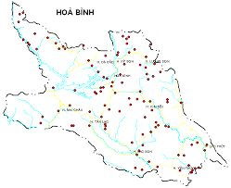
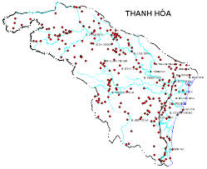
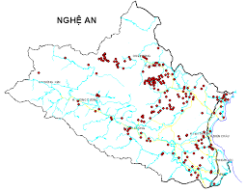
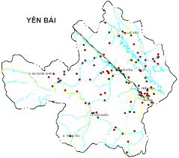

Slide 11
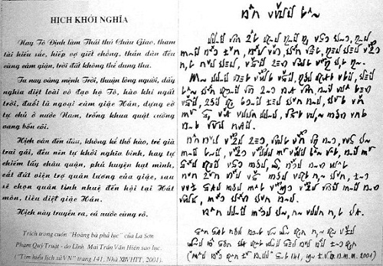
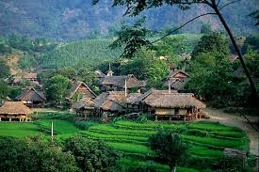
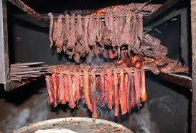
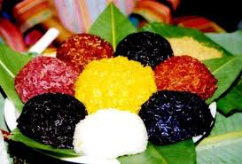
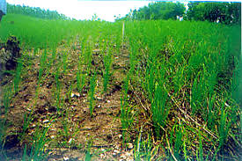
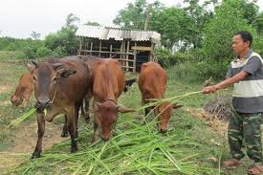
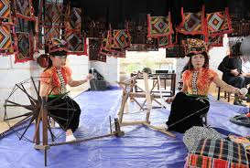
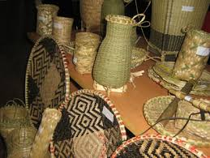
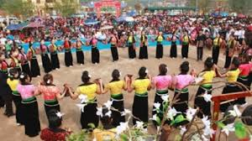
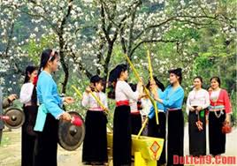
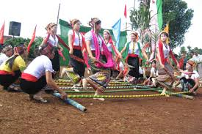
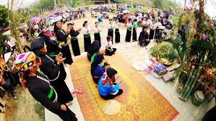
Main features
Language
Housing
Special food
Production activities
Festivals and ceremonies

Slide 12
What do you know about the Thai?
features | information
1. Population
2. Regions
3. Language
4. Housing
5. Main jobs
6. Main products
7. Costumes
8. Festivals
1,500,000
Lai Chau, Son La, Yen Bai, Nghe An…
Tay-Thai group
Stilt houses
Farming, cattle raising, cloth weaving
Bamboo items, cloth
Short blouse, long skirt, ornaments
Festivals with traditional games

Slide 13
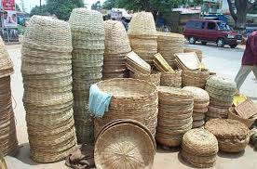
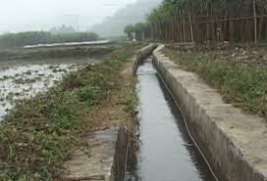
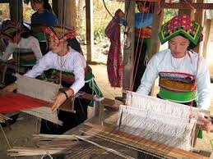
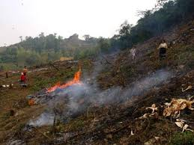

Slide 14
Read the text then complete these sentences
with no more than ONE word
0. The Thai_______________ belongs to the Tay-Thai group
1. They get water for their fields from________________
2. The Thai earn their living from_______________ rice, raising
cattle, weaving cloth or making items from_______________
3. The Thai live in _________________ with 40 to 50 houses each
4. Their________________ consists of a short blouse, a long skirt
and ornaments
5. “Xoe” is the traditional______________ of the Thai
6. The Thai worship their________________
language
canals
growing
bamboo
villages
costume
dance
ancestors

Slide 15
Make a summary about the Thai?
features | information
1. Population
2. Regions
3. Language
4. Housing
5. Main jobs
6. Main products
7. Costumes
8. Festivals
1,500,000
Lai Chau, Son La, Yen Bai, Nghe An…
Tay-Thai group
Stilt houses
Farming, cattle raising, cloth weaving
Bamboo items, cloth
Short blouse, long skirt, ornaments
Festivals with traditional games

Slide 16
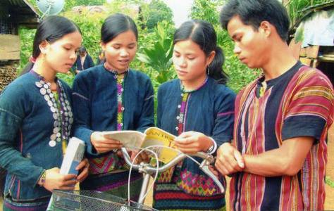
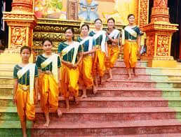
II- speaking
The bru-van kieu
The Khmer
Population: 74,500
Regions: Quang Binh, Quang Tri, Hue
Language: Mon- Khmer group
Productions: growing rice on terraced fields,
raising cattle and poultry
Festivals: Festival before sowing seeds
Population: 1,260,000
Regions: Mekong Delta
Language: Mon- Khmer group
Productions: growing rice, making sugar,
raising cattle
Festivals: Chaul Chnam Thmay
Greeting the Moon

Slide 17

HOMEWORK
Learn new words by heart.
Write a passage (100-120 words) about a people you know

