Slide 1
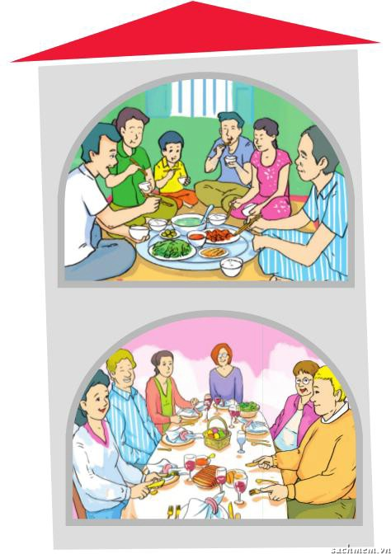

Picture 1:
1. What are they doing?
2. Are they Vietnamese?
3. Where are they sitting?
4. Are they using rice bowls and chopsticks to eat?
1
Picture 2
1.Where are they?
2. What are they doing?
3. Where are they from?
4. Are they using knives and folks to eat?
2

Slide 2

Unit 4:Our customs and traditions
Period 30- Lesson 4:communication

Slide 3
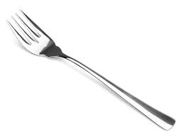
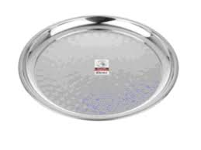
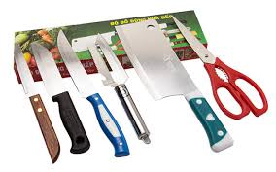
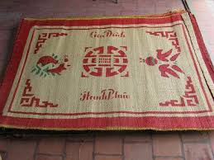
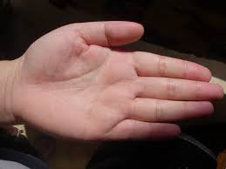
Extra vocabulary
prong
palm
prong (n)
răng nĩa
tray (n)
khay, mâm
cutlery(n)
dao kéo
mat(n)
chiếc chiếu
palm(n)
lòng bàn tay
host/hostess(n)
chủ nhà
guest (n) khách

Slide 4
1, Look at the pictures and show the difference between them.
Put the sentences in the right columns
1. They are sitting around on a mat to have meals.
2. They are using rice bowls and chopsticks.
3. They are eating around the dining table.
4. They are using cutlery to eat most of the food.
5. They are holding the folk in the left hands and the knife in the right hands.
6. They are holding the rice bowls in the left hands and the chopsticks in the right hands.
7. They are having rice, meat and vegetables.
8. They are having bread, butter and milk.
Vietnamese table manner
British table manner
Vietnamese table manners | British table manners
1 | 3

Slide 5
1, Look at the pictures and show the difference between them.
Put the sentences in the right columns
1. They are sitting around on a mat to have meals.
2. They are using rice bowls and chopsticks.
3. They are eating around the dining table.
4. They are using cutlery to eat most of the food.
5. They are holding the folk in the left hands and the knife in the right hands.
6. They are holding the rice bowls in the left hands and the chopsticks in the right hands.
7. They are having rice, meat and vegetables.
8. They are having bread, butter and milk.
Vietnamese table manner
British table manner
Vietnamese table manners | British table manners
1,2,6,7 | 3,4,5,8

Slide 6
2. Read the following sentences about table manners in Britain. Work in pairs. Write T (true) or F (false).
The knife is held in the left hand and the folk is held in the right hand.
You shouldn’t point the prongs of the folk up-wards during the meal.
People use the same cutlery to eat the main course and the dessert.
When the meal is finished, you should place the knife and folk on the plate.
You can use your fork to take more food from the serving dish.
You should use your knife to cut the bread.
Guests should start eating before the host starts eating.
You should ask someone to pass you a dish.

Slide 7
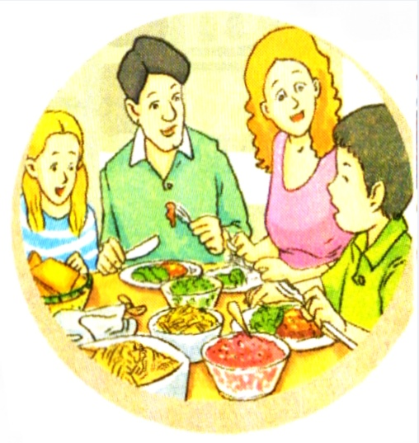
3.Now listen to Nick giving a presentation on table manners in Britain and check your answers.

Slide 8

.Read the following sentences about table of manners in Britain. Work in pairs. Write true(T) or false (F)
T
F
1.
2. You shouldn’t point the prongs of the fork up wards during the meal.
3.
4. When the meal is finished, you should place the knife and fork on the plate.
5.
6.
7.
8. You should ask someone to pass you a dish.
The knife is held in the left hand and the fork is held in the right hand.
F
You hold the folk in the left and the knife in the right
T
There is also a spoon and a fork for dessert.
People use the same cutlery to eat the main course and the dessert.
F
T
You can use your fork to take more food from the serving dish.
You should never use your own cutlery to take more food from the serving dish – use the serving spoon.
F
You should use your knife to cut the bread.
F
You should break off the bread with your hands.
Guests have to wait until the host or hostess starts eating.
Guests should start eating before host starts eating.
F
T

Slide 9
4.Work in pairs. Discuss if you follow these table manners in your family. Are there other table manners you follow?
1. We sit around a tray on a mat to have meal.
2. We use rice bowls and chopsticks.
3. When chewing food, we shouldn’t talk.
4. The host/hostess invites everybody to start eating.
5. The host/ hostess offers to serve the food for the guests.
6. When we have finished eating, we place our chopsticks on the top of rice bowl.

Slide 10
5. There is a British exchange student in your class. You invite her to dinner at your home. Play the following roles.
You are Minh. You invite your British friend to come for dinner. She asks a lot of questions about Vietnamese table manners.
You are Jessica from Britain. You want to learn about Vietnamese table manners, so you can feel comfortable at dinner. You compare these with British table manners.
Start the role- play like this:
Minh: Hey Jessica! My family would like to invite you to dinner.
Jessica: Oh! That’s nice but….I don’t know anything about
Vietnamese table manners.
Minh: Well. What do you want to know?
Jessica: well, do you eat around the dinner table like in Britain?
Minh: No, actually we sit on a mat with the food in the middle.
Jessica: You’re kidding!
Minh:…..

Slide 11
5.Start the role- play like this:
Minh: Hey Jessica! My family would like to invite you to dinner.
Jessica: Oh! That’s nice but….I don’t know anything about
Vietnamese table manners.
Minh: Well. What do you want to know?
Jessica: well, do you eat around the dinner table like in Britain?
Minh: No, actually we sit on a mat with the food in the middle.
Jessica: You’re kidding!
British table manner | Vietnamese table manner
eat around the dinner table . | sit on a mat with the food in the middle.
use cutlery to eat most of the food. | use rice bowls and chopsticks.
place the knife and the folk on the plate. | place the chopsticks on top of the rice bowls
have bread, butter and milk. | have rice , meat and vegetables.

Slide 12
Put the words in the box in the correct columns
Folk, rice, butter, bread, knife, rice bowl, chopstick, mat, dining table, cutlery, fish sauce
Vietnamese table manners | British table manners

Slide 13
Put the words in the box in the correct columns
Folk, rice, butter, bread, knife, rice bowl, chopstick, mat, dining table, cutlery, fish sauce
Vietnamese table manners | British table manners
Rice, rice bowl, mat, chopstick, fish sauce | Folk, butter, bread, dining table, cutlery

Slide 14
Homework
Read again the new words.
Write two sentences about the Vietnamese table manners and two sentences about British table manners.

