Slide 1
Unit 2: Life in the countryside
Lesson 5: Skills 2

Slide 2
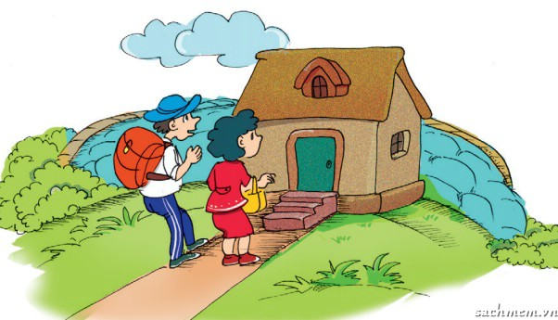
LISTENING
Listen to a boy talking about changes in his village.
Tick the changes he mentions.
A……………………..the roads in the village.
B……………………...electrical appliances in the homes.
C………………………means of transport.
D………………………entertainment.
E……………………….school.
F………………………..visitors.
V
V
V
V

Slide 3
Listen again and say if the sentences are T or F.
1. Nobody lives in an earthen house now.
2. The village has electricity now.
3. Horses are still the only means of transport in the village.
4. The children used to go a long way to school.
5. More visitors are coming to see them.
F
T
F
T
T

Slide 4
Listen again and answer the questions in no more
than 4 words..
Who often tells the boy stories about the past ?
2. What do the villagers now know more about ?
3. Where is the new school ?
4. What do the visitors want to experience in the village ?.
His parents.
Life outside their village.
Nearby / Near the village.
A nomadic life.

Slide 5
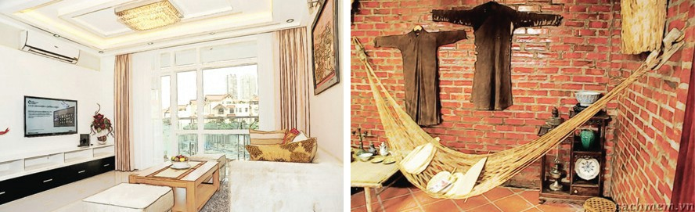
WRITING
Which changes in the listening do you see positive ?
Which do you see negative ?
Support your opinion with a reason.
Example:
It’s good for the villagers to have TVs.They can now have more
fun & learn more about different people & different places.

Slide 6
electricity/ modern equiptment / less hard
Brick house instead of earthen ones / more comfortable
Use motorcycles instead of riding a horse or walking.
Children no longer have to walk a long way & cross a
stream to school.
- More visitors from the city to village.

Slide 7
Discuss and find some changes in rural area.
Make note of the changes.
don’t use buffaloes for transport.
Use motorbikes.
Electricity & modern equiptment at home.
Some amusement centers.
Schools / near the villages.
Ss can access to modern technology in edu: computer ; projector;…
Hospitals .
Roads / widen……

Slide 8
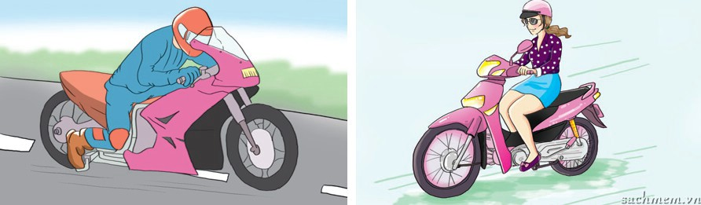
PROMT
My hometown / change / much. The first change / life /
local people. They / better life / because /electricity,
TV, hospital, school / nearby /village. The second change /the
people. / more people / more houses here. The houses
/modern / brick / not / soil / anymore. They / not/ use
buffaloes / transport/ they / motorbikes instead.The last change / the place / children / play. There / amusement centers / here.

Slide 9

My hometown has changed so much. The first change is life of
local people. They have a better life because they have electricity,
TV, hospital, school nearby the village. The second change is the
people. There are more people and more houses here. The houses
are more modern in brick not in soil anymore. They don’t use
buffaloes for transport, they use motorbikes instead. The last change is the place for children to play. There are some amusement centers here.

Slide 10


