Slide 1


English 8
UNIT 1 . LEISURE ACTIVITIES
PERIOD 1: GETTING STARTED
IT’S RIGHT UP MY STREET!
Welcome to our class

Slide 2

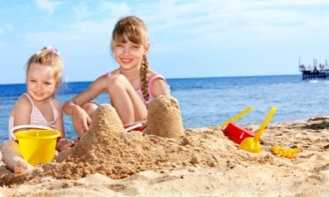



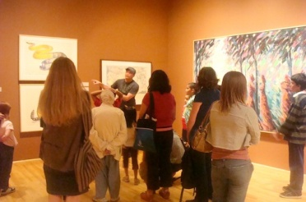
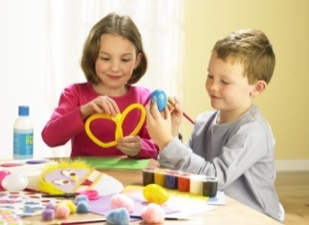

WARM UP
Find words or phrases in the box to describe the photos. Then listen to check the answers. (Ex. 2/ p. 7)
Playing beach games
Playing football
Making crafts
Texting
Playing computer games
Visiting museums
Doing DIY
1
2
3
4
5
6

Slide 3
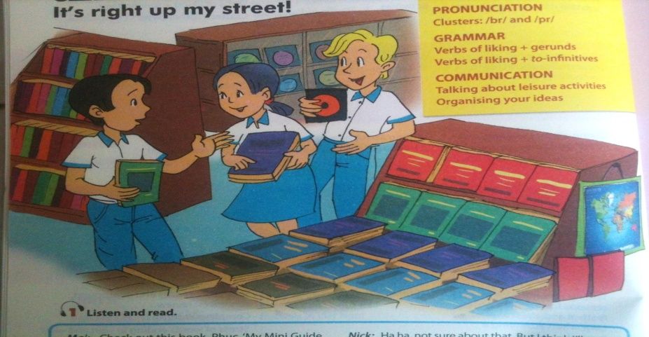
*Chatting
1. WHERE ARE MAI, PHUC AND NICK?
2. What are they holding in their hands?
3. What do they like doing in their free time?

Slide 4

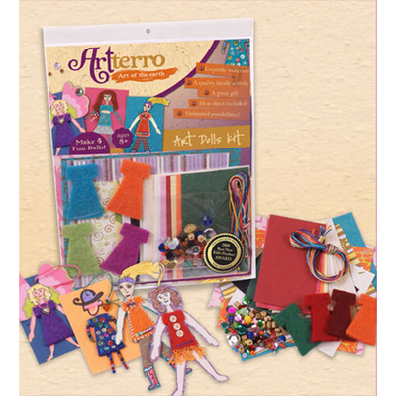

- check out (v)
: Kiểm tra lại, xem lại
- trick (n)
: mánh, mẹo, trò lừa bịp
- craft kit (n)
: bộ đồ nghề làm thủ công
- savings
: tiền tiết kiệm
- button
: cúc áo, khuy
- To be right up one’s street
: hợp với khả năng của ai, thứ mà ai đó thích
→ It’s right up my street (idiom):
Đúng vị của tôi

Slide 5
II. LISTEN AND READ
1. Circle the correct answers. (Ex. a/ p. 7)

Slide 6




EX. a
/ P. 7
1. Phuc, Mai and Nick are in a ________.
A
library
WHAT A PITY !
B
bookstore
PERFECT
C
sports club
SORRY !

Slide 7
EX. a
/ P. 7
2. Phuc is looking for a ___________.
A
book
PERFECT
B
dog
WHAT A PITY !
C
craft kit
SORRY !

Slide 8
EX. a
/ P. 7
3. Max is Phuc’s _______.
dog
A
PERFECT
cat
B
SORRY !
C
goldfish
WHAT A PITY !

Slide 9
EX. a
/ P. 7
4. Mai has found a _________ for herself.
A
book
WHAT A PITY !
B
CD
SORRY !
C
craft kit
PERFECT

Slide 10
EX. a
/ P. 7
5. Nick’s CD is of ____.
A
folk music
PERFECT
B
pop music
SORRY !
C
rock music
WHAT A PITY !

Slide 11
EX. a
/ P. 7
6. Nick is trying to learn ______.
A
Japanese
SORRY !
B
Vietnamese
PERFECT
C
English
WHAT A PITY !

Slide 12
2. Tick the boxes. Then find the information from the conversation to explain your choice. (Ex. b/ p. 7)
 | PHUC | MAI | NICK
Pet training
Making crafts
Reading
Listening to music
Learning languages
Playing sports
Helping parents with DIY projects

Slide 13
Complete the following sentences with words in the box.
(Ex. 3/ p. 7)
good relaxing fun
satisfied exciting boring
1. You do leisure activities in your free time and they make you feel_________________.
2. You can do ___________ activities such as yoga or ___________ ones such as mountain biking or skateboarding.
3. Hobbies such as making crafts or collecting things are _________.
4. You can surf the internet but some people say this is ___________.
5. You can spend time with family and friends, or become a volunteer for the community. This will make you feel _________________.
good / satisfied
relaxing
exciting
fun
boring
good / satisfied

Slide 14
IV. AT HOME
Learn by heart new words.
Practice dialogue with your friends.
Read the “learning trip” and do the ex. C / p. 7.
Be ready for A CLOSER LOOK 1.

Slide 15




The bye bye song
Bye, bye.
See you tomorrow.
Bye, bye.
See you tomorrow.
Bye, bye.
See you tomorrow.
Bye, bye. Bye, bye.
The bye bye
song
Notes:
15

