Slide 1
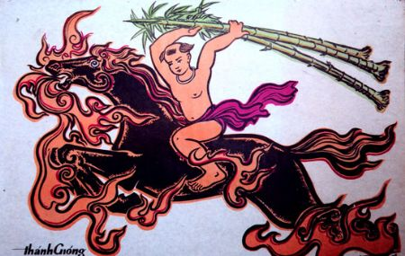
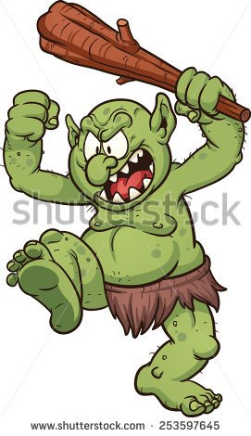
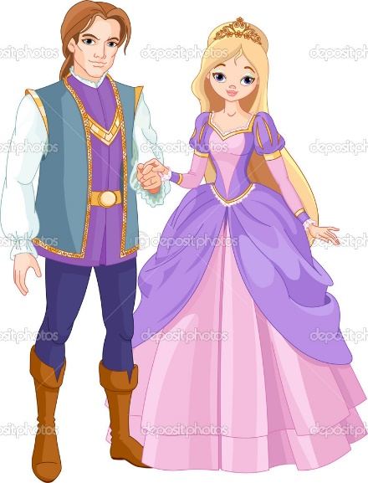
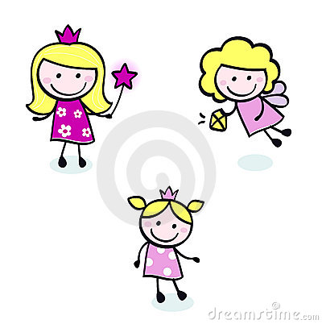
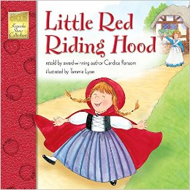
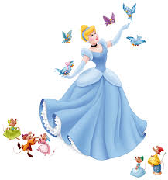
WELCOME TO MY CLASS
Good morning Everybody

Slide 2
Kim’s games
Kim’s games
Watch the clip and write down the words you see

Slide 3
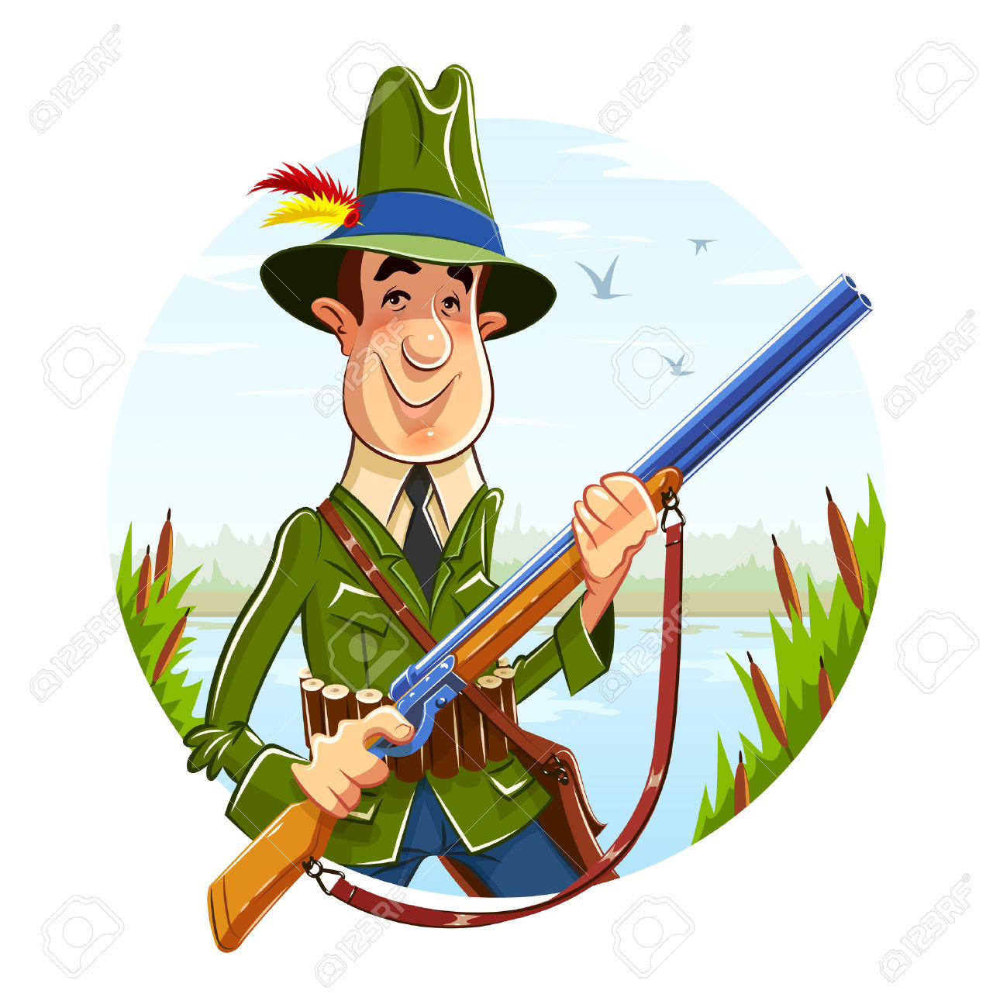
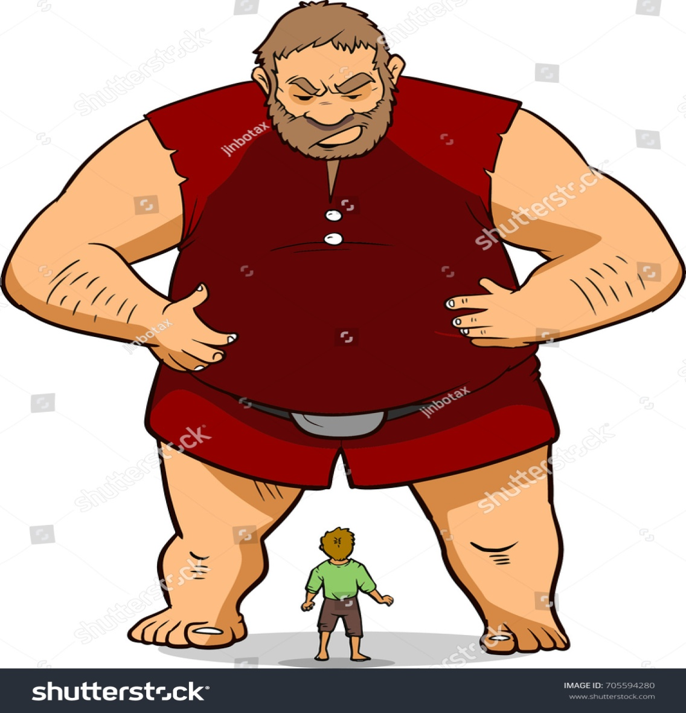
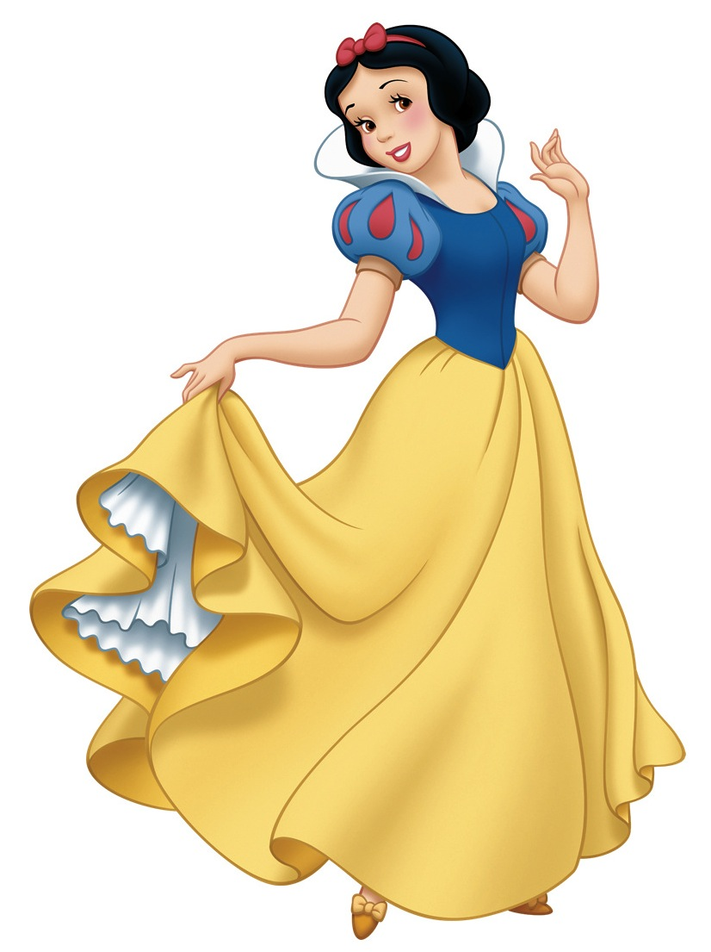
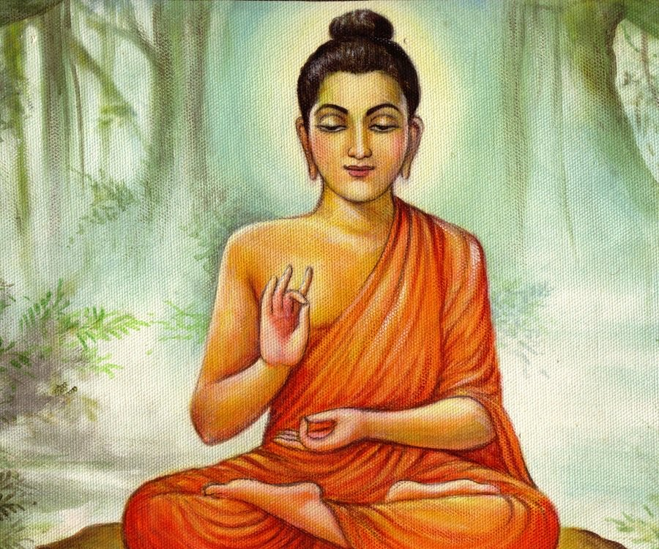
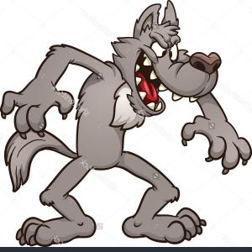
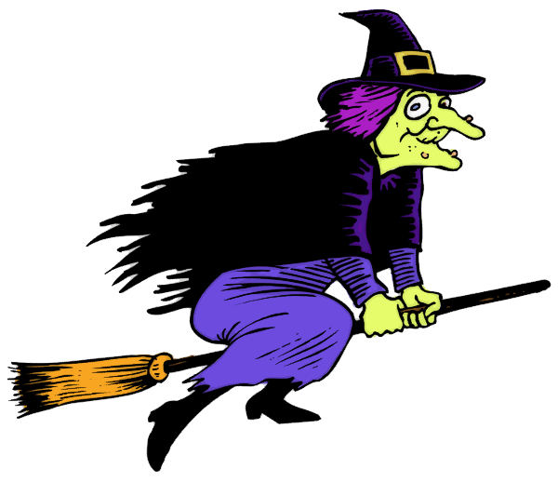
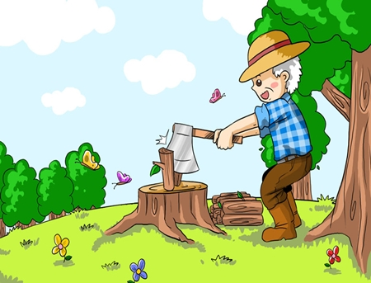


Slide 4
Let’s check
1. A fairy
5. princess
2. A hunter
6. witch
3. A wolf
7. woodcutter
4. Budhha
8. Giant

Slide 5
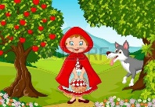
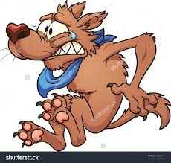

UNIT 6
Folk Tales
Period 48
communication

Slide 6
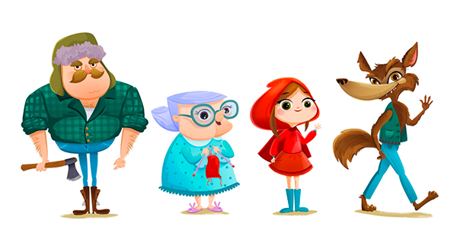
Little red riding hood

Slide 7
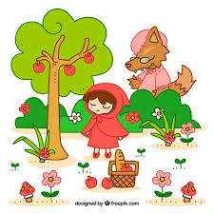
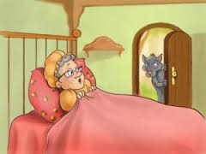
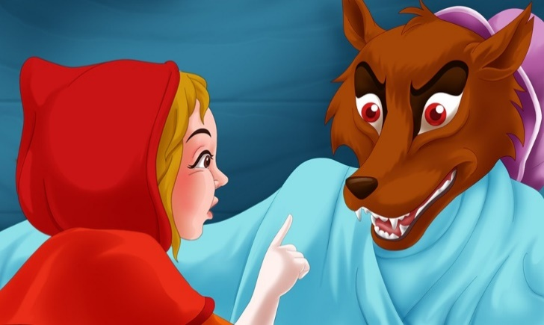
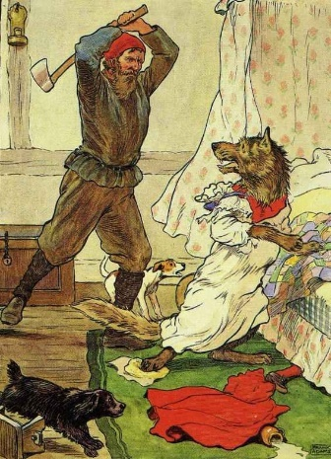
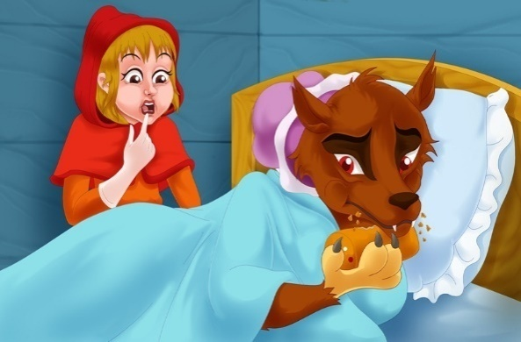
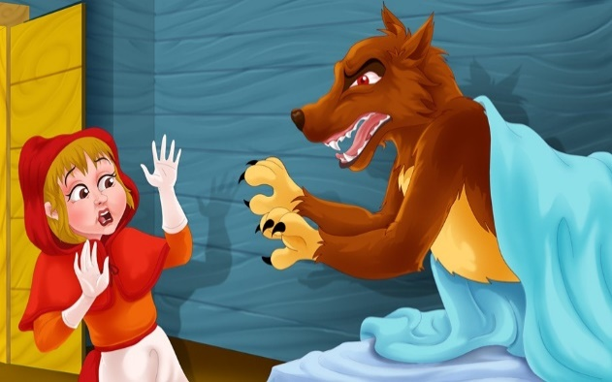
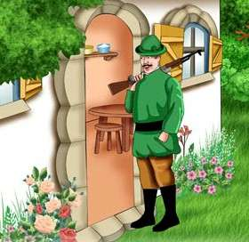
Look at pictures. Then put the parts of the fairy tale in order.
1
2
3
4
5
6
7
8

Slide 8
When she was picking some flowers on the side of the path, she met a wicked wolf. He asked, “Where are you going?”. “I’m going to see my grandmother,” she said.
A woodcutter was working in the woods. He heard a loud scream and ran to the house.
Finally she said, “Granny, what big teeth you have!”. “All the better to eat you with!” shouted the wolf.
Then she said, “Granny, what big ears you have!”. “All the better to hear you with!” he replied.
So the wolf had a plan. He ran to Granny’s house and swallowed Granny. He got into Granny’s bed.
A little later, Little Red Riding Hood reached the house. She looked at the wolf and said, “Granny, what big eyes you have!”. “All the better to see you with!” he replied.
He hit the wolf on the head. The wolf opened his mouth wide and shouted and Granny jumped out. The wolf ran away.
Little Red Riding Hood lived in a wood. One day, she went to visit her granny.

Slide 9
1
- h
2
- a
3
- e
4
- f
5
- d
6
- c
7
- b
8
- h

Slide 10
h. Little Red Riding Hood lived in a wood. One day, she went to visit her granny.
a. When she was picking some flowers on the side of the path, she met a wicked wolf. He asked, “Where are you going?”. “I’m going to see my grandmother,” she said.
e. So the wolf had a plan. He ran to Granny’s house and swallowed Granny. He got into Granny’s bed.
f. A little later, Little Red Riding Hood reached the house. She looked at the wolf and said, “Granny, what big eyes you have!”. “All the better to see you with!” he replied.
d. Then she said, “Granny, what big ears you have!”. “All the better to hear you with!” he replied.
c. Finally she said, “Granny, what big teeth you have!”. “All the better to eat you with!” shouted the wolf.
b. A woodcutter was working in the woods. He heard a loud scream and ran to the house.
g. He hit the wolf on the head. The wolf opened his mouth wide and shouted and Granny jumped out. The wolf ran away.

Slide 11
Work in groups of five
In turn, retell the fairy tale to your group members in your own words. Choose the best storyteller in your group.

Slide 12
Work in groups of five
Discuss and write an ending for the fairy tale. Share it with other groups.
The moral to the story of "Little Red Riding Hood" is that children must obey their parents and that they must never talk to strangers. Even a very friendly stranger is capable of having bad intentions.

Slide 13
The moral to the story of "Little Red Riding Hood" is that children must obey their parents and that they must never talk to strangers. Even a very friendly stranger is capable of having bad intentions
"Little Red Riding Hood" is a popular fairy tale from the Grimm Brothers. It is the story of a little girl going to take food to her sick grandmother. Her mother warns her to go straight there and not to talk to strangers. On the way, however, the little girl meets a friendly wolf and reveales(để lộ) where she is going. He beats her there, eats her grandmother and jumps into bed. Pretending to be the grandmother, the wolf leads the little girl along before finally eating her as well. Fortunately, someone comes along to save Little Red Riding Hood and her grandmother. Bad things happened because the little girl had not obeyed her mother.

Slide 14
HOMEWORK
Practise retelling stories.
Do Exercises in workbook.
Be ready for Unit 6- Skills 1.

Slide 15
1.

