Slide 1



Welcome to our class 9/6
AN HUU SECONDARY SCHOOL

Slide 2
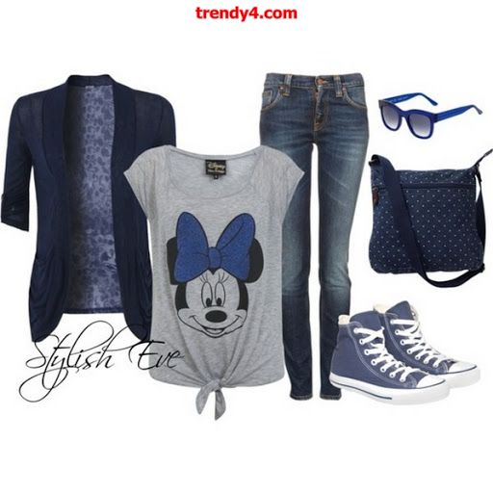
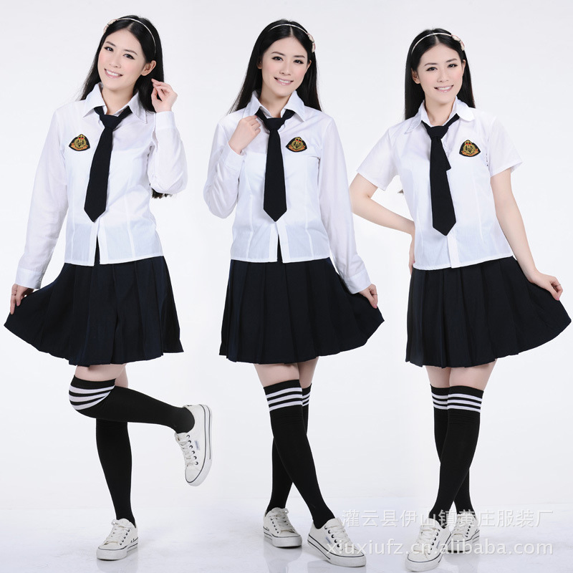

Slide 3

Unit 2: CLOTHING Lesson 5: Writing
I. Vocabulary
- Encourage (v) : khuyến khích
- equal in (adj) công bằng
- bear one’s name: mang tên
- self-confident (ajd): tự tin
- freedom of choice: tự do lựa chọn

Slide 4
Organization
Language
lets the reader know the
writer’s point of view
My opinion is …
Introduction
I think …
presents arguments in a
logical way (one in each
paragraph), gives
examples where possible
Firstly, …
Series of
arguments
Secondly, …
Finally, …
Therefore, …
Conclusion
sums up the argument
In conclusion, …

Slide 5

Secondary school students should wear uniforms
Outline A
Wearing uniforms:
- encourages students to be proud of their school because the uniforms bear their school’s name.
- helps students feel equal in many ways, whether they are rich or poor.
- is practical. No need to think of what to wear every day.

Slide 6
I think it is necessary for secondary school students to wear uniforms when they are at school.
Firstly, wearing uniforms encourages students to be proud of being students of their school because they are wearing the uniforms with labels bearing their school’s name.
Secondly, wearing uniforms helps students feel equal in many ways, whether they are rich or poor.
Finally, wearing uniforms is practical. You don’t have to think of what to wear every day.
Therefore, students in secondary schools should wear uniforms.

Slide 7

Writing: Use the outline below and write a paragraph
Secondary school students should wear casual clothes
Outline B
Wearing casual clothes :
makes students feel comfortable.
gives students freedom of choice (sizes, colors, and fashions, etc.).
makes students feel self-confident when they are in their favorite clothes.
makes school more colorful and lively.

Slide 8
Suggestion writing
My opinion is that secondary school students should wear casual clothes.
Firstly, casual clothes make students feel comfortable.
Secondly, wearing casual clothes gives students freedom of choice. They have rights to choose sizes,colors and fashions of clothes that they love.
Thirdly, casual clothes make students feel self-confident when they are in their favorite clothes.
Finally, casual clothes make school more colorful and lovely.
In conclusion, secondary school students should wear casual clothes. Wearing casual clothes is convenient, comfortable and fun.

Slide 9

Discussion
Secondary school girl students should or shouldn’t wear ao dai to school
Group A: Should wear
Group B: Shouldn’t wear

Slide 10

Homework
- Learn vocabulary by heart
Complete the writing.
Prepare : LANGUAGE FOCUS
( Review the present perfect, passive voice ).

Slide 11






Thanks for your attendance

