Slide 1


Slide 2

Unit 1- LEISURE ACTIVITIES
Lesson 1- GETTING STARTED

Slide 3


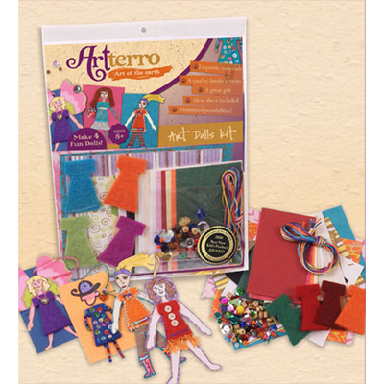



I. New words:
1. leisure (n):
: sự thư giãn nghỉ ngơi
2. check out (v)
: kiểm tra lại, xem lại
3. trick (n)
: mánh, mẹo, trò lừa bịp
4. craft (n):đồ thủ công - craft kit (n)
: bộ đồ nghề làm thủ công
5. folk song (n)
: bài hát dân ca
6. button (n)
: cúc áo, khuy
7. wool (n)
: len
8. DIY (n) = Do It Yourself
: đồ tự làm, tự sửa
9. tool
: dụng cụ
10. melody
: giai điệu
11.It’s right up my street (idom)
: đúng vị trí của tớ

Slide 4
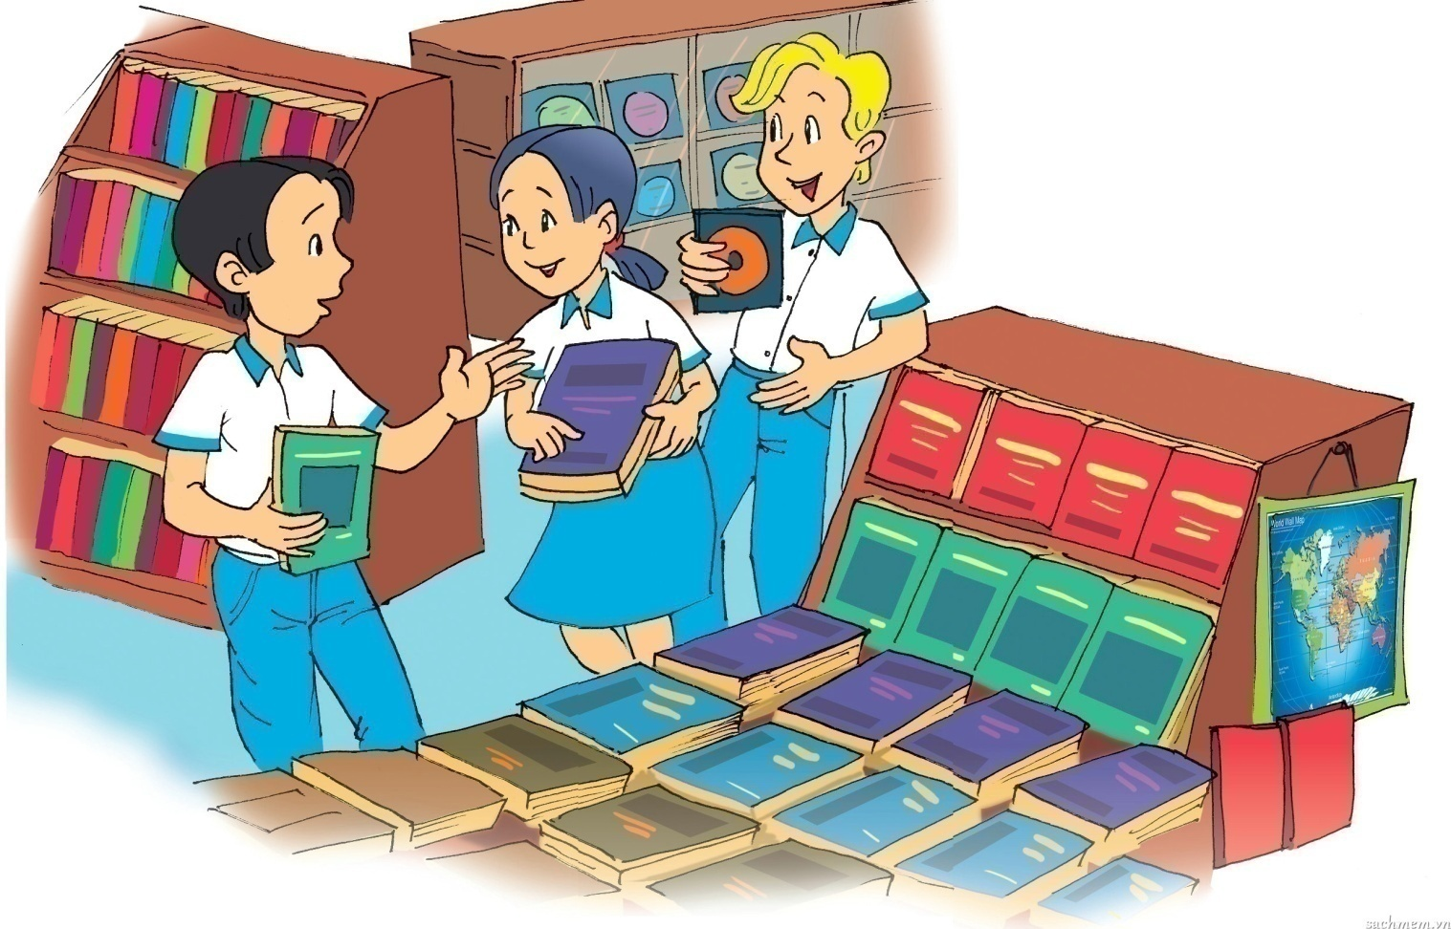
CHATTING
1. Where are Mai, Phuc and Nick?
2. What are they holding in their hands?
3.What do they like doing in their free time?

Slide 5
II. Listen and read
Mai: Check out this book, Phuc. ‘My Mini Guide to Dog Training’
Phuc: Sounds great! Max ‘ll like it too. Last weekend we lean some tricks. I love to watch him. It’s so much fun…Have you found your craft kit?
Mai: Yes, I’ve found this one. It’s got everything: beads, stickers, wool,button… I don’t kmow,it’ll take all my savings
Phuc: But it’s right up your street! Nick, what’s that?
Nick: It’s a CD folk songs.I’ll listen to it toinght.
Mai: And you’ll be able to improve your Vietnamese!
Nick: Ha ha, not sure about that. But think’ll enjoy listening to the melodies.
Phuc: Look at the language website I sent you. It’ll help you learn Vietnamese more easily.
Nick: Yes, I liked reading Doreamon comics while I was learning Japanese.
Phuc: Stop reading comics! I’ll bring you my favourite short story this Sunday when we play football.
Mai: Sorry, but we have to hurry. Mum and dad are waiting. We need to buy some tools to build a new house for Max this weekend.

Slide 6
a. Circle the corect answer.

Slide 7




1. Phuc, Mai and Nick are in a ________.
A
library
WHAT A PITY !
B
bookstore
PERFECT
C
sports club
SORRY !

Slide 8
2. Phuc is looking for a ___________.
A
book
PERFECT
B
dog
WHAT A PITY !
C
craft kit
SORRY !

Slide 9
3. Max is Phuc’s _______.
dog
A
PERFECT
cat
B
SORRY !
C
goldfish
WHAT A PITY !

Slide 10
4. Mai has found a _________ for herself.
A
book
WHAT A PITY !
B
CD
SORRY !
C
craft kit
PERFECT

Slide 11
5. Nick’s CD is of ____.
A
folk music
PERFECT
B
pop music
SORRY !
C
rock music
WHAT A PITY !

Slide 12
6. Nick is trying to learn ______.
A
Japanese
SORRY !
B
Vietnamese
PERFECT
C
English
WHAT A PITY !

Slide 13
b. Tick the boxes. Then find the information from the conversation to explain your choice. (Ex. b/ p. 7)
 | PHUC | MAI | NICK
Pet training
Making crafts
Reading
Listening to music
Learning languages
Playing sports
Helping parents with DIY projects










Slide 14
c. Answer the question.
1. What does Mai mean when she say ‘ Check out this book ’?
Mai means Phuc should examine this book.
2. What does Phuc mean when he say ‘ It’s right up your street!’?
He means that it is the thing that Mai enjoys.

Slide 15

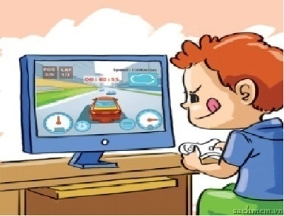
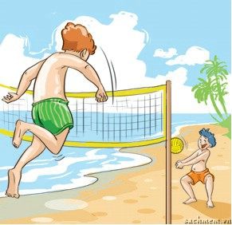
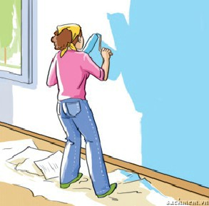
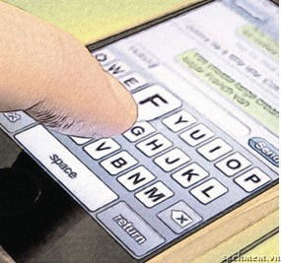
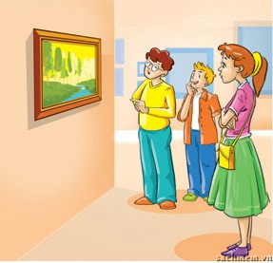
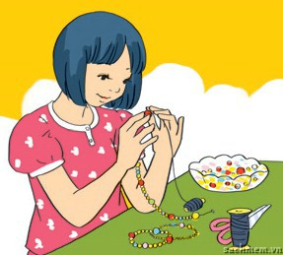
WARM UP
Find words or phrases in the box to describe the photos. Then listen to check the answers.
Playing beach games
Playing football
Making crafts
Texting
Playing computer games
Visiting museums
Doing DIY
1
2
3
4

Slide 16
3. Complete the following sentences with words in the box.
good relaxing fun
satisfied exciting boring
1. You do leisure activities in your free time and they make you feel_________________.
2. You can do ___________ activities such as yoga or ___________ ones such as mountain biking or skateboarding.
3. Hobbies such as making crafts or collecting things are _________.
4. You can surf the internet but some people say this is ___________.
5. You can spend time with family and friends, or become a volunteer for the community. This will make you feel _________________.
good / satisfied
relaxing
exciting
fun
boring
good / satisfied

Slide 17
Game: Changing partners
Choose one leisure activity from 2 or 3. In pair talk about it. Try to keep going for 1 minute each. When the time is up, find a new partner and talk about another activity.
You may:
+ describe the leisure activity
+ say if you have done it this activity or not
+ share your feelings about the activity
Suggested answer:
Playing computer games is one of my leisure activities. It is so exciting to play many kinds of games in computer. I like Pikachu, Angry Bird….They are very interesting. I feel so happy to play them.

Slide 18
IV. AT HOME
Learn by heart new words.
Practice dialogue with your friends.
Read the “learning trip” and do the ex. C / p. 7.
Be ready for A CLOSER LOOK 1.

Slide 19




The bye bye song
Bye, bye.
See you tomorrow.
Bye, bye.
See you tomorrow.
Bye, bye.
See you tomorrow.
Bye, bye. Bye, bye.
The bye bye
song
Notes:
19

