Slide 1

1.
Donate
_________ means give something to other people.
Recycle
2.
_________ means use something again to create a new one.
3.
Doing something special help you ____________
make a difference
4.
non-profit
Go green is a________ organisation.
Community service is the work you do for the_________ of the community.
5.
benefits

Slide 2
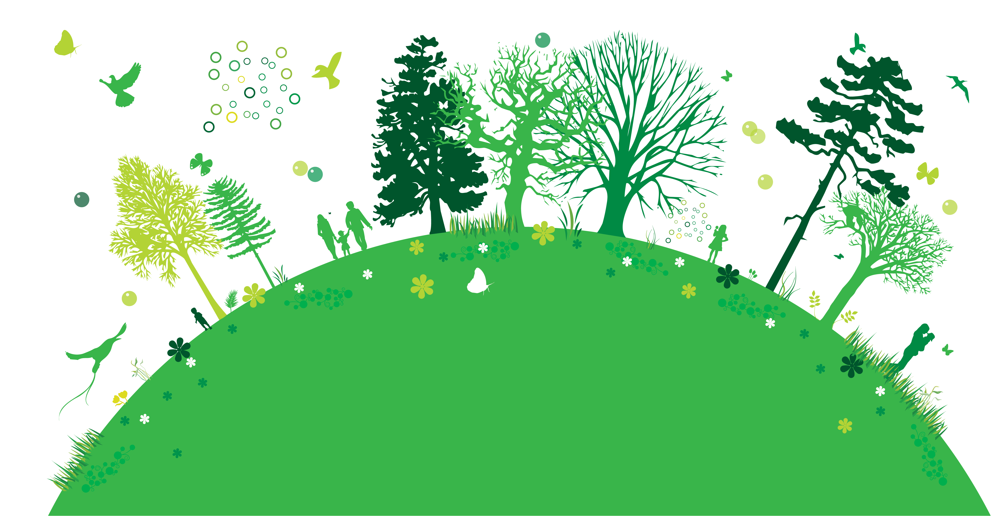
Unit 3. Community service
Period 16. lesson 2. A closer look 1

Slide 3
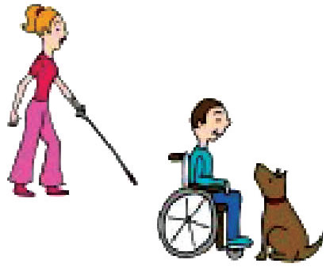
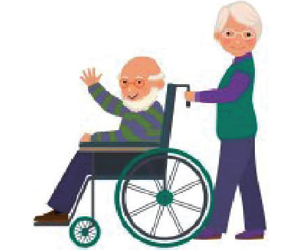
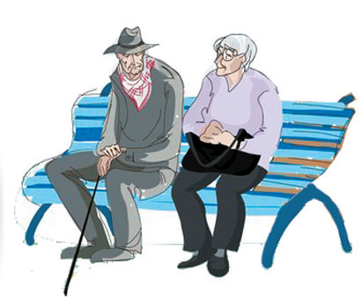
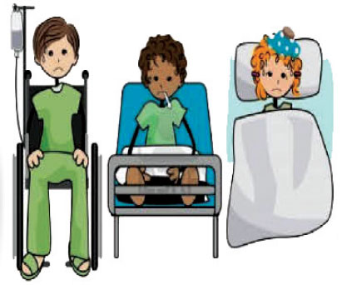
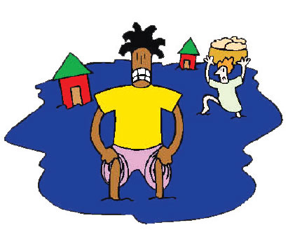
disabled people
elderly people
homeless people
sick children
people in a flooded area

Slide 4
Match the words in column A with their meanings in column B
Column A |  | Column B
Disabled people 2.Sick children 3.Homeless people 4.Elderly people 5.People in a flooded area |  | The kids who have sickness. People is very weak and old. People who have the house destroyed by flood. People who can’t go, hear, or speak. People who don’t have home

Slide 5
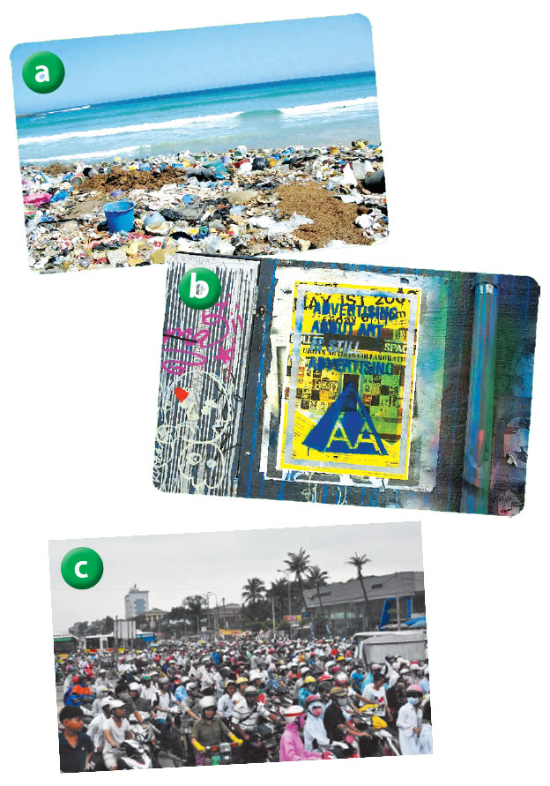
recycle rubbish
dirty beaches
clean the beach
clean the walls
penalise
graffiti
use public transports
traffic jams
widen the roads

Slide 6
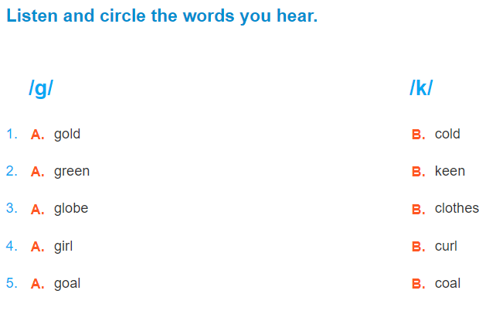

Slide 7
Homework: - learn by heart the new word - add 5 words with /g/ and /k/ sound - prepare for the next lesson

