Slide 1
Unit 3. My friends
Period 20. Lesson 2. Skills 2

Slide 2
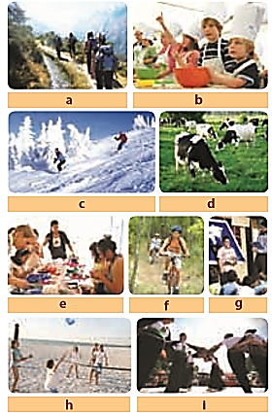
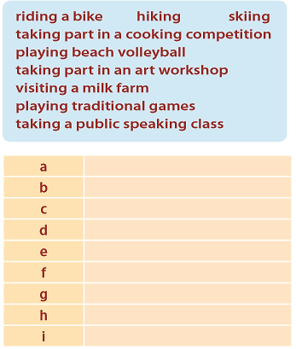
hiking
taking part in a cooking competition
skiing
visiting a milk farm
taking part in an art workshop
riding a bike
taking a public speaking class
playing beach volleyball
playing traditional game

Slide 3
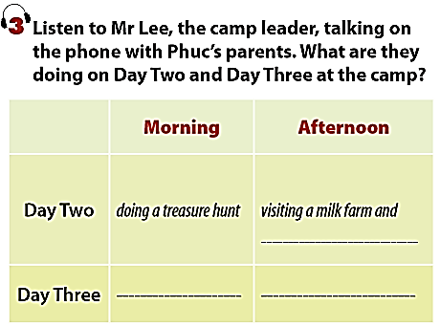
taking part in a public speaking class
taking part in the “Kids cook” contest
having a pool party

Slide 4




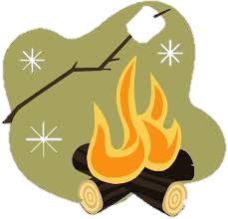
My name is Susan. I have a long black (1)_________ , big (2)________ and I am very friendly. My best friend is Linda. She has a short (3)___________ hair. She is kind. This weekend, we are visiting (4)_______ farm and having a (5)__________ at night.
hair
eyes
brown
milk
campfire

