Slide 1
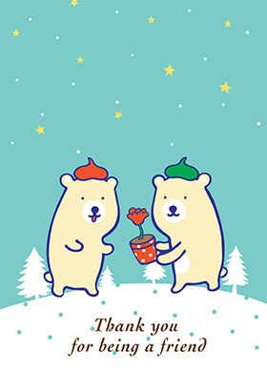
Unit 3. My friends
Period 16. Lesson 2. A closer look 1

Slide 2

arms
hair
face
Round/long
long/short
finger
tail
fur
hair
feet
Black/blonde/curly/straight
eyes
head
big/small
chubby
nose
shoulder
face
cheek
hand

Slide 3
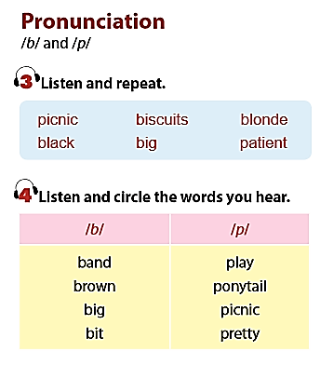

Slide 4
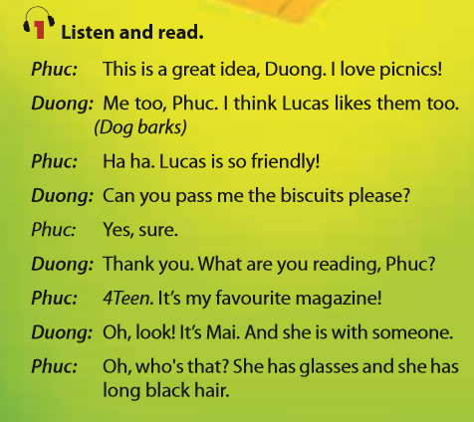

Slide 5
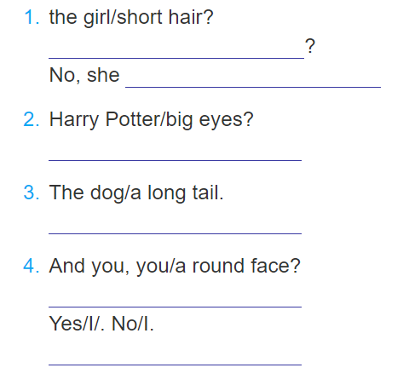
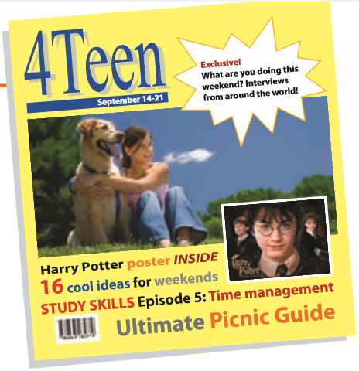
Does the girl have short hair?
doesn’t
Does Harry Potter have big eyes?
Does the dog have a long tail?
And you, do you have a round face?
Yes, I do/ No, I don’t

Slide 6
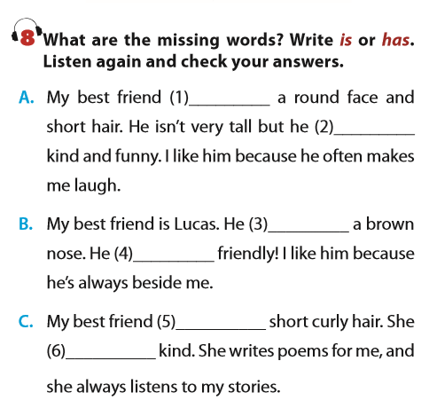
has
is
has
is
has
is

Slide 7
Homework:
learn by heart the new words
write 5 sentences to describe yourshelf
prepare for the next lesson

