Slide 1


Welcome to our class
English 5
English teacher: Cao Thi Dat

Slide 2

Thursday,24th, November,2016
Unit 8: What are you reading?
Lesson 1

Slide 3

Warm up:
How do you learn English?
How do you learn English?
How do you practise speaking?
I speak to my friends every day.

Slide 4

LUCKY NUMBER GAME LUCKY NUMBER GAME
LUCKY NUMBER GAME LUCKY NUMBER GAME
LUCKY NUMBER
1
6
2
5
7
3
4
continue

Slide 5



How do you practice reading English?
Question1
I read English short story.
1
2
3
4
5
BACK

Slide 6

Lucky Number
BACK

Slide 7
Question 2
Why do you learn English?
Because I want to talk to my foreign friends.
1
2
3
4
5
BACK

Slide 8
Question 3
How often do you have music?
A. One a week B. Once a week
B. Once a week
1
2
3
4
5
BACK

Slide 9
Lucky Number
BACK

Slide 10
Question 3
How do you practice listening to English?
I speak English everyday.
1
2
3
4
5
BACK

Slide 11
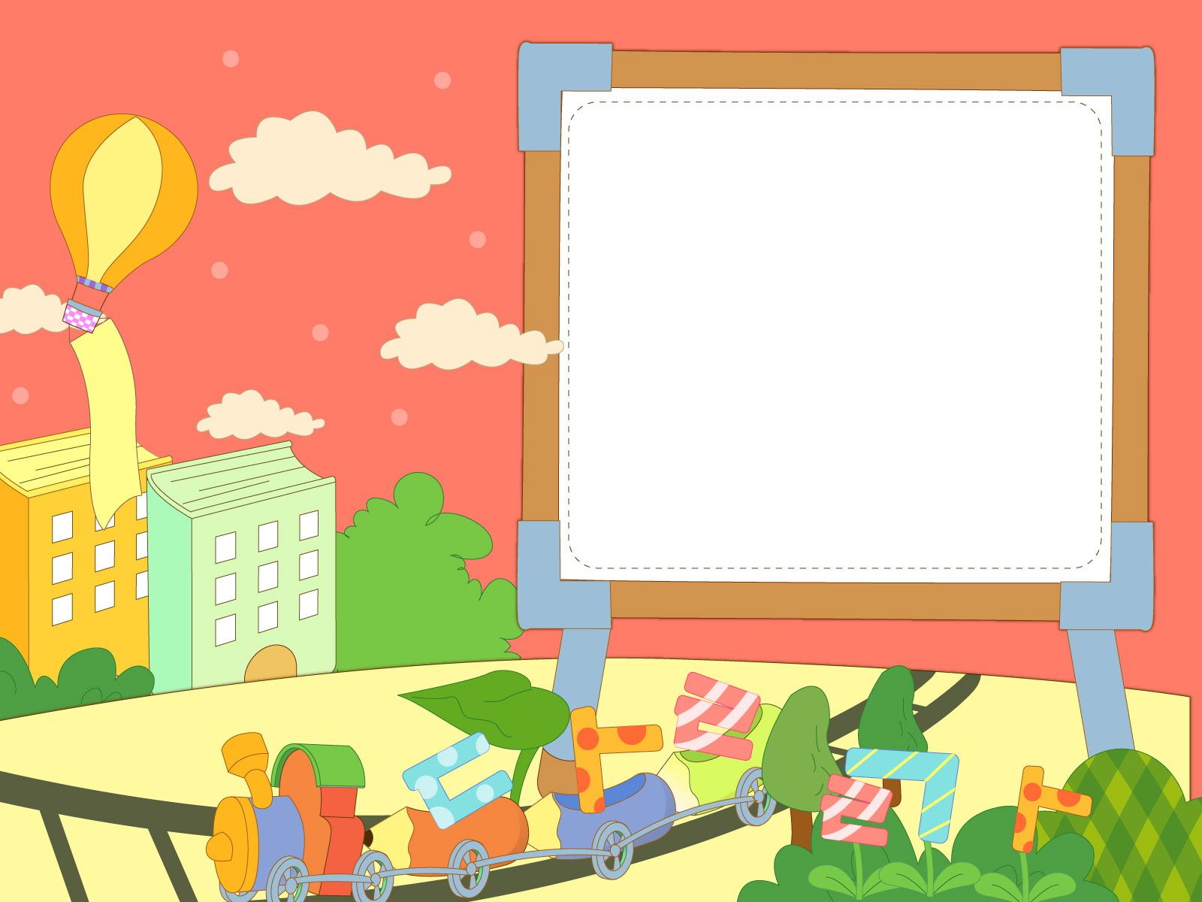
1.Vocabulary

Slide 12

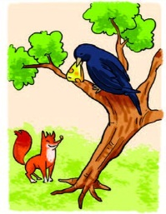
The Fox and the Crow

Slide 13

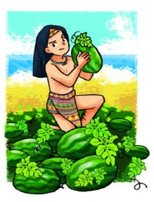
The story of Mai An Tiem

Slide 14

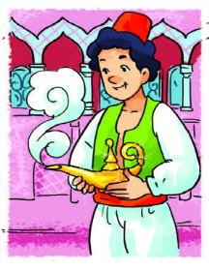
Aladdin and the Magic lamp

Slide 15

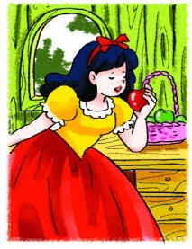
Snow White and the Seven Dwarfs

Slide 16
The Fox and the Crow
The Story of Mai An Tiem
Aladdin and the Magic Lamp
Snow White and the Seven Dwarfs

Slide 21

2. Look, listen and repeat

Slide 22
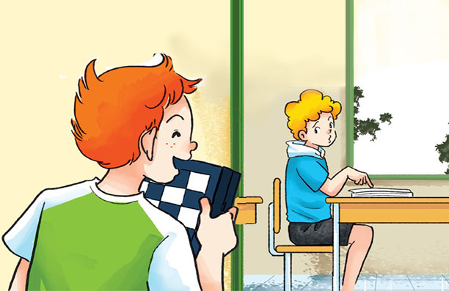
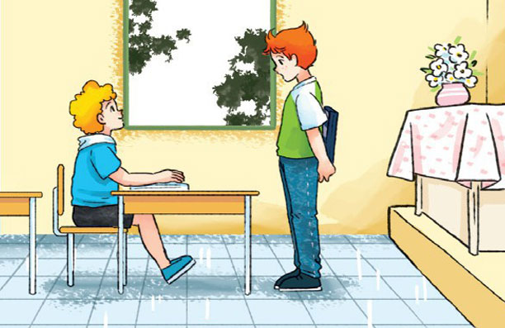
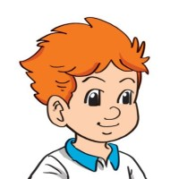

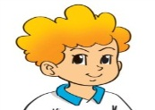
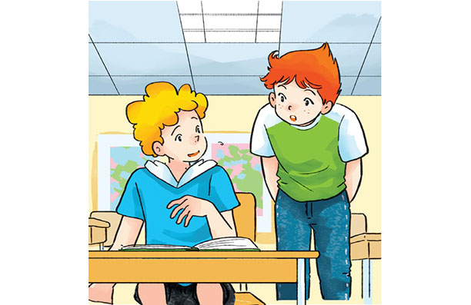
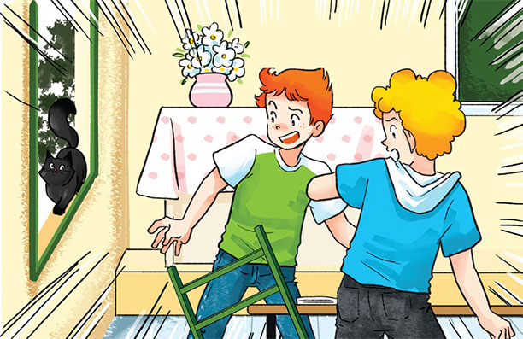
Hi, Peter. Let’s play chess.
What are you reading?
I can’t. I’m reading.
I’m reading a story about Halloween.
Is it a ghost story?
Is it a ghost?
Yes.Very scary.
Oh, no

Slide 23


Structure:
What are you reading?
I’m reading

Slide 24

Structure:
What are you reading?
I’m reading___________.
I’m = I am

Slide 25
Practice:

Slide 26
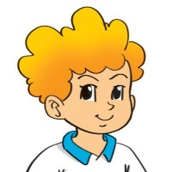
What are you reading?
I’m reading the Fox and the Crow.

