Slide 1


Welcome to class

Slide 2

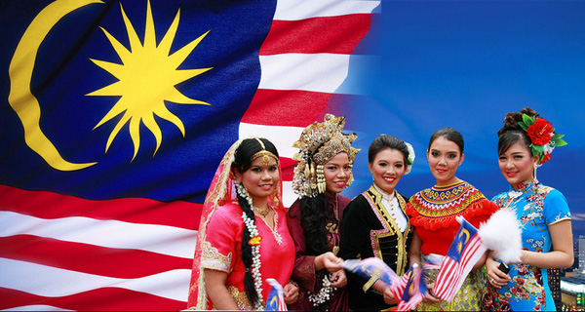
malaysian

Slide 3

American

Slide 4

Australian

Slide 5

Vietnamese

Slide 6
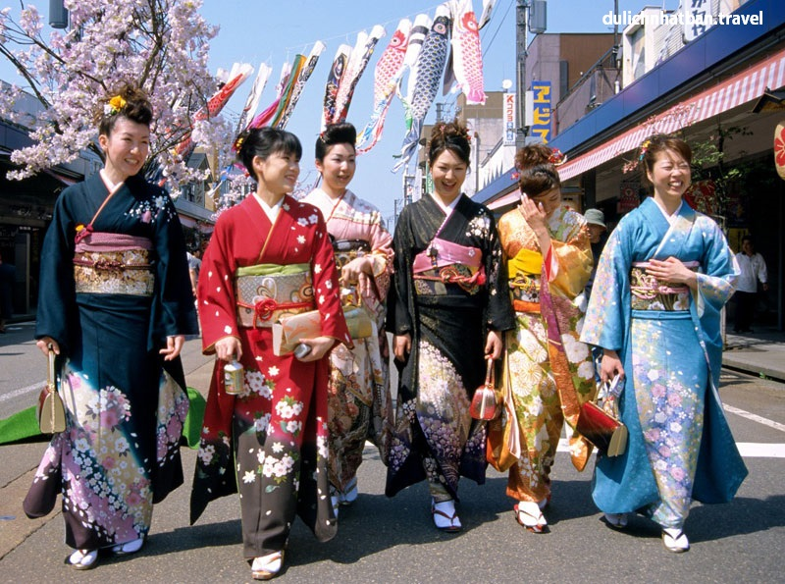
Japanese

Slide 7

English

Slide 8

I’m from Japan

Slide 9
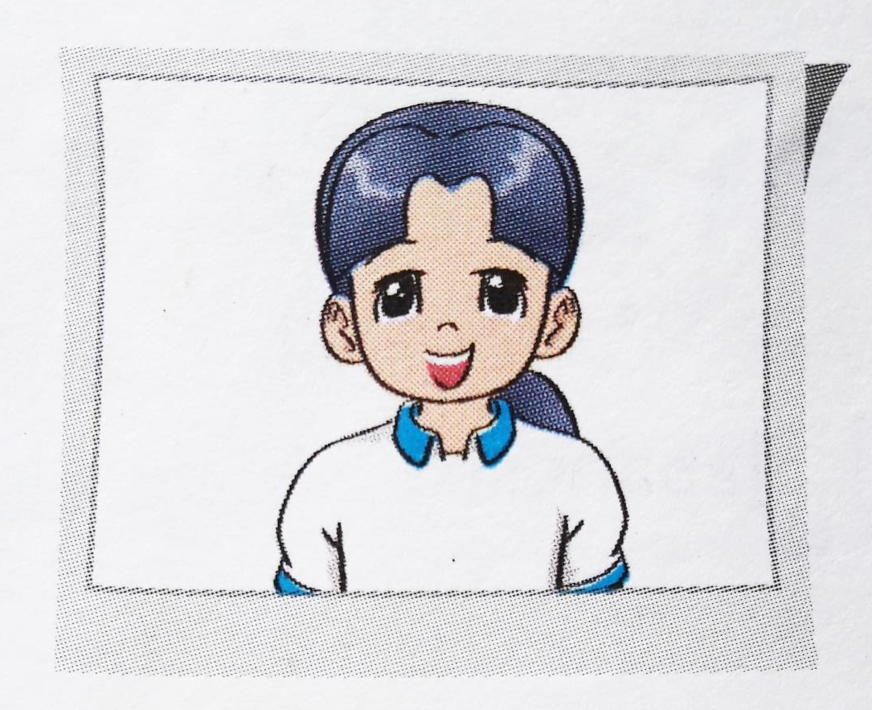

My name is Mai.
I am from .
I am .
Viet Nam
Vietnamese

Slide 10

2. My name is Tom.
I am from .
I am .
America
American
3. My name is Linda.
I am from .
I am .
England
English
4. My name is Akiko.
I am from .
I am .
Japan
Japanese

Slide 11
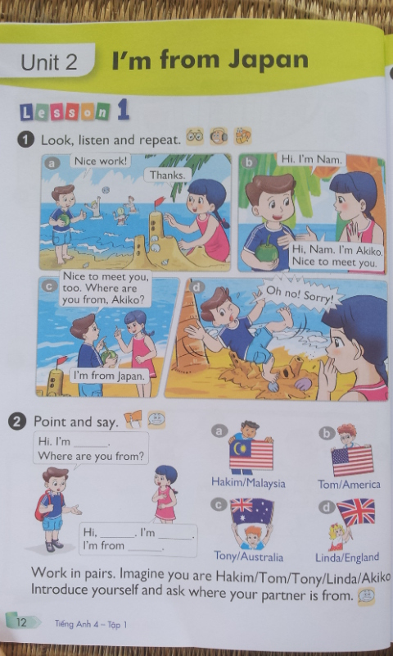
Hi. I’m Nam. Where are you from?
Hi, Nam. I’m Hakim. I’m from Malaysia

Slide 12
Hi. I’m Nam. Where are you from?
Hi, Nam. I’m Tom. I’m from America.

Slide 13
Hi. I’m Nam. Where are you from?
Hi, Nam. I’m Tony. I’m from Australia.

Slide 14
Hi. I’m Nam. Where are you from?
Hi, Nam. I’m Linda. I’m from England.

Slide 15

Let's play

Slide 16

anVetim
kTyoo
Tokyo
Vietnam
mAecair
lEgnnad
America
England

Slide 17
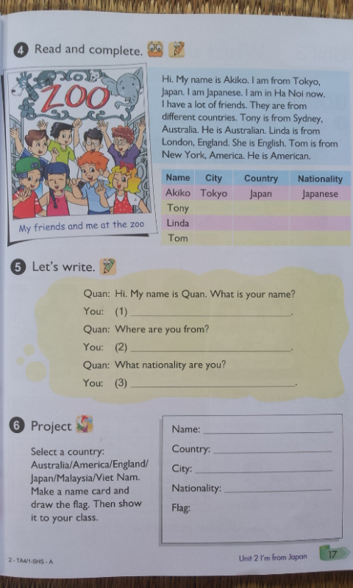
Sydney
Australia
Australian
London
England
English
New York
America
American

Slide 18

Goodbye
&
Thank you

