Slide 1


UNIT 18
What's your
phone number?
Lesson1

Slide 2
VOCABULARY

Slide 3
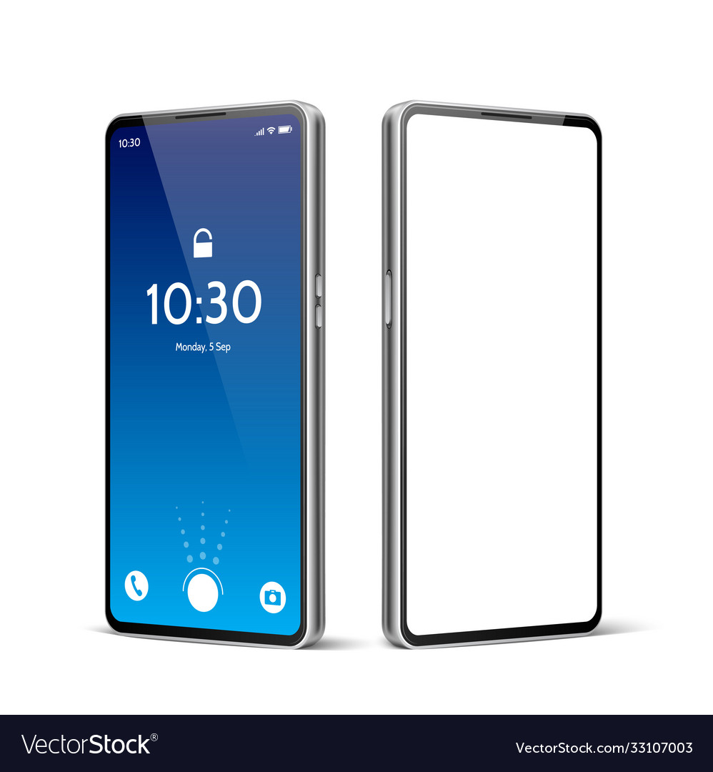
mobile phone
/ˌməʊbl ˈfəʊn/

Slide 4

phone number
/ˈfəʊn nʌmbər/

Slide 5
GRAMMAR

Slide 6
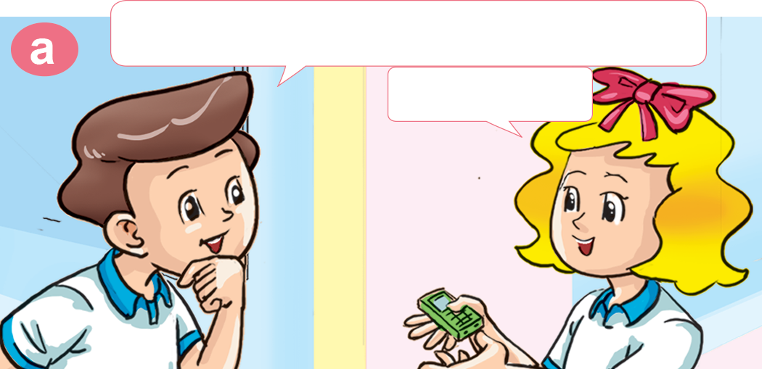
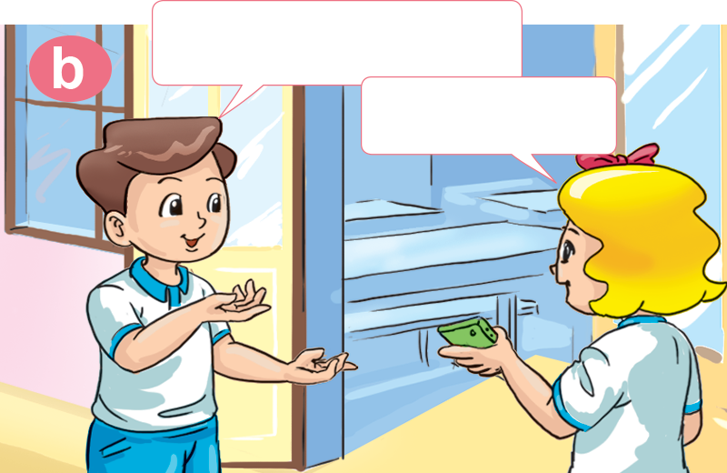

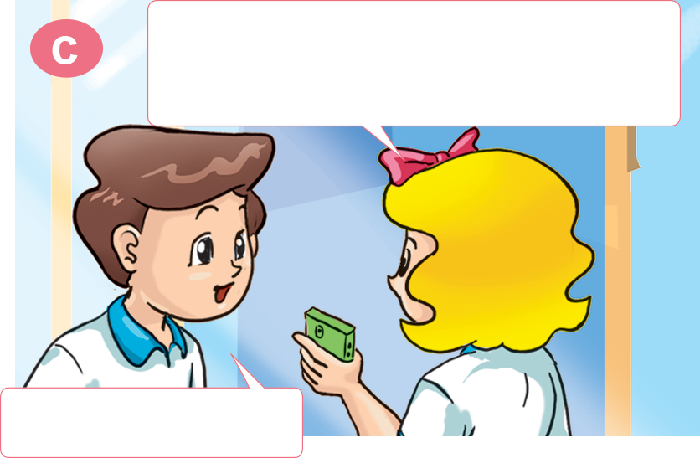

1. Look, listen and repeat
Wow! You have a mobile phone.
It's very nice!
Yes, I do.
Yes, it is.
It's a birthday present from my father.
What's your phone number?
That's great!
It's 0912 158 657.

Slide 7
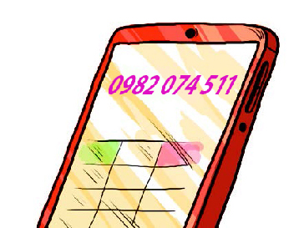
2. Point and say
What's ________ phone number?
It's ________________.
Lily's
0982 074 511

Slide 8

2. Point and say
What's ________ phone number?
It's ________________.
John's
0982 074 511

Slide 9
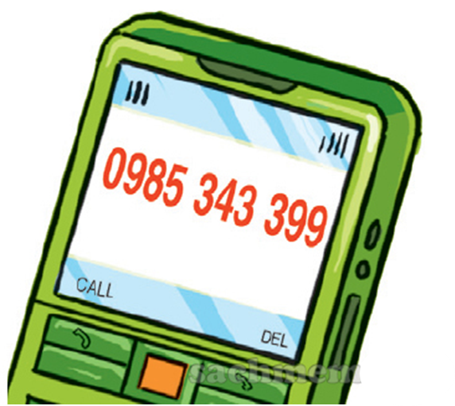
2. Point and say
What's ________ phone number?
It's ________________.
Saly's
0982 074 511

Slide 10
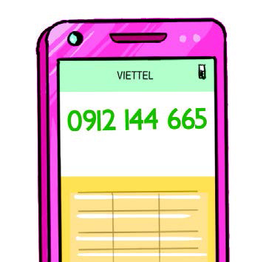
2. Point and say
What's ________ phone number?
It's ________________.
Sam's
0982 074 511

Slide 11

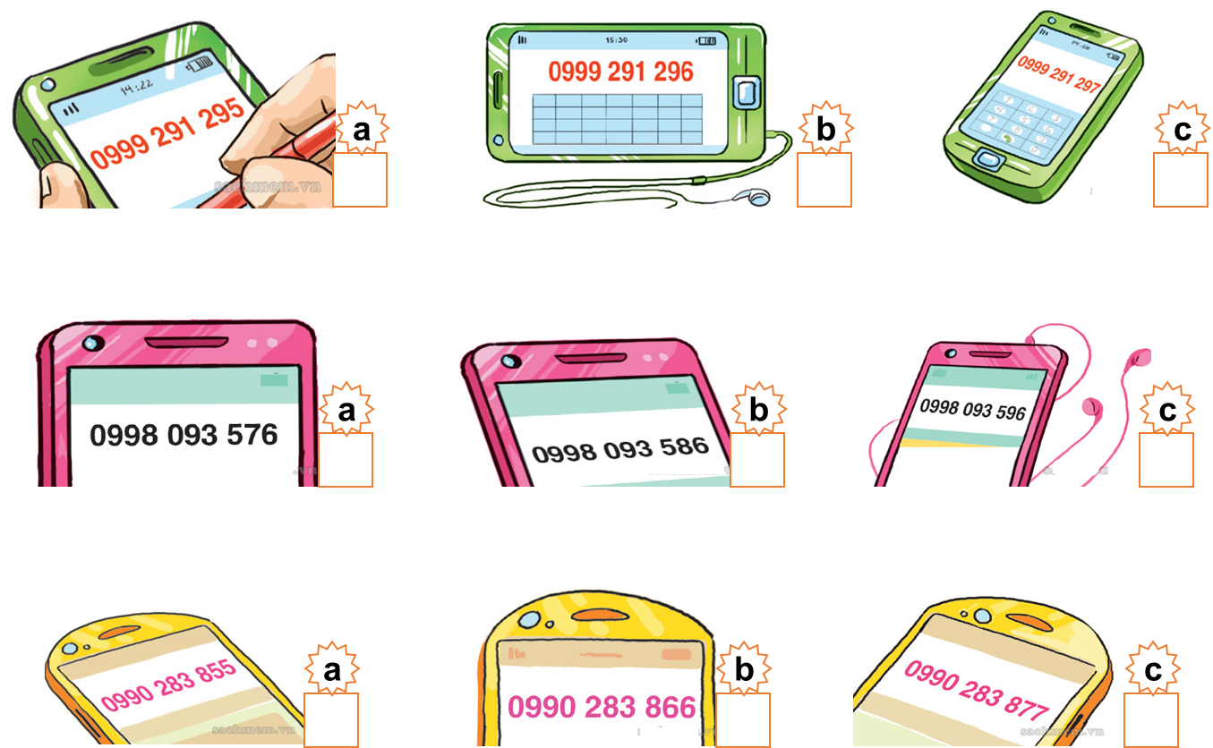

a
b
3. Listen and tick
1. What's Tom's phone number?
2. What's Mai's phone number?
3. What's Mr Loc's phone number?

Slide 12
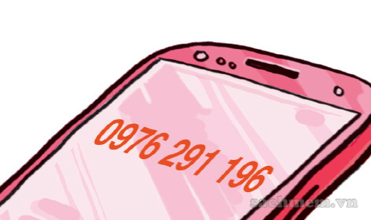
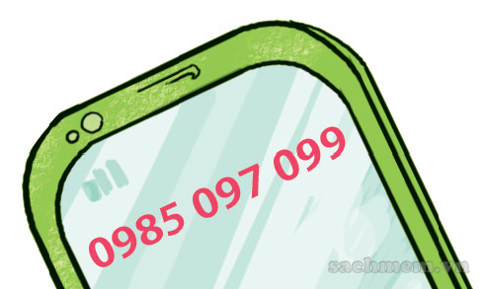
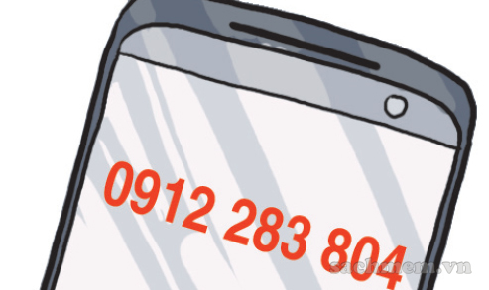
4. Look and write
What's Joe's phone number?
What's Ann's phone number?
What's Ben's phone number?
It's oh-nine-seven-six, two-nine-one, one-nine-six.
It's oh-nine-eight-five, oh-nine-seven, oh-nine-nine.
It's oh-nine-one-two, two-eight-three, eight-oh-four.

Slide 13





PRERENT WHEEL
10
50
30
30
20
Good job!
SPIN/STOP
SPIN/STOP
SPIN/STOP
SPIN/STOP
SPIN/STOP
SPIN/STOP
SPIN/STOP
SPIN/STOP
SPIN/STOP
SPIN/STOP
40
SPIN/STOP
60
60
40
20
30
10
50
Notes:
Ms Huyền Phạm - 0936.082.789 – YOUTUBE: MsPham. Facebook: Dạy và học cùng công nghệ.

Slide 14


What's Joe's phone number?
It's 0985 097 099
It's oh-nine-eight-five,
oh-nine-seven, oh-nine-nine.
It's 0985 097 098
Notes:
Ms Huyền Phạm - 0936.082.789 – YOUTUBE: MsPham. Facebook: Dạy và học cùng công nghệ.

Slide 15
What's Ann's phone number?
It's 097 291 196
It's oh-nine-seven-six,
two-nine-one, one-nine-six.
It's 0976 291 196
Notes:
Ms Huyền Phạm - 0936.082.789 – YOUTUBE: MsPham. Facebook: Dạy và học cùng công nghệ.

Slide 16
What's Mai's phone number?
It's 0998 093 496.
True
False
Notes:
Ms Huyền Phạm - 0936.082.789 – YOUTUBE: MsPham. Facebook: Dạy và học cùng công nghệ.

Slide 17
What's Ben's phone number?
It's 0911 283 804
It's oh-nine-one-two,
two-eight-three, eight-oh-four.
It's 0912 283 804
Notes:
Ms Huyền Phạm - 0936.082.789 – YOUTUBE: MsPham. Facebook: Dạy và học cùng công nghệ.

Slide 18
What’s your phone number?
____________________
My phone number
is 0912 144 655.
What’s Ben’s phone number?
What’s Mai’s phone number?
Notes:
Ms Huyền Phạm - 0936.082.789 – YOUTUBE: MsPham. Facebook: Dạy và học cùng công nghệ.

Slide 19
What's your phone number?
________________
His phone number is
0912 283 804
What's his phone number?
What's her phone number?
Notes:
Ms Huyền Phạm - 0936.082.789 – YOUTUBE: MsPham. Facebook: Dạy và học cùng công nghệ.

Slide 20
What’s is his phone number?
What’s is your phone number?
It's two million dong.
How much is the mobile phone?
Notes:
Ms Huyền Phạm - 0936.082.789 – YOUTUBE: MsPham. Facebook: Dạy và học cùng công nghệ.

Slide 21
How’s
________ Tom's phone number?
What
What is
Notes:
Ms Huyền Phạm - 0936.082.789 – YOUTUBE: MsPham. Facebook: Dạy và học cùng công nghệ.

Slide 22
Number phone
What's Linda's __________?
Mobile phone
It’s 0978 778 885.
Phone number
Notes:
Ms Huyền Phạm - 0936.082.789 – YOUTUBE: MsPham. Facebook: Dạy và học cùng công nghệ.

Slide 23
my
What's _____ phone number?
your
My phone number is
0934 558 442
her
Notes:
Ms Huyền Phạm - 0936.082.789 – YOUTUBE: MsPham. Facebook: Dạy và học cùng công nghệ.

Slide 24
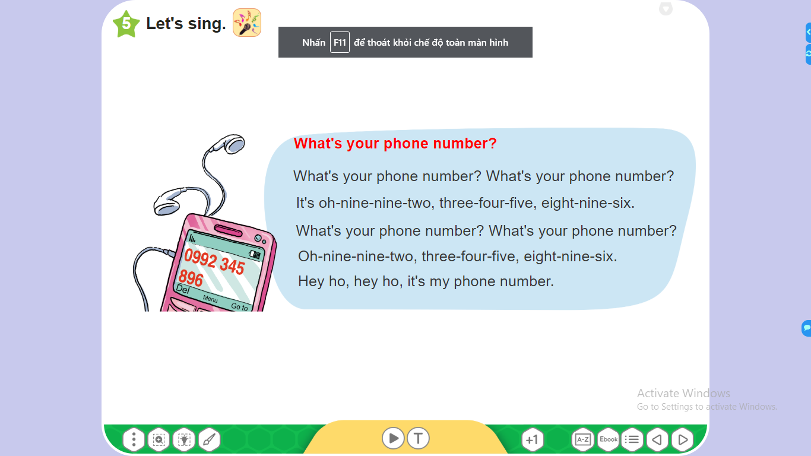
5. Let's sing

Slide 25
THANK YOU!

