Slide 1
Unit 18 – Lesson 3
What are you doing?

Slide 2
WARM-UP

Slide 3





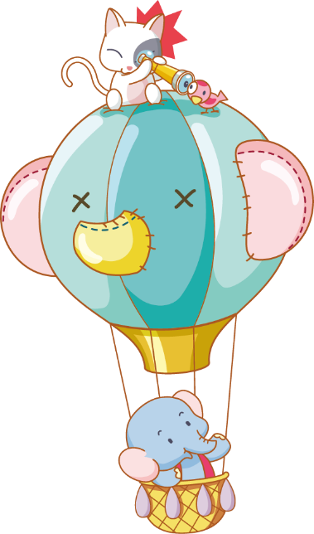


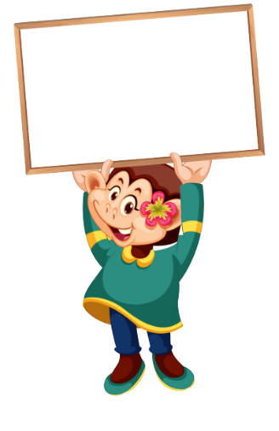




Luật chơi:
Chia lớp thành 2 đội
Bấm nút để quay, màu để dừng
Trả lời đúng được cộng điểm, nhường quyền trả lời cho đội bạn.
Kết thúc trò chơi đội nhiều điểm hơn sẽ chiến thắng.
PLAY
Notes:
Ms Huyền Phạm - 0936.082.789 – YOUTUBE: MsPham. Facebook: Dạy và học cùng công nghệ.

Slide 4





27
What are you doing?
20
I’m reading.
She’s reading.
A.
B.
QUESTION
He’s reading.
I reading.
C.
D.
Notes:
Ms Huyền Phạm - 0936.082.789 – YOUTUBE: MsPham. Facebook: Dạy và học cùng công nghệ.

Slide 5

10
What's she doing?
She singing.
She’s singing.
A.
B.
QUESTION
She’re singing.
He’s singing.
C.
D.
Notes:
Ms Huyền Phạm - 0936.082.789 – YOUTUBE: MsPham. Facebook: Dạy và học cùng công nghệ.

Slide 6
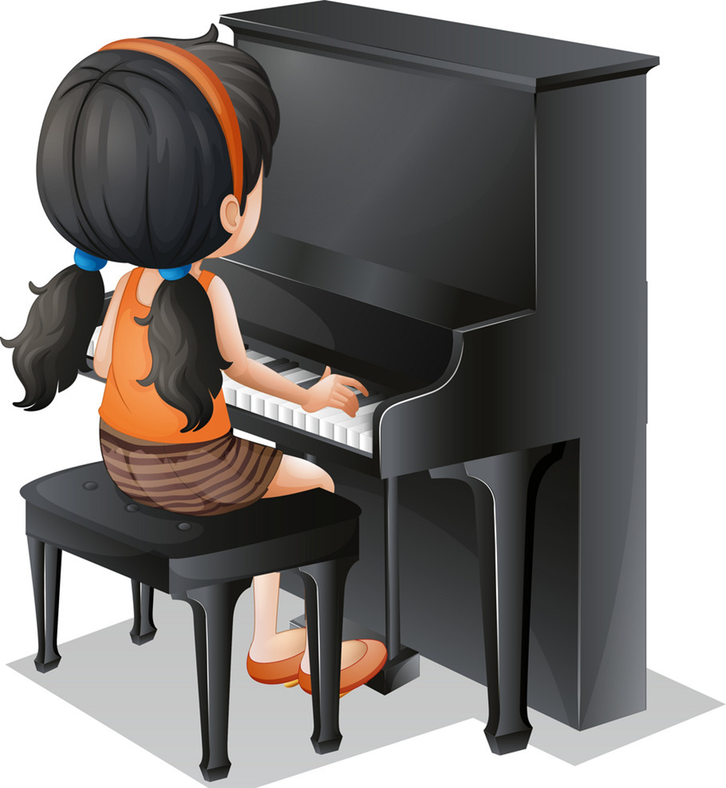
What's your friend doing?
10
He playing the piano.
She playing the piano.
A.
B.
QUESTION
He’s playing the piano.
She’s playing the piano.
C.
D.
Notes:
Ms Huyền Phạm - 0936.082.789 – YOUTUBE: MsPham. Facebook: Dạy và học cùng công nghệ.

Slide 7
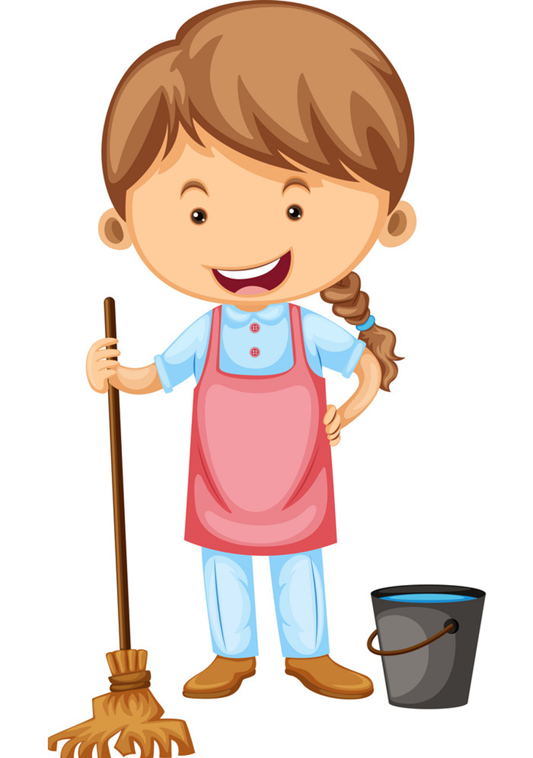
20
___________
She’s cleanning the house.
What she is doing?
What’s he doing?
A.
B.
QUESTION
What’s she doing?
What are you doing?
C.
D.
Notes:
Ms Huyền Phạm - 0936.082.789 – YOUTUBE: MsPham. Facebook: Dạy và học cùng công nghệ.

Slide 8

10
What's he doing?
She’s drawing.
They’re drawing.
A.
B.
QUESTION
He’s drawing.
I’m drawing.
C.
D.
Notes:
Ms Huyền Phạm - 0936.082.789 – YOUTUBE: MsPham. Facebook: Dạy và học cùng công nghệ.

Slide 9

20
_____________
She’s listening to music.
What’s your grandmother doing?
What’s your sister doing?
A.
B.
QUESTION
What’s your brother doing?
What’s your father doing?
C.
D.
Notes:
Ms Huyền Phạm - 0936.082.789 – YOUTUBE: MsPham. Facebook: Dạy và học cùng công nghệ.

Slide 10

What’s your sister ____?
She’s watching TV.
20
doing
going
A.
B.
QUESTION
do
go
C.
D.
Notes:
Ms Huyền Phạm - 0936.082.789 – YOUTUBE: MsPham. Facebook: Dạy và học cùng công nghệ.

Slide 11
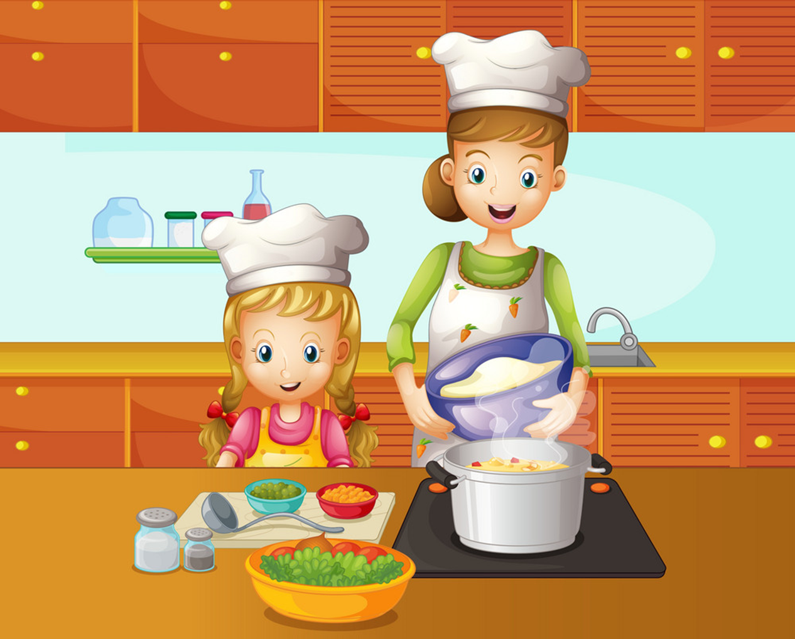
10
What are ____ doing?
They’re cooking.
they
she
A.
B.
QUESTION
you
he
C.
D.
Notes:
Ms Huyền Phạm - 0936.082.789 – YOUTUBE: MsPham. Facebook: Dạy và học cùng công nghệ.

Slide 12
What _______ doing?
I’m doing homework.
10
Is she
Is he
A.
B.
QUESTION
Are you
Are they
C.
D.
Notes:
Ms Huyền Phạm - 0936.082.789 – YOUTUBE: MsPham. Facebook: Dạy và học cùng công nghệ.

Slide 13
What is your brother doing?
_____ swiming.
10
She’s
He’s
A.
B.
QUESTION
I’m
They’re
C.
D.
Notes:
Ms Huyền Phạm - 0936.082.789 – YOUTUBE: MsPham. Facebook: Dạy và học cùng công nghệ.

Slide 14

Notes:
Ms Huyền Phạm - 0936.082.789 – YOUTUBE: MsPham. Facebook: Dạy và học cùng công nghệ.

Slide 15
PHONICS

Slide 16

drawing
She’s drawing a picture.
He’s reading.
reading
Listen and repeat.
ea | reading | He's reading.
aw | dawing | She's drawing a picture.

Slide 17
Listen and write.
1. My sister is __________.
2. Linda is ___________ in her room.
reading
drawing

Slide 18
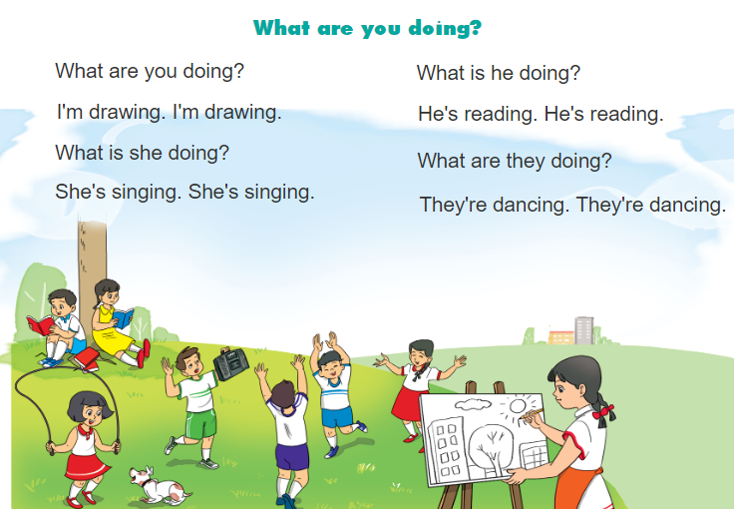

3. Let’s chan

Slide 19
PRACTISE

Slide 20
4. Read and complete.
playing
watching
is
listening
in
My name is Quan. Today my family (1) is at home. We are (2) in the living room. My father is (3) watching TV. My mother is (4) playing the piano. My brother is (5) listening to music and I am singing.
___
___
_______
_______
_______

Slide 21
5. Let's write
1. Where is Quan's family?
His family is at home.
2. What is his father doing now?
His father is watching TV.
3. What is his mother doing now?
His mother is playing the piano.
4. What is his brother doing now?
His brother is listening to music.
5. What is Quan doing now?
He is singing in his room.
My name is Quan. Today my family is at home. We are in the living room. My father is watching TV. My mother is playing the piano. My brother is listening to music and I am singing.

Slide 22
Project
Tell your classmates what they are doing.

Slide 23
Thank you!

