Slide 1
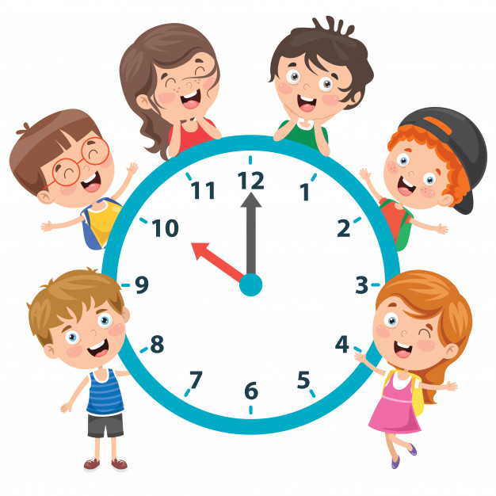
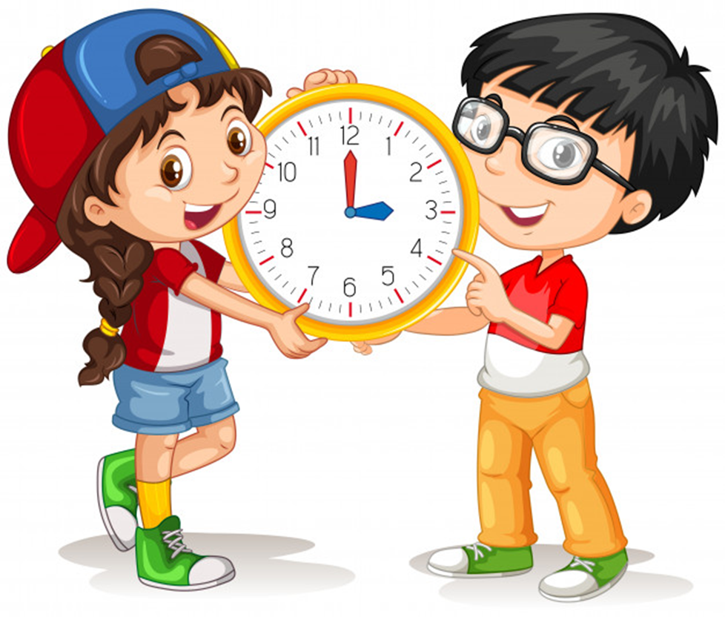
Unit 11
What time is it?
Lesson 1

Slide 2
WARM-UP

Slide 3
NUMBER

Slide 4



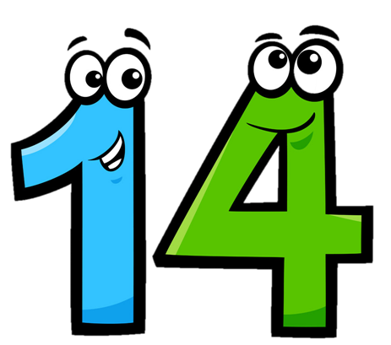
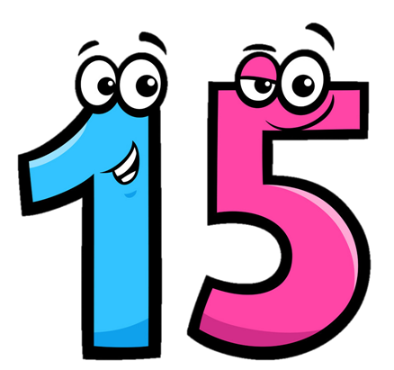
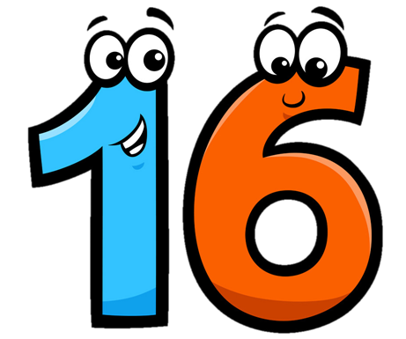
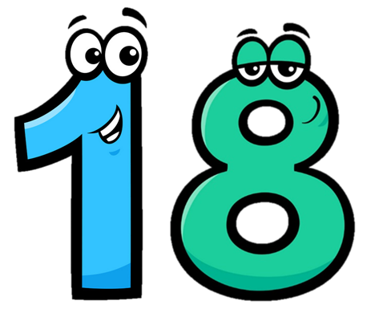



Eleven
/ɪˈlevn/
Twelve
/twelv/
Thirteen
/ˌθɜːˈtiːn/
Fourteen
/ˌfɔːˈtiːn/
Fifteen
/ˌfɪfˈtiːn/
Sixteen
/ˌsɪksˈtiːn/
Seventeen
/ˌsevnˈtiːn/
Eighteen
/ˌeɪˈtiːn/
Nineteen
/ˌnaɪnˈtiːn/
Twenty
/ˈtwenti/

Slide 5



Choose the correct number
a
b
c
Thirteen

Slide 6
Choose the correct number
a
b
c
fourteen

Slide 7
Choose the correct number
a
b
c
Fifteen

Slide 8
Choose the correct number
a
b
c
Sixteen

Slide 9
Choose the correct number
a
b
c
Seventeen

Slide 10
Choose the correct number
a
b
c
Eighteen

Slide 11
Choose the correct number
a
b
c
Nineteen

Slide 12
Look read and circle
Fifteen
Sixteen
Seventeen
Eleven
Thirteen
Twelve
Eighteen
Nineteen
Sixteen

Slide 13
Look read and circle
Fifteen
Thirteen
Eighteen
Eleven
Sixteen
Twelve
Fourteen
Fifteen
Sixteen

Slide 14
Look read and circle
Eleven
Nineteen
Eighteen
Twelve
Eleven
Thirteen
Fifteen
Fourteen
Twelve

Slide 15





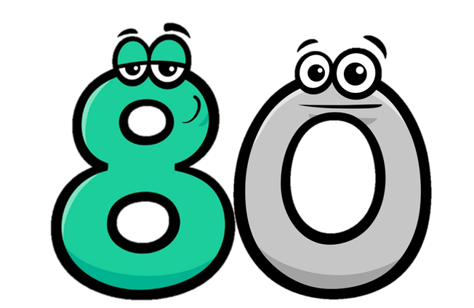

Twenty
/ˈtwenti/
Thirty
/ˈθɜːti/
Forty
/ˈfɔːti/
Fifty
/ˈfɪfti/
Seventy
/ˈsevnti/
Eighty
/ˈeɪti/
Ninety
/ˈnaɪnti/
Sixty
/ˈsɪksti/

Slide 16
Match
Forty
Thirty
Fifty
Twenty

Slide 17
Match
ninety
seventy
eighty
sixty

Slide 18
21
=
20
+
1
twenty-one
twenty
one
22
=
20
+
2
twenty-two
twenty
two

Slide 19
34
=
30
+
4
thirty-four
thirty
four
43
=
40
+
3
forty-three
forty
three

Slide 20
Look and say
15
fifteen
40
forty
20
twenty
45
forty-five
25
twenty-five
50
fifty
30
thirty
55
fifty-five
35
thirty-five

Slide 21

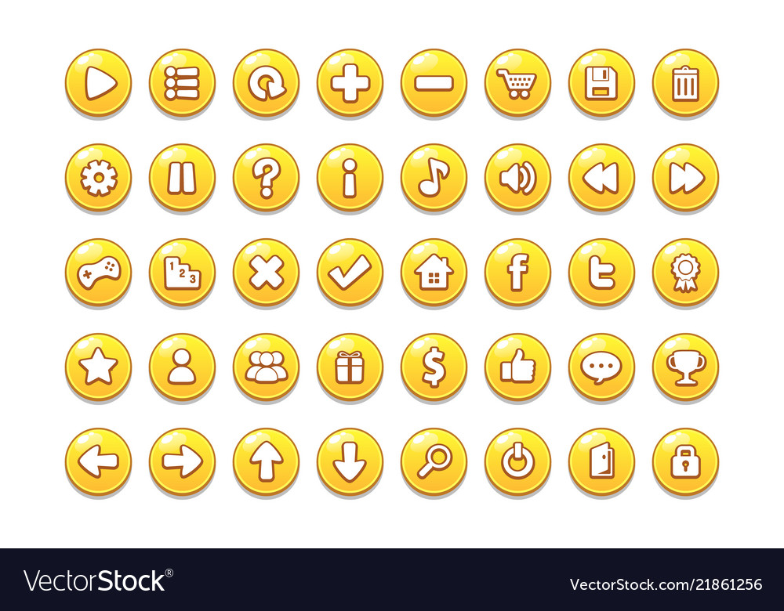


Slide 22
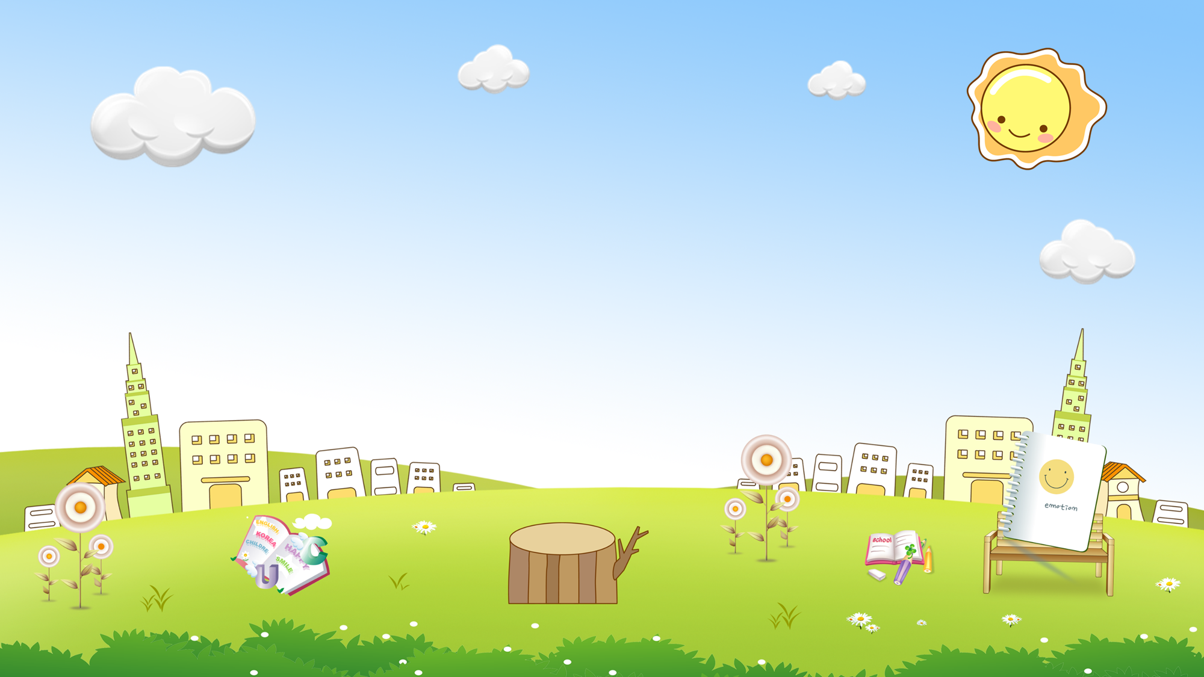










are
a. Thirteen b. Twelve
c. Eleven
a
b
c

Slide 23
old
a. Twoteen b. twenty
c. Twelve
a
b
c

Slide 24
you
a. Fifteen b. Fourteen
c. Fiveteen
a
b
c

Slide 25
old
a. Threeteen b. Thirteen
c. Thirty
a
b
c

Slide 26
are
a. Thirteen b. Twelve
c. Thirty
a
b
c

Slide 27
you
a. Fourteen b. Forteen
c. Fourty
a
b
c

Slide 28
are
a. Twelve b. Twenteen
c. Twenty
a
b
c

Slide 29
old
a. Fourty b. Forty
c. Fourteen
a
b
c

Slide 30
you
a. Fifty b. Fivety
c. Fifteen
a
b
c

Slide 31


are
a. Nine-two b. Nineteen-two
c. Ninety-two
a
b
c

Slide 32

old
a. Fifty b. Fifty-five
c. Fifteen
a
b
c

Slide 33


you
a. Eighty-six b. Sixteen
c. Eight-six
a
b
c

Slide 34


are
a. Seventeen b. Seventy
c. Seventy-three
a
b
c

Slide 35

old
a. Four-two b. Forty-two
c. Fourty-two
a
b
c

Slide 36

you
a. Thirty-one b. Eleven
c. Three-one
a
b
c

Slide 37


GOOD JOB!
STOP

Slide 38
GRAMMAR

Slide 39

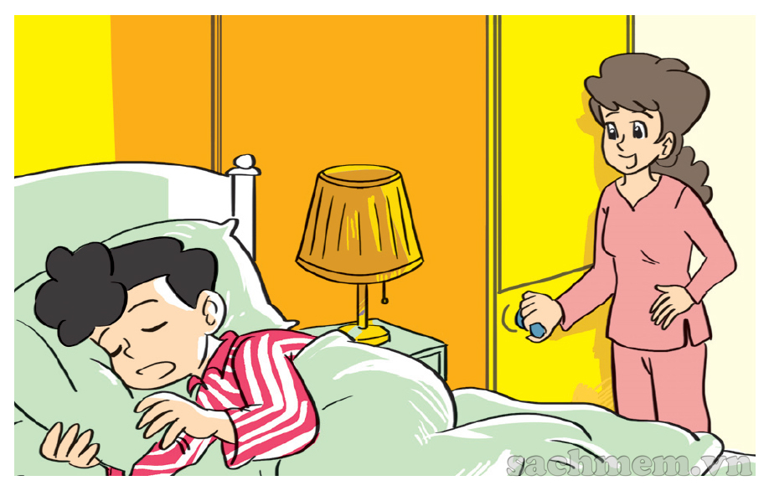
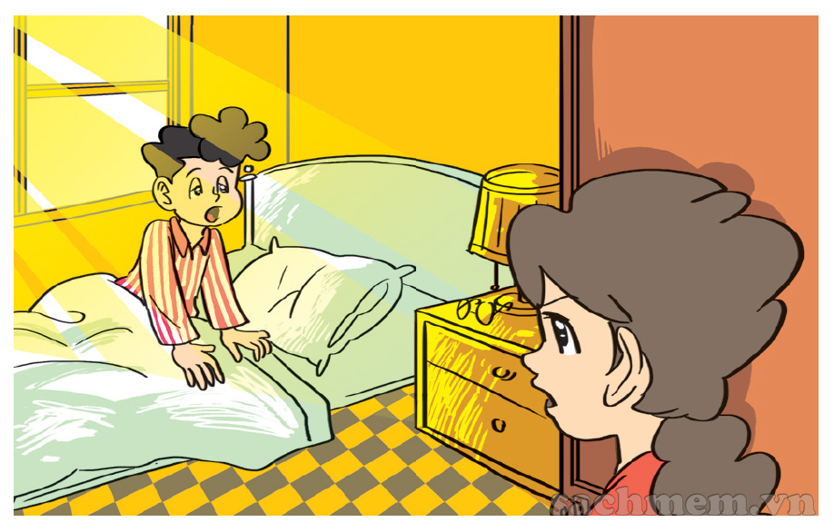
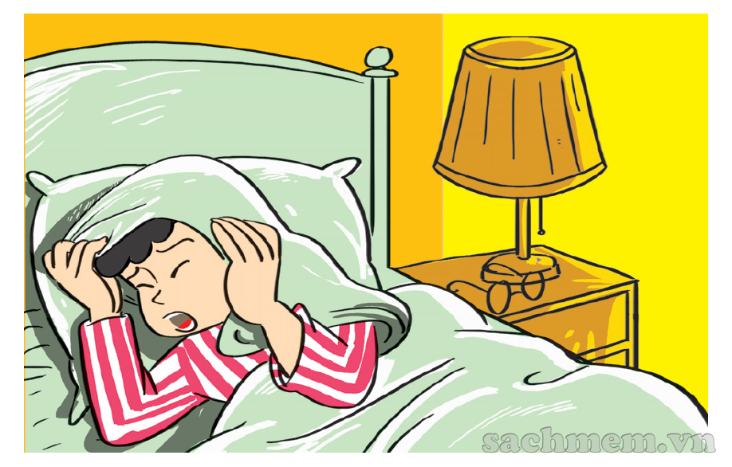
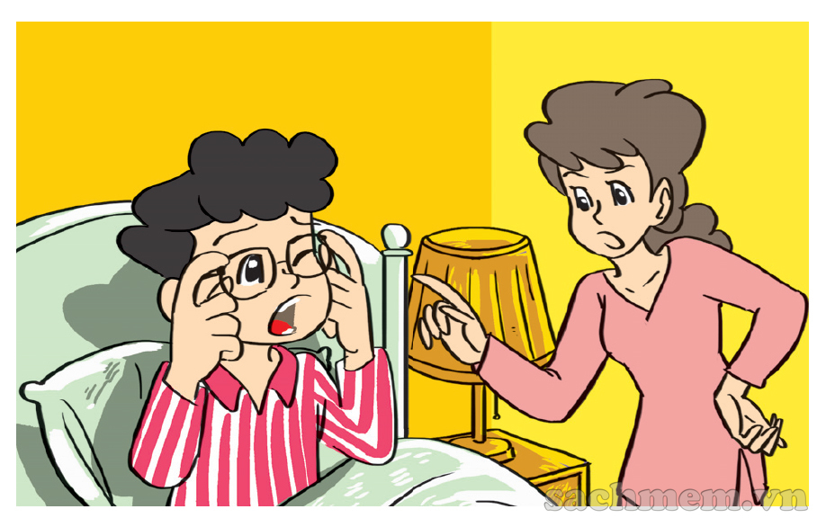
1. Look, listen and repeat.
What time is it, Mum?
It's time to get up, Phong.
It's seven o'clock
Today's Sunday and I
don't have to go to school.
But it's time
for breakfast.
Oh, yes, Mum.

Slide 40
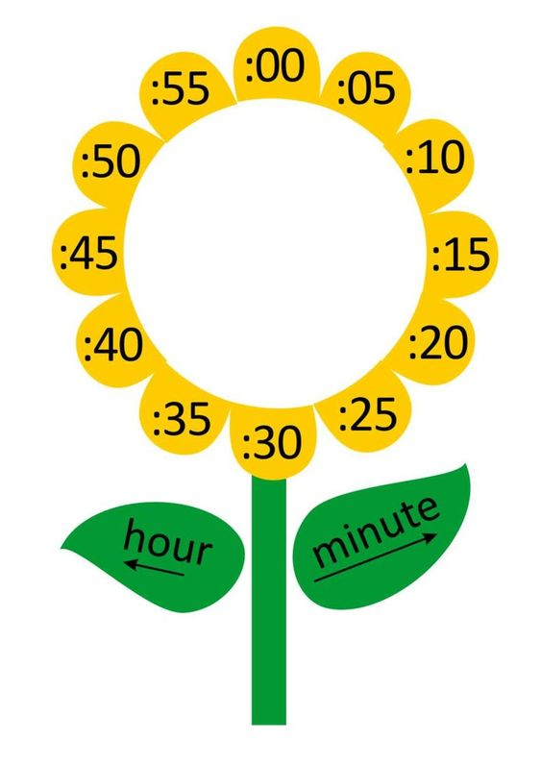
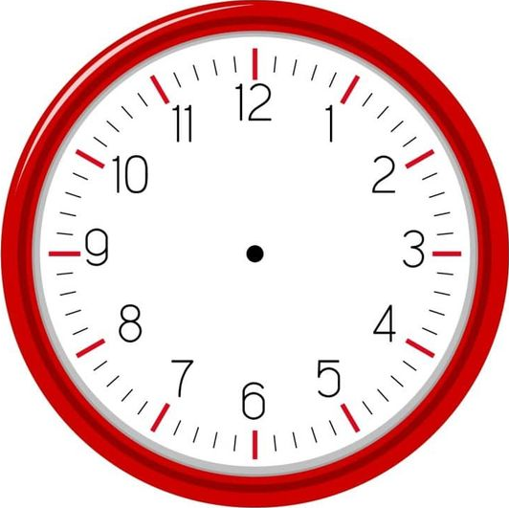

What time is it?
one
It's __________ o’clock.

Slide 41
What time is it?
two
It's __________ o’clock.

Slide 42
What time is it?
three
It's __________ o’clock.

Slide 43
What time is it?
six
It's __________ o’clock.

Slide 44
What time is it?
one
fifteen
It's _________________.

Slide 45
What time is it?
one
thirty
It's _________________.

Slide 46
What time is it?
one
forty
It's _________________.

Slide 47
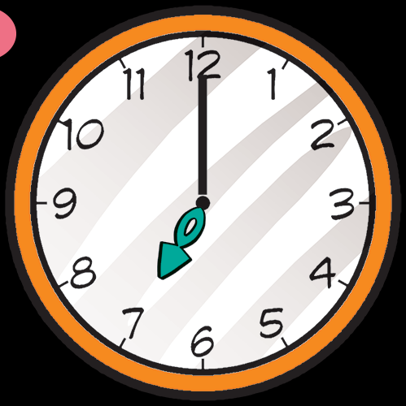
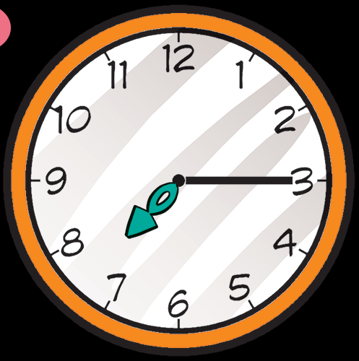
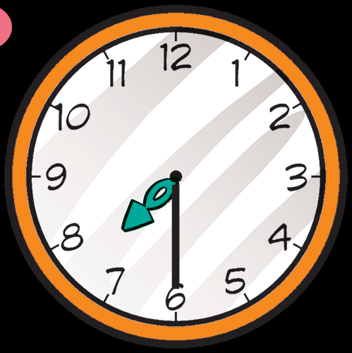
2. Point and say.
What time is it?
It's __________
It's __________
It's __________

Slide 48
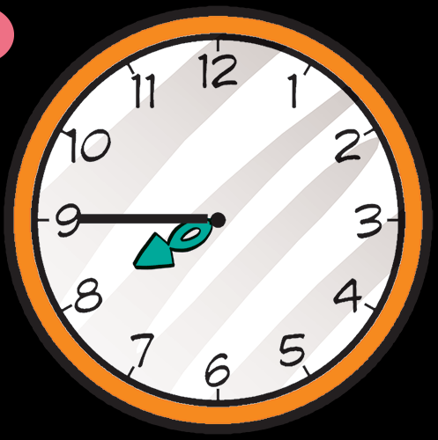
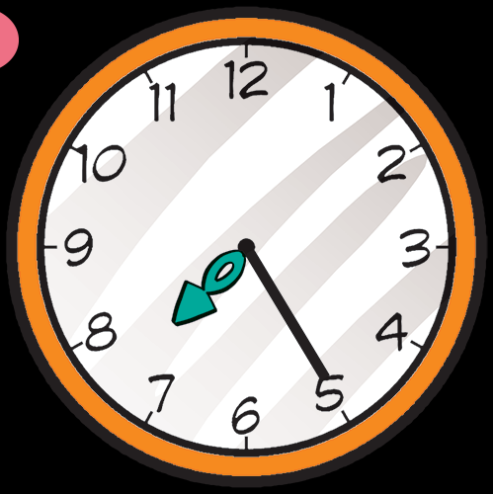
2. Point and say.
What tim is it?
It's __________
It's __________

Slide 49

3. Listen and tick.
a
b
c
1

Slide 50
3. Listen and tick.
a
b
c
1

Slide 51
3. Listen and tick.
a
b
c
1

Slide 52








Kiến chăm chỉ
PLAY

Slide 53

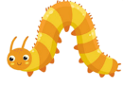


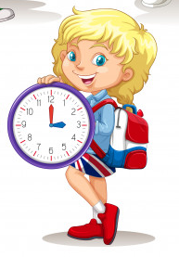



____________?
It’s three o’clock.
What time is it?
Next
Notes:
Ms Huyền Phạm - 0936.082.789 – YOUTUBE: MsPham. Facebook: Dạy và học cùng công nghệ.

Slide 54
What time is it?
It’s _________.
ten o’clock.
Next
Notes:
Ms Huyền Phạm - 0936.082.789 – YOUTUBE: MsPham. Facebook: Dạy và học cùng công nghệ.

Slide 55
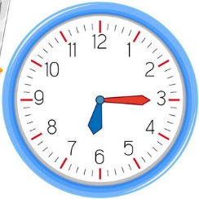
What time is it?
It’s _________.
Six fifteen
Next
Notes:
Ms Huyền Phạm - 0936.082.789 – YOUTUBE: MsPham. Facebook: Dạy và học cùng công nghệ.

Slide 56
_________ is it?
It’s six fifteen.
What time
Next
Notes:
Ms Huyền Phạm - 0936.082.789 – YOUTUBE: MsPham. Facebook: Dạy và học cùng công nghệ.

Slide 57
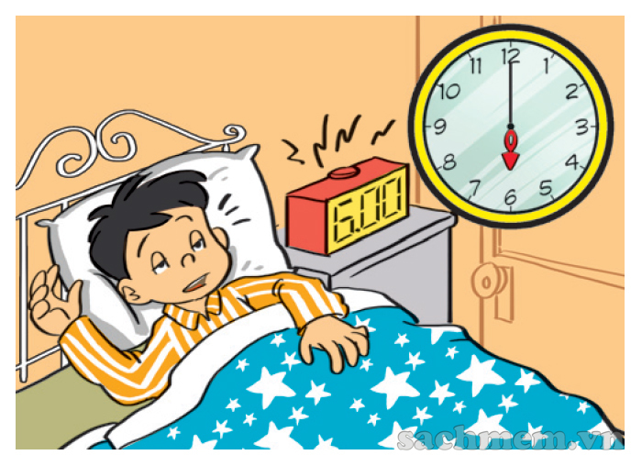
What time is it?
It’s six o’clock.
It’s twelve thirty.
It’s six o’clock.
Next
Notes:
Ms Huyền Phạm - 0936.082.789 – YOUTUBE: MsPham. Facebook: Dạy và học cùng công nghệ.

Slide 58
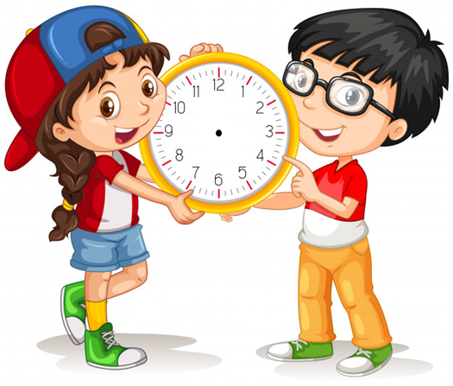
What time is it?
It’s ten thirty.
True
Fale
True
Next
Notes:
Ms Huyền Phạm - 0936.082.789 – YOUTUBE: MsPham. Facebook: Dạy và học cùng công nghệ.

Slide 59
What time is it?
It’s ten o’clock.
True
Fale
False
Next
Notes:
Ms Huyền Phạm - 0936.082.789 – YOUTUBE: MsPham. Facebook: Dạy và học cùng công nghệ.

Slide 60
Choose the correct number
a
b
c
Eleven

Slide 61
Choose the correct number
a
b
c
Twelve

Slide 62
WELL DONE!
EXIT
Notes:
Ms Huyền Phạm - 0936.082.789 – YOUTUBE: MsPham. Facebook: Dạy và học cùng công nghệ.

Slide 63
5. Look and write
What time is it?
What time is it?
It's four o’clock.
It's ten twenty.

Slide 64
5. Look and write
What time is it?
What time is it?
It's ten thirty.
It's eleven fifty.

Slide 65
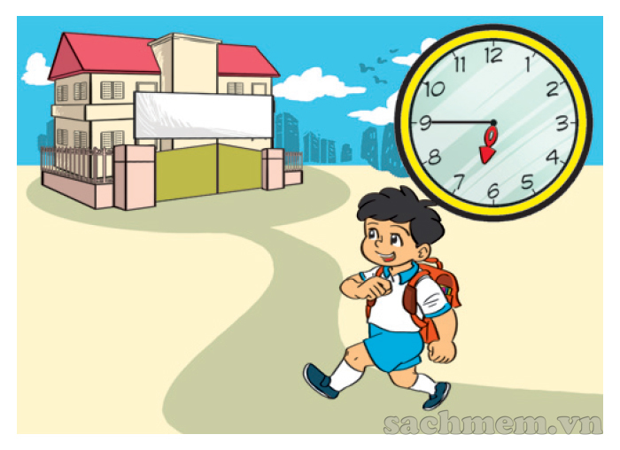
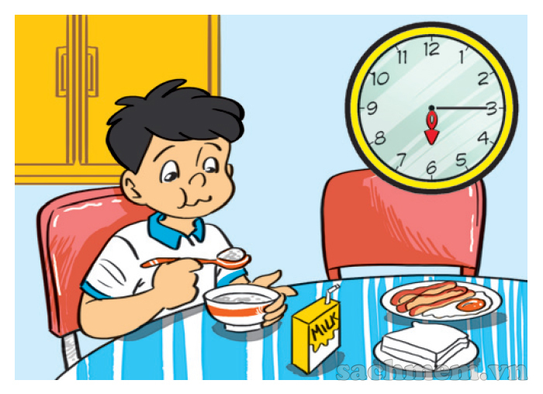
5. Let’s sing
1
2
3
a
b
c
What time is it?
It's six o'clock.
It's time to get up.
What time is it?
It's six fifteen.
It's time for breakfast.
What time is it?
It's six forty-five.
It's time for school.

Slide 66
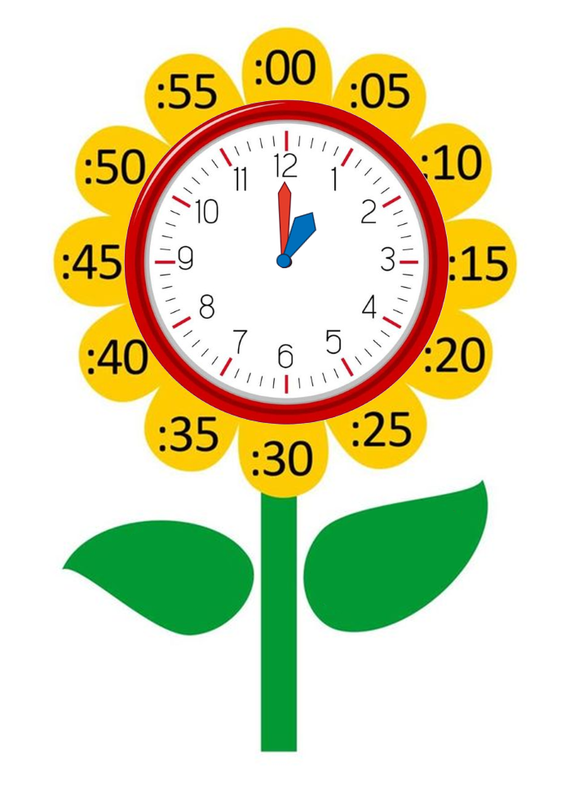
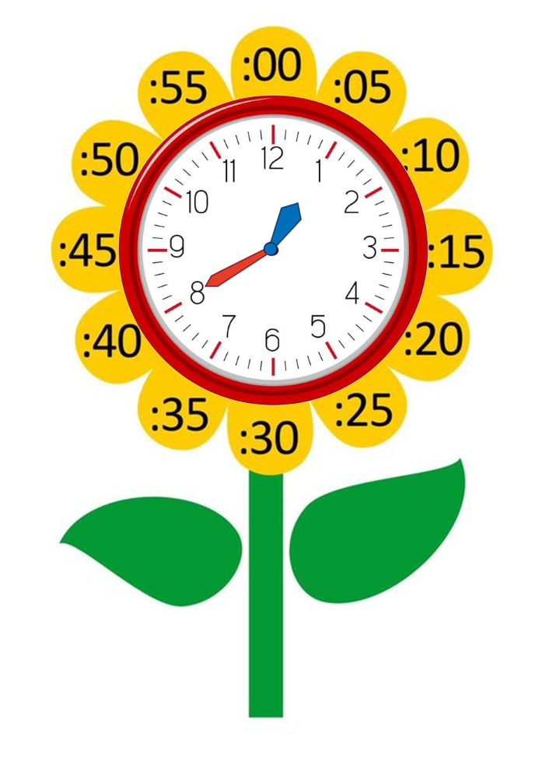
Model sentence
What time is it?
It's + số giờ + o’clock.
It's one o’clock.
It's + số giờ + số phút.
It's one forty.

Slide 67
Thank you!

