Slide 1


VU XUAN THIEU PRIMARY SCHOOL
Welcome
to my class
TEACHER:
NGUYEN THI MINH PHUONG

Slide 2



Slide 3

Monday, March 5th, 2018
UNIT 16:
Where’s the post office?
LESSON 1:
1 – 2 – 3

Slide 4
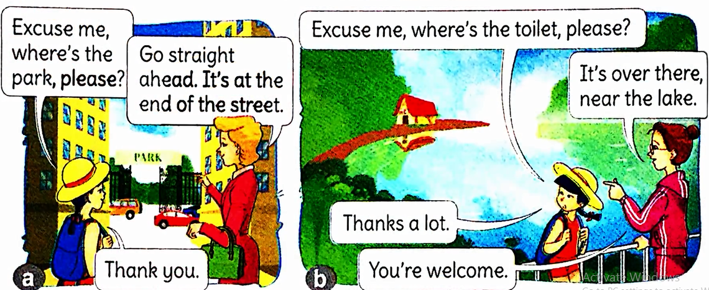
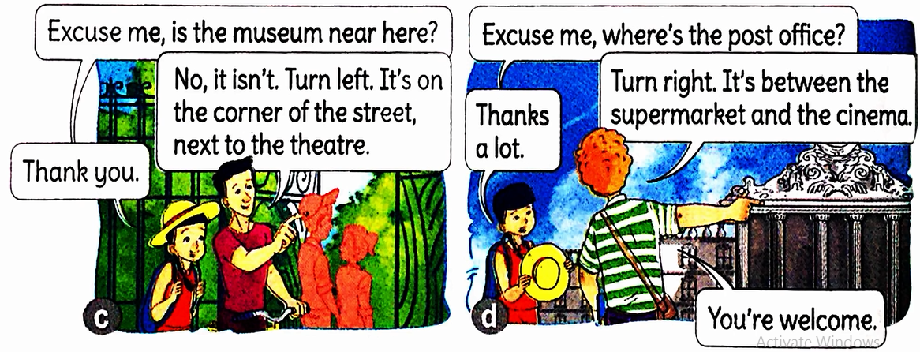

Slide 5


Slide 6
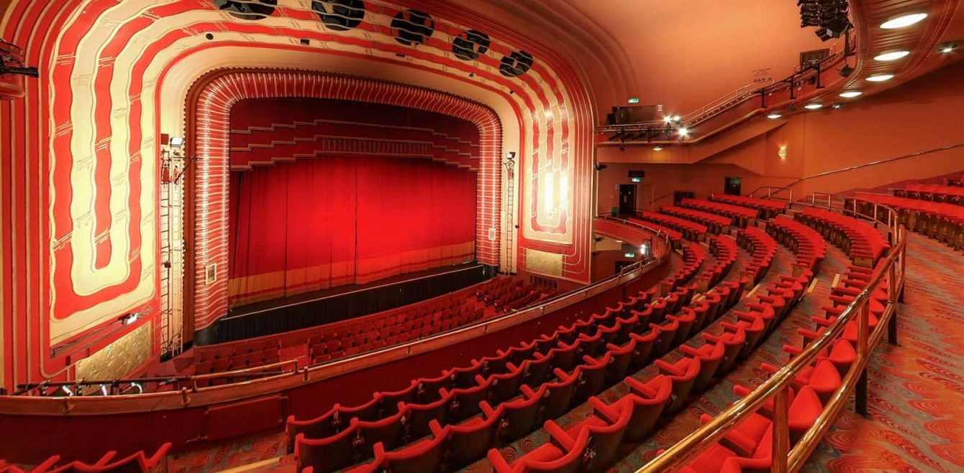
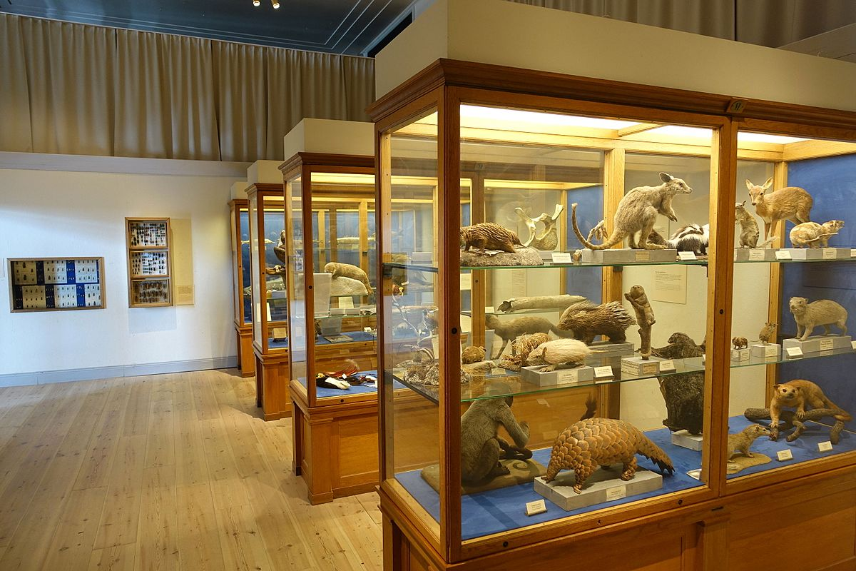
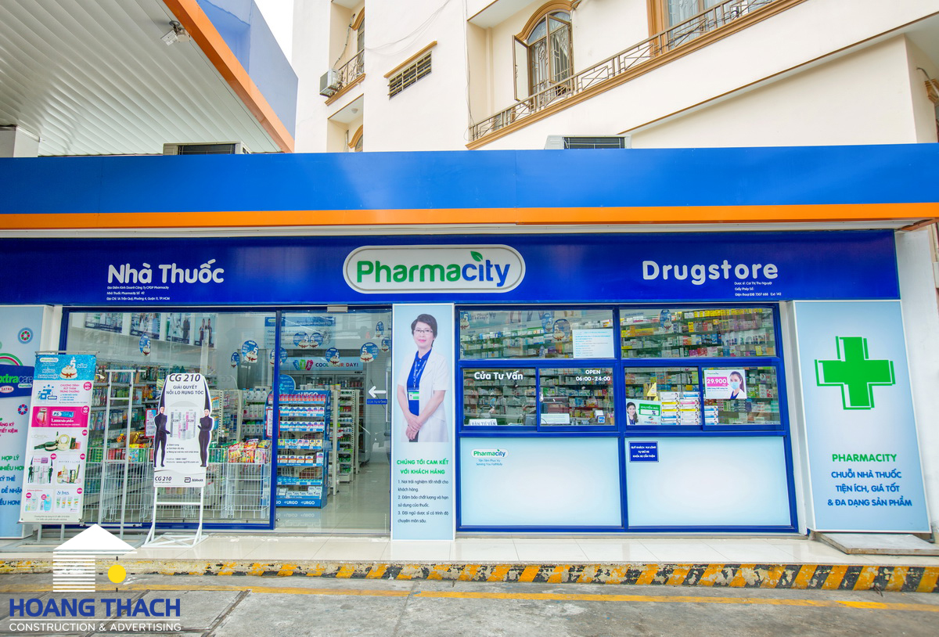
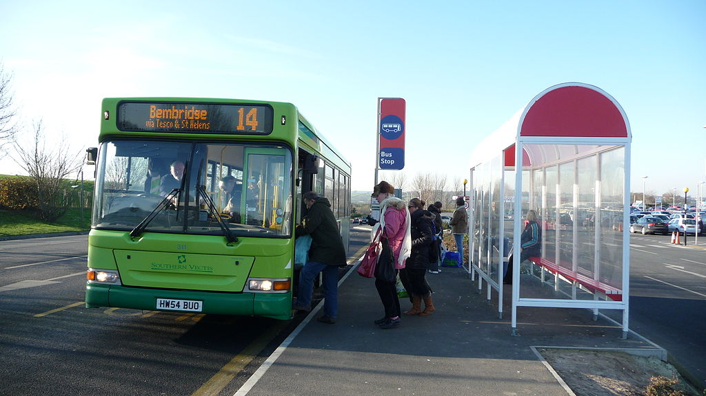
bus stop : điểm dừng xe buýt
pharmacy : tiệm thuốc
museum: viện bảo tàng
theatre : rạp hát

Slide 7

bus stop : điểm dừng xe buýt
pharmacy : tiệm thuốc
theatre : rạp hát
museum : viện bảo tàng

Slide 8
Check vocabulary
museum
rạp hát
theatre
tiệm thuốc
bus stop
viện bảo tàng
pharmacy
điểm dừng
xe buýt

Slide 9
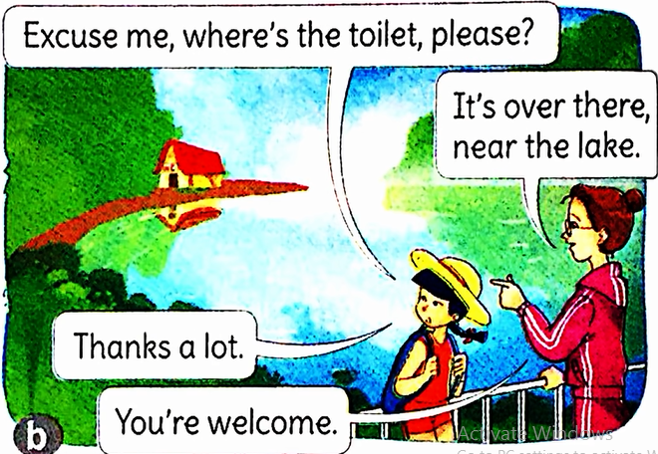
Sentence pattern:

Slide 10
Sentence pattern:
Excuse me, where’s the toilet, please?
It’s over there, near the lake.
Excuse me, where’s the ……….?
It’s…………………

Slide 11
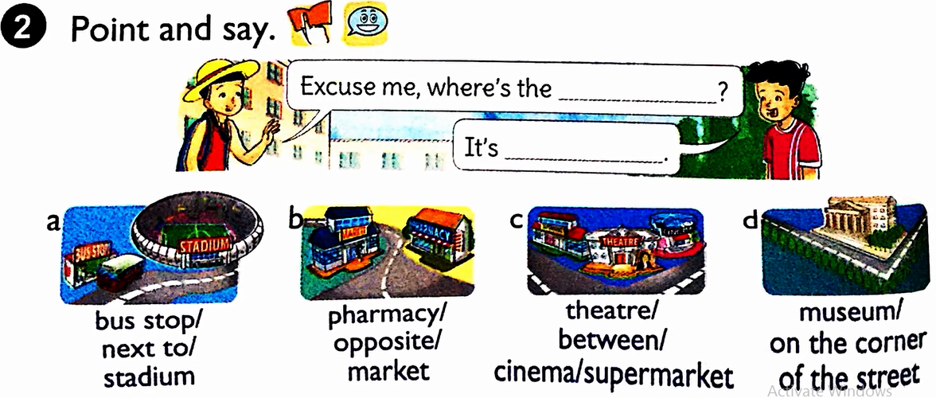
2. Point and say.
bus stop
next to the stadium

Slide 12
3. Let’s talk.
Where’s the ……….?
It’s next to/opposite…………
It’s between ……..and …..…
It’s on the corner of…………
Turn right/ left………………

Slide 13
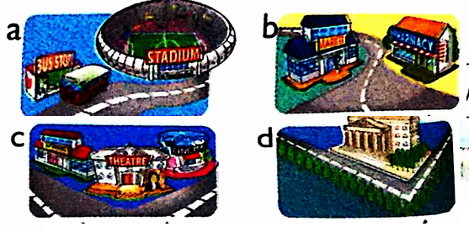
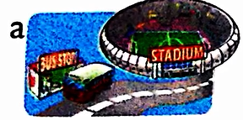
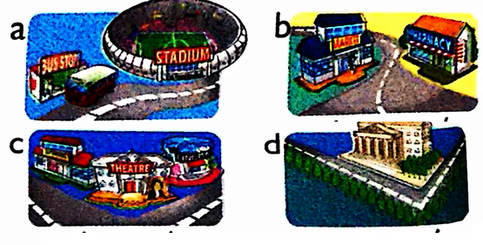
Where’s the ……….?
Where’s the stadium?
It’s near bus stop
It’s next to/opposite…………
It’s between ……..and …..…
It’s on the corner of…………
Turn right/ left………………

Slide 14
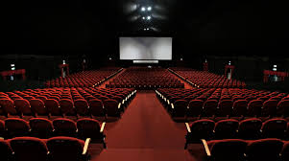
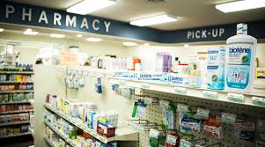


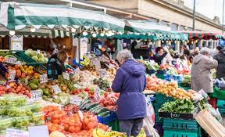
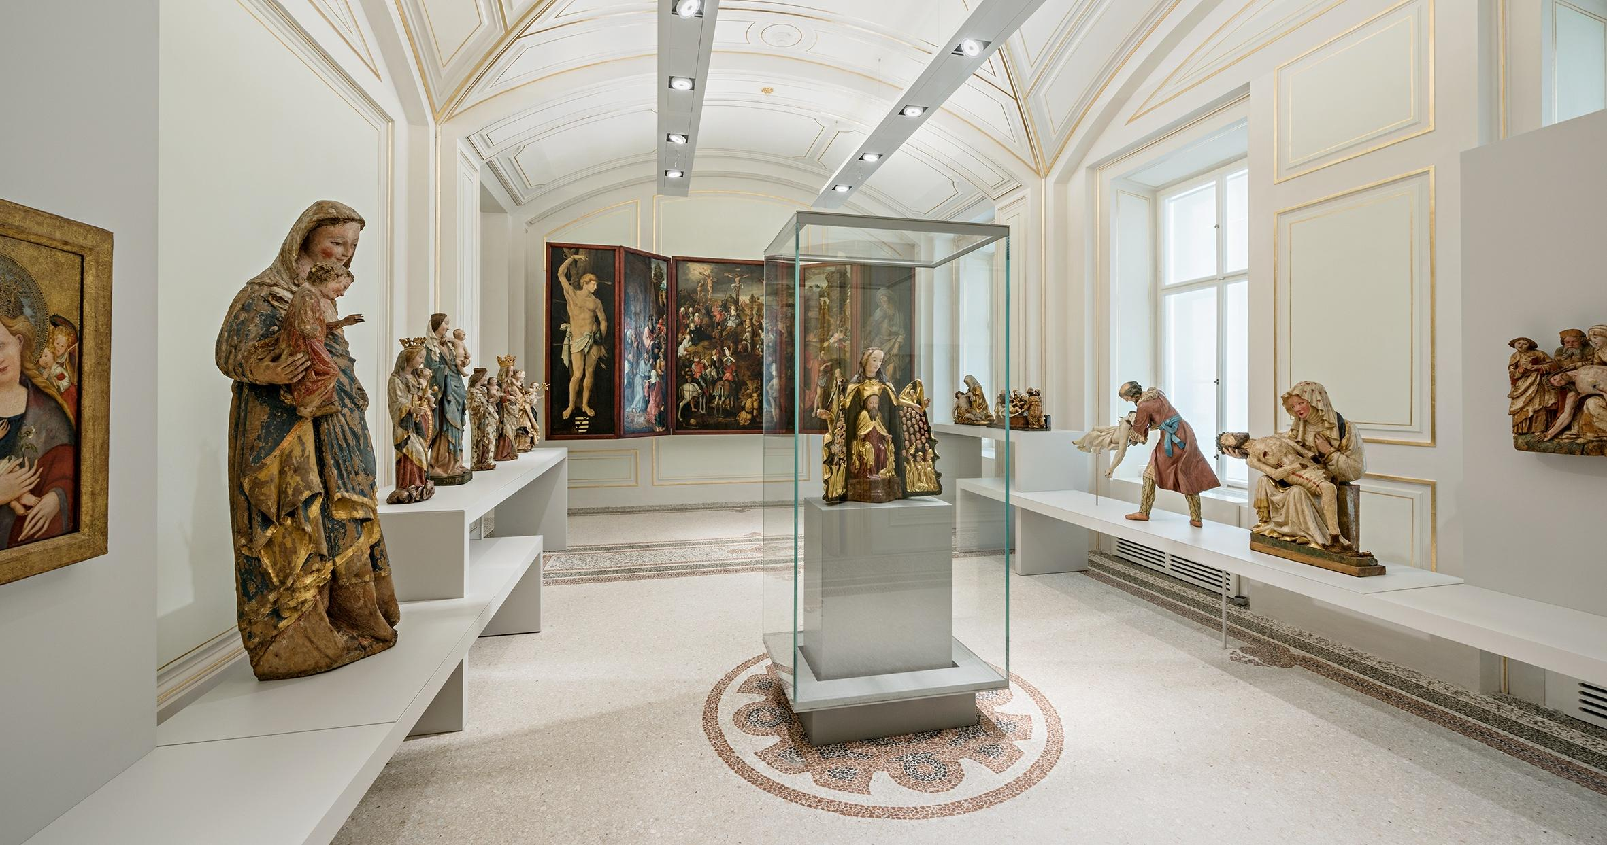
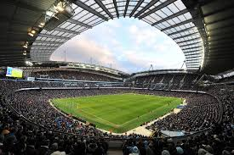
Game: Puzzle
1
2
3
4
5
6
7
1
?
B U S S T O P
Good job!
Sorry!
2
?
H O U S E
3
?
M U S E U M
4
?
C I N E M A
5
?
S T A D I U M
6
?
P H A R M A C Y
7
?
M A R K E T

Slide 15
Do exercises in workbook
- Learn by heart the new words.
Homework:

Slide 16

THANK YOU
FOR YOUR Listen!
GOOD BYE

