Slide 1
Unit 7
How do you
lern English
Lesson 1

Slide 2
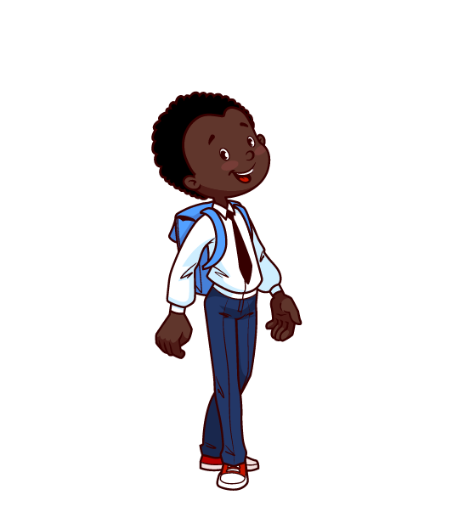

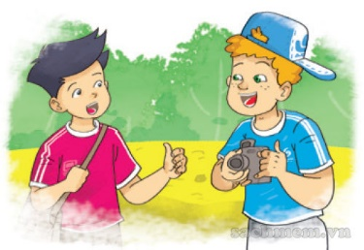
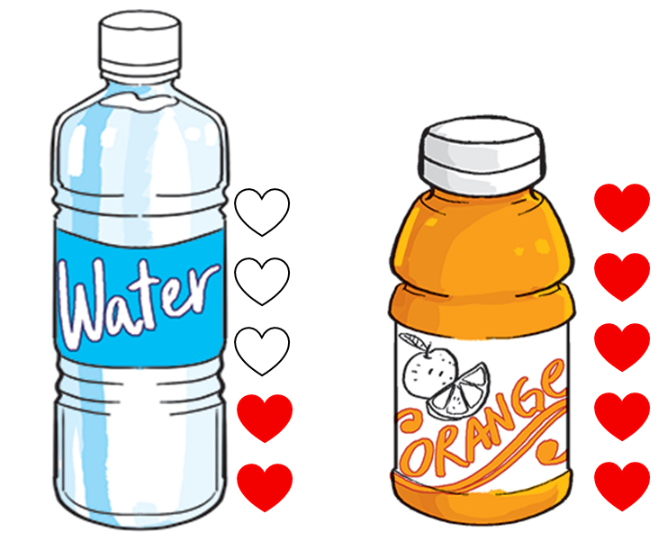
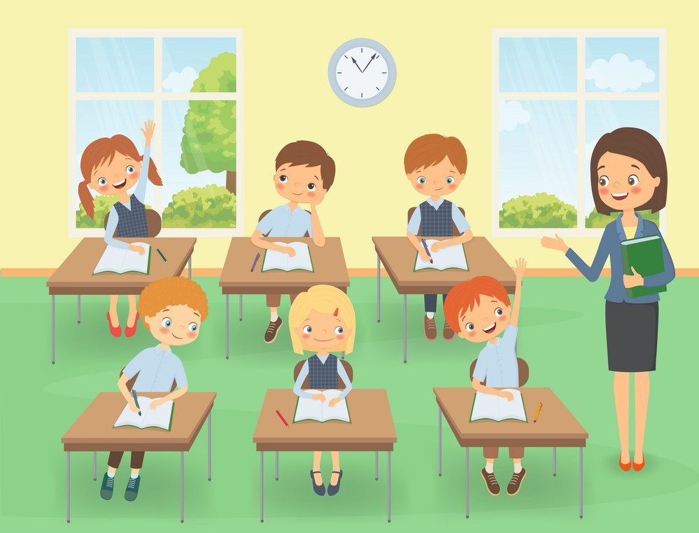
A. Vocabulary
French
English
French
language
foreign
/frentʃ/
/ˈlæŋɡwɪdʒ/
/ˈfɔːrən/
Tiếng Pháp
Ngôn ngữ
Nước ngoài
talk
favourite
learn
/tɔːk/
/ˈfeɪvərɪt/
/lɜːrn/
Nói chuyện
Yêu thích
Học

Slide 3



Choose the correct picture
a
b
c
d
language
French
English

Slide 4
Choose the correct picture
a
b
c
d
French
French
English

Slide 5
Choose the correct picture
a
b
c
d
foreign
French
English

Slide 6
Choose the correct picture
a
b
French
English
c
d
favourite

Slide 7
Choose the correct picture
a
b
c
d
talk

Slide 8
Choose the correct picture
a
b
French
English
c
d
learn

Slide 9
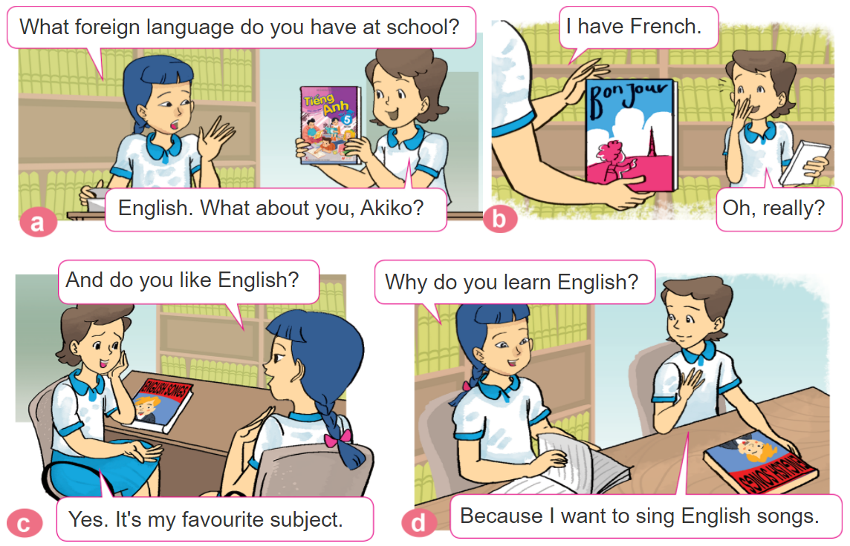

1. Look, listen and repeat.

Slide 10
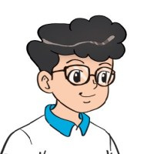

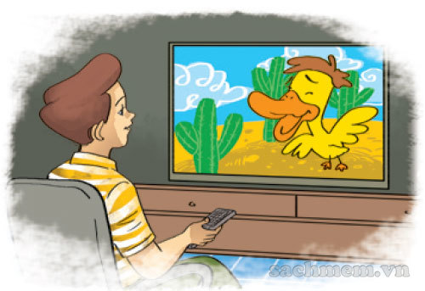

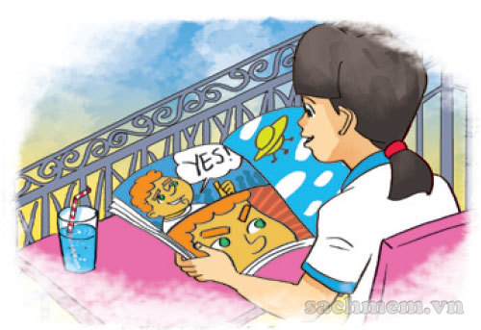
2. Point and say
Why do you learn English?
Because I want to __________.
watch English cartoons on TV
talk with my foreign friends
read English comic books

Slide 11
B. Grammar
Hỏi và trả lời vì sao bạn thích học Tiếng Anh:
(Tại sao bạn thích học Tiếng Anh)
Why do you learn English?
Because I want to ____________.
+ lí do thích học
(Bởi vì tớ muốn ______________)

Slide 12

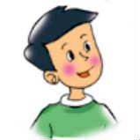
3. Let’s talk
How do you
learn English?
I _____________
Because I want to ______.
Why do you learn English?

Slide 13








Slide 14
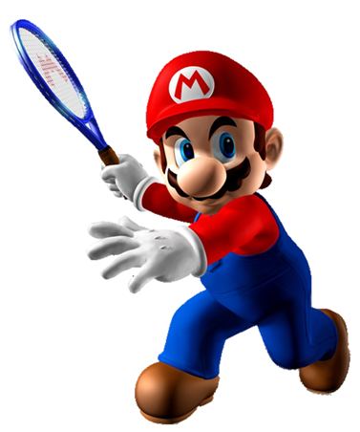
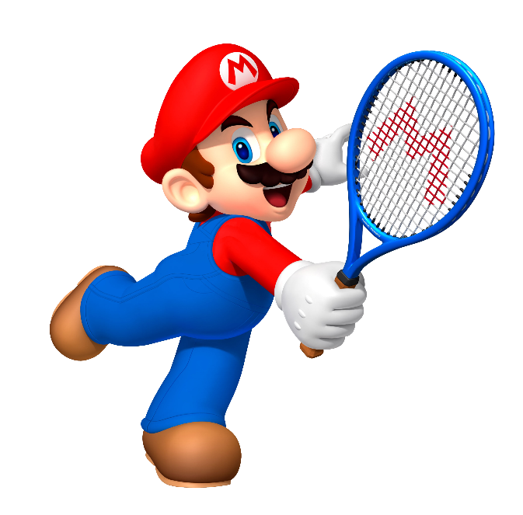


What
How
______ do you learn English?
Because I want to be an English teacher.
Why

Slide 15
Because I want to watch English cartoons on TV.
Because I want to talk with my foreign friends.
Why do you learn English?
Because I want to read English comic books.

Slide 16
Why do you learn nglish?
Because I want to watch English cartoons on TV.
Why do you learn English?
Because I want to talk with my foreign friends.

Slide 17
They is my friend
This is your friend
Why do you learn English?
This is my friend

Slide 18
How do you learn English?
Why do you learn English?
Because I want to
sing English song.
Do do you like to learn English?

Slide 19
do
are
How _____ you learn English?
were

Slide 20
I watch English cartoons on TV.
I read English comic books.
How do you
learn English?
I talk with my foreign friends.

Slide 21
I watch English cartoons on TV.
I talk with my foreign friends.
How do you
learn English?
I read English comic books.

Slide 22
I sing English song.
I talk with my foreign friends.
How do you
learn English?
I watch English cartoons on TV.

Slide 23
Time’s up!

