Slide 1
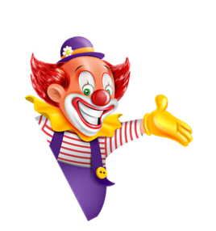

I always get up early.
How about you?
Unit
02
Lesson 1

Slide 2
Vocabulary

Slide 3
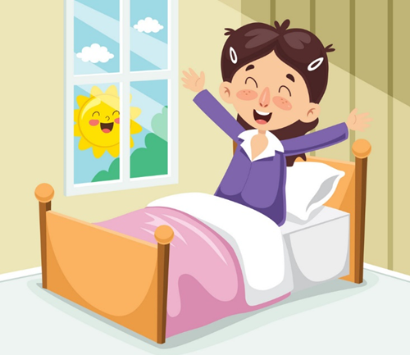
Get up

Slide 4

Do morning exercise

Slide 5
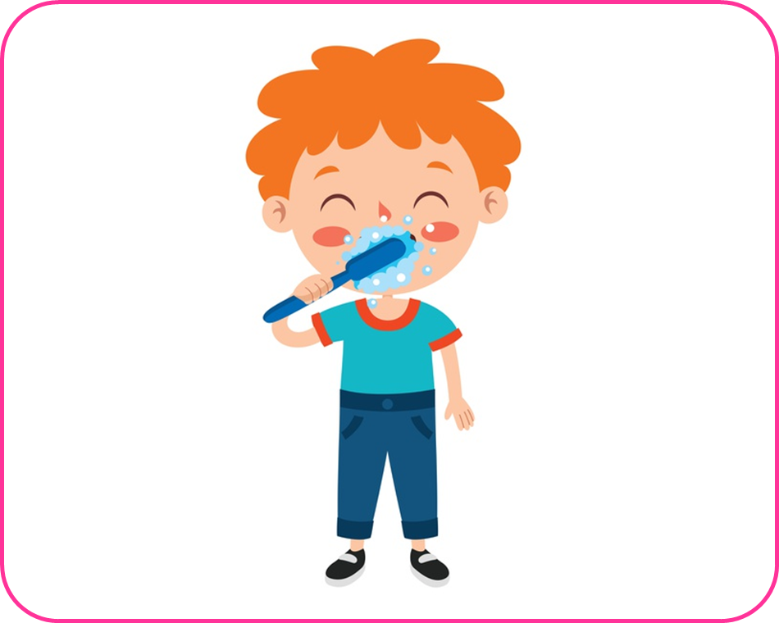
Brush my teeth

Slide 6
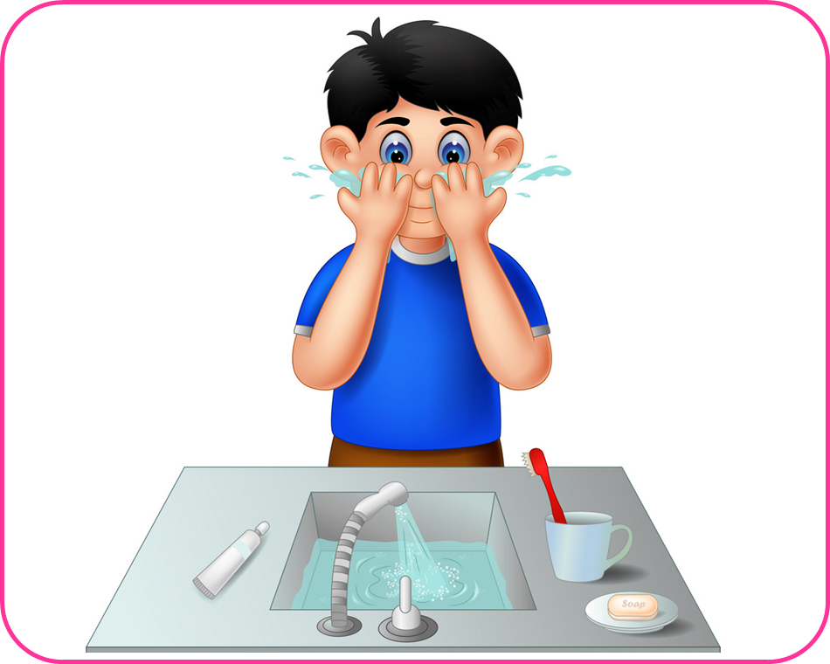
Wash my face

Slide 7

Have breakfast

Slide 8
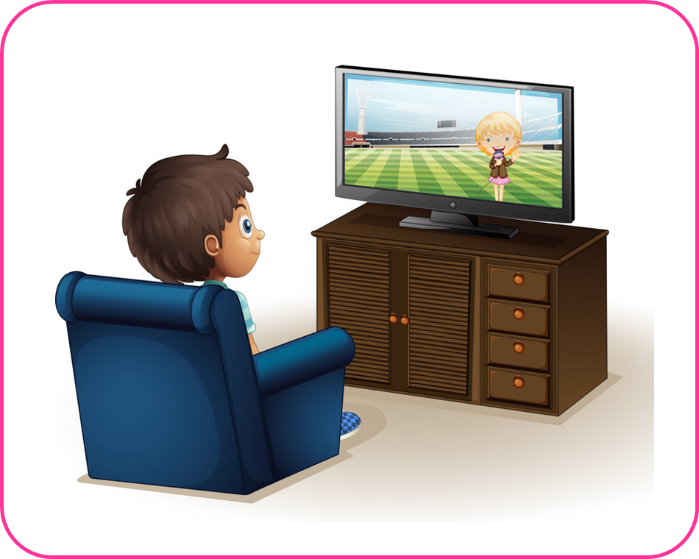
Watch TV

Slide 9
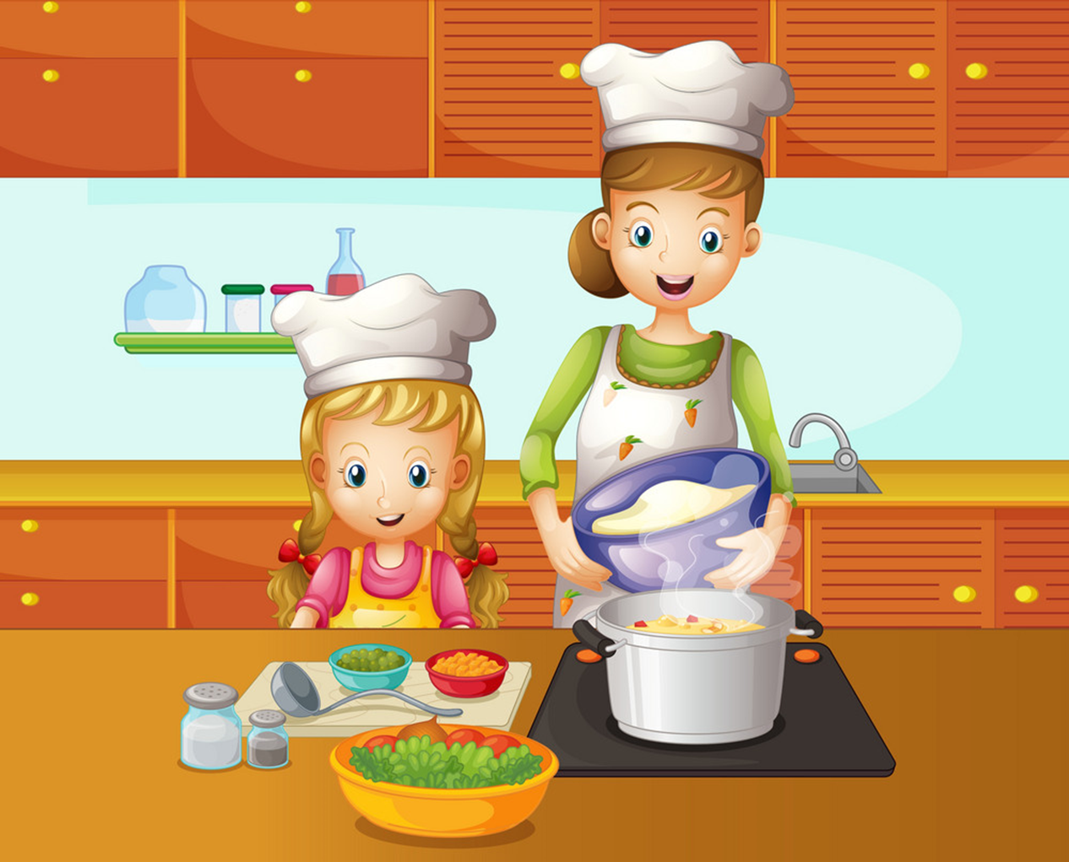
Cook dinner

Slide 10
1
2
3
Have breakfast
Do morning exercise
Brush my teeth
4
5
6
7
Wash my face
Get up
Cook dinner
Watch TV

Slide 11
Grammar

Slide 12
1
2
3
✔
Cook dinner

Slide 13
1
2
3
✔
Brush my teeth

Slide 14
1
2
3
✔
Get up

Slide 15
1
2
3
✔
Wash my face

Slide 16
1
2
3
✔
Watch TV

Slide 17
1
2
3
✔
Do morning exercise

Slide 18
1
2
3
✔
Have breakfast

Slide 19
1
2
3
Nấu ăn
Ăn sáng
Tập thể dục
buổi sáng
Have breakfast
Do morning exercise
Brush my teeth
Get up
Wash my face
Do morning exercise
Cook dinner
Have breakfast
Watch TV

Slide 20
4
5
6
7
Thức dậy
Đáng răng
Xem TV
Rửa mặt
Wash my face
Brush my teeth
Watch TV
Have breakfast
Have breakfast
Brush my teeth
Wash my face
Get up
Watch TV
Get up
Do morning
exercise
Cook dinner

Slide 21











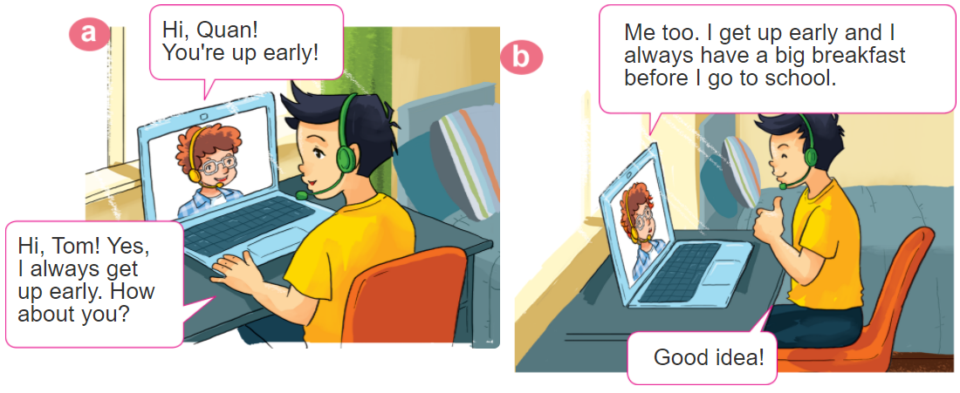
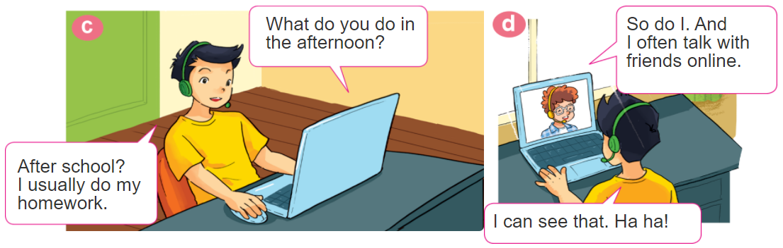
1. Look, listen and repeat

Slide 22
2. Point and say
What do you do in the _________?
I usually _____________________.
morning
do morning exsercise

Slide 23
2. Point and say
What do you do in the _________?
I often ____________.
afternoon
cook dinner

Slide 24
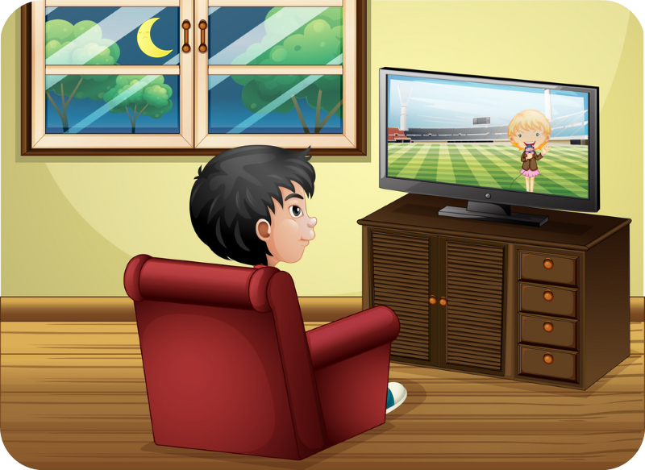
2. Point and say
What do you do in the _________?
I sometimes ____________.
evening
watch TV

Slide 25
2. Point and say
What do you do in the _________?
I usually _____________________.
morning
do morning exsercise

Slide 26
2. Point and say
What do you do in the _________?
I often ____________.
afternoon
cook dinner

Slide 27
2. Point and say
What do you do in the _________?
I sometimes ____________.
evening
watch TV

Slide 28
Sentences:
What do you do in the morning?
I always brush my teeth.
What do you do in the afternoon?
I sometimes get up early.
What do you do in the evening?
I usually wash my face.

Slide 29
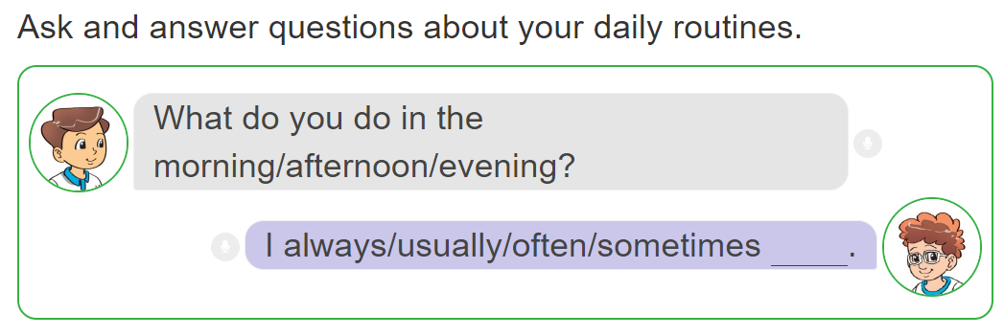
3. Let’s talk.

Slide 30
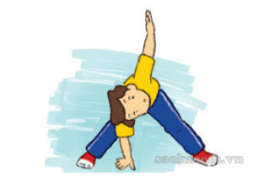
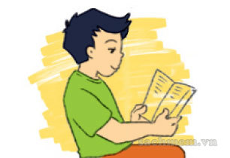
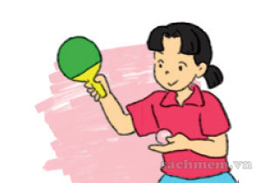

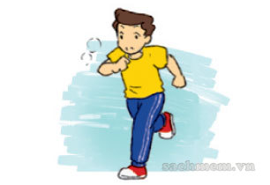
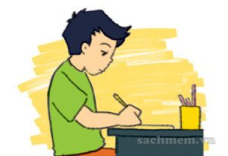
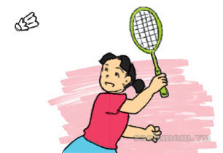
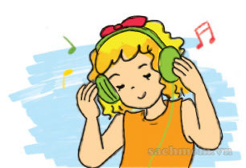
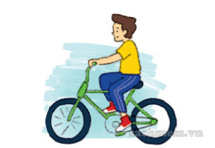
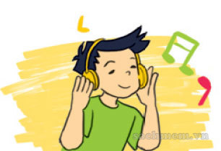
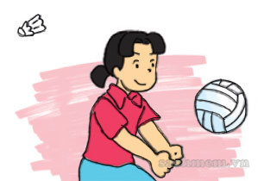
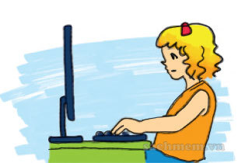
4. Listen and tick
1
2
3
4
a
a
a
a
✔
✔
b
b
b
b
✔
✔
c
c
c
c

Slide 31
5. Read and complete.
play do TV like usually
Hi. My name is Nam. Every morning, I get up early. I (1) do morning exercise, have breakfast and then go to school. After school, I (2) usually do homework with my classmates. Then I often go to the sports centre and (3) play football. In the evening, I sometimes watch (4) TV . I (5) like watching films after dinner.
_______
__________
______
______
______

Slide 32
Extra sentences:
What does she do in the morning?
She always gets up.
What does he do in the evening?
He usually washes his face.

Slide 33




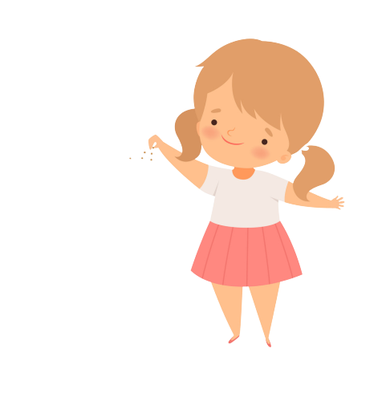



FEEDING FISH
Mỗi câu trả lời đúng là
CÂU THẦN CHÚ giúp cá Vàng
ngoi lên mặt nước nhận thức ăn.
Nào chúng mình cùng giúp
bạn nhỏ cho cá Vàng ăn nhé!
START

Slide 34

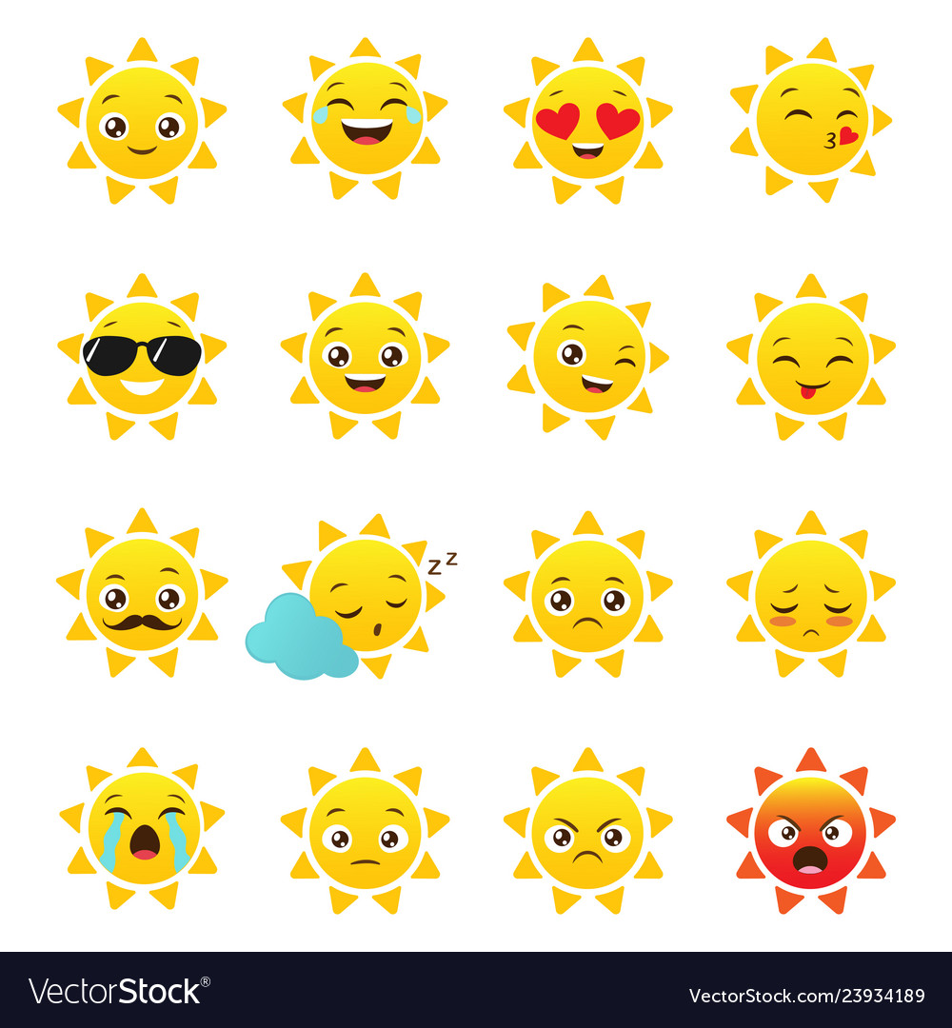
Next
__________in the morning?
I usually do morning exercise.
What does you do
What do you do
What do she do
Notes:
YOUTUBE: MsPham.
Facebook: Dạy và học cùng công nghệ.

Slide 35
Next
__________in the morning?
He often gets up early.
What do you do
What does she do
What does he do
Notes:
YOUTUBE: MsPham.
Facebook: Dạy và học cùng công nghệ.

Slide 36
Next
__________in the evening?
She always wash her face.
What does she do
What does he do
What do you do
Notes:
YOUTUBE: MsPham.
Facebook: Dạy và học cùng công nghệ.

Slide 37
What ____ your father do in the afternoon?
Next
do
does
Notes:
YOUTUBE: MsPham.
Facebook: Dạy và học cùng công nghệ.

Slide 38
What ____ your sister do in the afternoon?
Next
do
does
Notes:
YOUTUBE: MsPham.
Facebook: Dạy và học cùng công nghệ.

Slide 39
Next
What ____do you do in the free time?
I often play football.
is
do
does
Notes:
YOUTUBE: MsPham.
Facebook: Dạy và học cùng công nghệ.

Slide 40
Next
What ____ your friend do at school?
She often plays hide-and-seek.
is
do
does
Notes:
YOUTUBE: MsPham.
Facebook: Dạy và học cùng công nghệ.

Slide 41
Next
What ___ in the evening?
She always wash her face.
What does she do
What does he do
What do you do
Notes:
YOUTUBE: MsPham.
Facebook: Dạy và học cùng công nghệ.

Slide 42
THANK YOU!
Next
Notes:
YOUTUBE: MsPham.
Facebook: Dạy và học cùng công nghệ.

