Slide 1
Hello
Unit 1
Lesson 2
Teacher: Nguyen Thi Thuy Ha

Slide 2
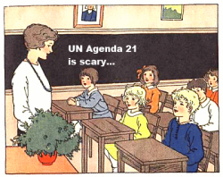
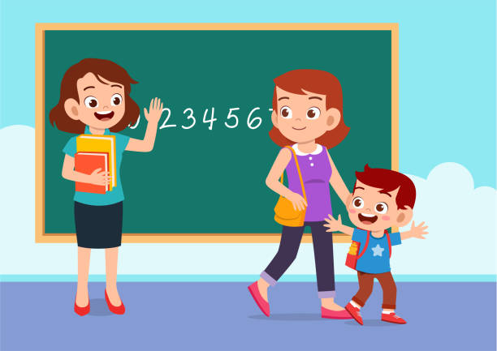
Bye
/baɪ/
Class
/klɑːs/
Goodbye
/ˌɡʊdˈbaɪ/

Slide 3
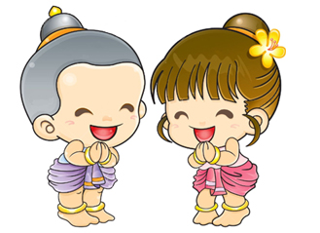
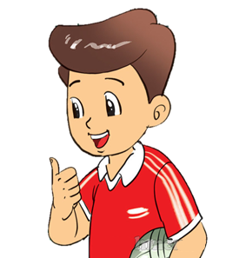

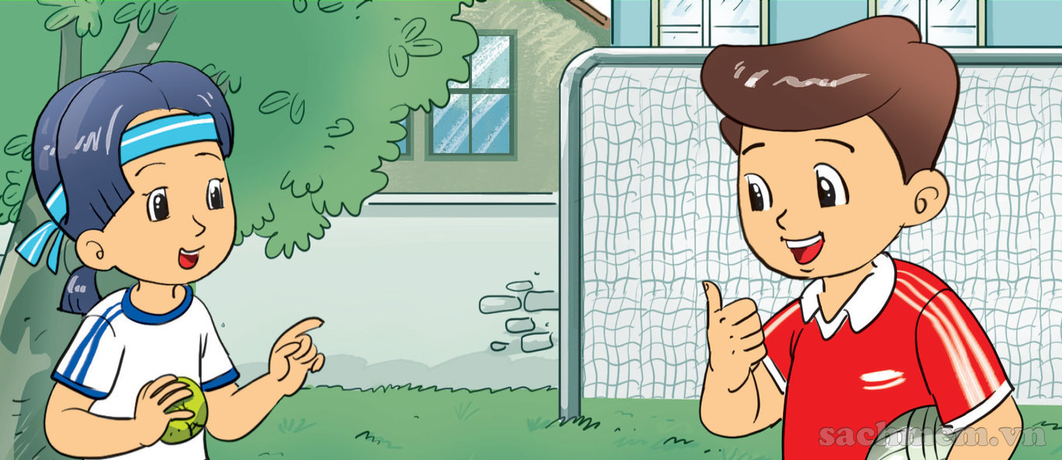
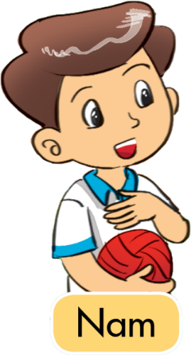
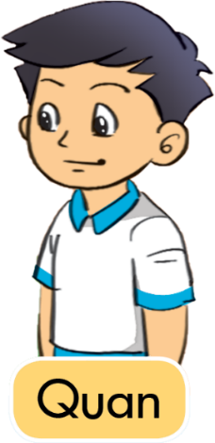
Thank you
/θæŋk juː/
Fine
/faɪn/
Thanks
/ θæŋks/
And
/aend/
How are you?
/haʊ ɑː juː/

Slide 4


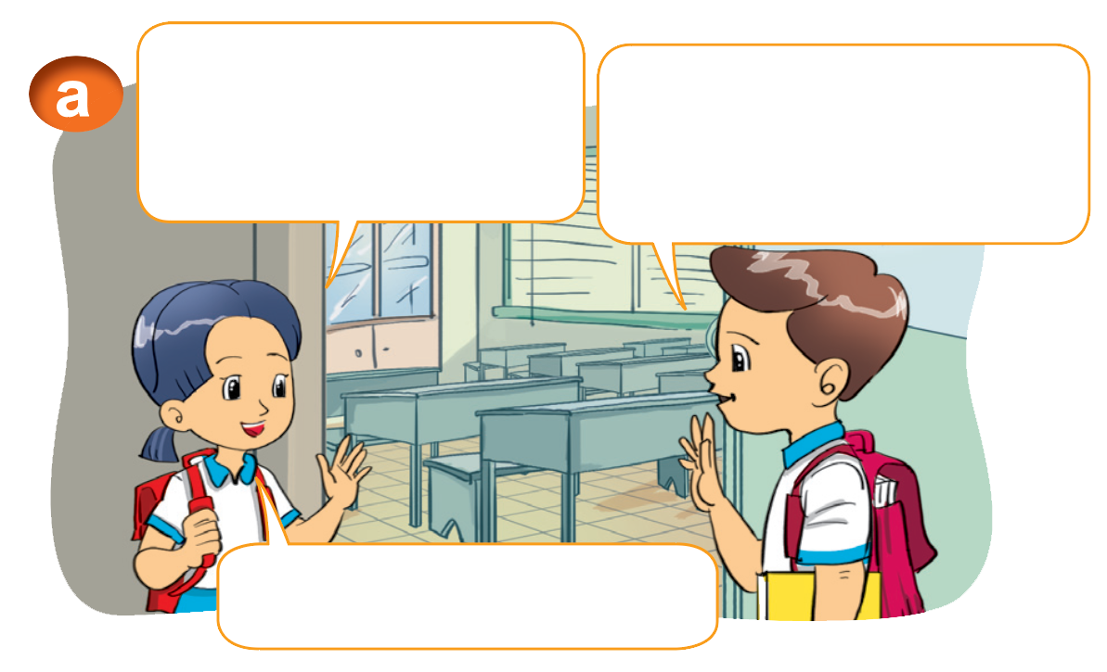
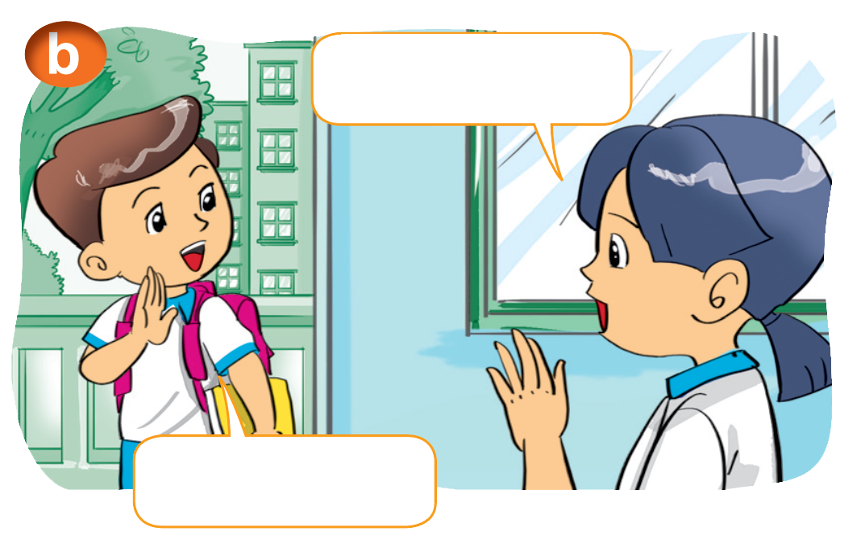
1. Look, listen and repeat
Hi, Nam.
How are you?
I'm fine, thanks.
And you?
Bye, Nam.
Fine, thank you.
Bye, Mai.

Slide 5
Ask about someone’s health:
How are you?
                I'm fine. Thank you. And you?

Slide 6
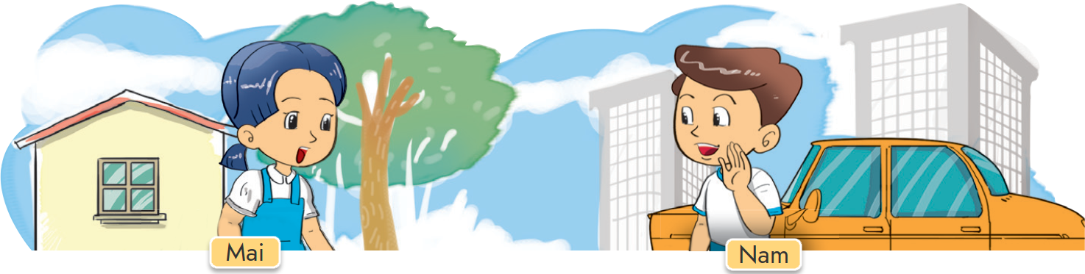


2. Point and say.
Fine, thanks. And you?
How are you, ______.
Nam
Fine, thank you.

Slide 7
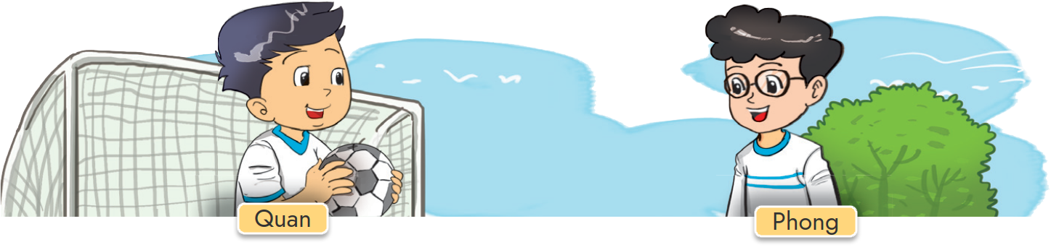
2. Point and say.
Fine, thanks. And you?
How are you, _______.
Phong
Fine, thank you.

Slide 8
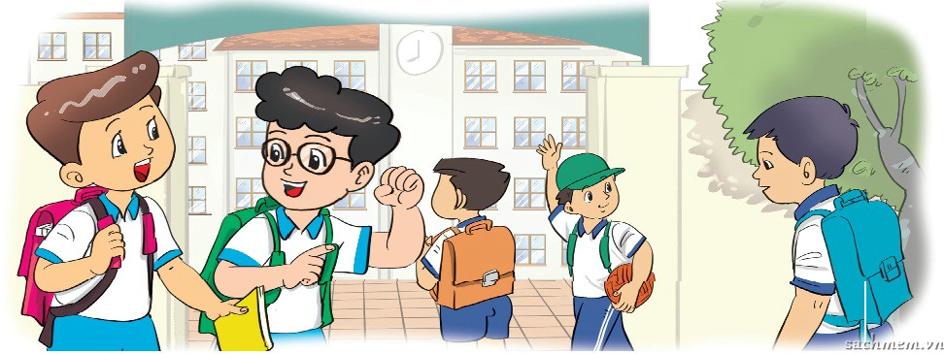
3. Let’s talk.
How are you, Phong?
I'm fine, thank you. And you?
I'm fine, thank you.

Slide 9
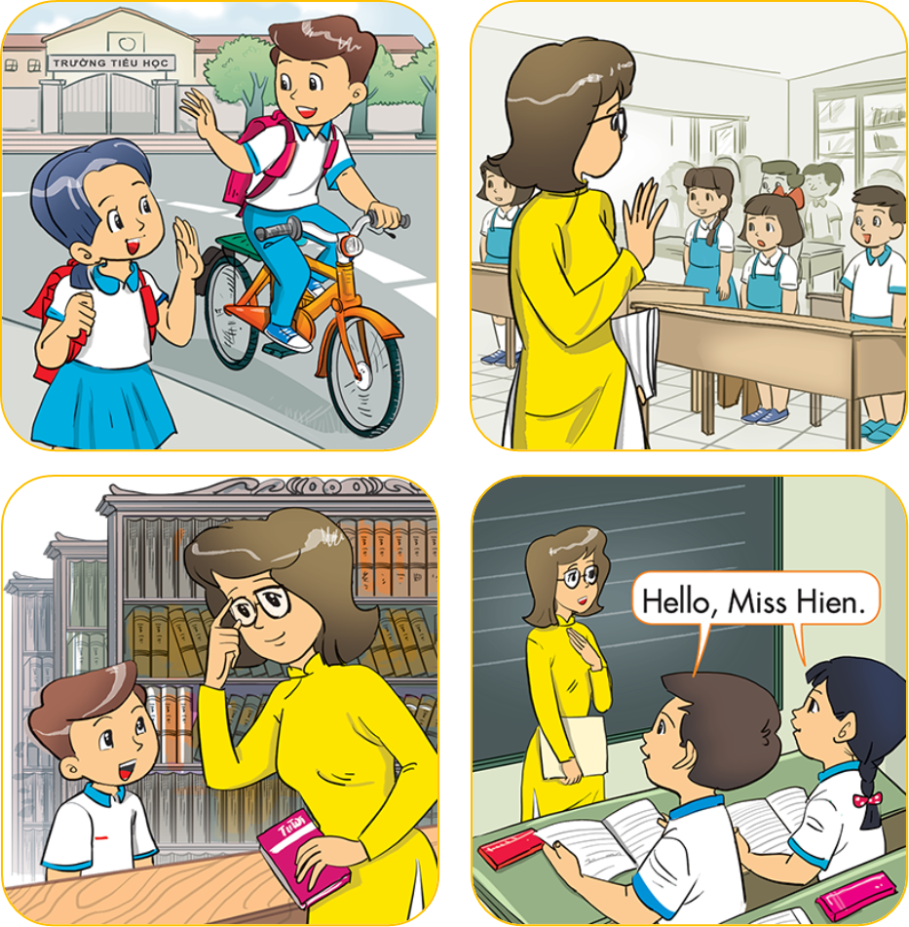

4. Listen and number
a
b
4
3
c
d
2
1

Slide 10
5. Read and complete
Miss Hien: Goodbye, class.
Class: (1) __________, Miss Hien.
Mai: Bye, Nam.
Nam: (2) _______________, Mai.
Nam: How are you, Quan?
Quan: (3) ______, thanks. And you?
Nam: Fine, (4) _____________.
goodbye
bye
fine
thank you
1
Goodbye
2
Bye
/ Goodbye
3
Fine
thank you

Slide 11
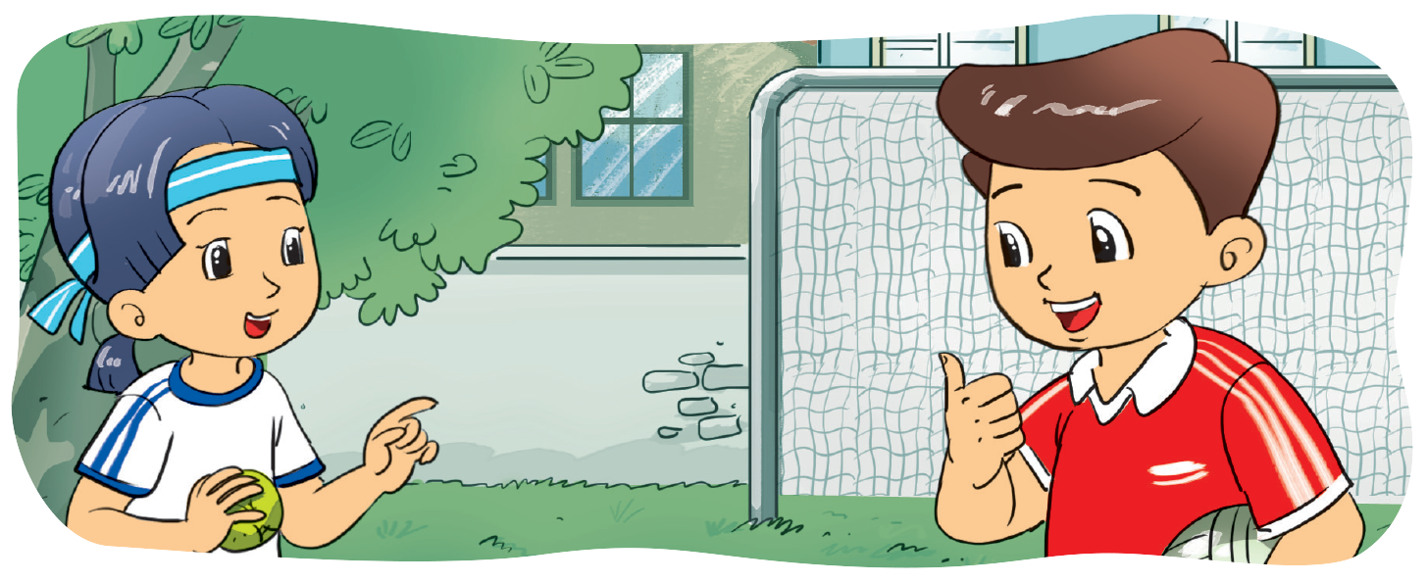
6. Let's write.
___________, ____________. And you?
________ are you?
Fine, thanks.

Slide 12
Thank you!

