Slide 1

Unit 3
What day is it today?
Lesson 1

Slide 2

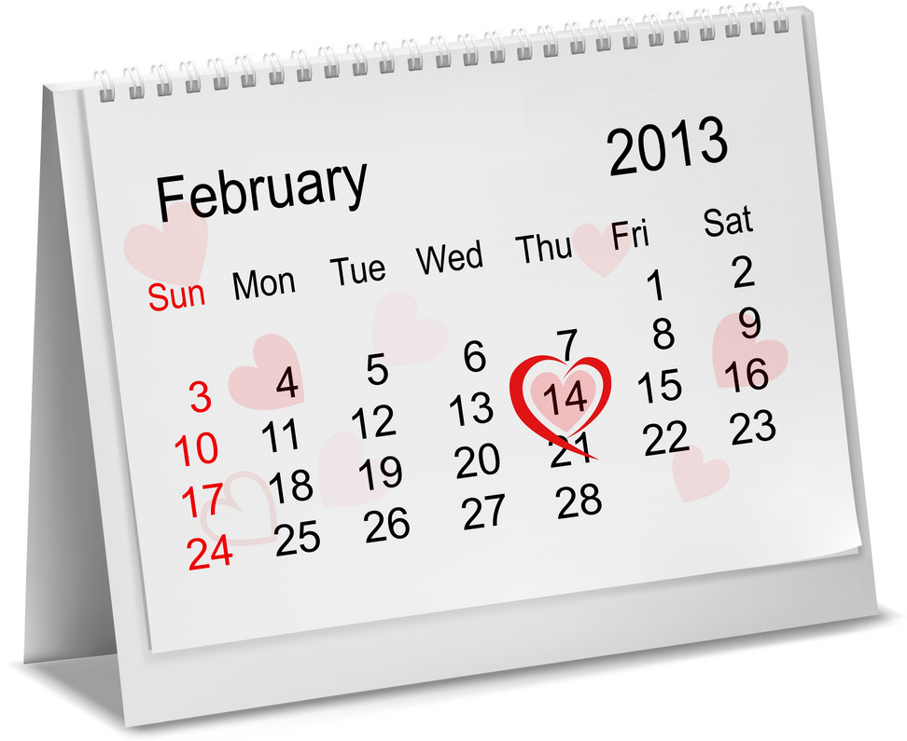
MsPham-9036082789
Calendar
Year
Month
Day
Week
Date

Slide 3
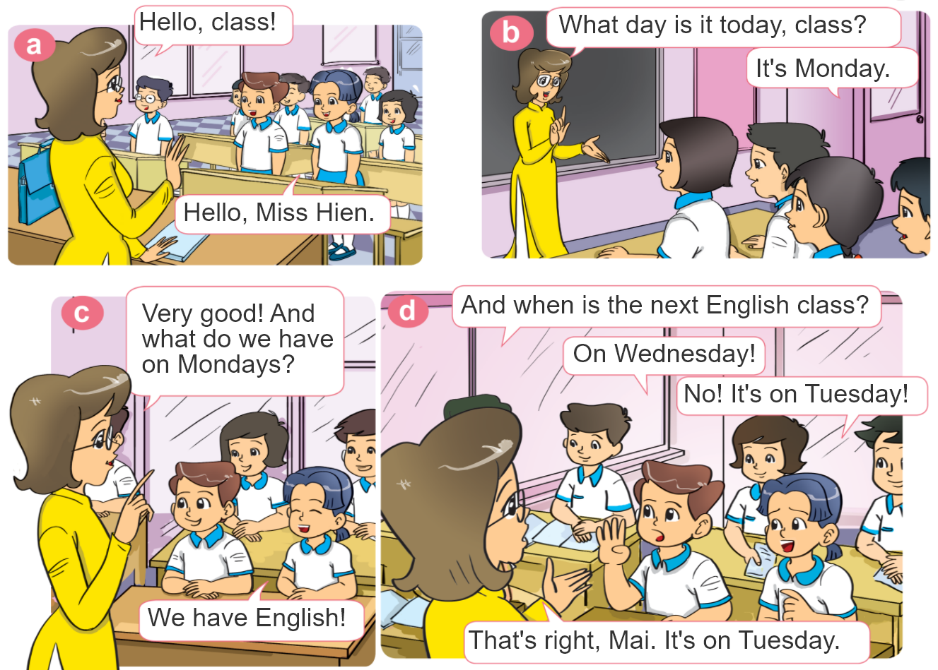


1. Look, listen and repeat.

Slide 4

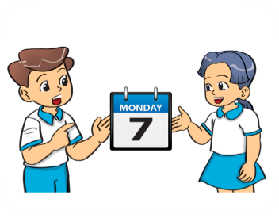


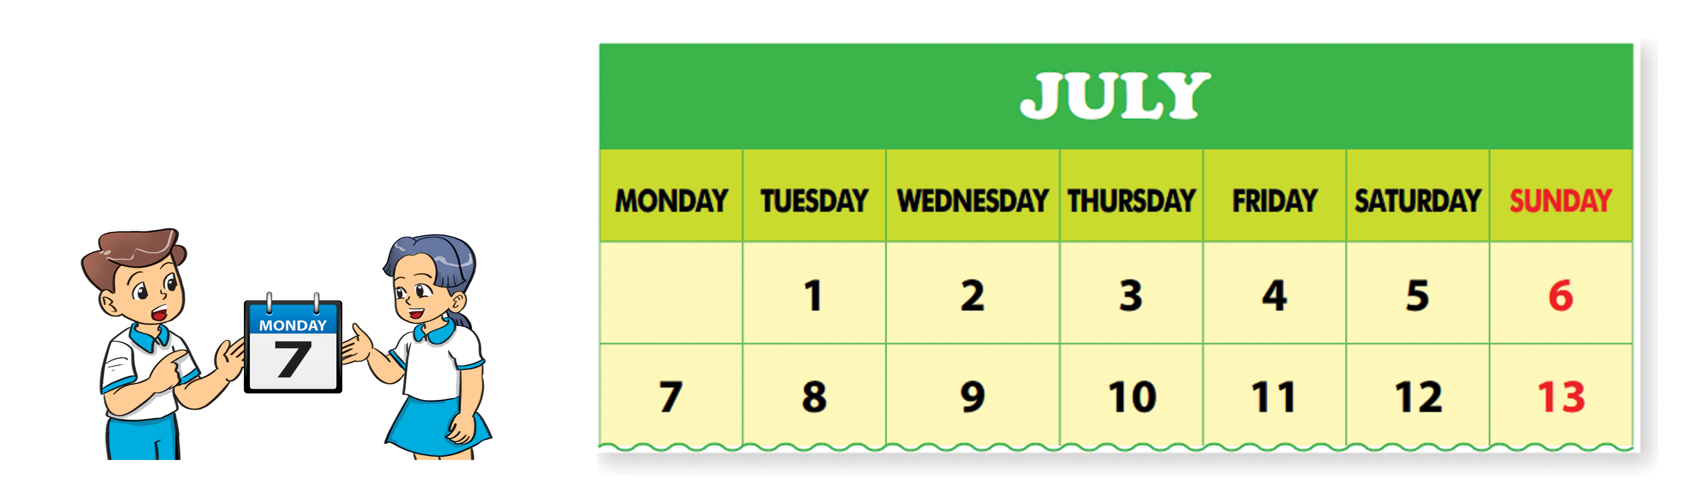
2. Point and say.
What day is it today?
It’s ___________.

Slide 5

Structures
Ask and answer about days:
What day is it today?
It’s _______.
+ day

Slide 6

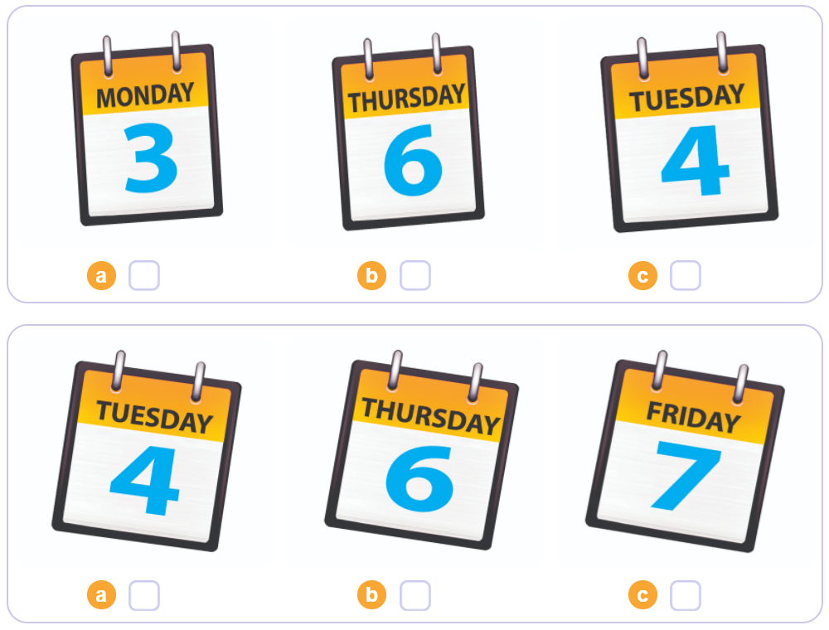

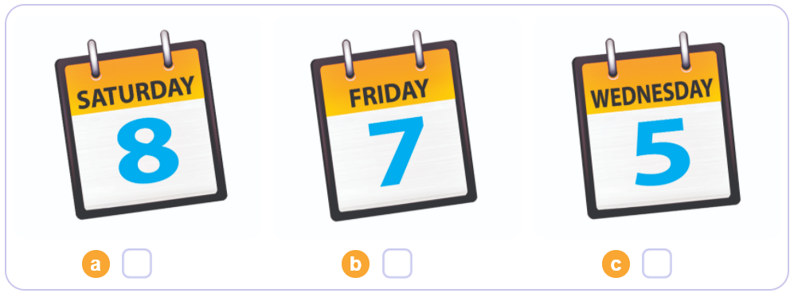
3. Listen and tick.
1
2
3

Slide 7
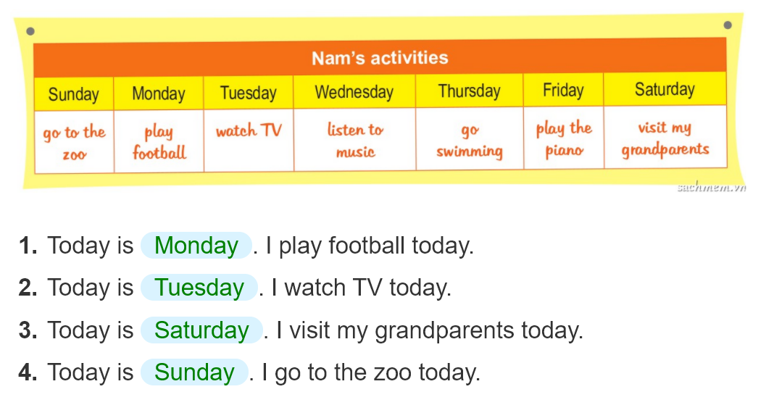
4. Look and write.
_______.
_______.
_______.
______.

Slide 8
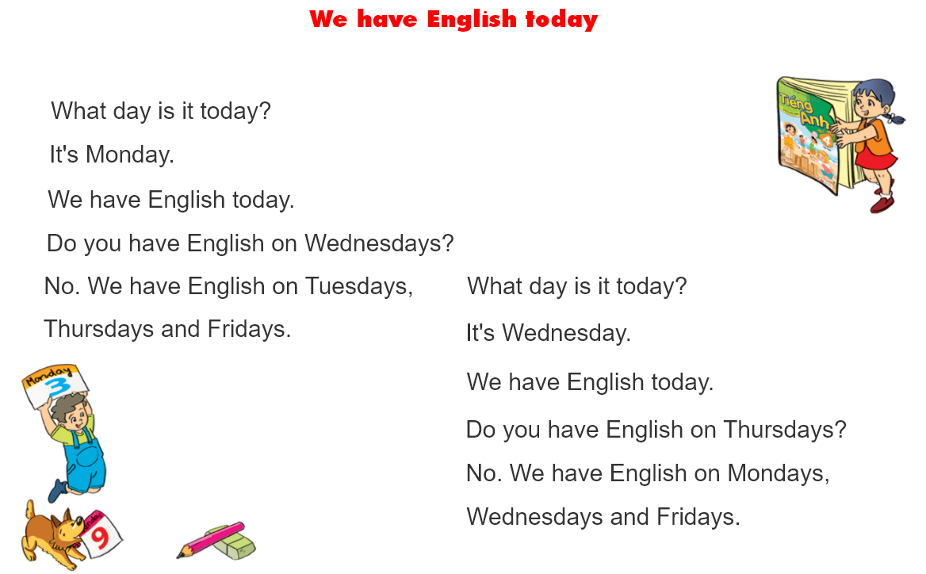
5. Let’s sing

Slide 9



Thank you!

