Slide 1
Unit 16: Where’s the post office?
Lesson 1 – Teacher: Ngoc Khue

Slide 2
Objectives
Use the words and phrases related to the topic Places.
Make and respond to suggestions to go somewhere, using: Let’s go to the …….. I want to ……… => Great idea/ Sorry. I’m busy.
Mục đích bài học:
Sử dụng các từ và cụm từ liên quan đến chủ đề Các địa điểm.
Đưa ra và trả lời đề nghị cùng đi đâu đó, sử dụng mẫu câu: Let’s go to the …….. I want to ……… => Great idea/ Sorry. I’m busy.

Slide 3






Table of Contents.
New words
Model sentence
Practice
Homelink
01
02
03
04

Slide 4
Let’s Warm Up!

Slide 5

New words
01

Slide 6

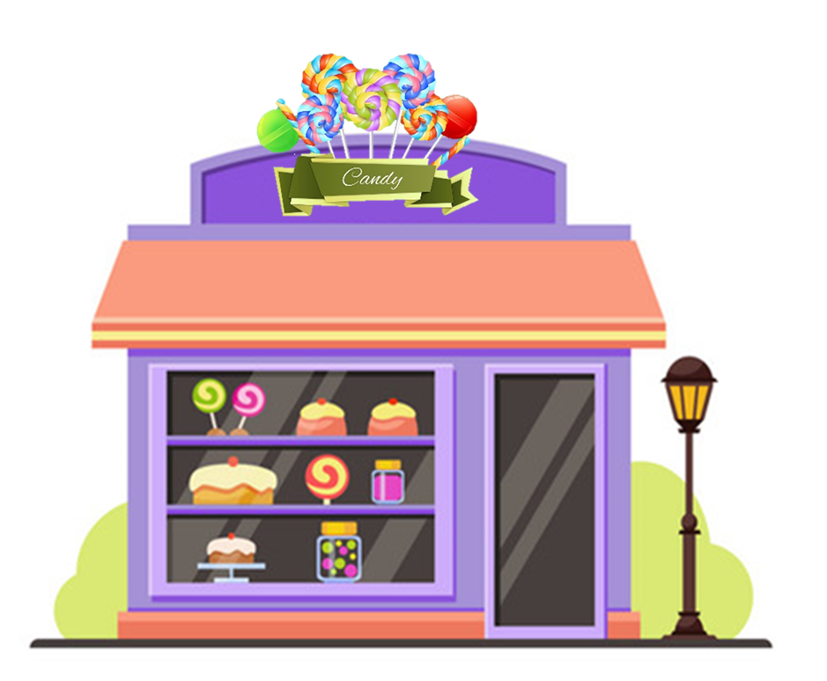

Vocabulary
sweet shop
/swiːt ʃɒp/

Slide 7
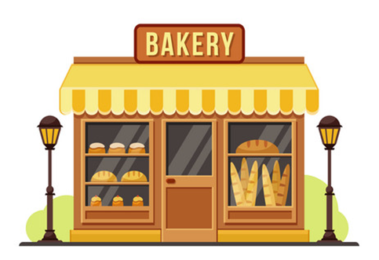
Vocabulary
Bakery
/ˈbeɪkəri/

Slide 8

Vocabulary
pharmacy
/ˈfɑːməsi/

Slide 9
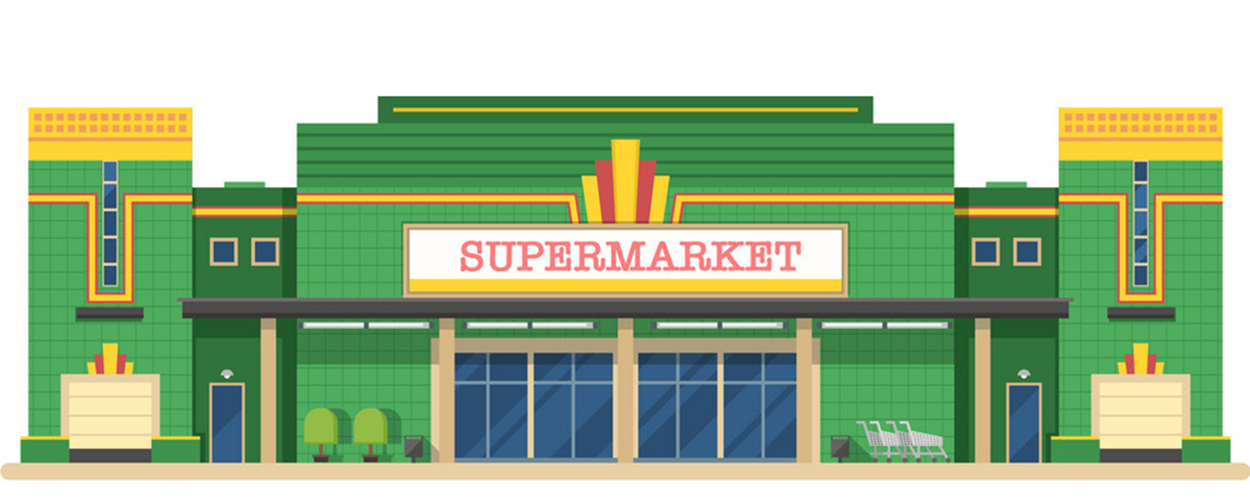


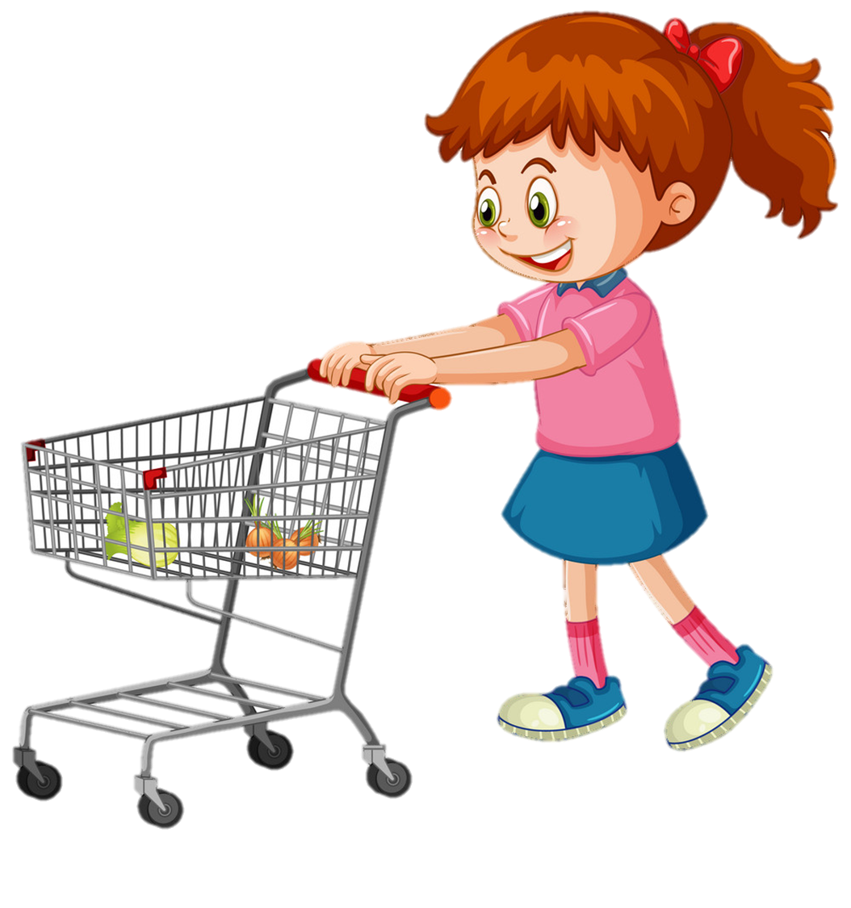
Vocabulary
supermarket
/ˈsuːpəmɑːkɪt/

Slide 10

Vocabulary
bookshop
/ˈbeɪkəri/

Slide 11
Vocabulary
1
2
3
sweet shop
bakery
bookshop
4
5
pharmacy
supermarket

Slide 12



Choose the correct picture
a
b
c
d
supermarket

Slide 13
Choose the correct picture
a
b
pharmacy
c
d

Slide 14
Choose the correct picture
a
b
sweet shop
c
d

Slide 15
Choose the correct picture
a
b
c
d
bookshop

Slide 16
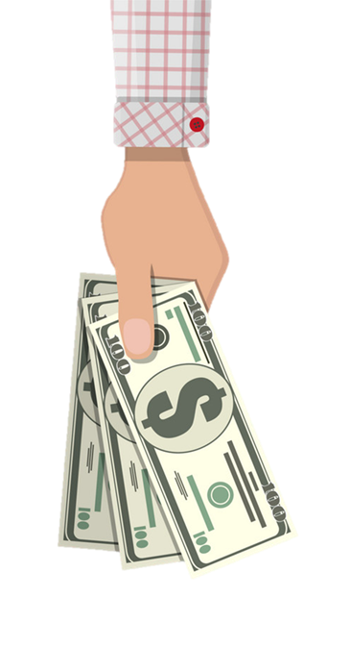

Vocabulary
buy some chocolate
/baɪ sʌm ˈtʃɒklət/

Slide 17


Vocabulary
buy some medicine
/baɪ sʌm ˈmedsn/

Slide 18

Vocabulary
buy some bread
/baɪ sʌm bred/

Slide 19

Vocabulary
buy some food
/baɪ sʌm fuːd/

Slide 20

Vocabulary
buy some books
/baɪ sʌm bʊks/

Slide 21
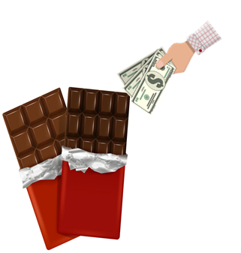


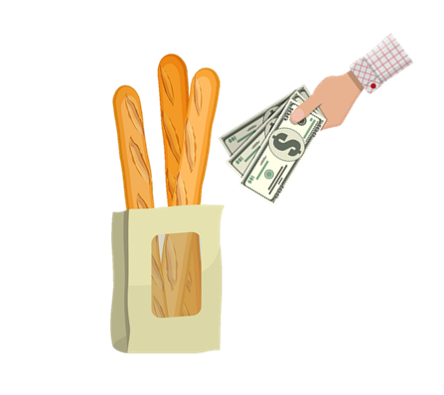
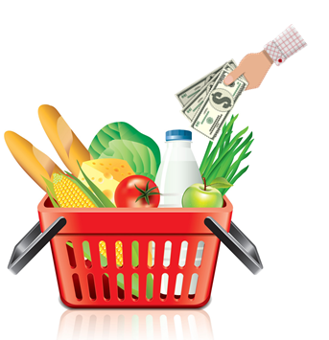
Vocabulary
1
2
3
buy some chocolate
buy some medicine
buy some books
4
5
buy some bread
buy some food

Slide 22
Choose the correct picture
a
b
buy
some bread
c
d

Slide 23
Choose the correct picture
a
b
buy some chocolate
c
d

Slide 24
Choose the correct picture
a
b
buy some books
c
d

Slide 25
Choose the correct picture
a
b
c
d
buy some food

Slide 26
Choose the correct picture
Choose the correct picture
a
b
c
d
buy some medicine

Slide 27
Model sentence
02

Slide 28
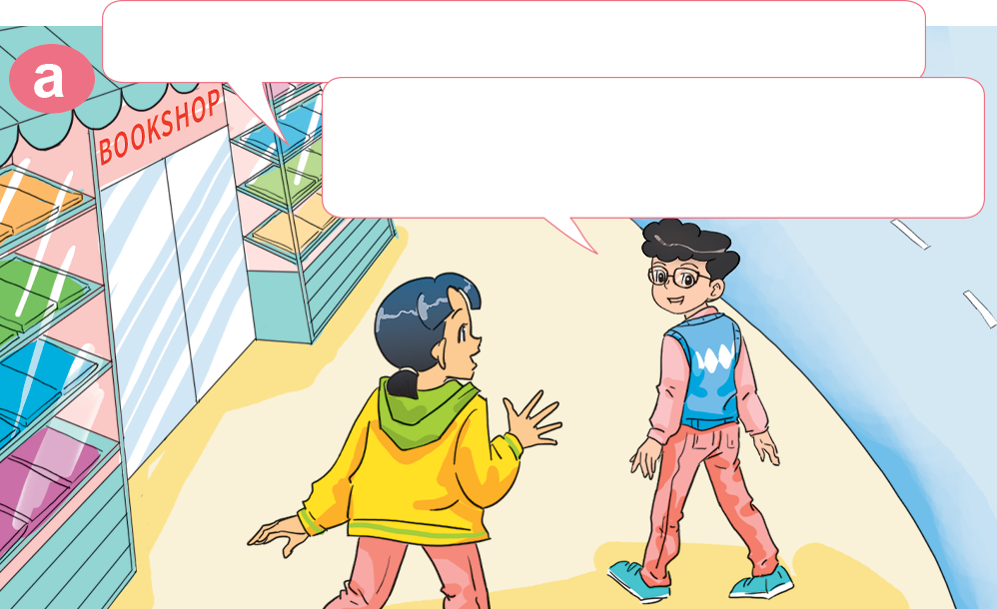
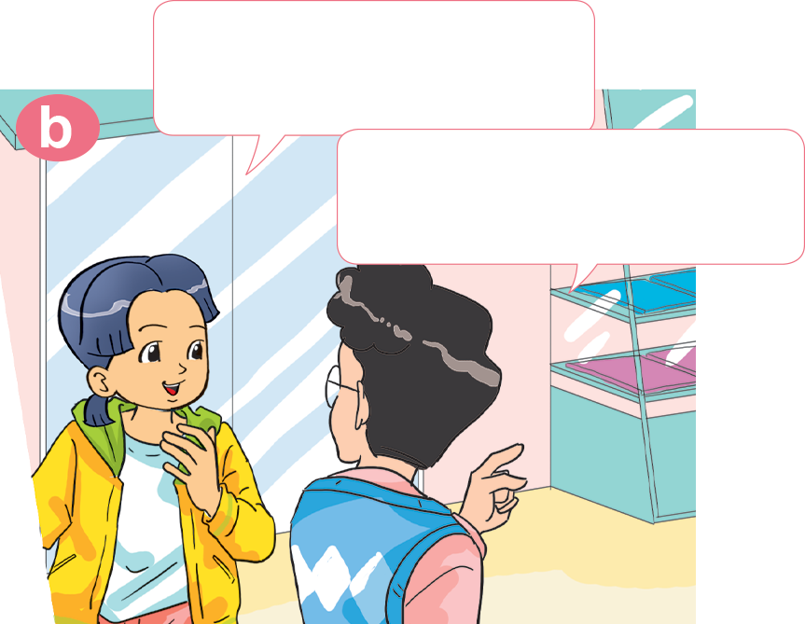

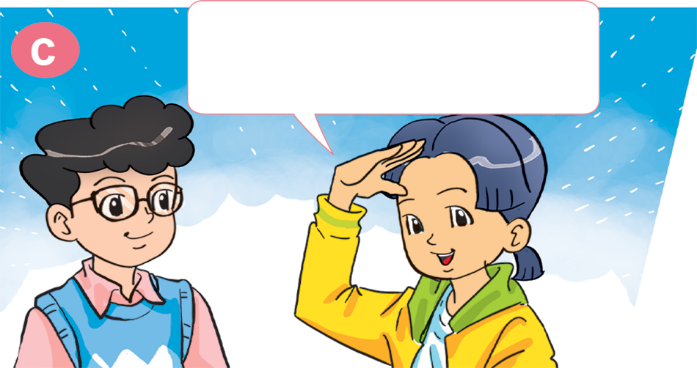
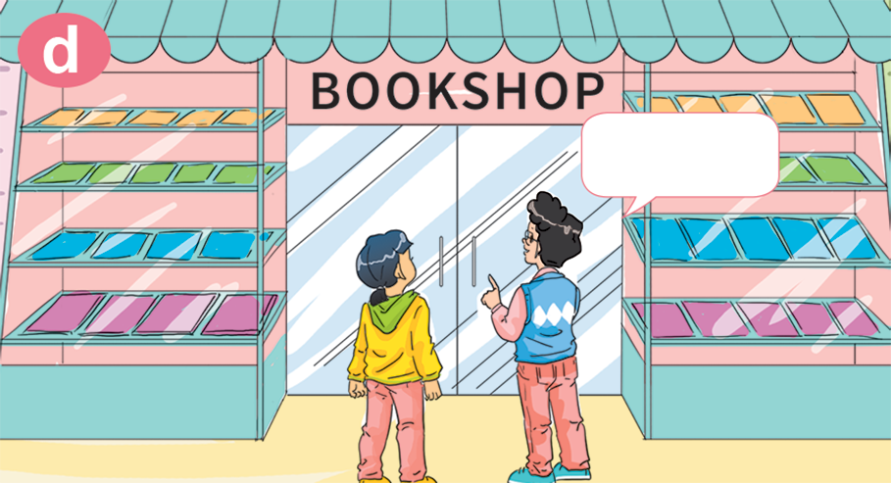
1. Look, listen and repeat.
Oh! I want to buy some books, too.
Hi, Phong. Where are you going?
I'm going to the bookshop. I want to buy some books.
OK. Let's go to the bookshop together.
Good idea! Where's the bookshop?
Here!

Slide 29



Let's go to the __________.
I want to ___________________.
pharmacy
buy some medicine
Great idea!

Slide 30
Let's go to the _____________.
I want to ___________________.
supermarket
buy some food
Great idea!

Slide 31
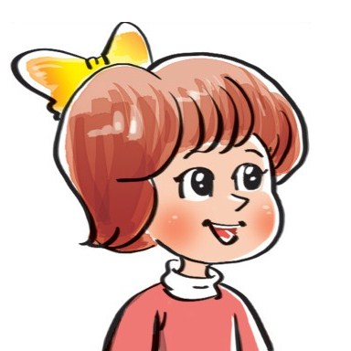

Let's go to the __________.
I want to ___________________.
bakery
buy some bread
Sorry. I'm busy.

Slide 32
Let's go to the ____________.
I want to ___________________.
sweet shop
buy some chocolate
Sorry. I'm busy.

Slide 33
Practice
03

Slide 34



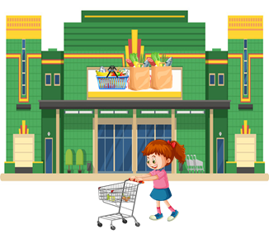
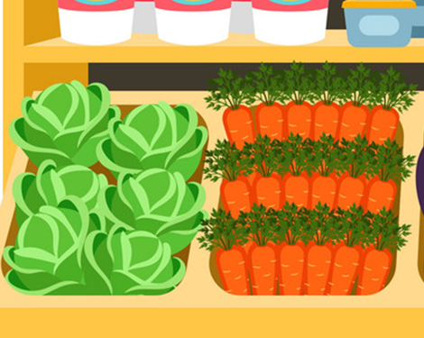
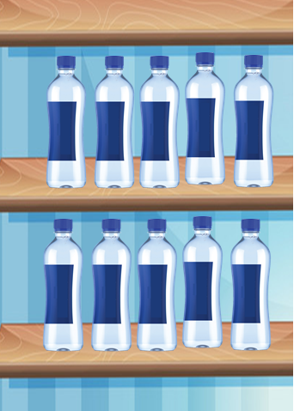
3. Listen and tick.
1. Where do Phong and Linda go?
2. What do they want?
a
b
a
b
3. Where do Mai and Tony go?
4. What do they want?
a
b
a
b

Slide 35
4. Look and write
to the bookshop
to the bakery
Let's go ________________. I want to ________________.
Let's go________________. I want to ________________.
buy some books
buy some cakes
to the sweet shop
to the pharmacy
Let's go ________________. I want to ________________.
Let's go ________________.
I want to __________________.
buy some sweets
buy some medicine

Slide 36
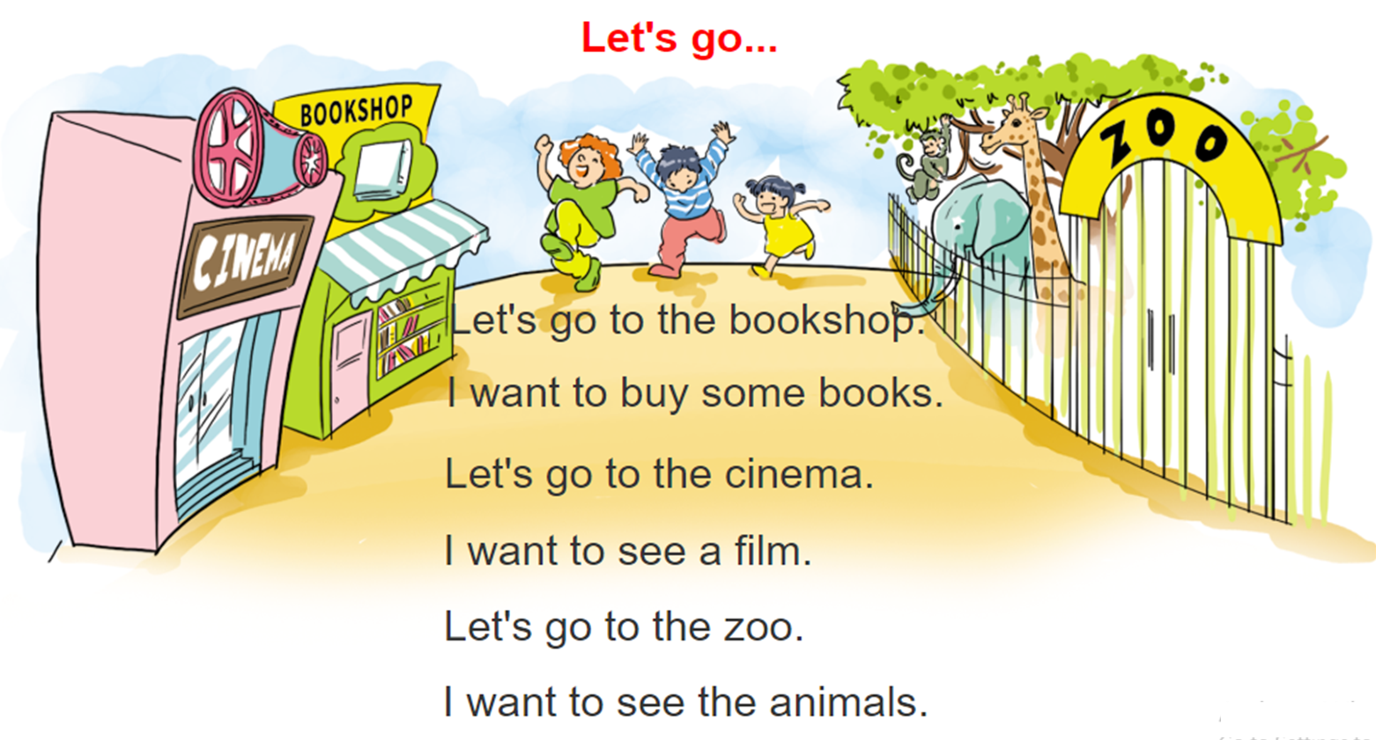
5. Let's sing.

Slide 37
Homelink
04

Slide 38
Monday, March 14th 2022 Unit 16: Let’s go to the book shop! Lesson 1
1. New words:
2. Model sentence:
Sweet shop: cửa hàng đồ ngọt
Bakery: tiệm bánh mì
Pharmacy: hiệu thuốc
Book shop: hiệu sách
Cinema: rạp chiếu phim
Zoo: sở thú
Buy some chocolate: mua sô cô la
Buy some books: mua vài quyển sách
Buy some food mua chút đồ ăn
Buy some medicine: mua ít thuốc
See the animals: xem thú
See a film: xem phim
Let’s go to the book shop! I want to buy some books.
Great idea!/ Sorry, I’m busy.
3. Homework:
Write NW x 2 lines.
Do WB: part B- 1,2 (page 64,65)
part E-1,2 (page 66)

Slide 39
Thank you!
Thank you!

