Slide 1
Unit 15: When’s Children’s Day?
Lesson 2
Teacher: Ngoc Khue

Slide 2
Objectives
Use the words and phrases related to the topic Popular Festivals.
Ask and answer about what people do in a festival, using What do you do in/at....? – I...........
Mục đích bài học:
Sử dụng các từ và cụm từ liên quan đến chủ đề Các lễ hội phổ biến.
Hỏi và trả lời xem mọi người thường làm gì trong lễ hội, sử dụng mẫu câu: What do you do in/at....? – I...........

Slide 3
Table of Contents
01
02
New words
Model sentence
03
Practice
04
Homelink

Slide 4
Warm Up!

Slide 5
01
New words

Slide 6

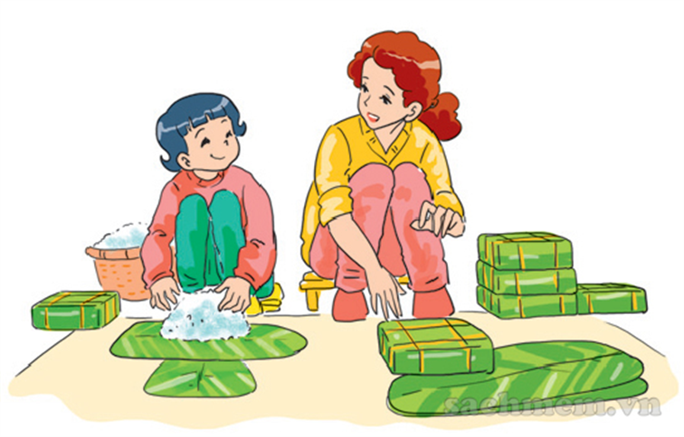
make banh chung
/meɪk banh chung/

Slide 7
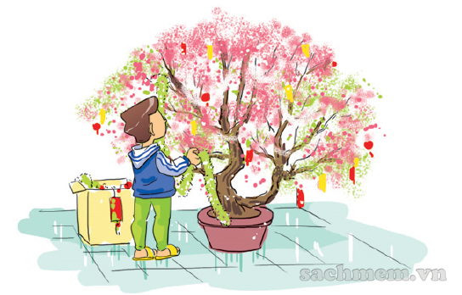
decorate the house
/ˈdɛkəˌreɪt ðə haʊs/

Slide 8
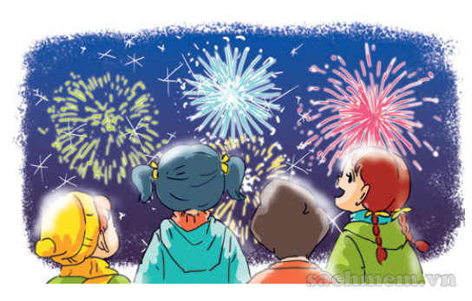
watch firework displays
/wɑʧ ˈfaɪrˌwɜrk dɪˈspleɪz/

Slide 9
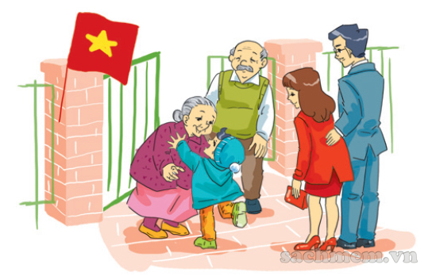
visit grandparents
/ˈvɪzət ˈgrændˌpɛrənts/

Slide 10
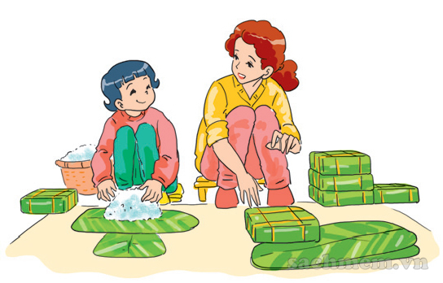
Vocabulary
decorate the house
make banh chung
watch firework displays
visit grandparents
/meɪk banh chung/
/ˈdɛkəˌreɪt ðə haʊs/
/wɑʧ ˈfaɪrˌwɜrk dɪˈspleɪz/
/ˈvɪzət ˈgrændˌpɛrənts/

Slide 11

have a party
/hæv ə ˈpɑːti/

Slide 12
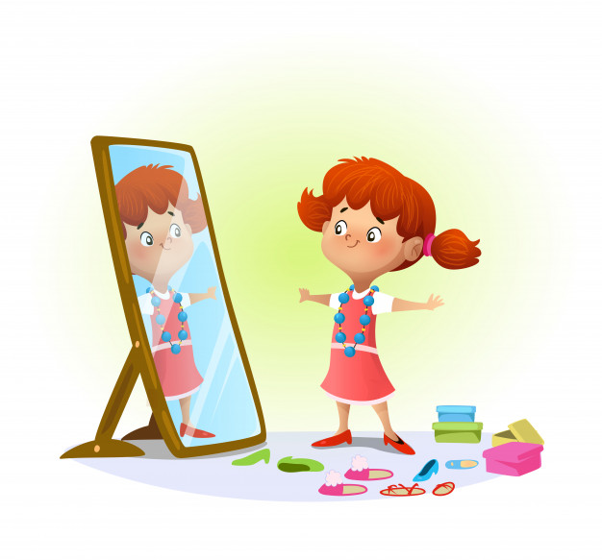
wear new clothes
/weə njuː kləʊðz/

Slide 13
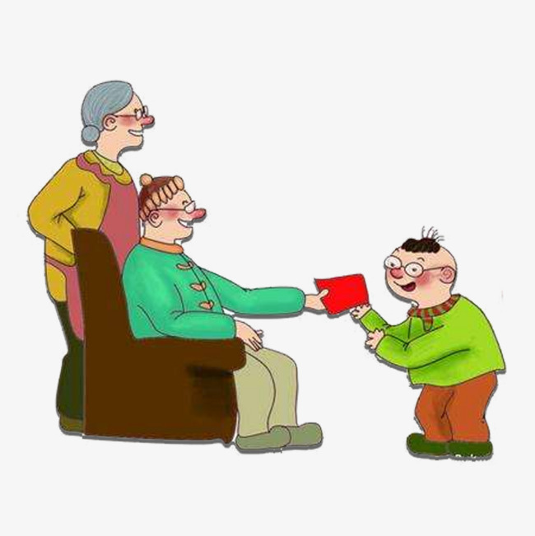
get lucky money
/gɛt ˈlʌki ˈmʌni/

Slide 14
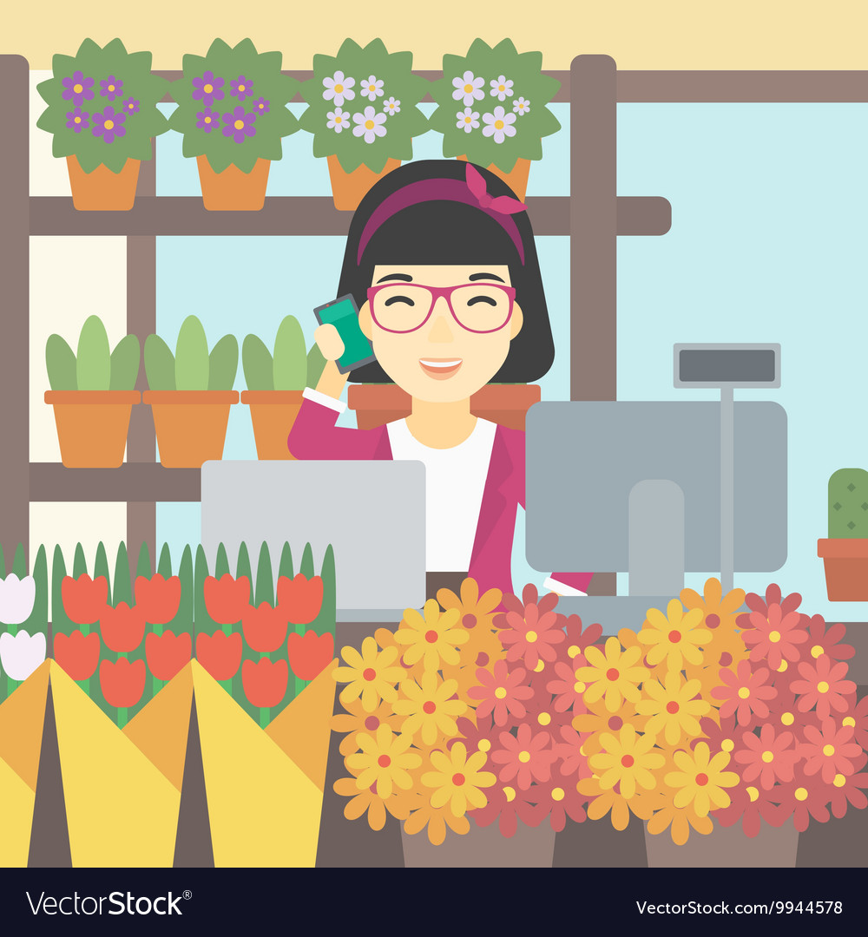
buy flowers
/baɪ ˈflaʊəz/

Slide 15
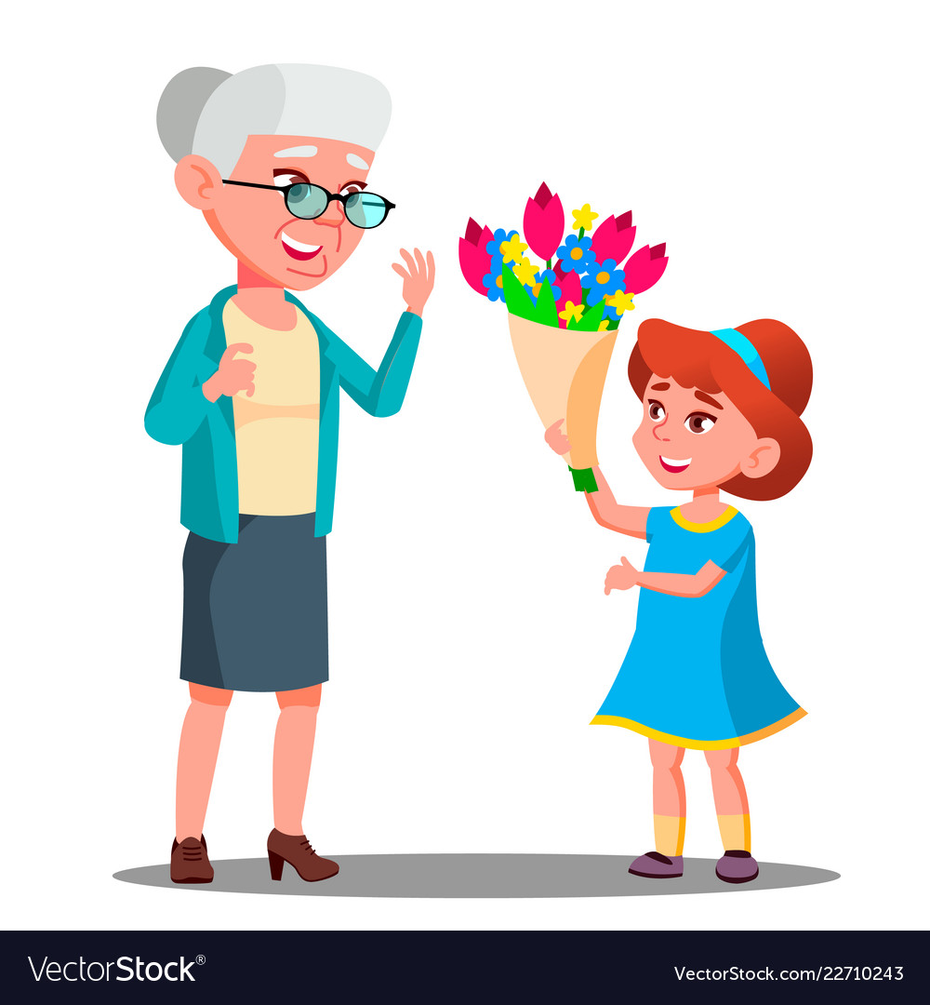
give flowers
/gɪv ˈflaʊəz/

Slide 16

go shopping
/gəʊ ˈʃɒpɪŋ/

Slide 17

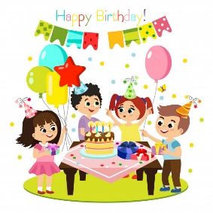


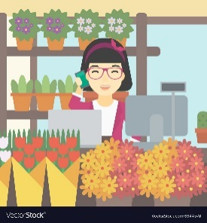


VOCABULARY
wear new clothes
get lucky money
have a party
buy flowers
give flowers
go shopping

Slide 18
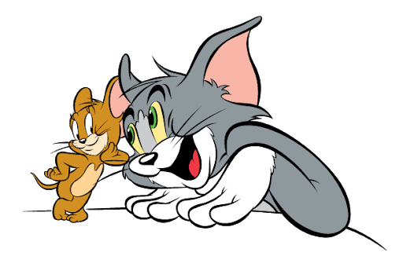
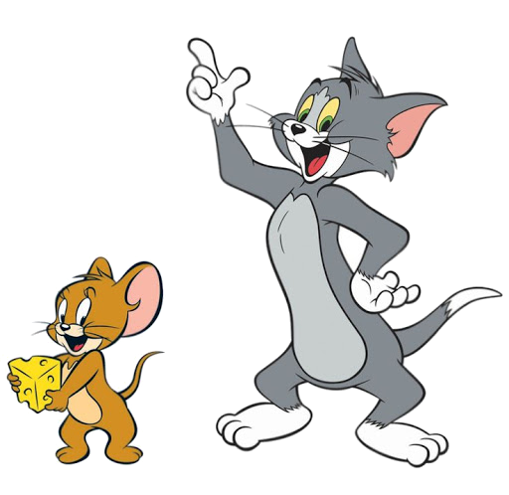

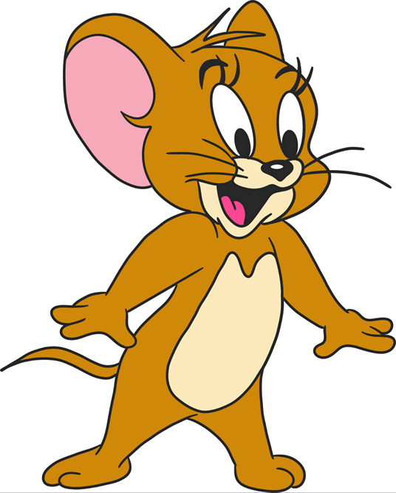
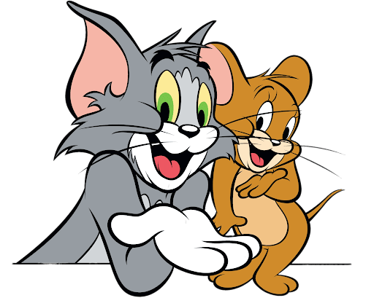

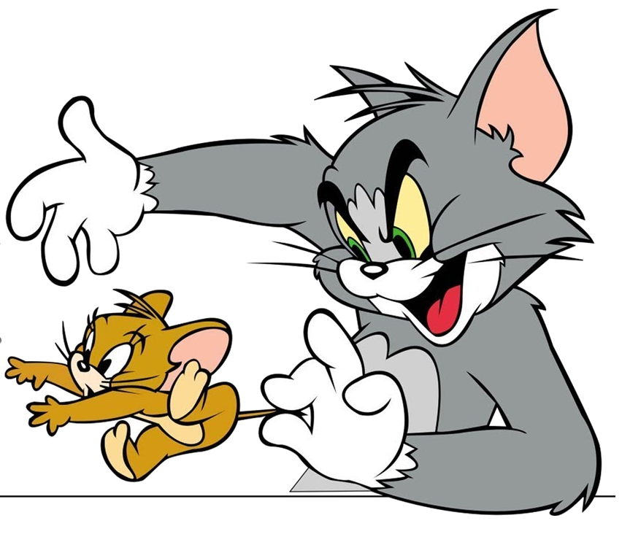
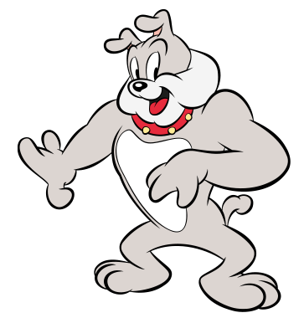
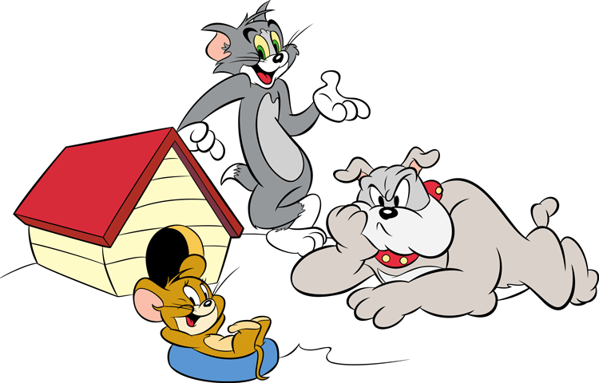
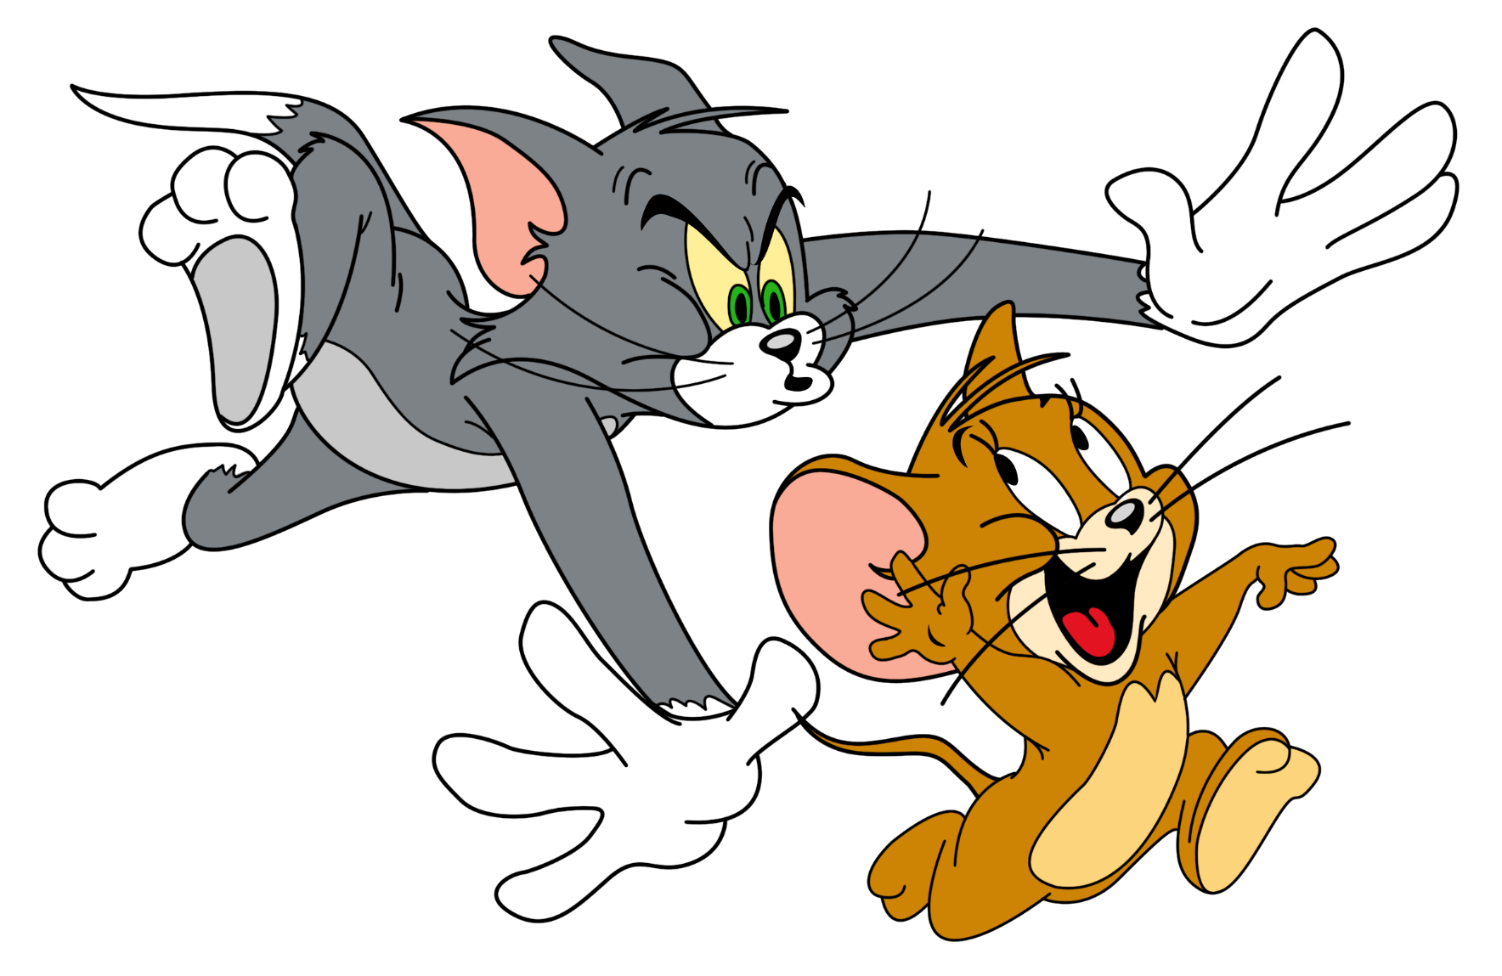

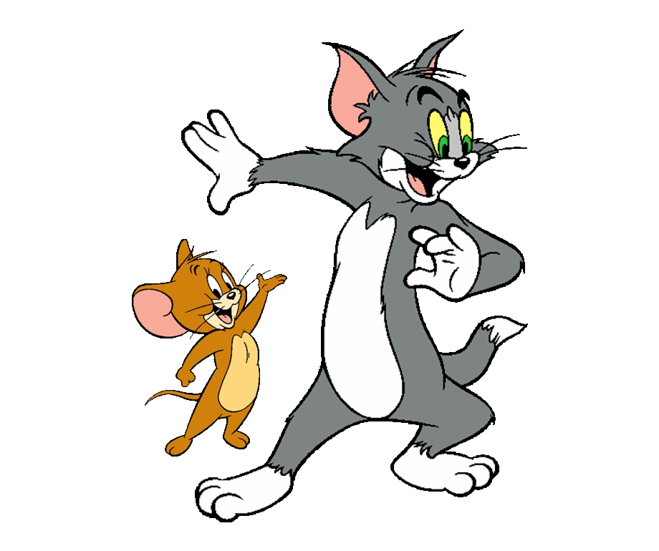
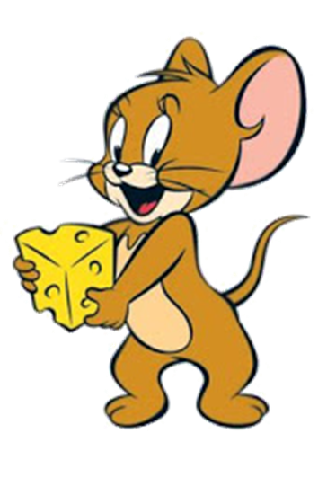
GAME

Slide 19


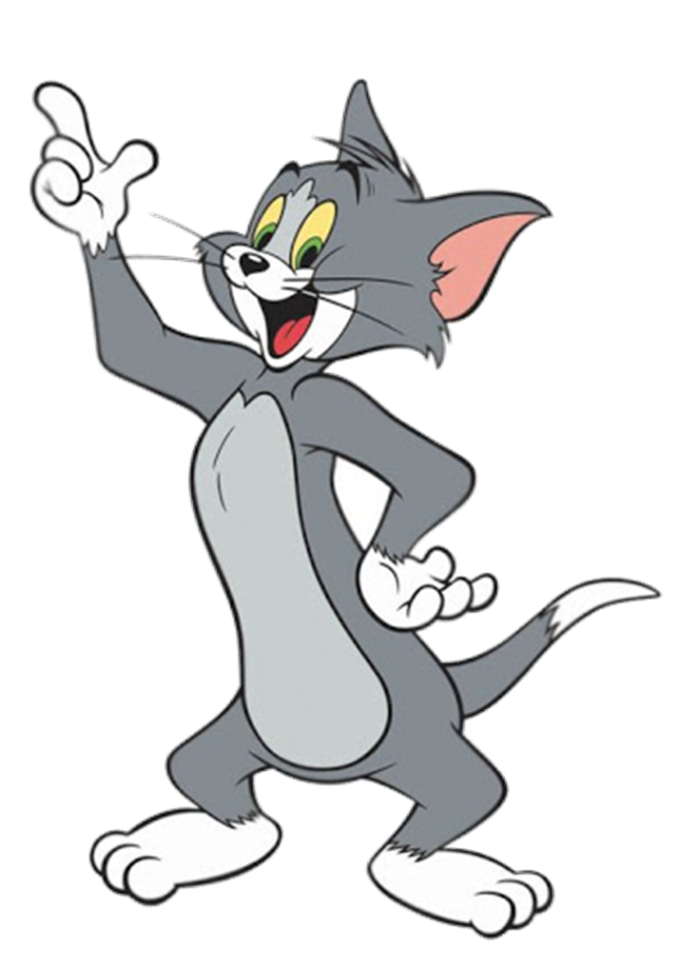

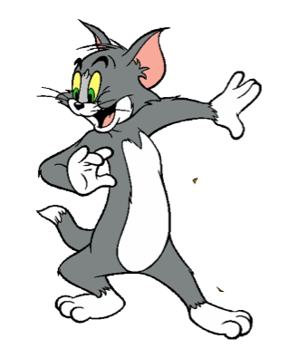






YOUTUBE: MsPham.
Facebook: Dạy và học cùng công nghệ.
decorate the house
YOUTUBE: MsPham.
Facebook: Powerpoint thật dễ
YOUTUBE: MsPham.
Facebook: Dạy và học cùng công nghệ.
YOUTUBE: MsPham.
Facebook: Dạy và học cùng công nghệ.
YOUTUBE: MsPham.
Facebook: Dạy và học cùng công nghệ.

Slide 20
YOUTUBE: MsPham.
Facebook: Dạy và học cùng công nghệ.
watch firework displays
YOUTUBE: MsPham.
Facebook: Powerpoint thật dễ
YOUTUBE: MsPham.
Facebook: Dạy và học cùng công nghệ.
YOUTUBE: MsPham.
Facebook: Dạy và học cùng công nghệ.
YOUTUBE: MsPham.
Facebook: Dạy và học cùng công nghệ.

Slide 21
YOUTUBE: MsPham.
Facebook: Dạy và học cùng công nghệ.
visit grandparents
YOUTUBE: MsPham.
Facebook: Powerpoint thật dễ
YOUTUBE: MsPham.
Facebook: Dạy và học cùng công nghệ.
YOUTUBE: MsPham.
Facebook: Dạy và học cùng công nghệ.
YOUTUBE: MsPham.
Facebook: Dạy và học cùng công nghệ.

Slide 22
YOUTUBE: MsPham.
Facebook: Dạy và học cùng công nghệ.
make banh chung
YOUTUBE: MsPham.
Facebook: Powerpoint thật dễ
YOUTUBE: MsPham.
Facebook: Dạy và học cùng công nghệ.
YOUTUBE: MsPham.
Facebook: Dạy và học cùng công nghệ.
YOUTUBE: MsPham.
Facebook: Dạy và học cùng công nghệ.

Slide 23
YOUTUBE: MsPham.
Facebook: Dạy và học cùng công nghệ.
make banh chung
YOUTUBE: MsPham.
Facebook: Powerpoint thật dễ
YOUTUBE: MsPham.
Facebook: Dạy và học cùng công nghệ.
YOUTUBE: MsPham.
Facebook: Dạy và học cùng công nghệ.
YOUTUBE: MsPham.
Facebook: Dạy và học cùng công nghệ.

Slide 24
YOUTUBE: MsPham.
Facebook: Dạy và học cùng công nghệ.
watch firework displays
YOUTUBE: MsPham.
Facebook: Powerpoint thật dễ
YOUTUBE: MsPham.
Facebook: Dạy và học cùng công nghệ.
YOUTUBE: MsPham.
Facebook: Dạy và học cùng công nghệ.
YOUTUBE: MsPham.
Facebook: Dạy và học cùng công nghệ.

Slide 25
YOUTUBE: MsPham.
Facebook: Dạy và học cùng công nghệ.
visit grandparents
YOUTUBE: MsPham.
Facebook: Powerpoint thật dễ
YOUTUBE: MsPham.
Facebook: Dạy và học cùng công nghệ.
YOUTUBE: MsPham.
Facebook: Dạy và học cùng công nghệ.
YOUTUBE: MsPham.
Facebook: Dạy và học cùng công nghệ.

Slide 26
YOUTUBE: MsPham.
Facebook: Dạy và học cùng công nghệ.
Gói bánh trưng
visit grandparents
YOUTUBE: MsPham.
Facebook: Powerpoint thật dễ
YOUTUBE: MsPham.
Facebook: Dạy và học cùng công nghệ.
YOUTUBE: MsPham.
Facebook: Dạy và học cùng công nghệ.
YOUTUBE: MsPham.
Facebook: Dạy và học cùng công nghệ.

Slide 27
YOUTUBE: MsPham.
Facebook: Dạy và học cùng công nghệ.
Xem pháo hoa
watch firework displays
YOUTUBE: MsPham.
Facebook: Powerpoint thật dễ
YOUTUBE: MsPham.
Facebook: Dạy và học cùng công nghệ.
YOUTUBE: MsPham.
Facebook: Dạy và học cùng công nghệ.
YOUTUBE: MsPham.
Facebook: Dạy và học cùng công nghệ.

Slide 28
YOUTUBE: MsPham.
Facebook: Dạy và học cùng công nghệ.
Đi thăm ông bà
decorate the house
YOUTUBE: MsPham.
Facebook: Powerpoint thật dễ
YOUTUBE: MsPham.
Facebook: Dạy và học cùng công nghệ.
YOUTUBE: MsPham.
Facebook: Dạy và học cùng công nghệ.
YOUTUBE: MsPham.
Facebook: Dạy và học cùng công nghệ.

Slide 29

YOUTUBE: MsPham.
Facebook: Dạy và học cùng công nghệ.
THANK YOU!
YOUTUBE: MsPham.
Facebook: Powerpoint thật dễ
YOUTUBE: MsPham.
Facebook: Dạy và học cùng công nghệ.
YOUTUBE: MsPham.
Facebook: Dạy và học cùng công nghệ.
YOUTUBE: MsPham.
Facebook: Dạy và học cùng công nghệ.

Slide 30
02
Model sentence

Slide 31
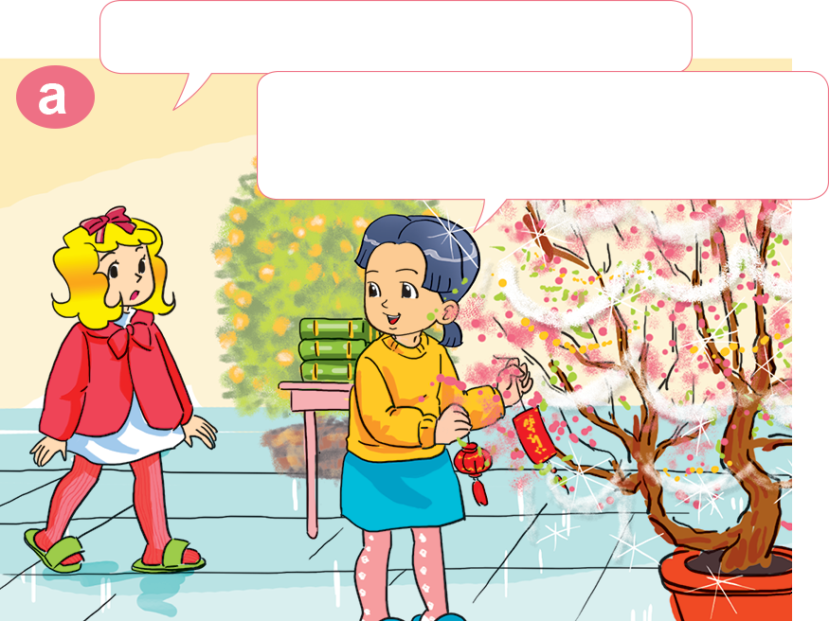
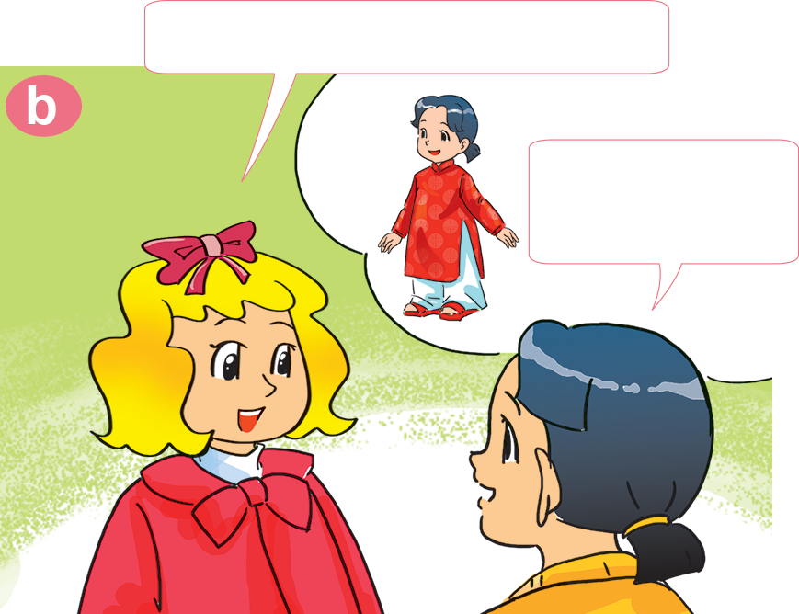

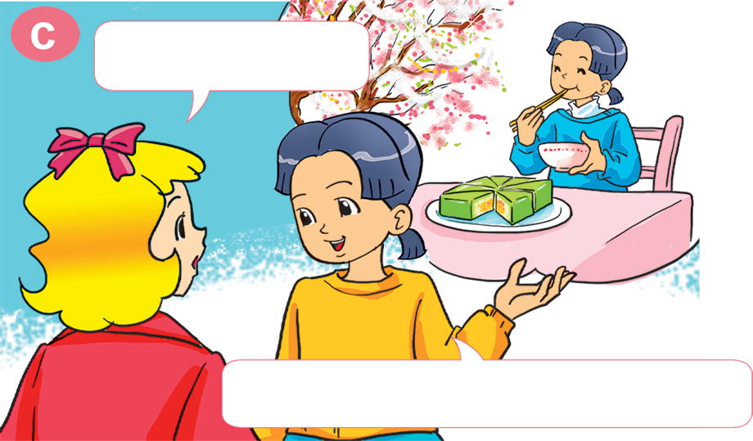
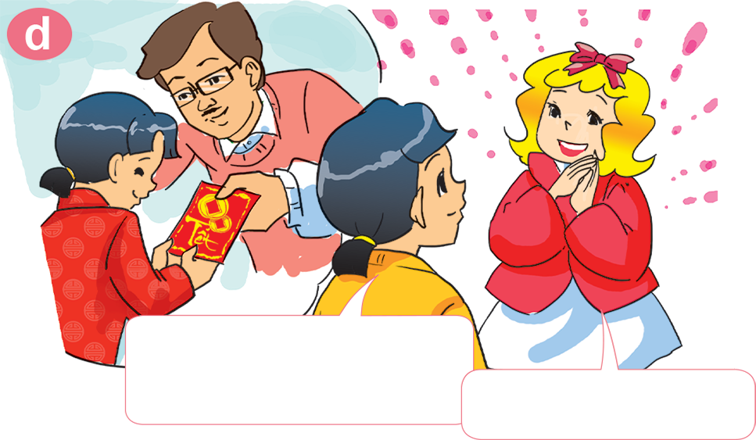
1. Look, listen and repeat
What are you doing, Mai?
What do you do at Tet?
I'm decorating my house. It's Tet soon.
I wear nice clothes.
What else?
I get lucky money from my parents.
I eat a lot of banh chung.
Oh, I like Tet!

Slide 32
What do you do
at Tet?
I _________.
make banh chung
visit grandparents
decorate the house
watch firework displays

Slide 33
2. Point and say
What do you do at Tet?
I ______________________.
make banh chung

Slide 34
2. Point and say
What do you do at Tet?
I ______________________.
decorate the house

Slide 35
2. Point and say
What do you do at Tet?
I ______________________.
watch firework displays

Slide 36
2. Point and say
What do you do at Tet?
I ______________________.
visit grandparents

Slide 37
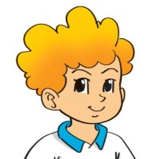
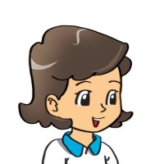
3. Let’s talk
New Year
When is___________?
the first of January
It's on________________.
Tet
What do you do at/on_________?
I ___________________________.
decorate the house and wear new clothes

Slide 38
03
Practice

Slide 39
4. Listen and circle
What do they do at Tet?
1. Phong ___________.
a. buys flowers b. decorates the house
2. His parents ___________.
a. go shopping b. make banh chung
3. His sister ___________.
a. wears new clothes b. gets lucky money
4. Phong and his sister ___________.
a. watch firework displays b. visit teachers

Slide 40
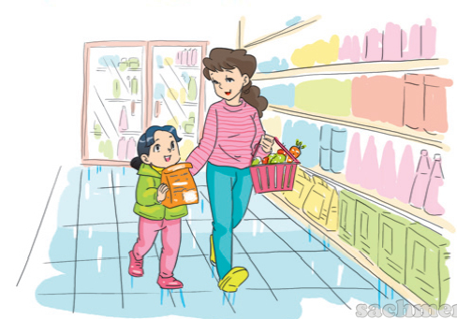
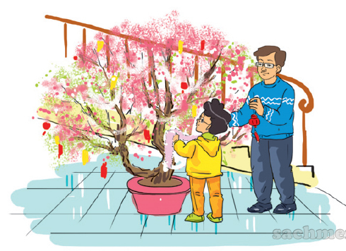
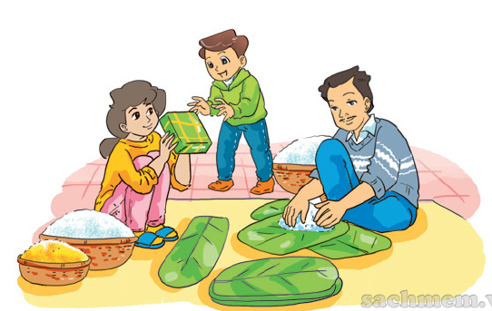
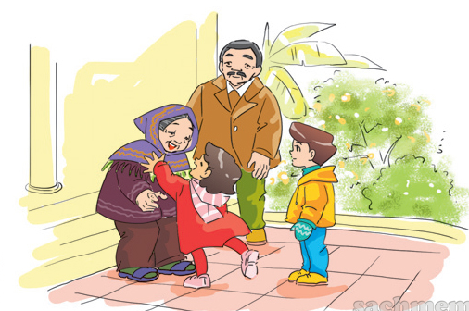
5. Look and write
go shopping
1. Mai and her mother ________________.
2. Phong and his father ___________________.
decorate their house
make banh chung
3. Nam and his family ___________________.
visit their grandparents
4. Hoa and her brother _____________________.

Slide 41











Ms Huyền Phạm
0936.082.789
Ms Huyền Phạm
0936.082.789
Ms Huyền Phạm
0936.082.789
Ms Huyền Phạm - 0936.082.789 – YOUTUBE: MsPham. Facebook: Dạy và học cùng công nghệ.
Ms Huyền Phạm
0936.082.789

Slide 42
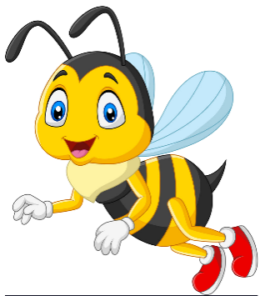





What do you do at Tet?
I _______ the house.
Next
do
decorate
make
visit

Slide 43
What do you do at Tet?
I _____ my grandparents.
Next
decorate
go
visit
do

Slide 44
What do you do at Tet?
I _____ Banh Chung
Next
make
do
decorate
visit

Slide 45
What do you do at Tet?
I go _________.
Next
shopping
to school
swimming
to the farm

Slide 46
What do you do at Tet?
I _____ firework displays.
Next
visit
make
do
watch

Slide 47
What _____you do at Tet?
I go shopping.
Next
are
does
do
like

Slide 48
______________
I get luckey money.
Next
What do you do at Tet?
What do you do at Christmas?
What do you do at Teacher’s Day?
What do you do?

Slide 49
______ do you do at Tet?
I visit my teachers.
Next
Where
How
when
what

Slide 50
What do you do at Tet?
I get _________.
Next
good mark
lucky money
books
Banh Chung

Slide 51
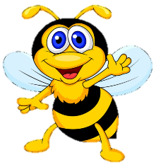








Slide 52
04
Homelink

Slide 53


Thursday, March 3rd 2022
Unit 15: When’s Children’s day?
Lesson 2
1. New words:
2. Model sentence:
Make banh Chung: gói bánh chưng
Decorate the house: trang trí nhà cửa
Watch firework display: xem pháo hoa
Visit grandparents: thăm ông bà
Wear new clothes: mặc quần áo mới
Get lucky money: nhận tiền lì xì
Buy flowers: mua hoa
Give flowers: tặng hoa
Go shopping: đi mua sắm
What do you do on/at …….?
I………
3. Homework:
Write NW x 2lines, learn by heart.
Do WB: part B- 1,2 (page 60, 61)
part F- 1,2 ( page 63)

Slide 54

THANK YOU!

