Slide 1
Online Classroom Rules
Be on time.
Mute yourself.
Turn on Camera.
Raise your hand to talk.
Prepare your supplies.

Slide 2
Unit 15: When’s Children’s Day?
Lesson 1
Teacher: Ngoc Khue

Slide 3
Objectives
Use the words and phrases related to the topic Popular Festivals.
Ask and answer about when a festival is, using When’s ……..? – It’s on the….. of……
Mục đích bài học:
Sử dụng các từ và cụm từ liên quan đến chủ đề Các lễ hội phổ biến.
Hỏi và trả lời xem khi nào diễn ra lễ hội đó, sử dụng mẫu câu: When’s ……..? – It’s on the….. of……

Slide 4
Table of contents
01
02
New words
Model sentence
03
04
Practice
Homelink

Slide 5
Warm Up!
https://quizizz.com/admin/quiz/620f92fb5f4fce001db82d49/g4-unit-14-lesson-2

Slide 6
01.
New words

Slide 7




New year
/ˌnjuː ˈjɜːr/

Slide 8
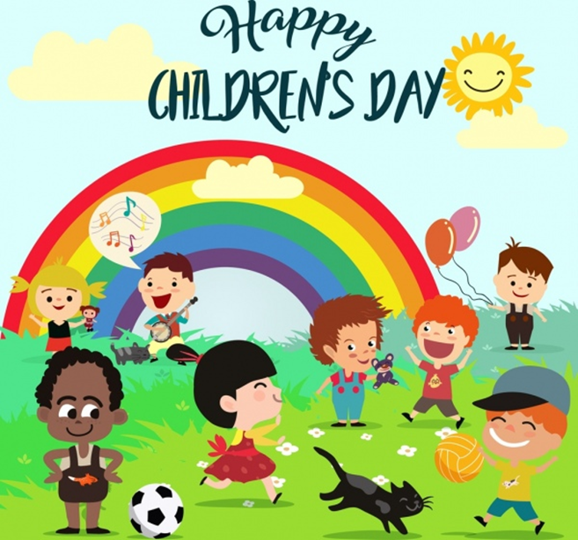

Children’s Day
/ˈʧɪldrənz deɪ/

Slide 9


Teachers’ Day
/ˈti:ʧərz deɪ/

Slide 10
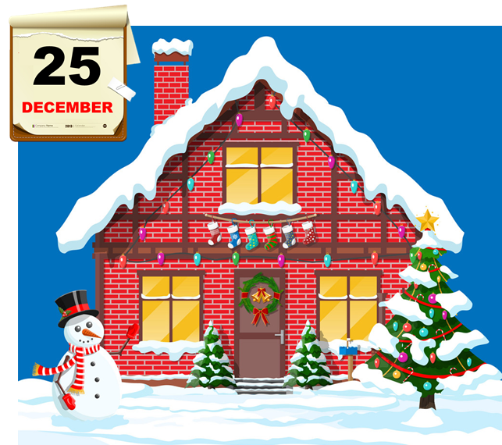
Christmas
/ˈkrɪsməs/

Slide 11





Vocabulary
New year
Children’s Day
Teachers’ Day
Christmas

Slide 12

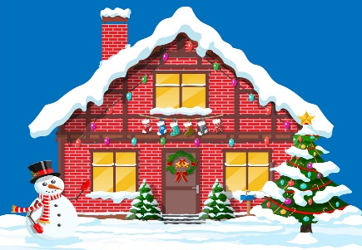
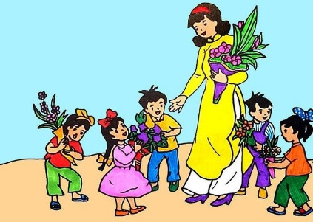


Click the best bee.
Children’s Day
1
Christmas
2
Teachers’ Day
New year
3
4

Slide 13
02.
Model sentence

Slide 14
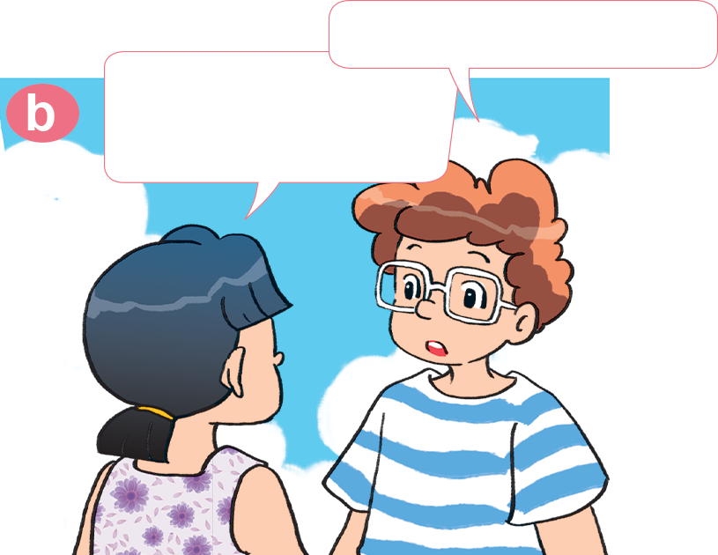

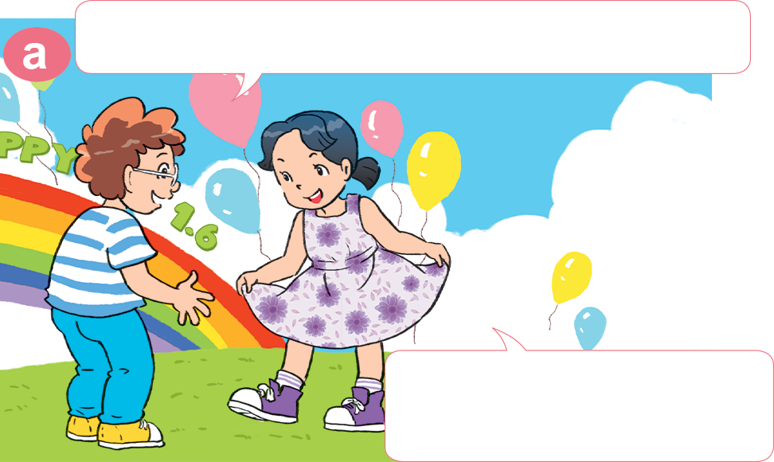
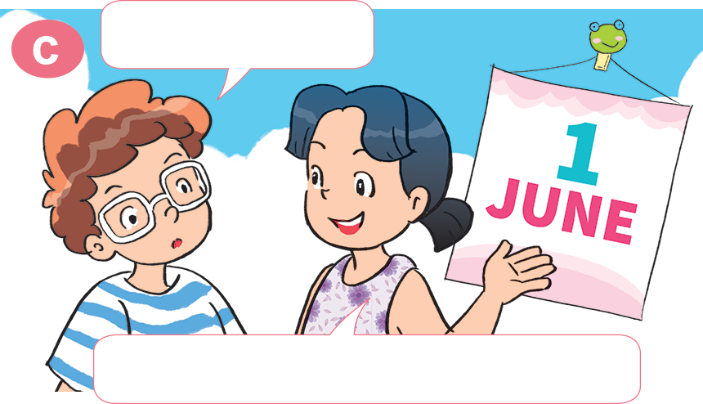
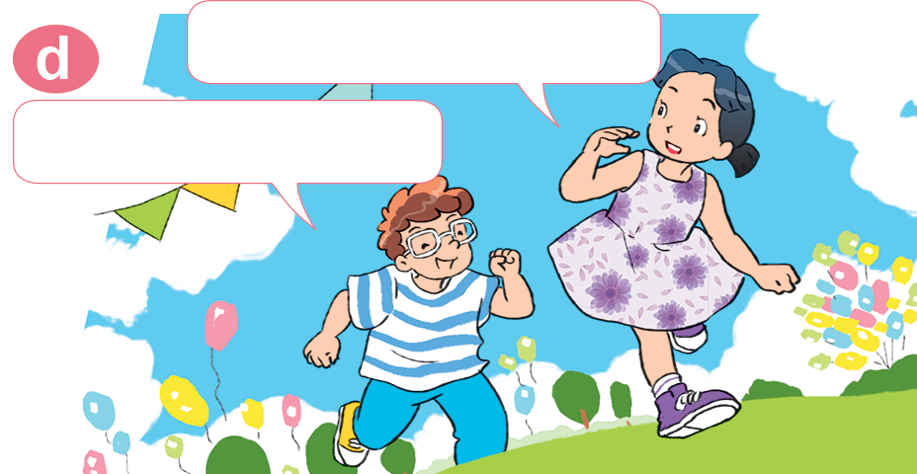
2. Look, listen and repeat
What party is it?
Hi, Mai. You look very smart today!
It's a party for Children's Day.
Yes, because we're having a party.
When is it?
Come and join us.
Yes! Thank you.
It's on the first of June.

Slide 15
2. Point and say
When is _________________?
It's on _______________________.
New Year
the first of January

Slide 16
2. Point and say
When is _________________?
It's on _______________________.
Children’s Day
the first of June

Slide 17

2. Point and say
When is _________________?
It's on _________________________.
Teacher’s Day
the twentieth of November

Slide 18
2. Point and say
When is _________________?
It's on __________________________.
Christmas
the twenty-fifth of December

Slide 19
When is ________________?
It’s on _____________.
New year
Christmas
Children’s Day
Teacher’s Day
on the first of January
the twenty-fifth
of December
the first of June
the twentieth of November

Slide 20
03.
Practice

Slide 21
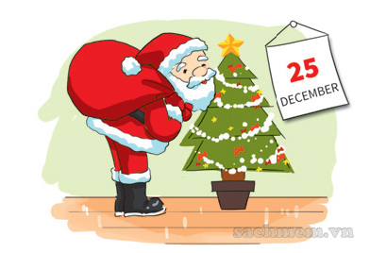
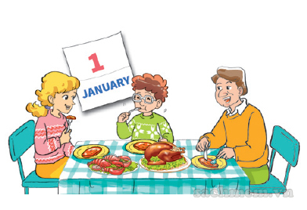
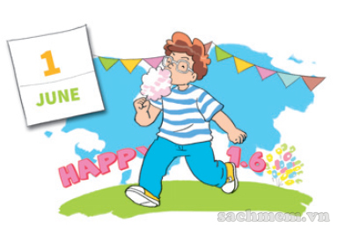

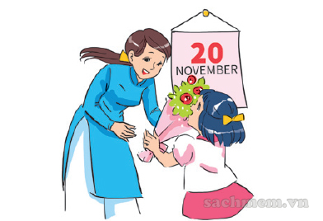
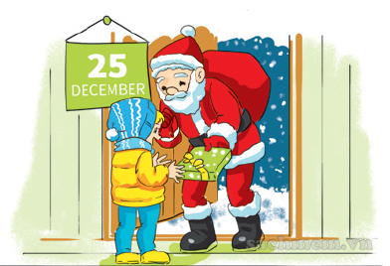

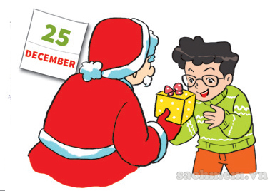
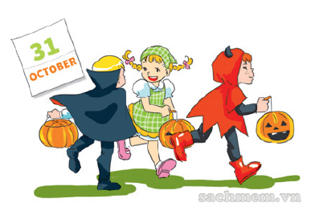
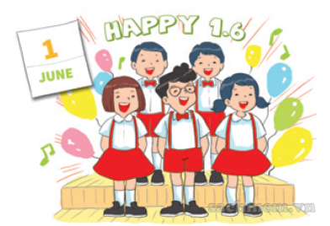
3. Listen and tick
1
a
b
c
2
a
b
c
3
a
b
c

Slide 22
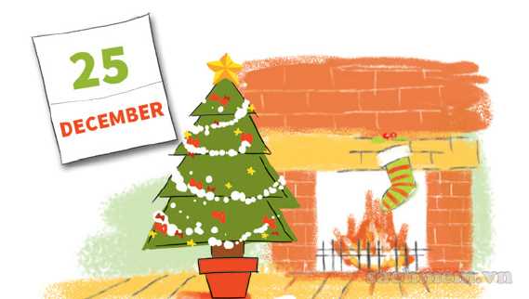
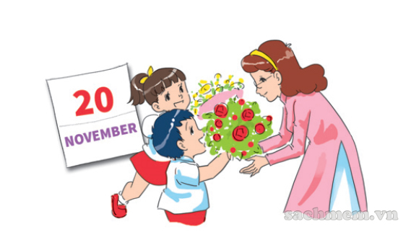
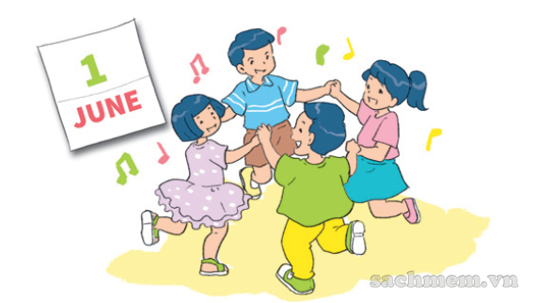
5. Look and write
When is Christmas?
It's on _______________________.
the twenty-fifth of December
When is Teacher's Day?
It's on _______________________.
the twentieth of November
When is Children's Day?
It's on _______________________.
the first of June

Slide 23

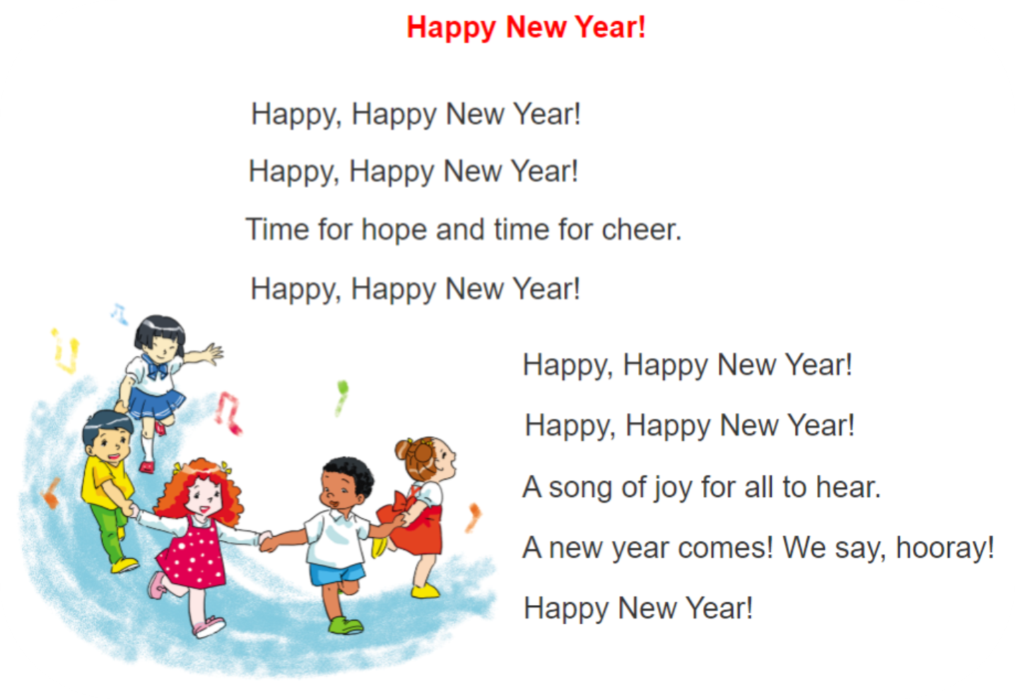
6. Let’s sing

Slide 24
04
Homelink

Slide 25
Monday, February 28th 2022
Unit 15: When’s Children’s day?
Lesson 1
1. New words:
2. Model sentence:
New year: Năm mới
Children’s Day: Quốc tế thiếu nhi
Teachers’ Day: Ngày nhà giáo
Christmas: Giáng sinh
When’s Children’s Day?
It’s on the first of June.
3. Homework:
Write NW x 2lines, learn by heart.
Do WB: part C- 1,2 (page 61)

