Slide 1
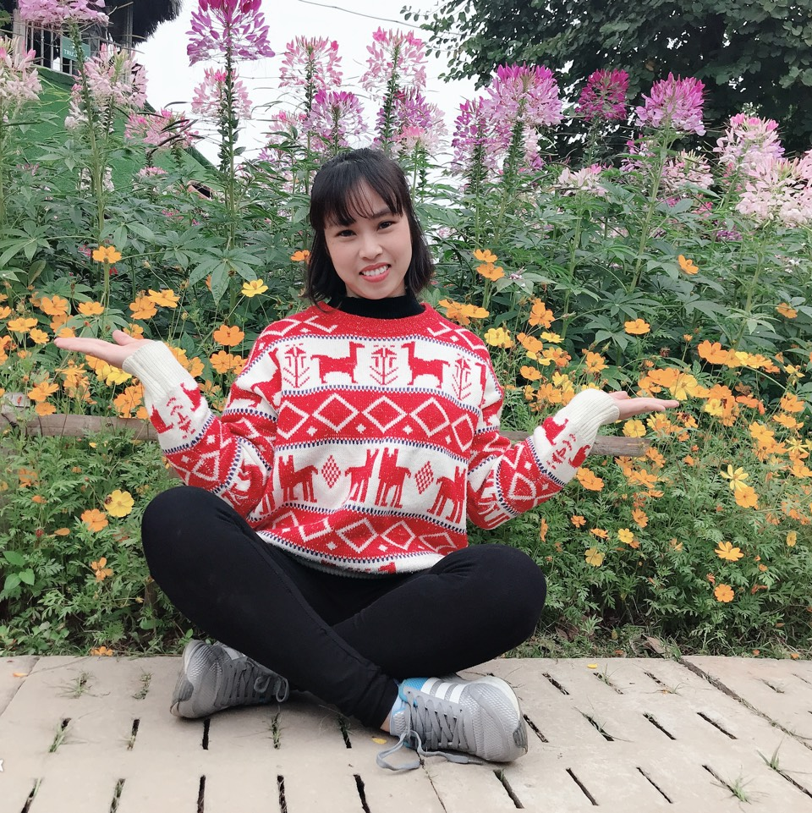
Online Classroom Rules
Be on time.
Mute yourself.
Turn on Camera.
Raise your hand to talk.
Prepare your supplies.

Slide 2
Unit 14: What does he look like?
Lesson 3
Teacher: Ngoc Khue

Slide 3
Table of Contents.
Revision
Phonics
Practice
Homelink

Slide 4
Objectives
Use the words and phrases related to the topic Physical Appearance.
Pronounce the sounds “th”
Mục đích bài học:
Sử dụng các từ và cụm từ liên quan đến chủ đề Ngoại hình.
Phát âm đúng âm “th”

Slide 5
Revision
1

Slide 6
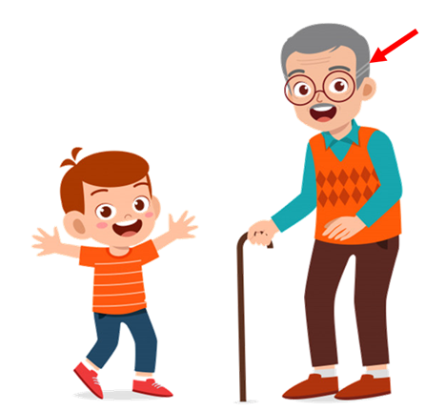
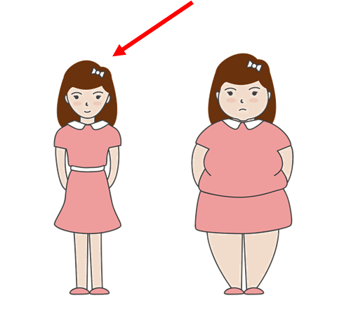
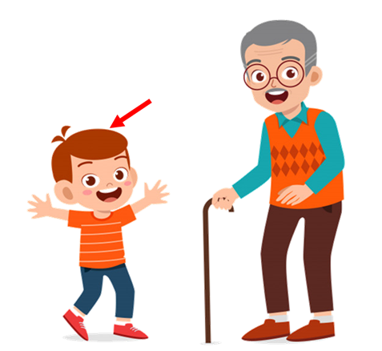
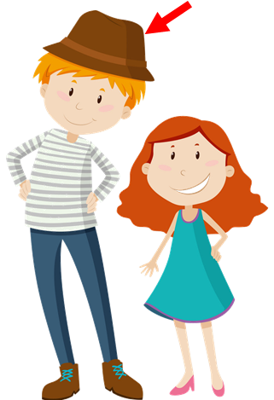
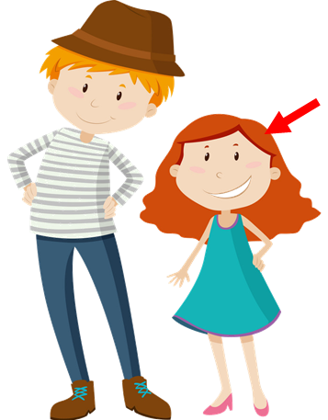
What does she / he look like?
She / He ____________.
old
slim
short
young
tall

Slide 7
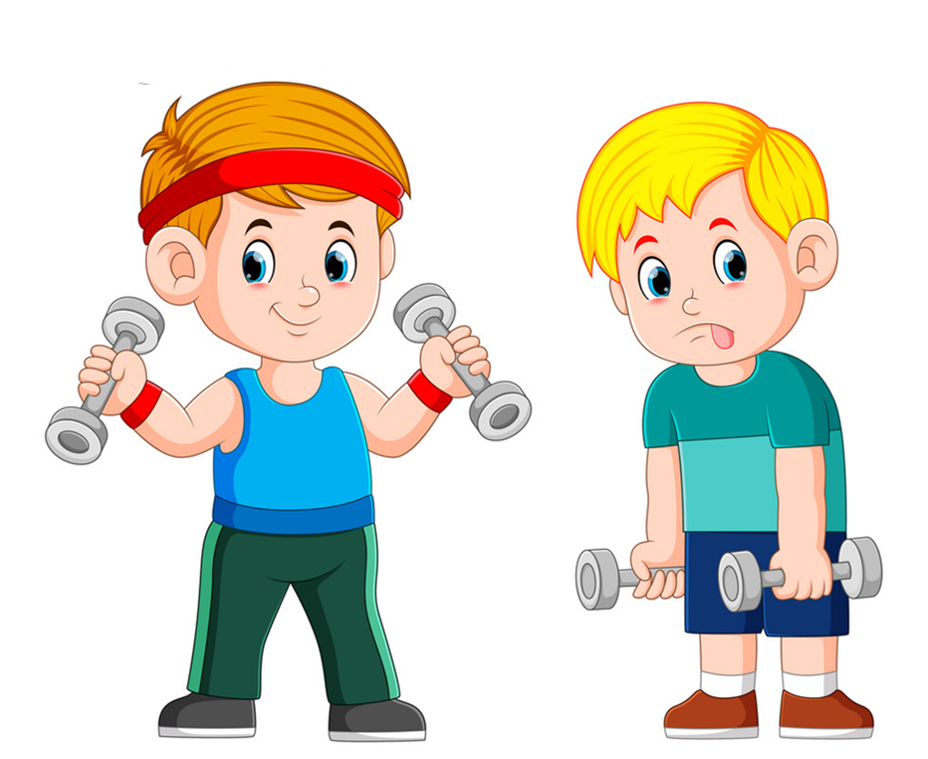
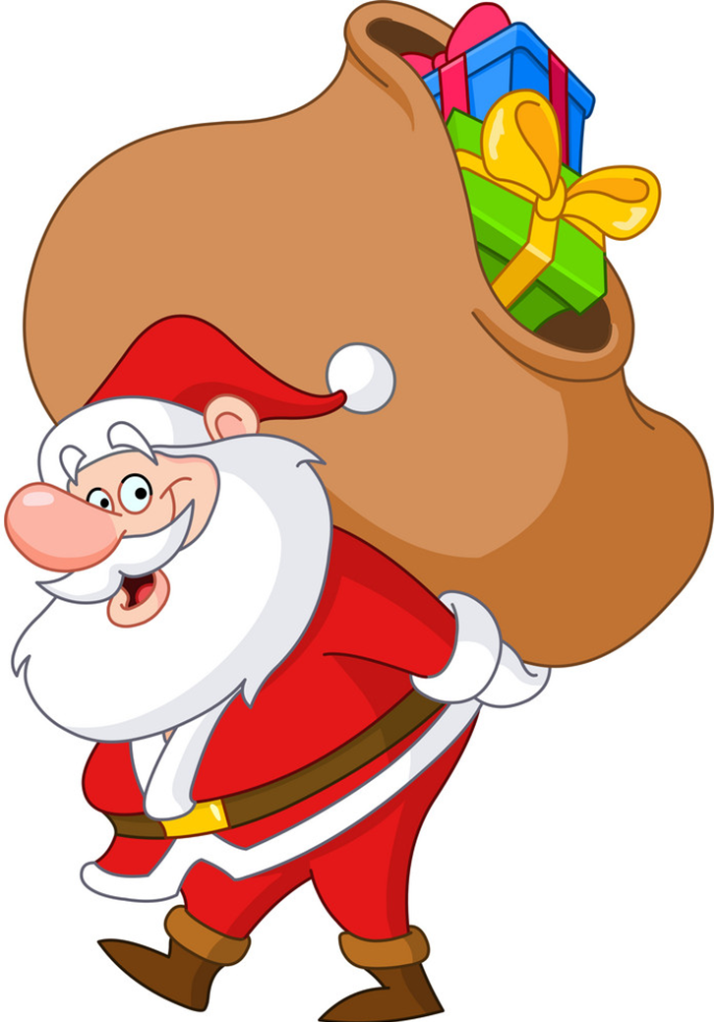
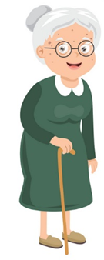
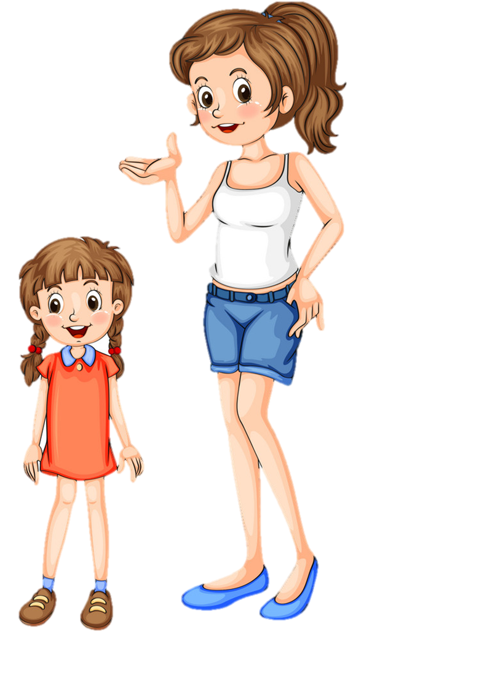
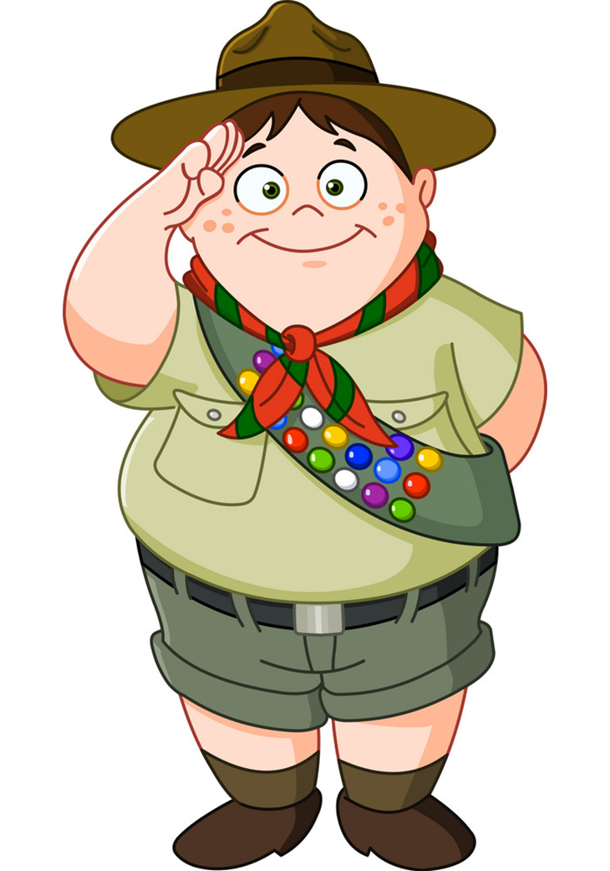
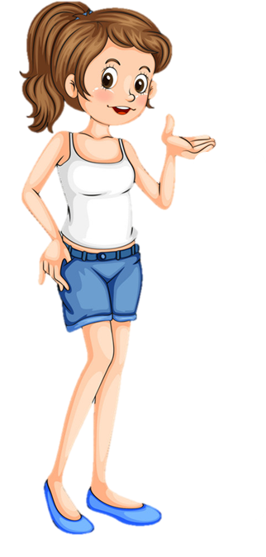
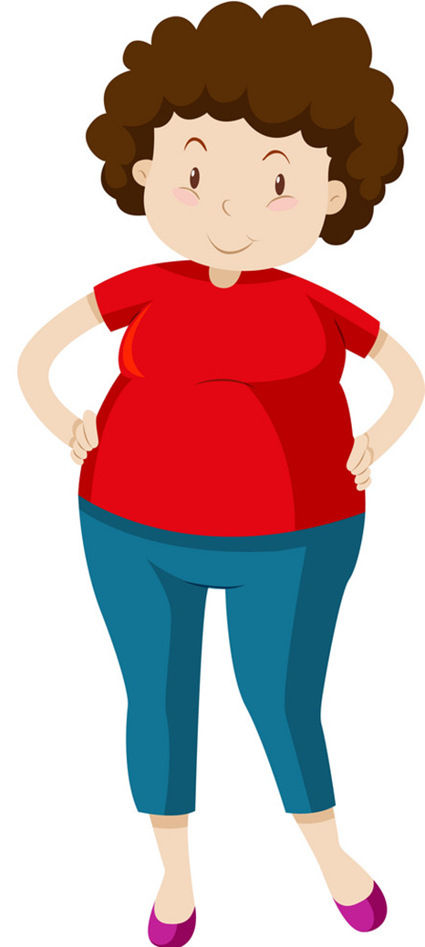
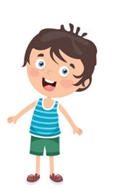
Who's ________?
_______ is _____ than ______.
younger
stronger
older
taller
bigger
shorter

Slide 8
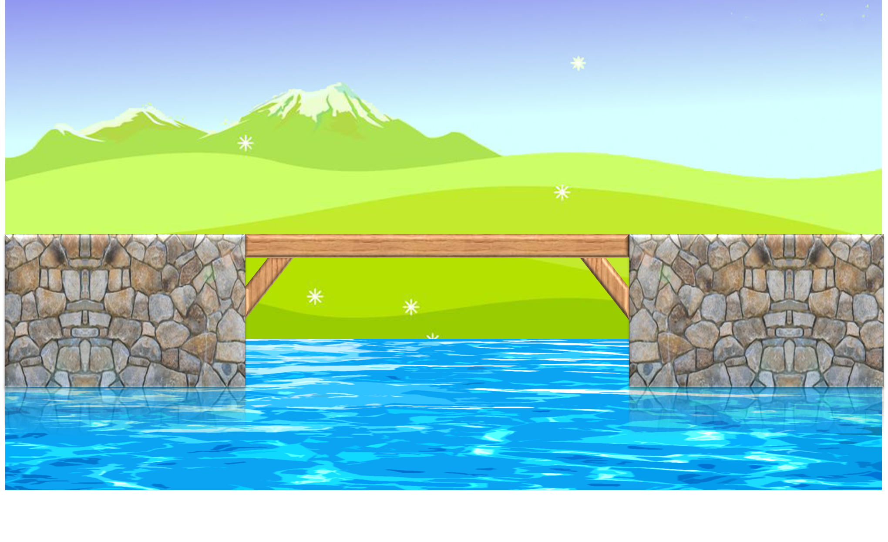
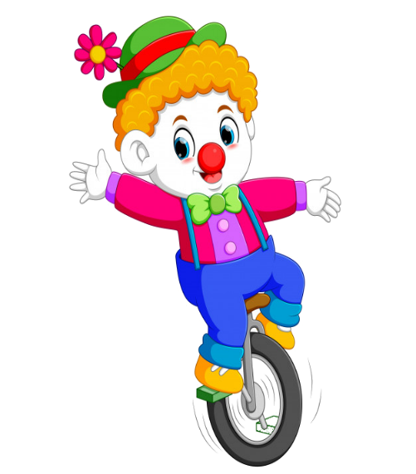



Slide 9



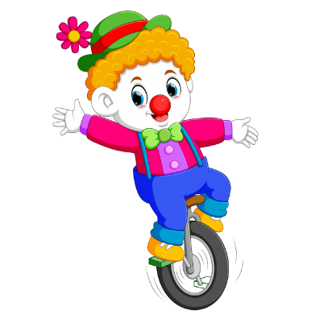
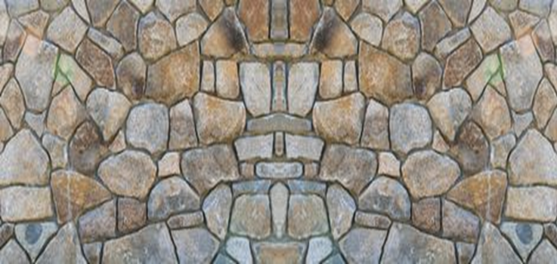




Tony is _____ than his father.
Shorter
Bigger
Taller
Tronger

Slide 10

My mother’s thirty-three years old. She’s ___________ than my father.
slimmer
older
younger
stronger

Slide 11

My sister’s slim. She’s _____ than my mother.
shorter
slimmer
taller
limmer

Slide 12

I’m not very tall, but I’m taller than my ______.
brother
friend
mother
sister

Slide 13
A: ___ does your father look like?
B: He’s tall and strong.
What
How
Who
When

Slide 14
A: What does your ____ look like?
B: She’s small and short.
brother
grandfather
mother
father

Slide 15
My sister is shorter _____ me.
then
than
them
the

Slide 16
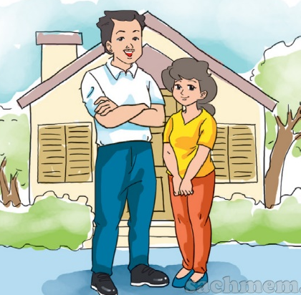
The mother is shorter
than the father.
What does your father look like?
How old is your mother?
Who’s that man?
Who’s shorter?

Slide 17



Slide 18
Phonics
2

Slide 19

1. Listen and repeat.
th | this | This is my mother.
 | that | That is my father.
th | thin | The book is thin.
 | thick | The dictionary is thick.

Slide 20
1. Listen and repeat.
th | this | This is my mother.
 | that | That is my father.
th | thin | The book is thin.
 | thick | The dictionary is thick.

Slide 21
2. Listen and circle.
1. My brother is ___________.
a. thin b. there
2. My sister is ___________.
a. There b. three
3. ___________ books are on the table.
a. Their b. The
4. Their books are ___________.
a. Thin b. thick

Slide 22

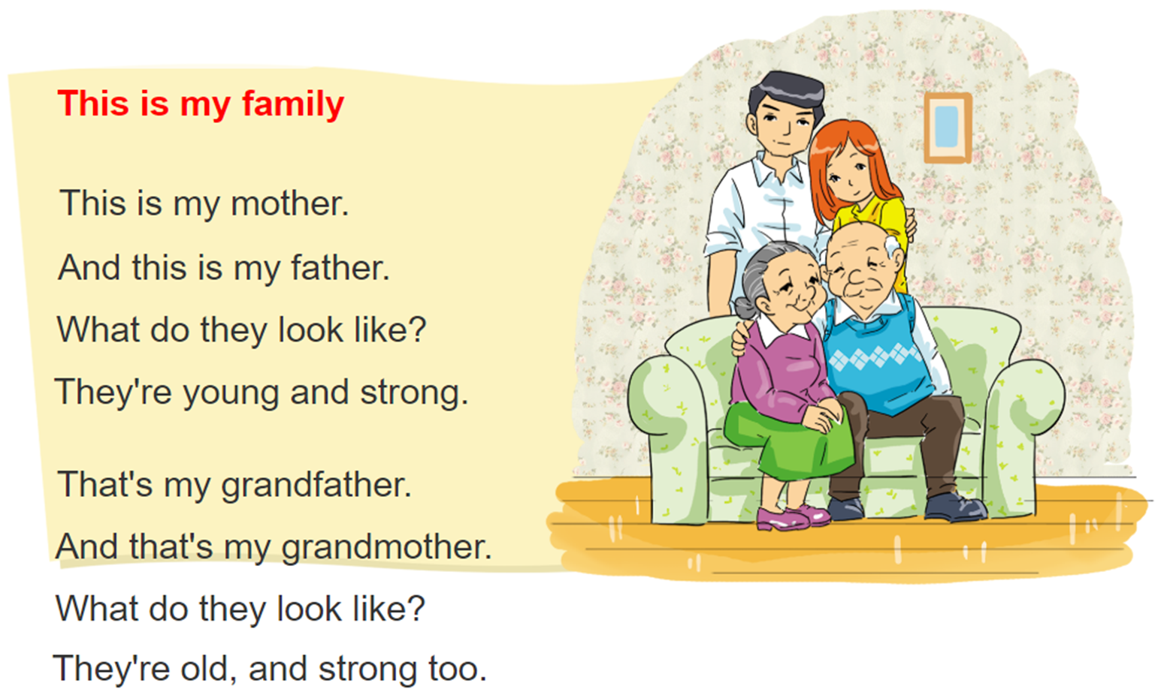

3. Let's chant

Slide 23
3.
Practice

Slide 24
4. Read and write
Dear Jane,
My name's Marie. I'm nine years old and I live in Can Tho. There are four people in my family: my father, my mother, my brother and me. My father's 34 years old. He's a teacher, and he's tall and slim. My mother's 31 years old. She's a doctor. I think she's very beautiful! My brother and I are pupils at Hoa Sen Primary School. I'm older than my brother but he's taller than me.
Best wishes, Marie.
1. What does Marie's father do?
2. What does her father look like?
3. What does her mother look like?
4. Who is younger, Marie or her brother?
5. Who is shorter, Marie or her brother?
______________________.
______________________. ______________________. ______________________. ______________________.
He is a teacher
He is tall and slim
Her mother is beautiful
Her brother is younger
Marie is shorter

Slide 25
5. Write:
Dear, __________
My name's ____________. I'm _______ years old.
There are ____________ people in my family.
My father's ____________.
My mother's _______________________.
Best wishes.
Lucy
Khue
nine
three
tall and slim
shorter than my father

Slide 26
4.
Homelink

Slide 27
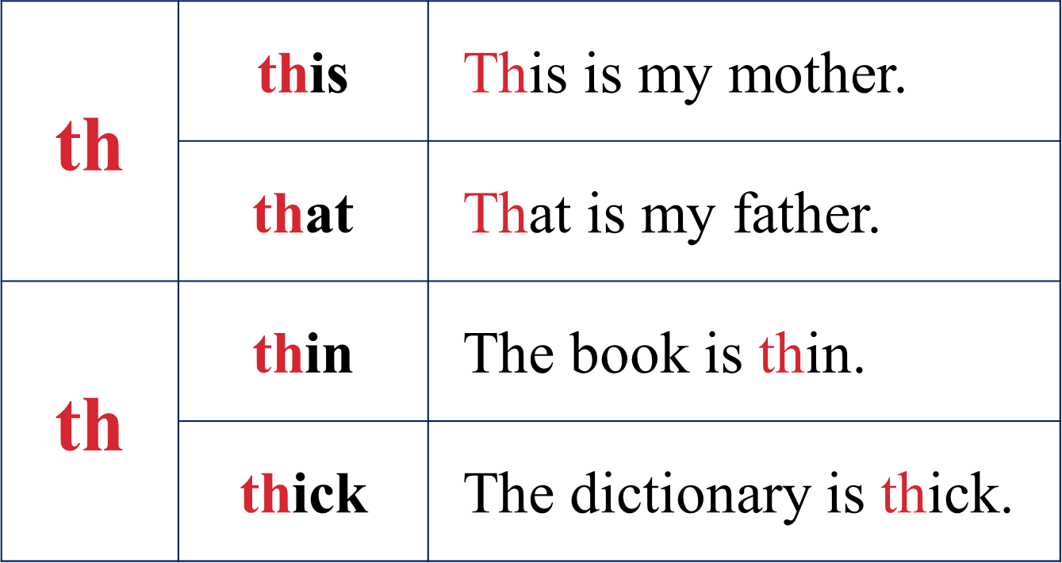
Thursday, Freruary 24th 2022
Unit 14: What does he look like?
Lesson 3
1. Phonic:
2. Homework
Practise the sound “th”.
Do WB: part A-1,2 (page 56)

Slide 28
Thank you!

