Slide 1
Online Classroom Rules
Be on time.
Mute yourself.
Turn on Camera.
Raise your hand to talk.
Prepare your supplies.

Slide 2
Unit 14: What does he look like?
Lesson 1
Teacher: Ngoc Khue

Slide 3
Objectives
Use the words and phrases related to the topic Physical Appearance.
Ask and answer about someone’s physical appearance, using What does he/she look like? - He’s/ She’s....
Mục đích bài học:
Sử dụng các từ và cụm từ liên quan đến chủ đề Ngoại hình.
- Hỏi và trả lời xem ngoại hình của ai đó như thế nào, sử dụng mẫu câu: What does he/she look like? - He’s/ She’s.....

Slide 4
01
03
New words
Practice
02
04
Model sentence
Homelink

Slide 5
Warm Up!

Slide 6
01
New words

Slide 7

Vocabulary
tall
short
/tɔːl/
/ʃɔːt/

Slide 8
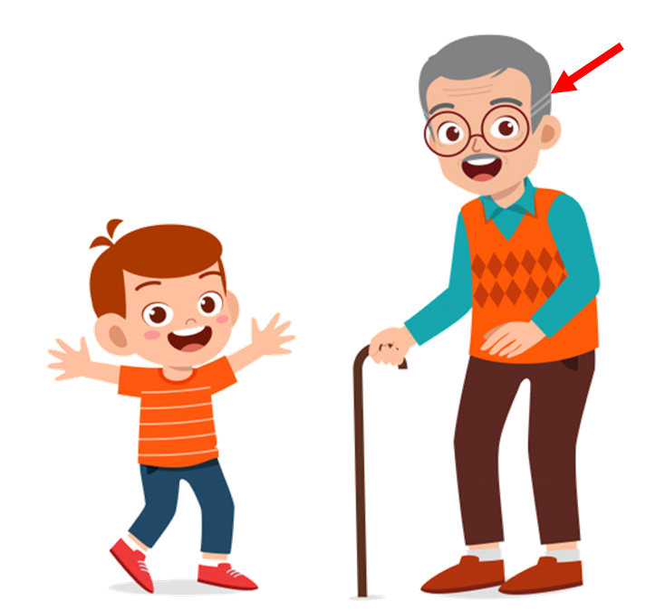
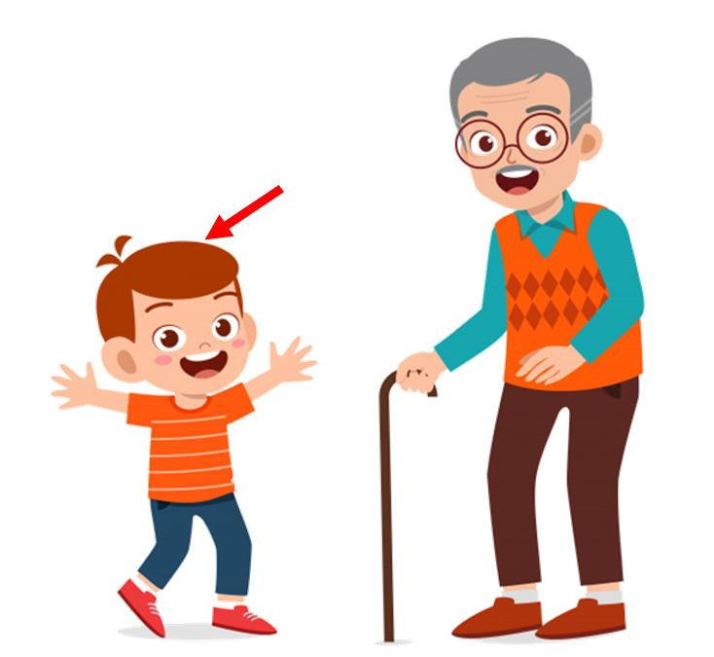
Vocabulary
old
young
/əʊld/
/jʌŋ/

Slide 9
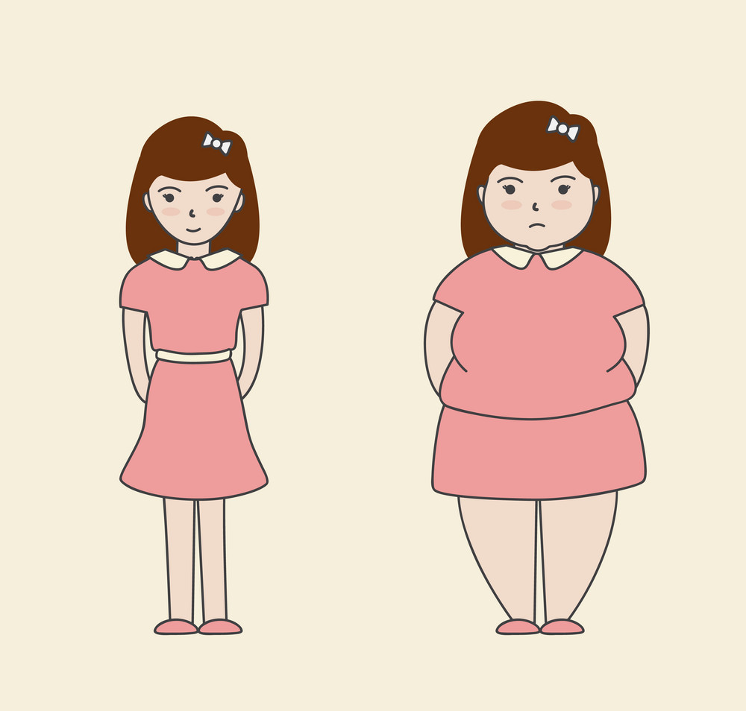
Vocabulary
slim
/slɪm/

Slide 10
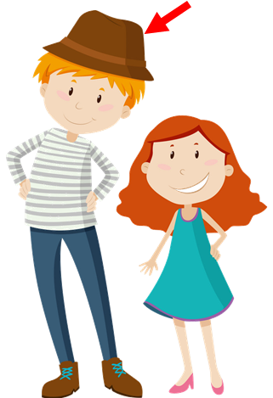
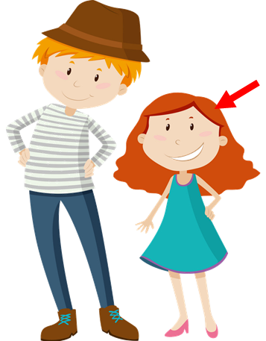

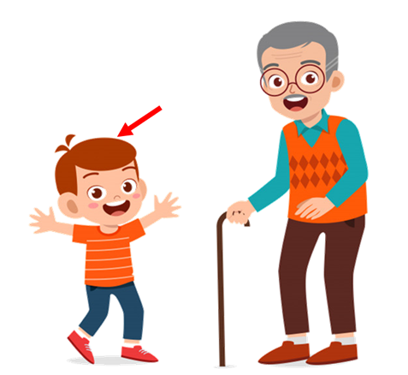
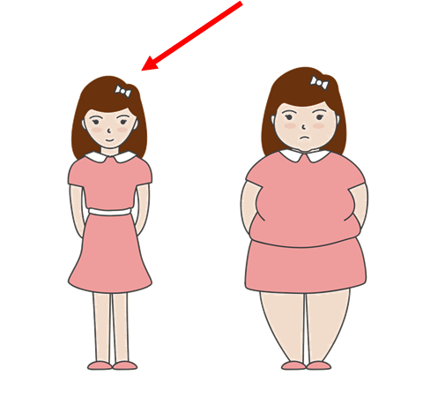
Vocabulary
tall
short
old
young
slim

Slide 11





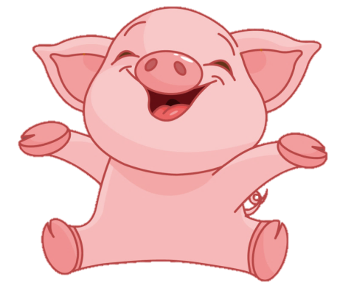
Click nút PLAY 2 lần để chơi
PLAY
PLAY

Slide 12
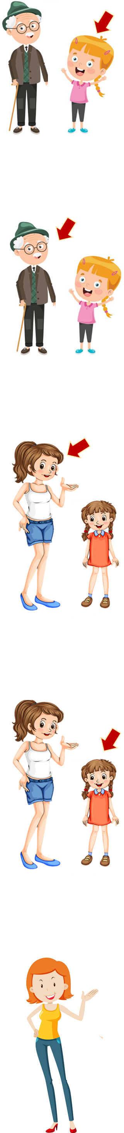

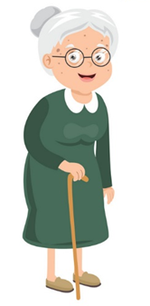
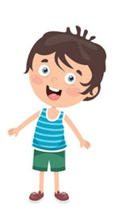
tall
Answer
Next

Slide 13
old
Answer
Next

Slide 14
young
Answer
Next

Slide 15
short
Answer
Next

Slide 16
thin
Answer
Next

Slide 17
old
Answer
Next

Slide 18
tall
Answer
Next

Slide 19
short
Answer
Next

Slide 20
thin
Answer
Next

Slide 21
young
Answer
Next

Slide 22
short
Answer
Next

Slide 23
tall
Answer
Next

Slide 24
young
Answer
Next

Slide 25
thin
Answer
Next

Slide 26
old
Answer
Next

Slide 27
Good job!
EXIT

Slide 28
02
Model sentence

Slide 29
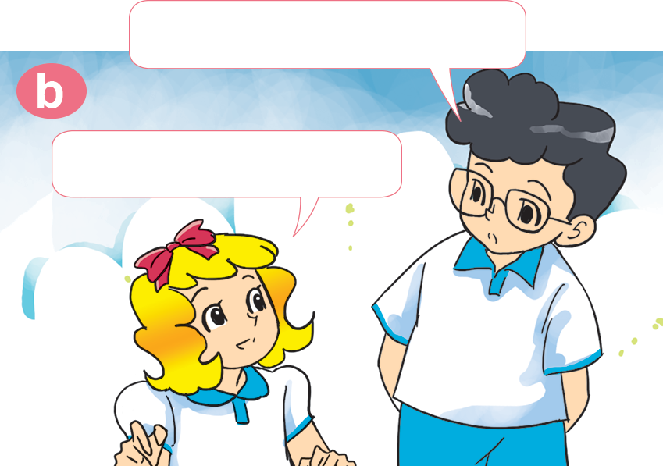
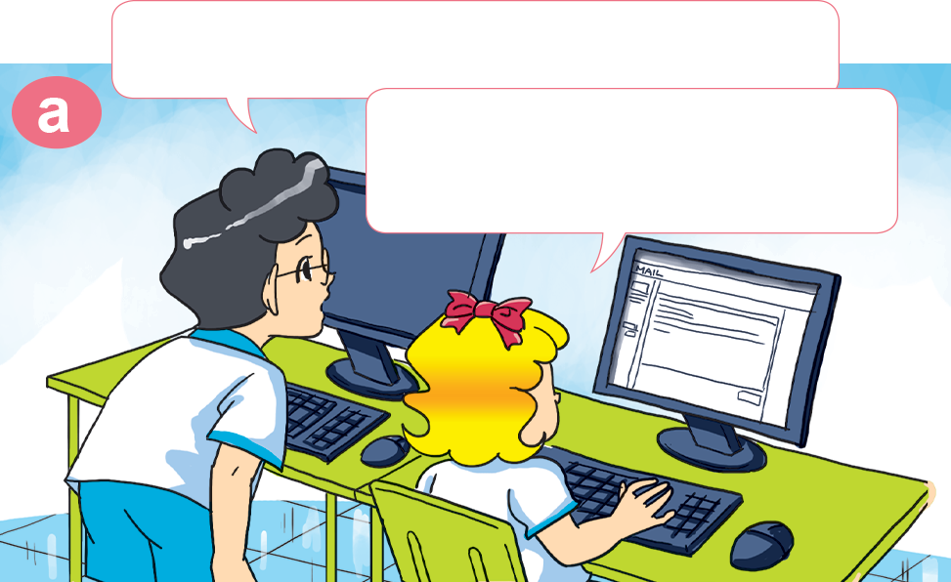

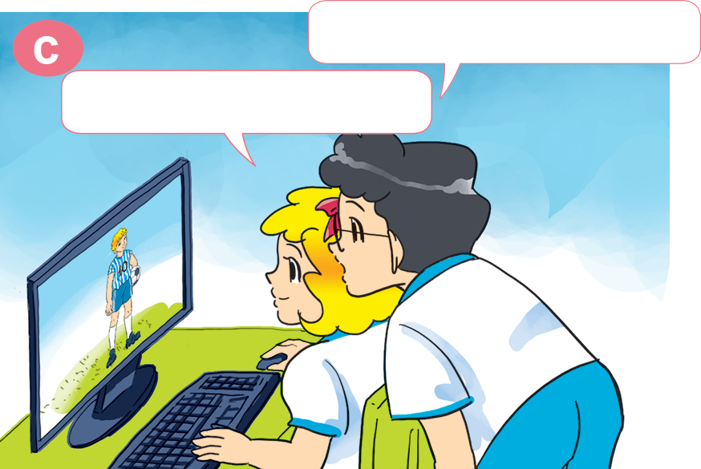
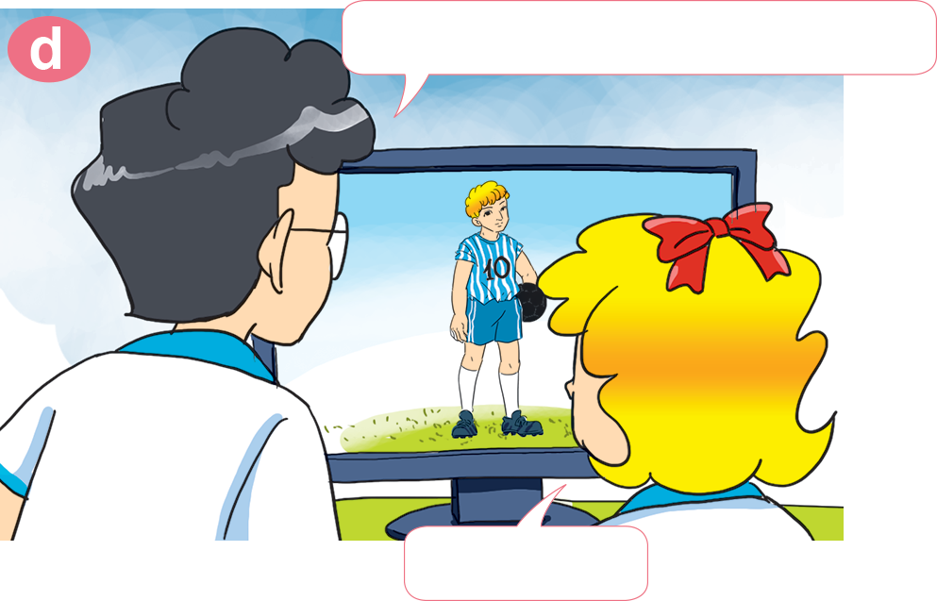
1. Look, listen and repeat.
Where is he now?
What are you doing, Linda?
l'm writing an e-mail to my brother.
He's in England.
What does he do?
What does he look like?
He's a footballer.
He's tall.

Slide 30
What does she / he look like?
She / He ____________.
old
slim
short
young
tall

Slide 31



2. Point and say
What does she look like?
She's ____________.
slim

Slide 32
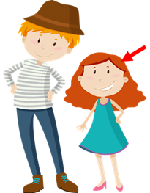
2. Point and say
What does she look like?
She's ____________.
short

Slide 33
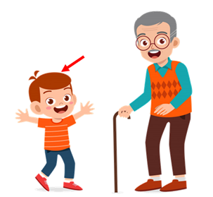
2. Point and say
What does he look like?
He's ___________.
young

Slide 34

2. Point and say
What does he look like?
He's ____________.
old

Slide 35
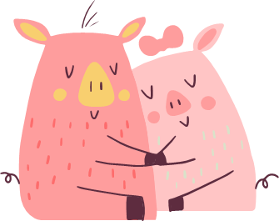
03
Practice

Slide 36
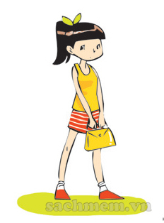
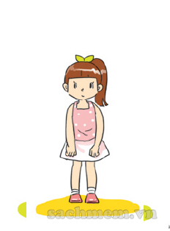
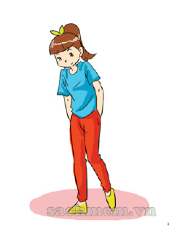




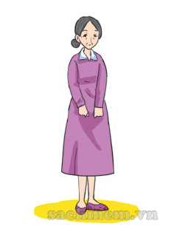
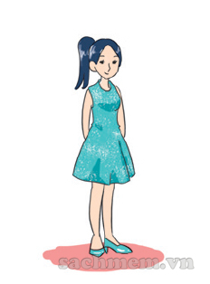
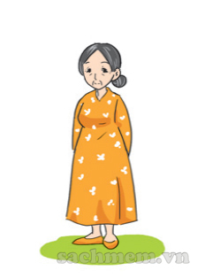

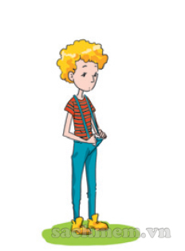
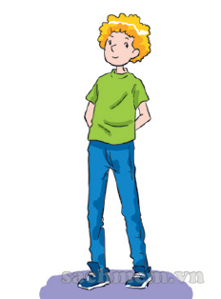
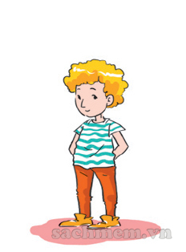

3. Listen and tick.
✔
✔
✔

Slide 37
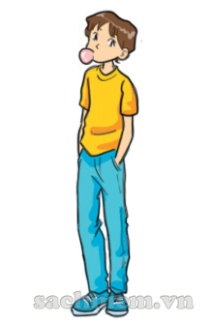
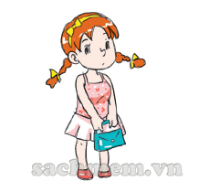
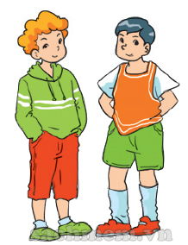
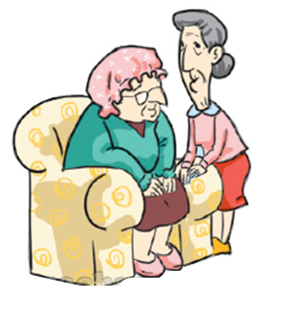
4. Look and write
What ___________ look like?
_______'s ____________.
What ___________ look like?
_______'s ____________.
does he
does she
He
tall
She
short
What ___________ look like?
_______'s ____________.
What ___________ look like?
_______'s ____________.
do they
do they
They
young
They
old

Slide 38





1
1
ant
2
mouse
3
elephant
4
dog
5
fish
6
iguana
7
hen
8
pet
9

Slide 39


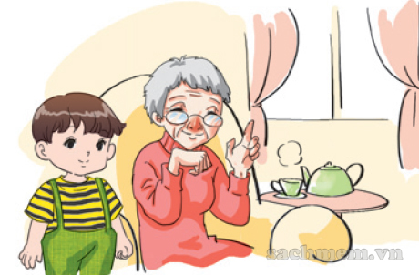


Question
1
2
3
4
5
6
7
8
9
10
The boy is ________ and the grandmother is old.
Time’s up
young
Answer
Back

Slide 40
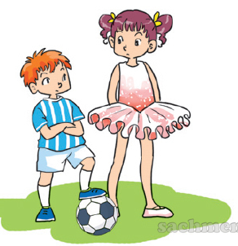
Question
The sister is tall
and the brother is _______.
1
2
3
4
5
6
7
8
9
10
Time’s up
short
Answer
Back

Slide 41
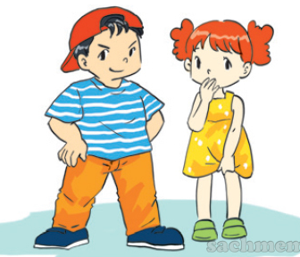
Question
He is big and she is ______.
1
2
3
4
5
6
7
8
9
10
Time’s up
Small
Answer
Back

Slide 42
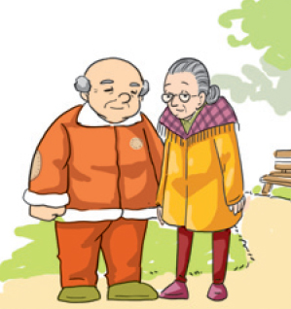
Question
My grandparents are ______.
1
2
3
4
5
6
7
8
9
10
Time’s up
old
Answer
Back

Slide 43
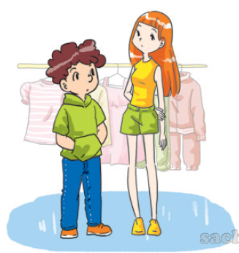
Question
The girl is ______.
1
2
3
4
5
6
7
8
9
10
Time’s up
slim
Answer
Back

Slide 44
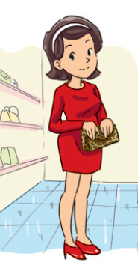
Question
What does her mother look like?
a. She's old.
b. She's young.
1
2
3
4
5
6
7
8
9
10
Time’s up
b. She's young.
Answer
Back

Slide 45
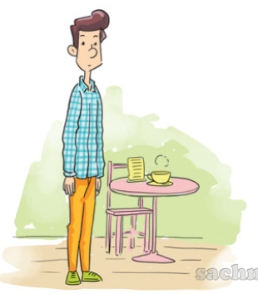
Question
What does her father look like?
a. He's short.
b. He's slim.
1
2
3
4
5
6
7
8
9
10
Time’s up
b. He's slim.
Answer
Back

Slide 46
Question
1
2
3
4
5
6
7
8
9
10
Time’s up
does
What do / does her father look like?
He's tall.
Answer
Back

Slide 47
Question
1
2
3
4
5
6
7
8
9
10
Time’s up
What does he look like?
________________________.
He's tall.
Answer
Back

Slide 48
04
Homelink

Slide 49
Monday, February 14th 2022
Unit 14: What does he look like?
Lesson 1
1. New words:
2. Model sentence:
tall: cao
Short: thấp
Old: già
Young: trẻ
Slim: mảnh khảnh, gầy
What does he/she look like?
He’s/ She’s tall.
3. Homework:
Write NW x 2lines and learn by heart.
Do WB: part C- 1,2 (page 57,58)
part E- 1,2 (page 58,59)

