Slide 1
Unit 13: Would you like some milk?
Lesson 2
Teacher: Ngoc Khue

Slide 2
Objectives
Use the words and phrases related to the topic Food and Drink.
Ask and answer about offer someone food/ drinks and accept/ decline someone’s offer, using Would you like some …….? Yes, please/ No, thanks.
Mục đích bài học:
Sử dụng các từ vựng liên quan đến chủ đề Đồ ăn/ Đồ uống.
Hỏi và trả lời để đưa ra lời mời, cách đồng ý/ chấp nhận lời mời đó với mẫu câu: Would you like some …….? Yes, please/ No, thanks.

Slide 3
Table of content
New words
01
02
Model sentence
03
04
Practice
Homelink

Slide 4
Warm up!

Slide 5
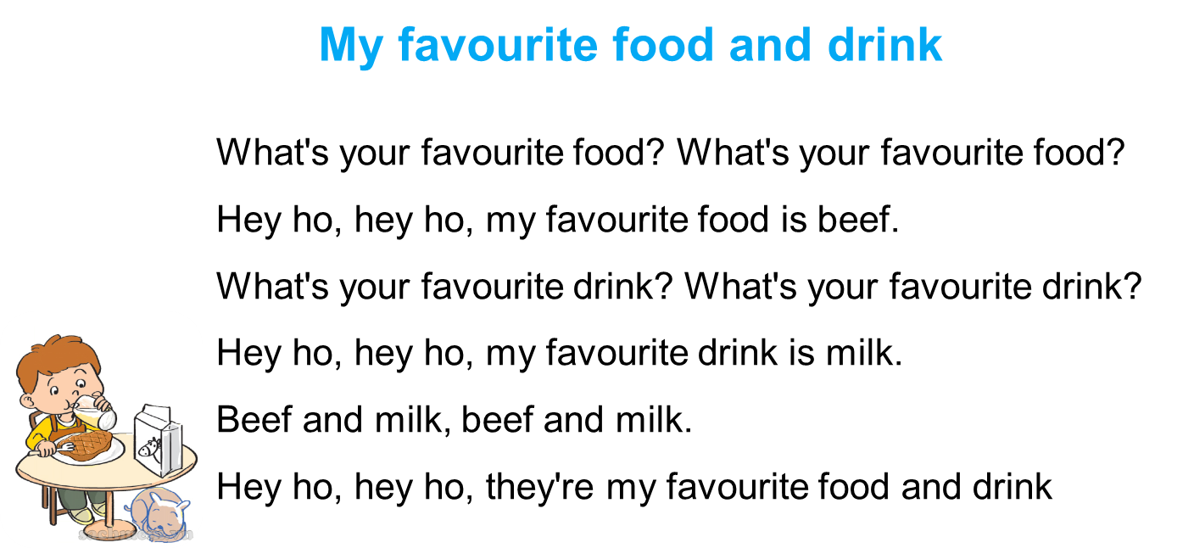

Let’s sing.

Slide 6
01
New words
Topic: Food and Drink

Slide 7

bread
/bred/

Slide 8
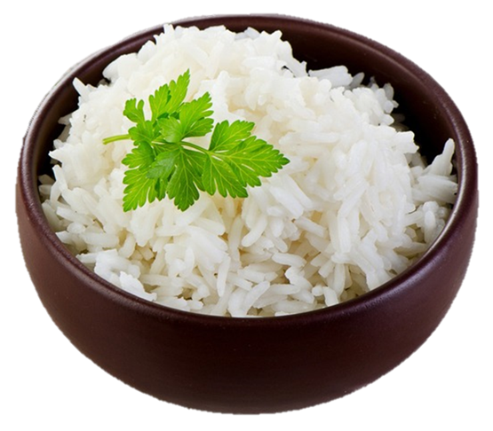
rice
/raɪs/

Slide 9

vegetables
/ˈvedʒtəblz/

Slide 10

lemonade
/leməˈneɪd/

Slide 11
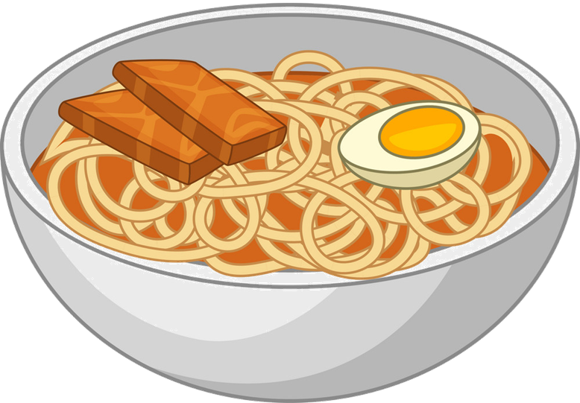
noodles
/ˈnuːdls/

Slide 12



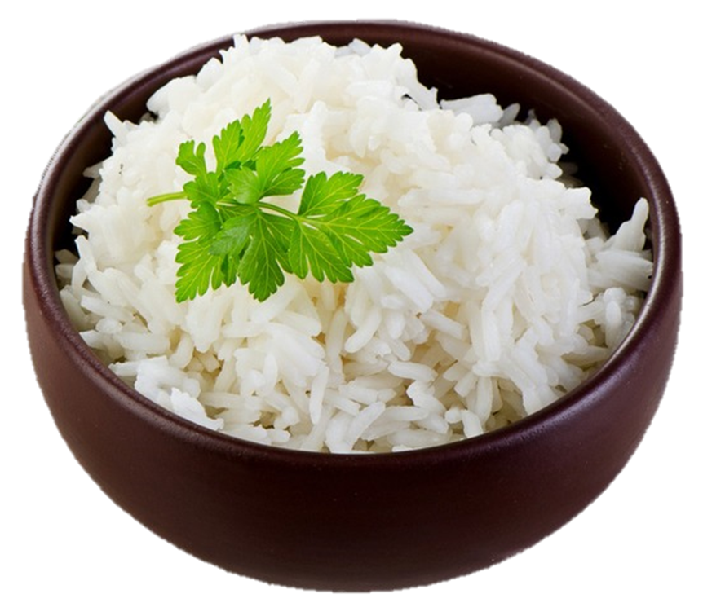

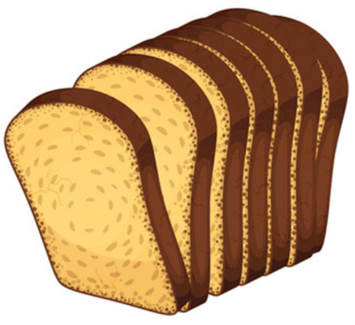
Vocabulary
Lemonade
vegetables
Noodles
Rice
Bread

Slide 13

BRICK WALL GAME
PLAY

Slide 14
What’s your favourite food?
It’s ________.
a. vegetables
b. lemonade
c. beef
PLAY
Next

Slide 15
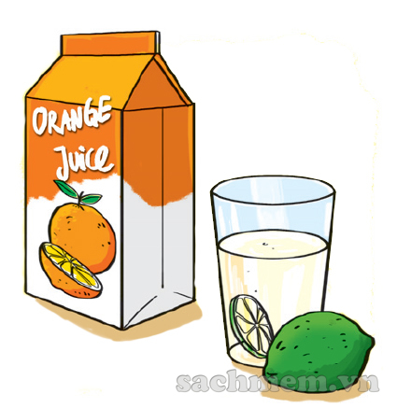
What’s your favourite drink?
It’s ________.
a. milk
b. orange juice
c. lemonade
Next
PLAY

Slide 16
What’s your favourite food?
It’s ________.
a. bread
b. rice
c. egg
Next
PLAY

Slide 17
What’s your favourite drink?
It’s ________.
a. lemonade
b. lemon juice
c. orange juice
PLAY
Next

Slide 18
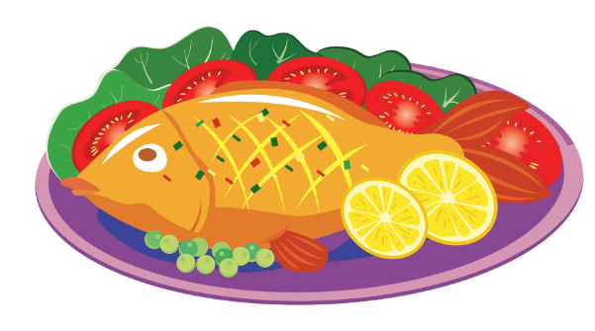
What’s your favourite food?
It’s ________.
a. fish
b. pork
c. vegetable
PLAY
Next

Slide 19
What’s your favourite food?
It’s ________.
a. chicken
b. rice
c. bread
PLAY
Next

Slide 20

Next
GOOD JOB!

Slide 21
02 Model sentence

Slide 22
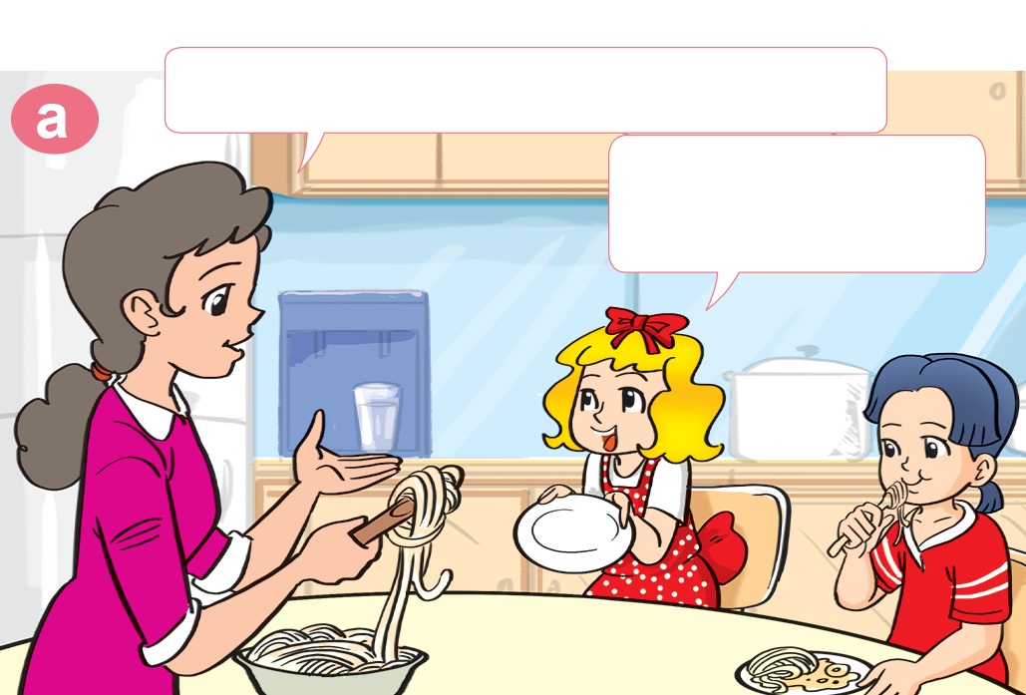
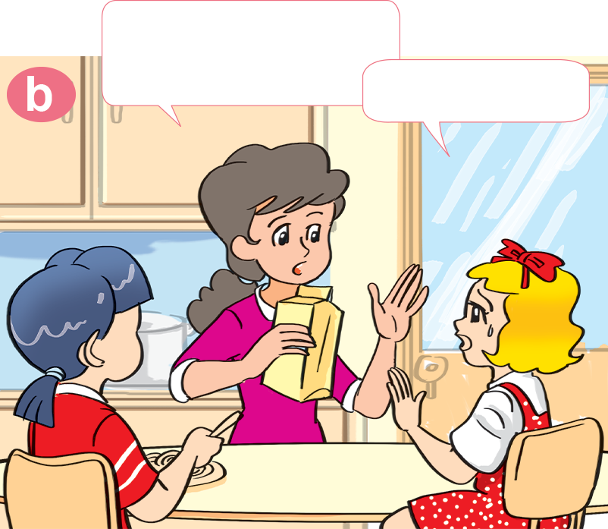

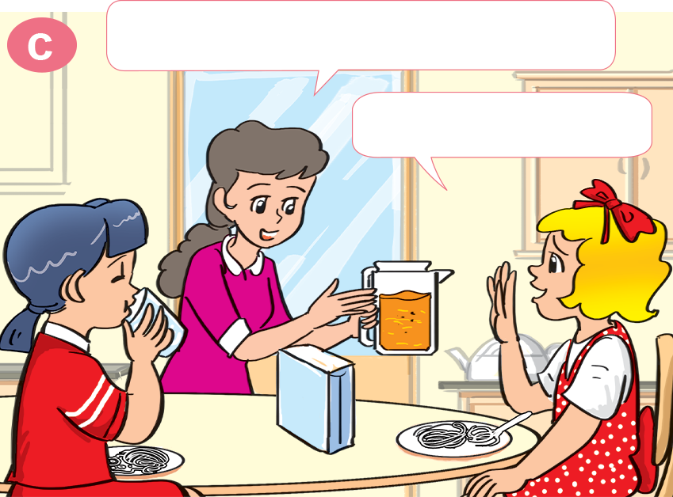
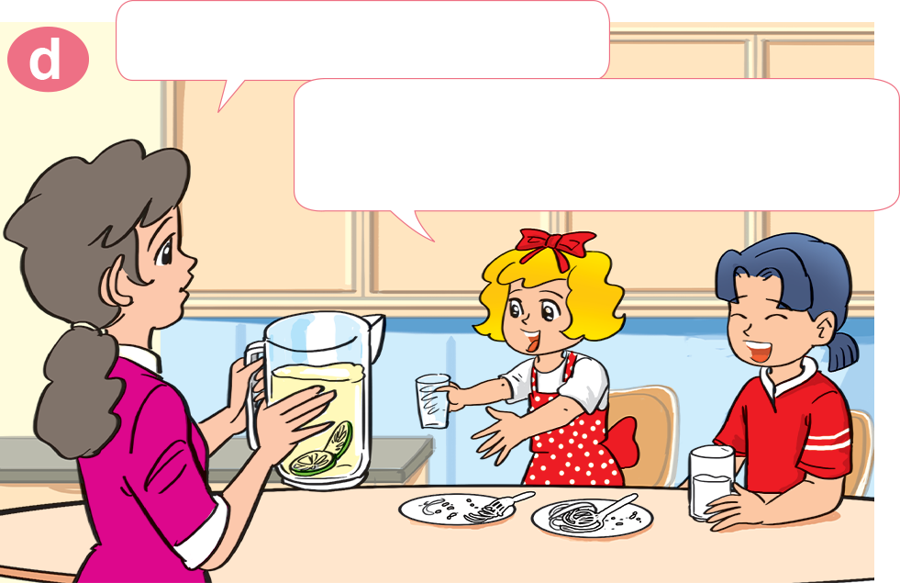
1. Look, listen and repeat
Would you like some milk?
Would you like some noodles?
No, thanks.
Yes, please. I love noodles.
What about orange juice?
How about lemonade?
Lemonade! Yes, please!
That's my favourite drink.
No, thank you.

Slide 23
Yes, please.
Would you like some ________?
No, thank you.
vegetables
Lemonade
Rice
Bread

Slide 24
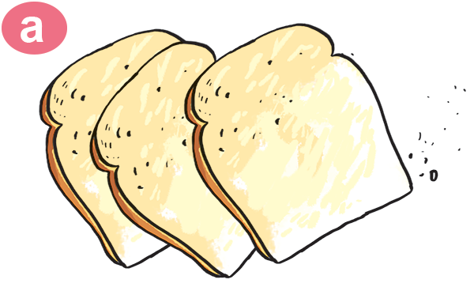

2. Point and say.
Would you like some _________?
bread
Yes, please.

Slide 25

2. Point and say.
Would you like some _________?
rice
Yes, please.

Slide 26
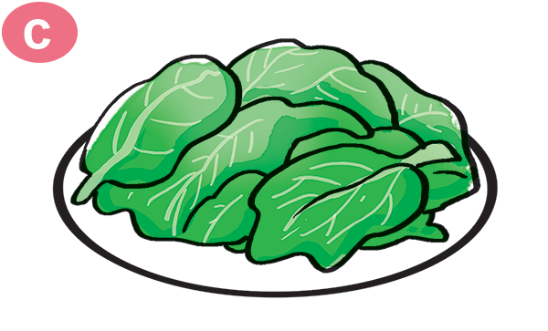

2. Point and say.
vegetable
Would you like some _________?
No, thanks.

Slide 27
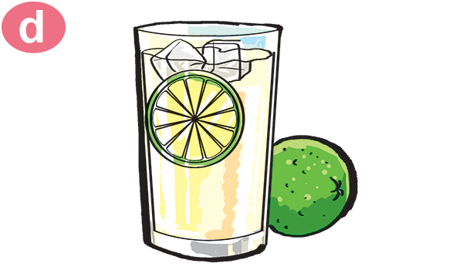
2. Point and say.
Would you like some _________?
lemonade
No, thanks.

Slide 28
03 PRACTICE
Topic: Food and Drink

Slide 29
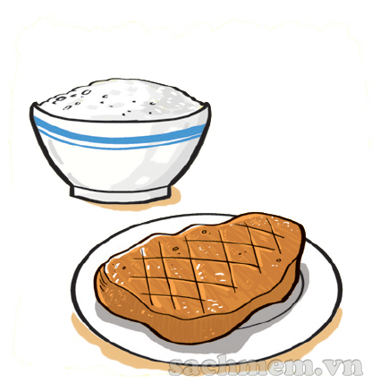
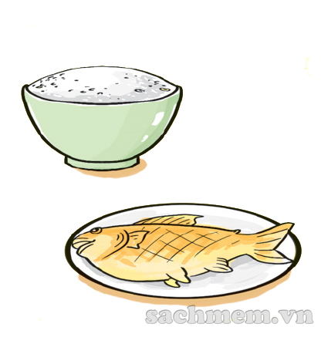
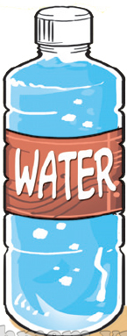

3. Listen and number
a
3
b
1
c
2
d
4
1
2
3
4

Slide 30





4. Look and write.
Orange juice
Milk
Lemonade
Water
Chicken
Fish
Rice
Bread

Slide 31



AND
GAME
PLAY

Slide 32



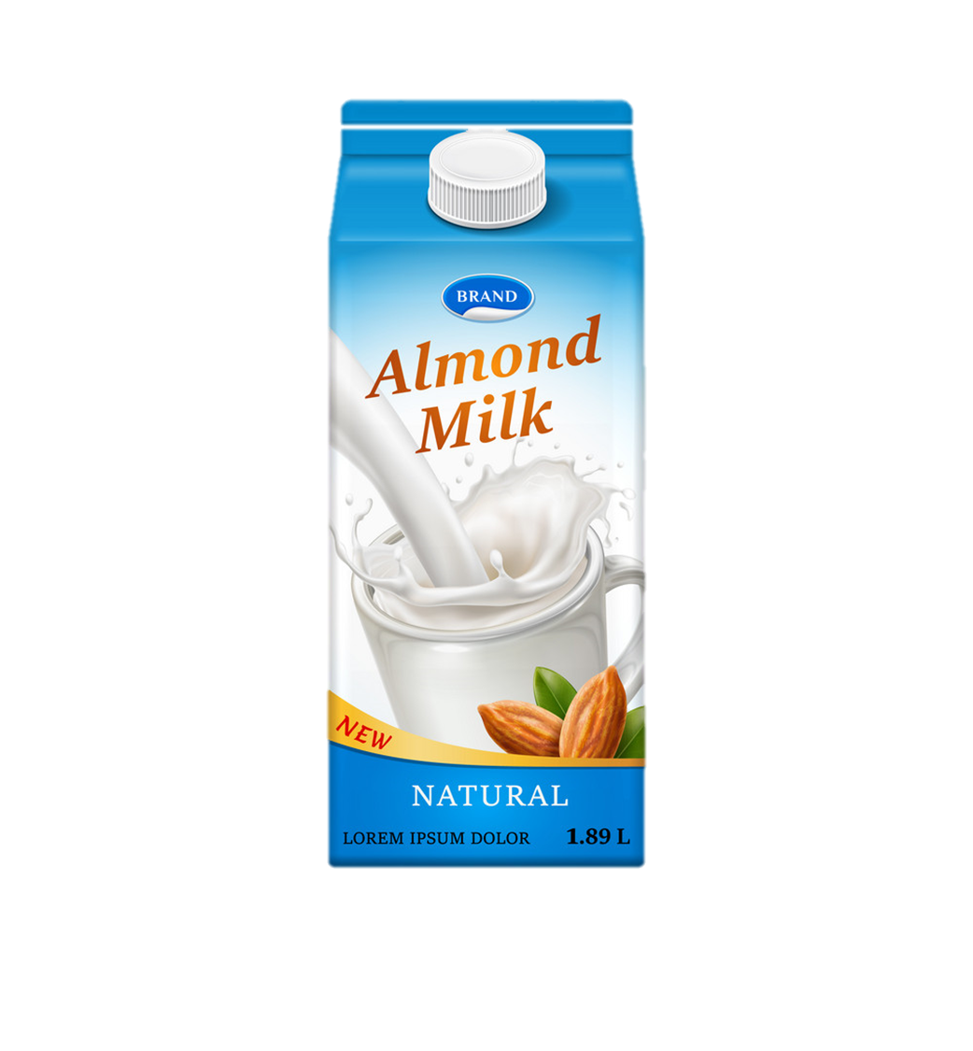
Yes
No
Would you like some milk?
____, please.
Next

Slide 33
please
Thank you
Would you like some lemonade?
Yes, _________.
Next

Slide 34
please
Thank you
Would you like some vegetable?
No, _________.
Next

Slide 35
please
Thank you
Would you like some rice?
No, _________.
Next

Slide 36
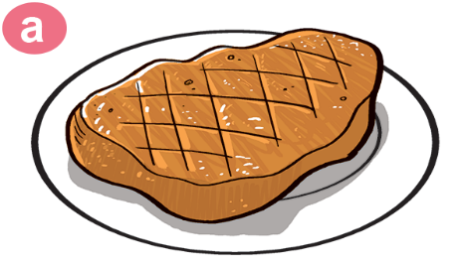
some
a
Would you like _____ beef?
No, thank you.
Next

Slide 37
please
Thank you
Would you like some bread?
Yes, _________.
Next

Slide 38

No
Yes
Would you like some orange juice?
_____, please.
Next

Slide 39


Would
What
______ you like some chicken?
Yes,please.
Next

Slide 40
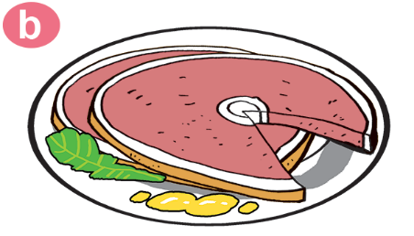
favourite
like
Would you ____ some pork?
No, thank you.
Next

Slide 41

Next

Slide 42
04 Homelink
Topic: Food and Drink

Slide 43
Thursday, February 10th 2022
Unit 13: Would you like some milk?
Lesson 2
1. New words:
2. Model sentence:
Rice: cơm, gạo
Noodles: mì
Lemonade: nước chanh ép
Vegetables: rau quả
Bread: bánh mì
Would you like some noodles?
-> Yes, please.
-> No, thank you./ thanks.
3. Homework:
Write NW x 2 lines and learn by heart.
Do WB: part B- 1,2 (page 52, 53)
part C-1 (page 53)

Slide 44
Thanks

