Slide 1
Unit 12: What does your father do?
Lesson 3
Teacher: Ngoc Khue
December 31

Slide 2
Objectives
- Use the words and phrases related to the topic Jobs.
- Pronounce the sounds of the letters “ie and ea”.
Mục đích bài học:
Sử dụng các từ liên quan đến chủ đề Nghề nghiệp.
Phát âm đúng các âm sau: “ie” và “ea”

Slide 3
Table of contents
01
03
02
04
Revision
Practice
Phonics
Homelink

Slide 4
01
Revision

Slide 5



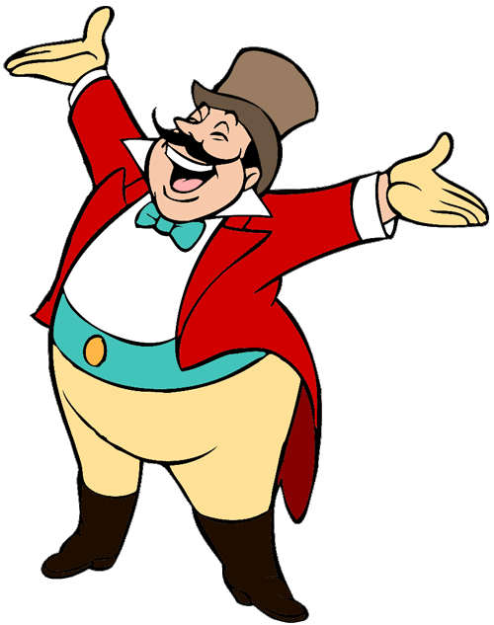
START

Slide 6

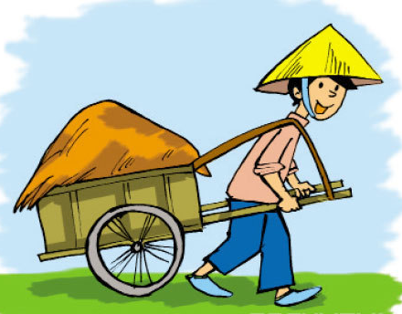



My father is a farmer. He works in _____.
a factory
a field
a school

Slide 7

I'm a pupil. I study _______.
in a school
in a hospital
in a field
Next

Slide 8
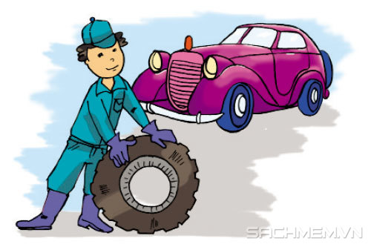
My brother is a factory worker. He works________.
in a company
in a factory
in a school

Slide 9
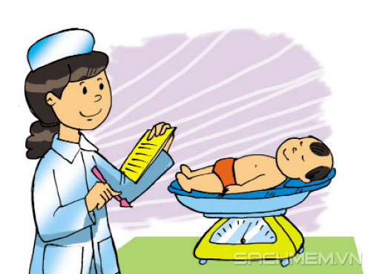
My mother is a nurse. She works _______.
in a hospital
in a school
in a field
Next

Slide 10
My brother is a factory worker. ____ works in a factory.
He is
He
He’s

Slide 11
My mother is a nurse. She _______ in a hospital.
is
work
works

Slide 12
_____ works in the field.
A teacher
A doctor
A farmer

Slide 13
A doctor works ____ a hospital.
in
on
up
Next

Slide 14
What does your grandfather do?
A. She's a doctor.
B. He's a doctor.
C. He works in a hospital.

Slide 15
Where does your brother work?
A. She works in a hospital.
B. He work in a hospital.
C. He works in a hospital.

Slide 16
Where does your father work?
A. He works on the farm.
B. She works on the farm.
C. He is a farmer.
Next

Slide 17
Where does your mother work?
A.She is a nurse.
B.She is a doctor.
C. She works in the hospital.

Slide 18



GOOD JOB!
Ms Huyền Phạm
0936.082.789

Slide 19
02
Phonics

Slide 20

1. Listen and repeat
ie | field | My grandpa works in a field.
 | piece | I want a piece of chocolate.
ea | teacher | My mother is a teacher.
 | reading | She's reading a book now.

Slide 21
2. Listen and circle. Then say sentences with the circled words.
a. field b. piece
a. teaching b. reading

Slide 22

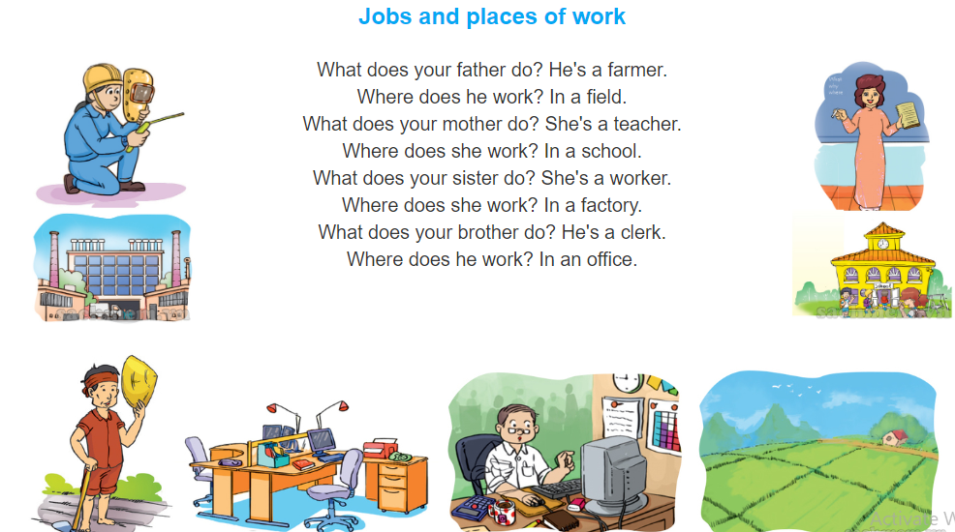
3. Let’s chant

Slide 23
03
Practice

Slide 24
4. Read and complete.
Report
This is the report of my interview with Phong. His father is a teacher. He works in Le Hong Phong Primary School. His mother is a nurse. She works in Thanh Nhan Hospital. Phong has a brother but he doesn't have a sister. His brother is a worker in a car factory. And as you know, Phong is a pupil in Class 4A. Thank you for reading.
 | Job | Place of work
Father
Mother
Brother
teacher
Le Hong Phong Primary School
nurse
Thanh Nhan Hospital
worker
car factory

Slide 25

5. Write about the jobs of your family members and where they work.
There are _____ people in my family.
My father is a/an _______. He works ______________.
My mother is a/an _______. She works ____________.
My brother is a/an _______. He works/study ________.
My sister is a/an _______. She works/study _________.
And I am a/an _______. I work/study ______________.

Slide 26
04
Homelink

Slide 27

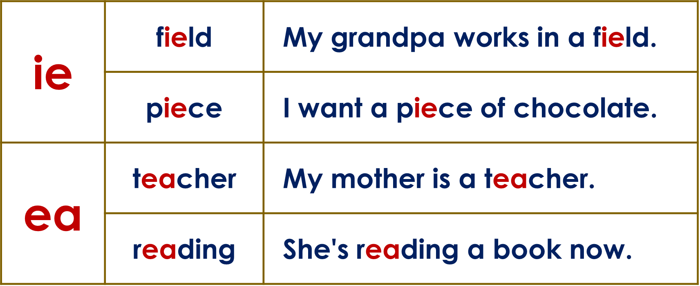
Friday, January 28th 2022
Unit 12: What does your father do?
Lesson 3
1. Phonics:
2. Homework:
Do WB: part A-1,2 (page 48)
Practice Quizziz game (at least 90%)

Slide 28
HAPPY NEW YEAR!

Slide 29
Thanks!

