Slide 1


Unit 12: What does your father do?
Lesson 1
Teacher: Ngoc Khue

Slide 2
Objectives
- Use the words and phrases related to the topic Jobs.
- Ask and answer about someone’s jobs.
Mục đích bài học:
Sử dụng các từ liên quan đến chủ đề Nghề nghiệp.
Hỏi và trả lời xem ai đó làm nghề gì.

Slide 3
CONTENTS
1
New words
2
Model sentence
3
Practice
4
Homelink

Slide 4
01
New words

Slide 5

teacher
/ˈtiːtʃər/

Slide 6

student
/ˈstuːdnt/

Slide 7

farmer
/ˈfɑːrmər/

Slide 8

worker
/ˈwɜːrkər/

Slide 9
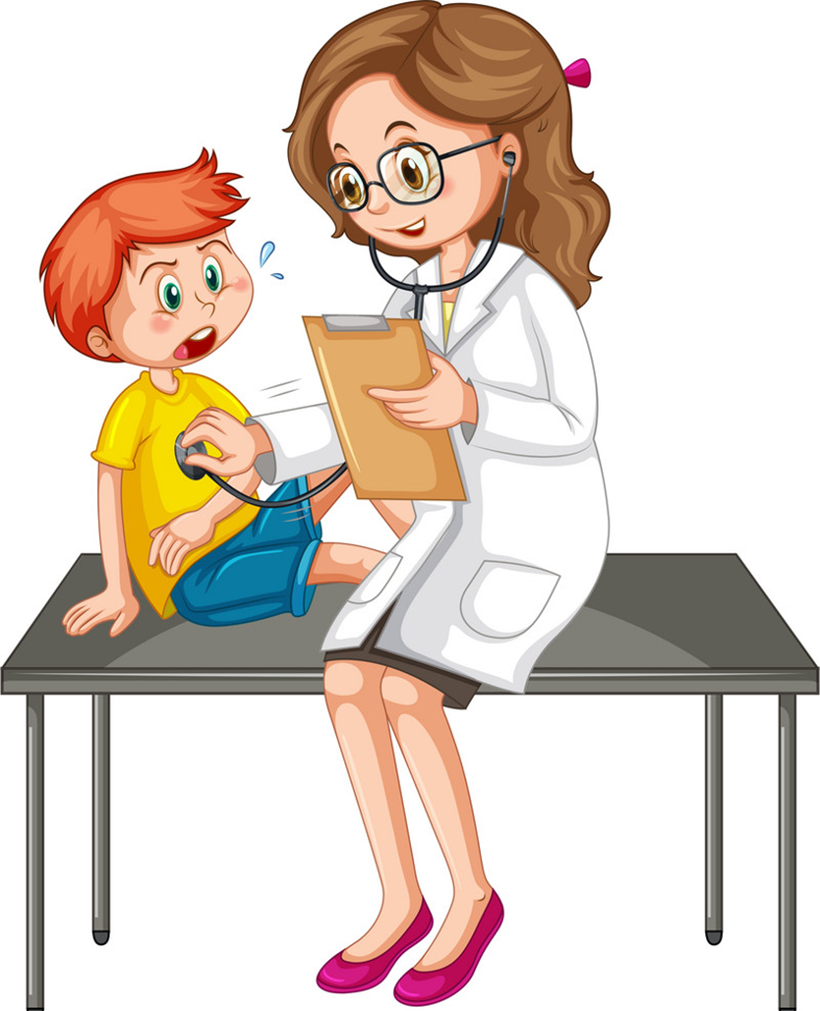
doctor
/ˈdɒktər/

Slide 10

nurse
/nɜːrs/

Slide 11

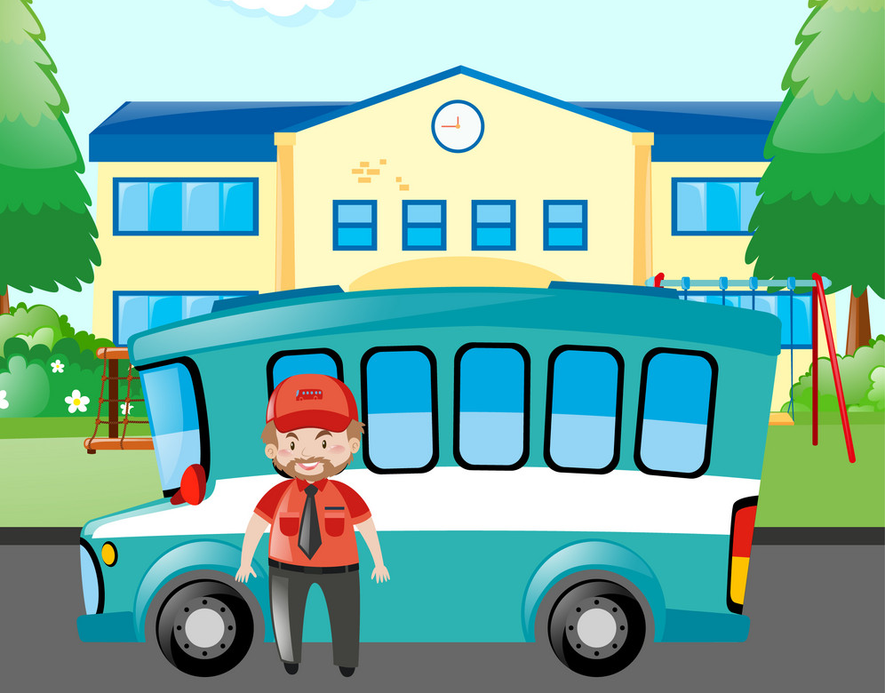
driver
/ˈdraɪvər/

Slide 12

job
dʒɒb/

Slide 13


factory
/ˈfæktəri/

Slide 14




Vocabulary
student
teacher
farmer
worker
factory
driver
doctor
nurse
job

Slide 15
Match
factory
teacher
farmer
student
doctor

Slide 16
Match
worker
nurse
driver
job

Slide 17


Look, read and fill
student
farmer
They are _________s.
This boy is a __________.
worker
teacher
The _________ is young.
My mother is a ___________.
factory
doctor
That’s a ___________.
She’s a ___________.
driver
nurse
The _________ is kind.
This is a beautiful _______.

Slide 18
02
Model sentence

Slide 19
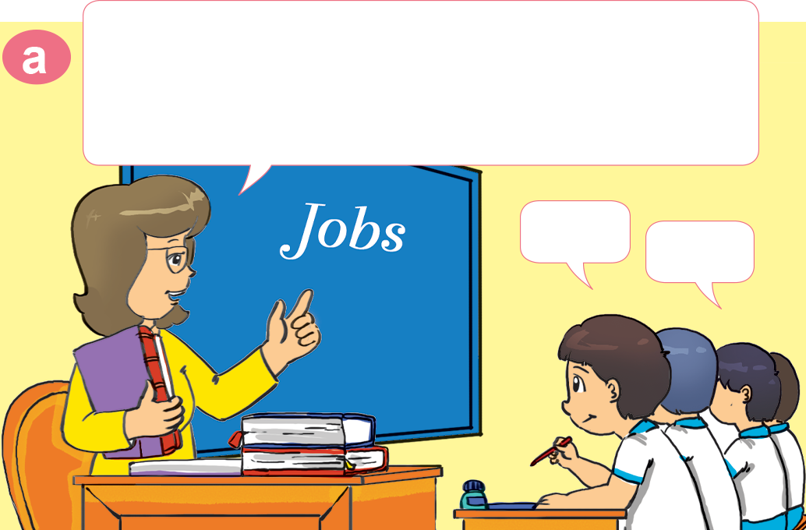
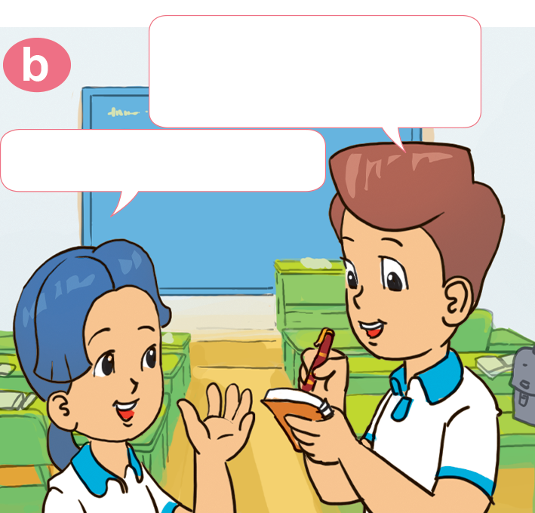

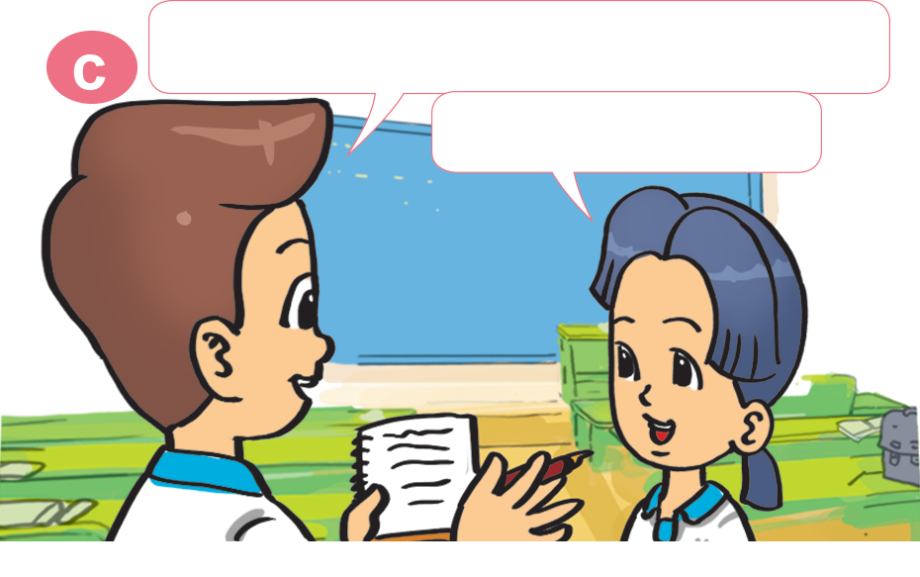
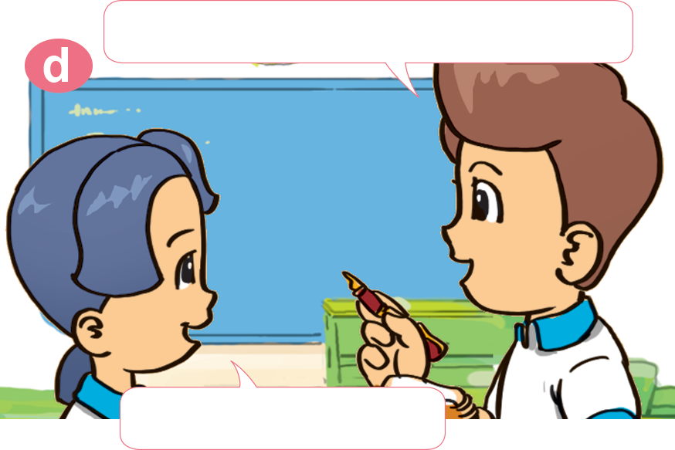
1. Look, listen and repeat
Class, get into pairs, please!
lnterview your partner about the
jobs of his or her family members.
What does your father do, Mai?
He's a teacher.
Yes.
Ok.
And what about your mother?
What does your sister do?
She's a nurse.
She's a student.

Slide 20
What does your ___________ do?
He/she is a/an _________.
driver
teacher
farmer
student
worker
doctor
nurse

Slide 21
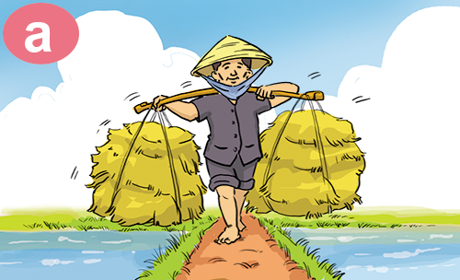
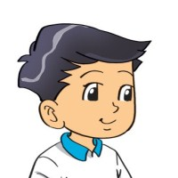
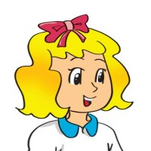
2. Point and say
What does your ___________ do?
father
He's ___________________.
a farmer

Slide 22
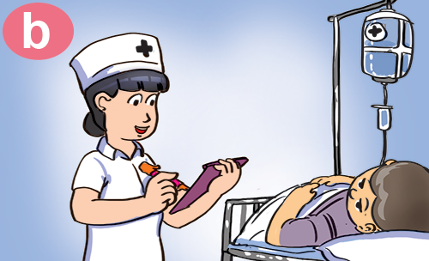

2. Point and say
What does your ___________ do?
mother
She's ___________________.
a nurse

Slide 23
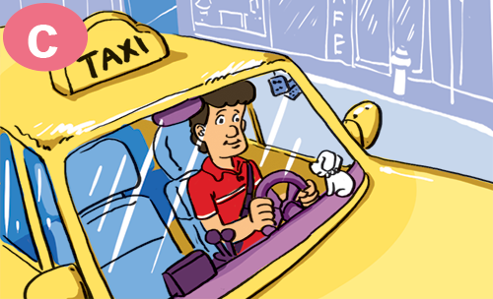
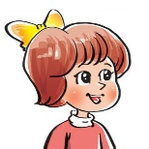
2. Point and say
What does your ___________ do?
uncle
He's ___________________.
driver

Slide 24
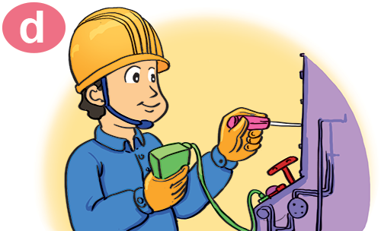

2. Point and say
What does your ___________ do?
brother
He's ___________________.
a factory worker

Slide 25
03
Practice

Slide 26
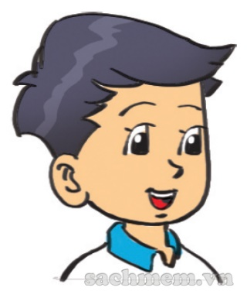
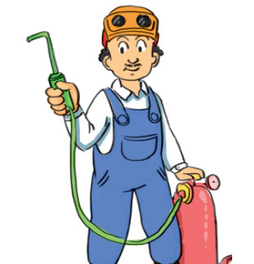
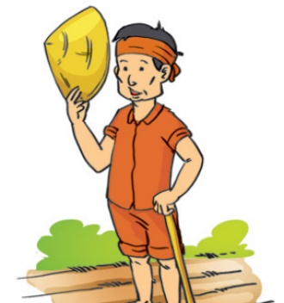
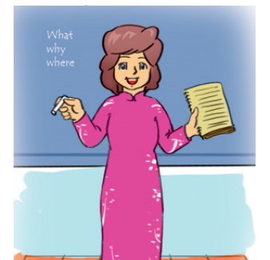
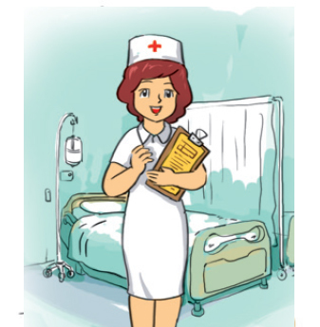
3. Listen and tick.
1. Father
2. Mother
3. Brother
4. Sister
✓
✓
✓

Slide 27
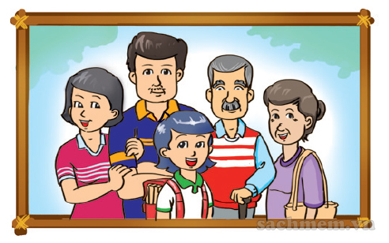
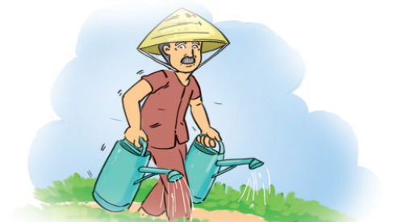
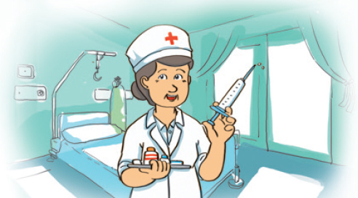
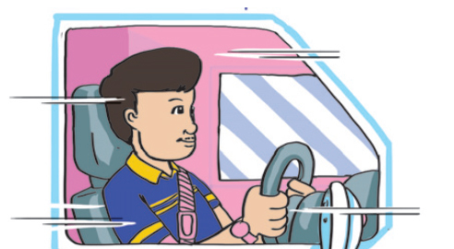
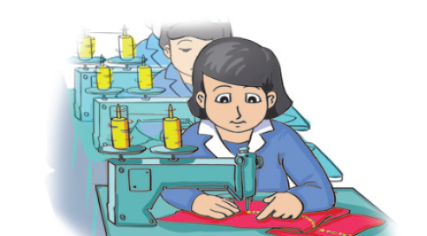
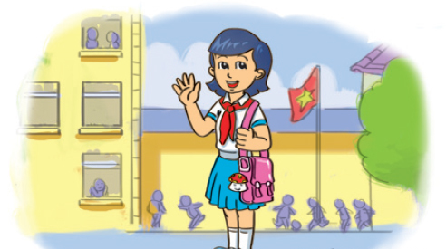
4. Look and write.
This is a photo
of my __________.
My grandpa is a ______________.
My grandma
________________.
family
farmer
is a nurse
My father
________________.
My mother
__________________.
a student
I am ____________.
is a driver
is a factory worker

Slide 28
04
Homelink

Slide 29
Saturday, January 22nd 2022 Unit 12: What does your father do? Lesson 2
1. New words:
2. Model sentence:
Where does your father work?
He works in a filed.
Clerk: nhân viên văn phòng
In a factory: trong nhà máy
In a hospital: trong bệnh viện
In a field: trên cánh đồng
In an office: trong văn phòng
3. Homework:
Learn by heart the vocabularies.
Practice Quizziz.

Slide 30
THANKS

