Slide 2
Friday, February 25th, 2022
UNIT 14 - LESSON 3
What happened
in the story?
P-28.29

Slide 3

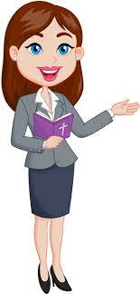
OBJECTIVES
(Mục tiêu của bài học hôm nay)
01
- Review the vocabularies and grammar in Lesson 1 and Lesson 2.
(Ôn tập từ vựng và cấu trúc ngữ pháp đã học trong Tiết 1 và 2)
- Identify the intonations of the sentences
(Xác định được ngữ điệu của câu)
02
- Practice speaking, listening and reading skills.
(Luyện tập các kĩ năng nói, nghe và đọc hiểu.)
03
Notes:
Thanh Yến Trần 0967 255 149 zalo/ FB https://www.facebook.com/thanhyentrananhngutaymy/

Slide 4
Warm-up

Slide 5


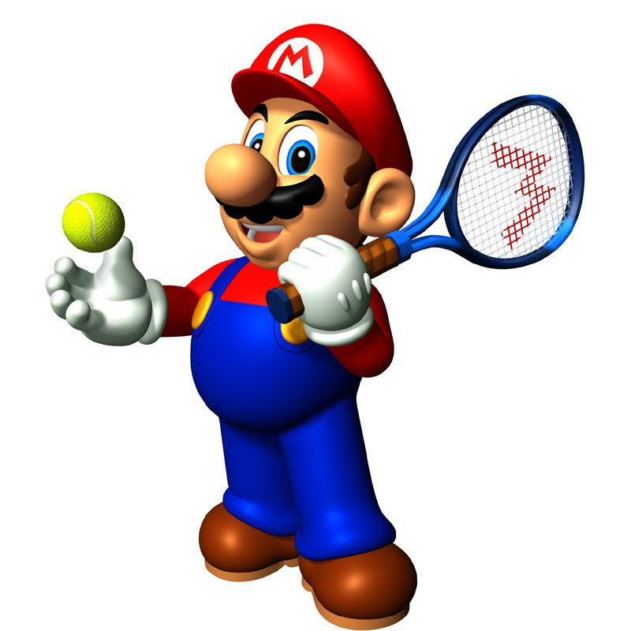


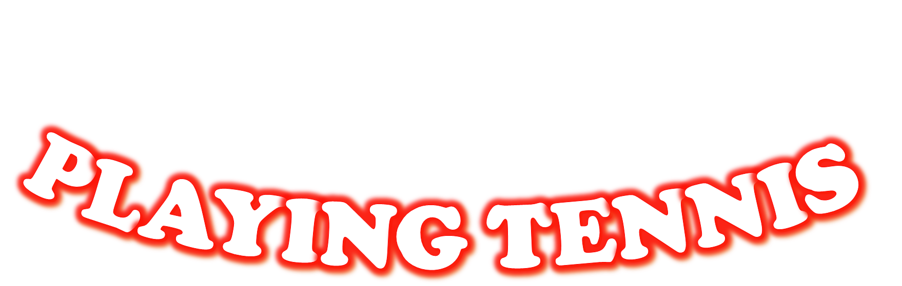


Slide 6
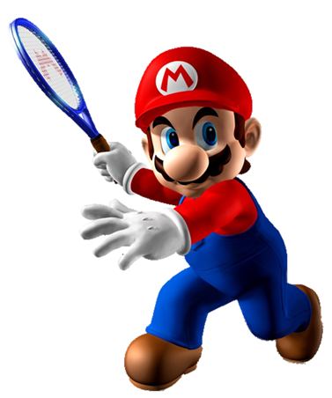
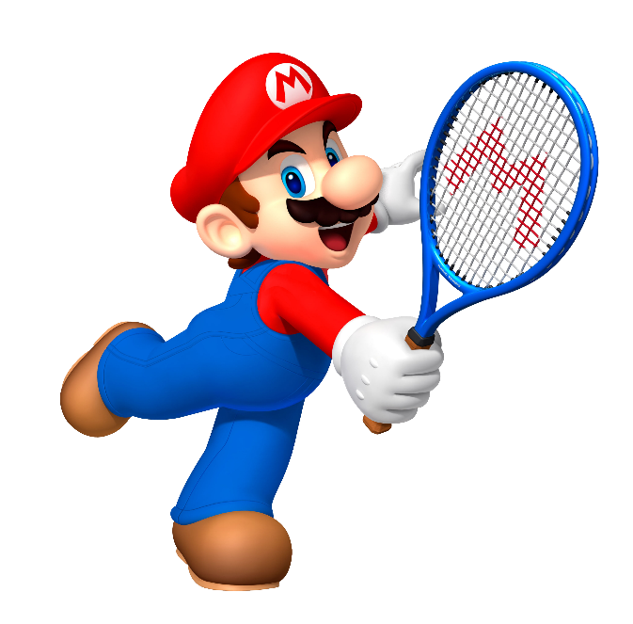

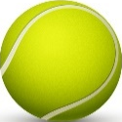
An Tiem
First
Tick the odd one out
Snow White

Slide 7
The mouse
Kind
Tick the odd one out
Intelligent

Slide 8
Next
Then
Tick the odd one out
Of

Slide 9
like
think
What do you _________ of Mai An Tiem?
do

Slide 10
mouse
fox
What do you think of the ______________ in the story The Lion and the Mouse?
cat

Slide 11
Of the end
On the end
_____, the prince married the princess, and they lived happily ever after.
In the end

Slide 12
How happened in the story?
What happened in the story?
________________________
The hare and the tortoise had a race.
Why happened in the story?

Slide 13
What do you think
What do you like
____________ of the characters in story?
What happened

Slide 14
happen
think of
What ________ in the story?
happened

Slide 15
Time’s up!

Slide 16
Pronounciation

Slide 17
1. Listen and repeat.
What happened in the story? ↷
First, King Hung ordered Mai An Tiem and his family to live on an island. ↷
Then one day, An Tiem found some black seeds and he grew them. ↷
Next, An Tiem's family exchanged the watermelons for food and drink. ↷
In the end, King Hung let An Tiem and his family go back home. ↷

Slide 18

2. Listen and circle a or b
1. First, the poor girl went to the _________.
a. castle b. forest
2. Then she met a/an _________.
a. young man b. old man
3. Next, he gave her three _________.
a. wishes b. apples
4. In the end, she _________.
a. married a prince b. became a queen

Slide 19
Practise

Slide 20
3. Listen to the story.
The Fox and the Crow
A long time ago, there was a fox and a crow. The crow stood on the roof of a house with a piece of meat in its beak. The hungry fox was standing on the ground. The fox asked the crow, “Can you give me some meat?” The crow shook its head. Then the fox asked, “Can you dance?” The crow shook its head. Then the fox asked, “Can you sing?” “Yes,...” the crow opened his beak and said. He dropped the meat on the ground. The fox picked up the meat and said, “Ha ha! Thanks for the meat.”

Slide 21
4. Read and write
Hi, I'm Mai. My hobby is reading folk tales. Folk tales are usually short and interesting. They often give me one surprise after another. The characters are sometimes honest, sometimes greedy, sometimes wise, sometimes stupid. I like The Fox and the Crow very much. The fox was clever and the crow was not. The crow lost its delicious meat and the fox got it. I love folk tales very much because each of them gives me a lesson in life.
1. What kinds of stories does Mai like reading?
She likes reading folk tales.

Slide 22
4. Read and write
Hi, I'm Mai. My hobby is reading folk tales. Folk tales are usually short and interesting. They often give me one surprise after another. The characters are sometimes honest, sometimes greedy, sometimes wise, sometimes stupid. I like The Fox and the Crow very much. The fox was clever and the crow was not. The crow lost its delicious meat and the fox got it. I love folk tales very much because each of them gives me a lesson in life.
2. What does she think of folk tales?
She thinks they are usually short and interesting.

Slide 23
4. Read and write
Hi, I'm Mai. My hobby is reading folk tales. Folk tales are usually short and interesting. They often give me one surprise after another. The characters are sometimes honest, sometimes greedy, sometimes wise, sometimes stupid. I like The Fox and the Crow very much. The fox was clever and the crow was not. The crow lost its delicious meat and the fox got it. I love folk tales very much because each of them gives me a lesson in life.
3. What does she think of the characters in folk tales?
She thinks the characters are sometimes honest, sometimes greedy, sometimes wise, sometimes stupid.

Slide 24
4. Read and write
Hi, I'm Mai. My hobby is reading folk tales. Folk tales are usually short and interesting. They often give me one surprise after another. The characters are sometimes honest, sometimes greedy, sometimes wise, sometimes stupid. I like The Fox and the Crow very much. The fox was clever and the crow was not. The crow lost its delicious meat and the fox got it. I love folk tales very much because each of them gives me a lesson in life.
4. What does she think of the characters in The Fox and the Crow?
She thinks the fox was clever and the crow was not.

Slide 25
4. Read and write
Hi, I'm Mai. My hobby is reading folk tales. Folk tales are usually short and interesting. They often give me one surprise after another. The characters are sometimes honest, sometimes greedy, sometimes wise, sometimes stupid. I like The Fox and the Crow very much. The fox was clever and the crow was not. The crow lost its delicious meat and the fox got it. I love folk tales very much because each of them gives me a lesson in life.
5. Why does she love folk tales?
Because each of them gives her a lesson in life.

Slide 26
5. Write about the characters in your favourite story
My favourite story is _______________________.
The main characters are _____________________.
I Iike because he/she is _____________________.

Slide 27

Let’s remember!
(Cùng ghi nhớ nhé!)
WB (SBT): p58
Review the words, model sentences and practice writing
Do exercises in Workbook.
- Ôn lại từ vựng và mẫu câu trong tiết 1,2,3
- Hoàn thành BT
PREVIEW
(Xem trước)
Unit 15 – Lesson 1

Slide 28
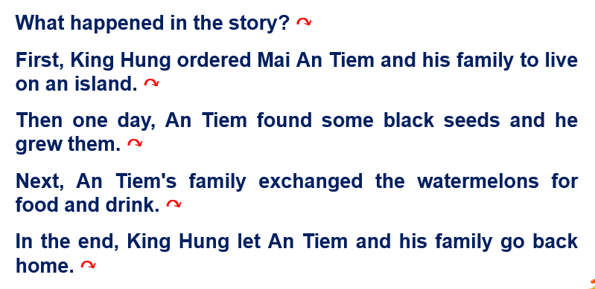
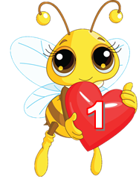
Friday, February 25th , 2022
Unit 14: Lesson 3 – p28,29
1. Read and write

Slide 29
6. Project
Tell a story and say what you think of the characters.

